Slide 1


Patch Management for Windows Servers
SCCM
24/01/2020

Slide 2
Introduction
          What is SCCM ?
            System Center Configuration Manager (SCCM) helps IT manage PCs and servers. By using SCCM, administrators can fully keep system and software up-to-date, setting configuration and security policies. Configuration Manager provides remote control and monitoring system status

Slide 3
Purpose
          Why should we use SCCM ?
          To avoid security risks by protecting our system from malicious software
            Potential consequences of not installing security updates are damaged software, loss of data, or identity theft. Every year, malware causes damage of millions of dollars worldwide. The main reason is that users don’t install critical software or security updates, allowing malware to exploit loopholes that have long been patched. Vulnerabilities can potentially be exploited within hours of them becoming publicly known. So once a security update is available, we should install the fix to protect our system from malware attacks.

Slide 4
Goal of this presentation
          Validated with SSI committee the following target :
            Implement security and critical updates for Windows servers and workstations
            Implement automatic restart for workstations and servers once per month
            Keep track of updates approval in Jira
          Validated that SSI committee should communicate to all users why it is required to restart computers for security reasons. (Applying updates without restarting the computers is not efficient)

Slide 5
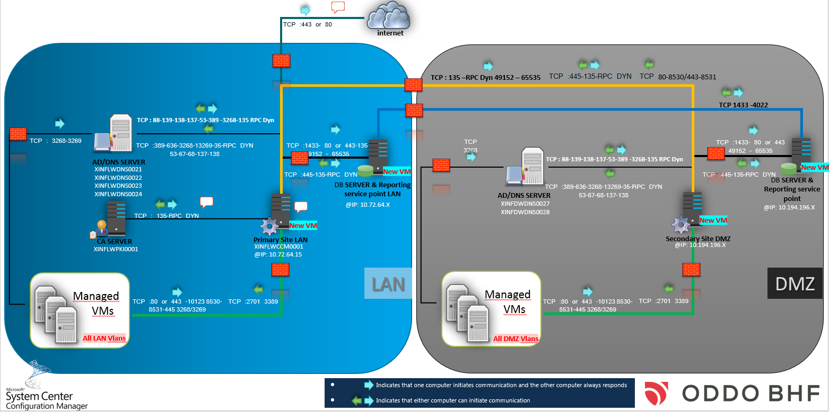
Architecture Overview

Slide 6
Schedule for Servers
Updates Installation
Every Saturday – Starting from 4 PM to Midnight | Saturday – Starting from 4 PM to Midnight |  | Validation group
3rd Saturday | Saturday – Starting from 4 PM to Midnight | Install of new updates and restart (Updates Published < 1 week) | Update group1
4th Saturday | Saturday – Starting from 4 PM to Midnight | Install of new updates and restart (Updates Published < 2 weeks) | Update group2
The next Month 1st Saturday | Saturday – Starting from 4 PM to Midnight | Install of new updates and restart (Updates Published < 3 weeks) | Update group3
The next Month 2nd Saturday | Saturday – Starting from 4 PM to Midnight | Install of new updates and restart (Updates Published < 4 weeks) | Update group4

Slide 7
Summary
          Update classifications : security and critical
          Products :
            Windows servers 2008, 2008R2, 2012, 2012R2, 2016
          Servers :
            Installation of updates : Starting from 4 PM to Midnight
            Process in 5 steps : 1 validation group and 4 deployment groups to avoid general problems
          Updates installed on servers maximum 1 month after being released by Microsoft
          Nagios check by Monitoring and production control team on Mondays at 05:00 AM

Slide 8
Potential Risks
            Servers that have not received updates for a long time might need more disk space

