Slide 1


Paper Review
Fostering Communication between
Minimally Verbal Autistic Children and Parents with
Contextual Guidance and Card Recommendation

Slide 2
Presented To
Dr. Jannatun Noor Mukta
Associate Professor, Dept. Of CSE
Presented By
Afshin Nahian Tripto (0122410045)
Ekra (0122310034)

Slide 3
Novelty of Our Work
Title: Fostering Communication between Minimally Verbal Autistic Children and Parents with Contextual Guidance and Card Recommendation
Authors: Dasom Choi, SoHyun Park, Kyungah Lee, Hwajung Hong, and Young-Ho Kim
Publication: CHI Conference on Human Factors in Computing Systems (CHI ’25), 2025
Key Words: Parent-child interaction, autism, minimally verbal, AAC, large language model, LLM, artificial intelligence, and conversational guidance

Slide 4
Main Contribution
Findings from a formative study with nine autism experts and five parents of minimally verbal autistic (MVA) children, which identified unique communication challenges and current best practices in the field.
The design and implementation of AACessTalk, an AI-driven communication mediation system that facilitates turn-taking conversations by offering parental guidance and recommending AAC cards to children, thereby encouraging mutual participation. The source code for AACessTalk is publicly available.

Slide 5
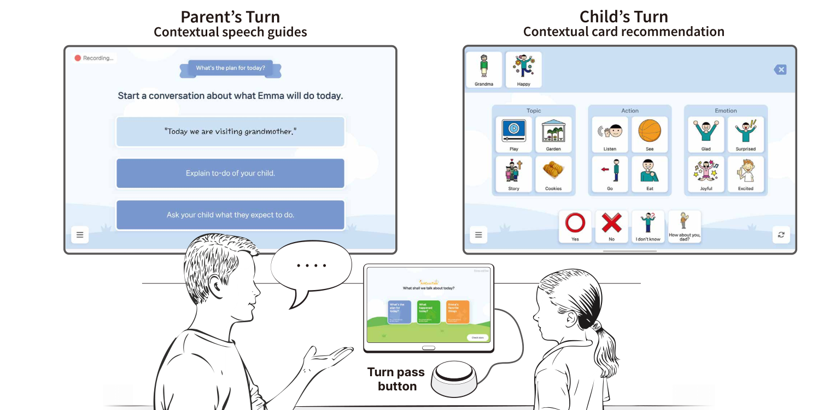
Main Contribution
Fig: AACessTalk is a communication mediation system that runs on a tablet device accompanied by a hardware button
(Bottom)

Slide 6
Main Contribution
Empirical findings from a two-week deployment study involving 11 parent-MVA child dyads, demonstrating how these dyads used AACessTalk for communication and how this experience influenced parents' perceptions of communicating with MVA children.
Design considerations for communication technologies that promote parental reflection on interactions with MVA children and foster the inclusion of neurodiverse children as active conversational partners.

Slide 7
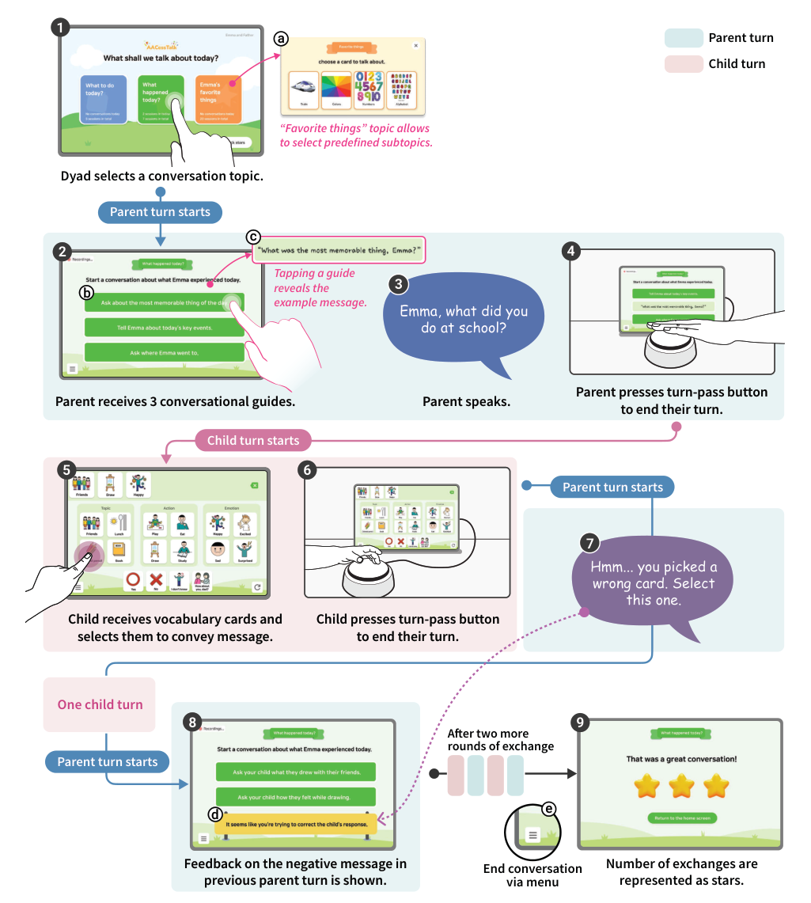
Main Contribution
Fig: Main screens and usage flow of AACessTalk

Slide 8
Methodology
Formative Study: This phase used semi-structured interviews with nine autism experts and five parents of minimally verbal autistic (MVA) children to understand communication challenges and effective practices. The insights gained highlighted the need for supporting turn-taking and led to the system's design rationales.
System Design and Implementation (AACessTalk): The system was developed as a tablet-based, AI-mediated communication tool with a hardware turn-pass button. Its design focused on three rationales: structuring turn-taking with expressive cues, providing contextualized parental guidance (conversational guides and feedback alerts), and prioritizing MVA children's vocabulary (categorized cards, refresh option, custom photos). Large Language Models (LLMs), specifically gpt-4-0613, were

Slide 9
Methodology
Deployment Study: A two-week home deployment study was conducted with 11 parent-MVA child dyads in South Korea. Participants used AACessTalk on a Samsung Galaxy Tab S9 tablet with a physical turn-pass button. The procedure included pre-study preparation, an introductory session, the two-week deployment period, and post-study debriefing interviews.
Data Analysis: Both quantitative (descriptive statistics on usage, mixed-effect models for conversation quality, Friedman test for parental self-efficacy, overlap coefficient for personalization) and qualitative (Thematic Analysis of interviews and daily reflections, open coding of conversations) methods were used to analyze the collected data.

Slide 10
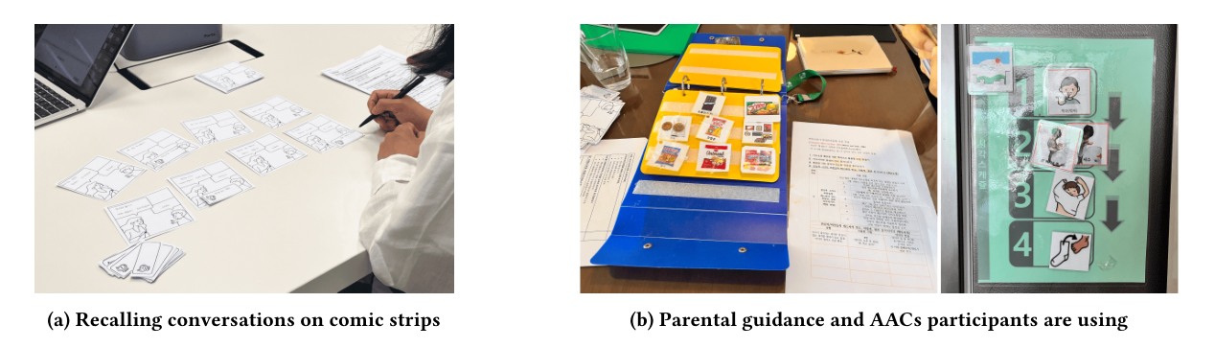
Methodology

Slide 11
Strengths
Demonstrated High Engagement and Increased Conversation: The two-week deployment study showed high engagement from all 11 dyads, leading to a statistically significant increase in the frequency of conversations and turn-taking. Participants averaged 1.55 conversations per day and 2.66 exchanges per session.
Empowered Children and Parents: AACessTalk empowered children to have more agency in communication and encouraged parents to explore diverse interaction strategies. Children used various system components to express intent, such as initiating conversations by bringing the tablet, using "I don't know" to indicate confusion, or pressing "End Conversation".
Notes:
On this slide, we introduce the deployment study of AACessTalk. The study involved 11 parent-child dyads, mostly minimally verbal autistic children and their parents. They used AACessTalk over a two-week period in their natural home environment, aiming to assess how well the system supports everyday communication

Slide 12
Strengths
Alleviated Parental Burden and Shifted Perception: The system alleviated parental pressure to lead "perfect" conversations or for children to produce complete sentences. Parents moved from brief, instructive dialogues to interactions focused on empathy and understanding, incorporating conversations with their MVA children into daily routines.
Contextual and Actionable Guidance: AACessTalk provided real-time, context-aware parental guidance based on expert strategies (e.g., Hanen More Than Words, PCIT), which parents found useful and adopted in 78% of their turns. The delayed feedback mechanism also encouraged parental reflection.
Notes:
Next, we explore parents’ experiences with AACessTalk. Parents reported feeling less pressure to conduct ‘perfect’ conversations, allowing them to focus on being more empathetic and reflective. The real-time feedback was particularly appreciated for helping parents adjust their communication style dynamically."

Slide 13
Weaknesses
Accuracy and Cultural Relevance of AI Outputs: Parents gave lower ratings for the appropriateness of recommended words and symbols, attributing this to inaccuracies in speech recognition and suggestions that did not always align with the Korean cultural context.
Need for Deeper Personalization: Parents expressed a desire for even more individualized AAC recommendations that better reflect their child's specific cognitive and developmental levels and daily events.
Notes:
Now let’s take a look at some of the key weaknesses identified in our evaluation.
First, we noticed issues with the accuracy and cultural relevance of AI outputs. Many parents gave lower ratings, particularly because the recommended words and symbols didn’t always align with Korean cultural context.
Second, there’s a clear need for deeper personalization. Parents emphasized the importance of more individualized AAC recommendations—ones that truly reflect their child’s unique cognitive and developmental stages, as well as their daily routines and events.
These weaknesses highlight important areas for future improvement, especially in making AI more adaptive and culturally aware.

Slide 14
Weaknesses
Limited Generalizability of Participants: The participants were selectively sampled through a single expert, meaning the findings may not be representative of the broader MVA population with diverse backgrounds and characteristics.
Risk of Parental Over-Imposition: Early in the deployment, some parents initially physically guided their children's hands, which sometimes led to the child refusing to engage. This highlights a risk of parents unconsciously imposing the tool's use
Notes:
Continuing with the weaknesses, two additional concerns were identified:
First, they faced a limited generalizability of participants. Since the participants were recruited through a single expert, the sample may not represent the wider MVA population with varying backgrounds. This limits how broadly we can apply the findings.
Second, there's the risk of parental over-imposition. In the early stages, some parents physically guided their children’s hands to use the tool. While well-intentioned, this sometimes-caused resistance from the child and reduced engagement. It shows the importance of letting the child take the lead to ensure authentic interaction.

Slide 15
Discussion
AACessTalk significantly improved conversations and turn-taking between minimally verbal autistic (MVA) children and their parents, fostering mutual engagement. It provided structured turn-taking and contextual parental guidance, helping parents diversify their interaction strategies and feel less pressure. MVA children were empowered to express intent with recommended vocabulary cards, surprising parents with their language use and sometimes imitating the AI voice. The system also encouraged parents to move beyond "autism labels" and increased their confidence.
emerging complexities and threats.
Notes:
In our discussion, we found that AACessTalk played a meaningful role in improving communication between minimally verbal autistic children and their parents.
The tool supported turn-taking and mutual engagement, giving parents structured guidance and helping them feel more confident and less pressured. It also encouraged parents to try new interaction strategies.
Children, in turn, were empowered to express themselves using vocabulary cards, and some even surprised their parents by imitating the AI voice.
Overall, the system not only boosted confidence but also helped shift perspectives—encouraging parents to see beyond traditional 'autism labels' and recognize their child's unique potential.

Slide 16
Discussion
However, the study identified several areas for improvement:
Personalization: Parents desired more personalized vocabulary recommendations tailored to their child's specific developmental levels and daily events, suggesting continuous assessment and analysis of past interactions.
Neurotypical Bias: The LLMs, trained on Western and neurotypical communication norms, might implicitly enforce these standards, raising concerns about limiting MVA children's communicative agency. Future work should consider neurodiverse datasets and broader communication modalities.
Authentic Child Voice: The study relied on parental interpretations, highlighting the need for more direct evaluation and participatory design involving MVA children themselves to authentically represent their intent.
Generalizability: The deployment study's participants were selectively sampled and not fully representative, requiring further investigation with diverse populations.
Long-term Engagement: Maintaining engagement as children grow and their needs evolve is a challenge, necessitating continuous updates and assessment.
Notes:
Now let’s move on to the discussion. While the study showed promising results, several key areas for improvement were identified.
First, there's a need for more personalization. Parents expressed the desire for vocabulary recommendations tailored to their child’s unique developmental stage and daily experiences, which calls for ongoing assessment and analysis.
Second, they must address neurotypical bias. Since the language models were trained on Western, neurotypical communication norms, there’s a risk of excluding or misrepresenting neurodiverse communication styles. Future research should incorporate more diverse datasets.
Third, we noticed a lack of the authentic child voice. The study mostly relied on parental input, which underlines the importance of involving the children themselves in design and evaluation processes to better reflect their true intentions.
Fourth, generalizability was limited. The study participants were selectively chosen, which means the findings may not apply to broader, more diverse populations.
And finally, maintaining long-term engagement is a challenge. As children grow and their needs change, systems must be regularly updated and reassessed to stay relevant.
These findings highlight important directions for future work to create more inclusive and effective tools.

Slide 17
Thanks

