Slide 1
Mastering Data Story Telling
5 Key Principles (5 Cs)

Slide 2
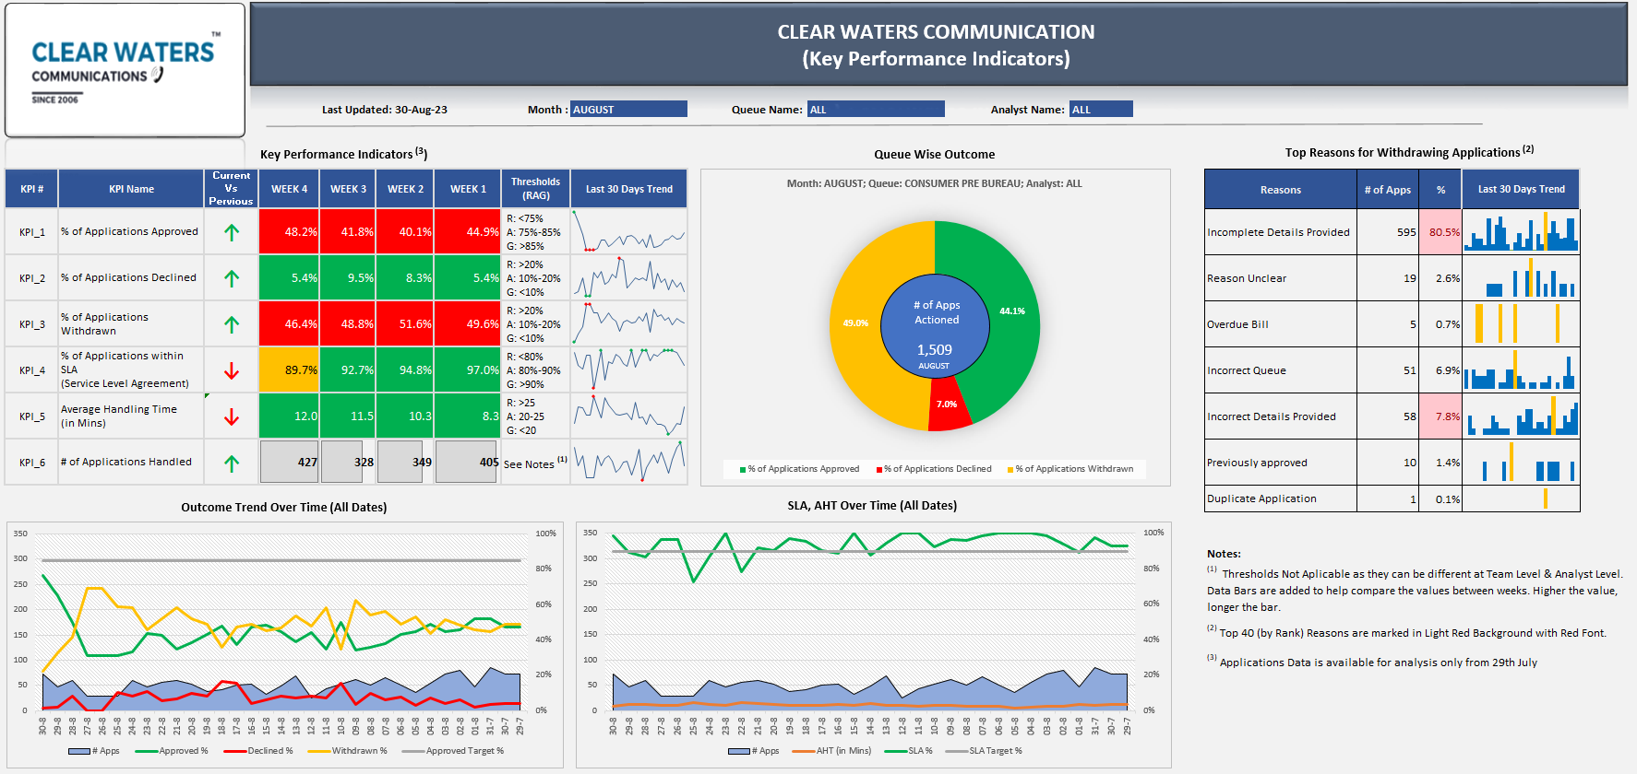
Mastering Data Story Telling
5 Key Principles (5 Cs)
5 Key Principles aka 5Cs helps in conveying key insights effectively through a Story Telling that just works..!
1
Clarity
Avoiding Unnecessary jargons & complexity that can confuse audience

Slide 3
Mastering Data Story Telling
5 Key Principles (5 Cs)
5 Key Principles aka 5Cs helps in conveying key insights effectively through a Story Telling that just works..!
2
Conciseness
Simple Language; focusing on the most important insights
“Lower Approval Rate for new contracts, whether for existing or new consumers, poses substantial sales and consumer experience challenges”

Slide 4
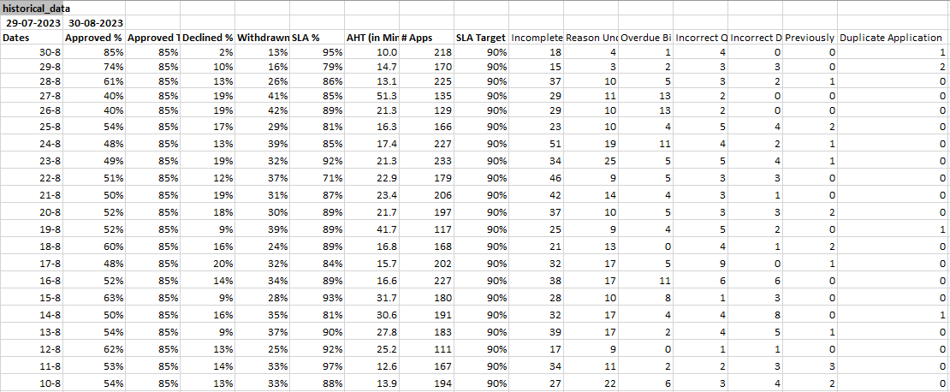
Mastering Data Story Telling
5 Key Principles (5 Cs)
5 Key Principles aka 5Cs helps in conveying key insights effectively through a Story Telling that just works..!
3
Compelling Visuals
Focus on simplifying complex data; engage the audience

Slide 5
Mastering Data Story Telling
5 Key Principles (5 Cs)
5 Key Principles aka 5Cs helps in conveying key insights effectively through a Story Telling that just works..!
4
Causality
Identify & explain patterns or trends; cause-&-effect relationships; why things are happening
“A Higher Rate of Application Withdrawals is CAUSED due to Incorrect Details or Incomplete Applications submitted at the stores”
EFFECT?
“Lower Approval Rate for existing & new consumers, posing substantial sales and consumer experience challenges”

Slide 6
Mastering Data Story Telling
5 Key Principles (5 Cs)
5 Key Principles aka 5Cs helps in conveying key insights effectively through a Story Telling that just works..!
5
Chronology
How we got here?; Understand & explain the progression of events
July’23
A Higher Rate of Application Withdrawals leading to a fewer applications being Approved
15th July’23
KPI Dashboard was Deployed by Data Analytics & Root Cause Analysis was Kicked-Off
15th Aug’23
Withdrawal Rate Continues to be High; Root Cause Analysis Completed
20th Aug’23
6 weeks Training Program for Stores Kicked-Off
30th Aug’23
Withdrawal Rate in last week of Aug declined by ~2%
Approval Rate improved by >4% during the same period

