Slide 1
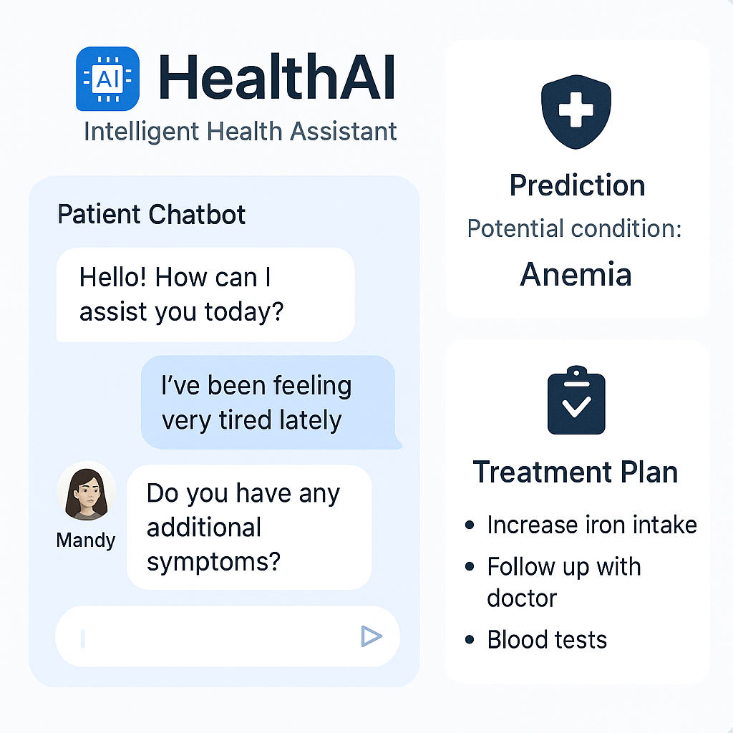

Slide 2
TITLE
HEALTHAI – INTELLIGENT HEALTHCARE ASSISTANT

Slide 3
TOOLS REQUIREMENTS
FASTAPI IN VS CODE
UVICORN
JINJA2 (EXTRA TOOLS IN VS CODE)

Slide 4
FUNCTIONALITIES
PATIENT CHAT
DISEASE PREDICTION
TREATMENT PLAN GENERATION
HEALTH ANALYTICS

Slide 5
LANGUAGES
PYTHON(FOR BACKEND)
HTML AND CSS(FOR FRONTEND AND STYLING)

Slide 6
ADVANTAGES
IT IS USER-FRIENDLY.
IT IS ACCESSIBLE ON BOTH MOBILE AND DESKTOP.
IT IS DESIGNED FOR NON – TECHNICAL USERS.
IT CAN HANDLE BASIC SYMPTOM CHECKING EVEN WITHOUT A DOCTOR.

Slide 7
THANK YOU

