Slide 1

When applicable,
add seal(s) below
the LSPU seal.
REAL-TIME ARNIS TECHNIQUE EVALUATION USING POSE ESTIMATION FOR POSTURE CORRECTION
Font size may be adjusted as needed.
JBS
James Bryan B. Tolentino
Shane A. Florentino
Jericho I. Peregrina
BSCS 3-IS
CCS
Laguna State Polytechnic University
Siniloan

Slide 2

Background of the Study
Human pose estimation is widely used in:
Sports, healthcare, and training systems
Deep learning enables algorithms like AlphaPose to:
Detect body keypoints, track movement in real time
Arnis is recognized under Republic Act No. 9850,
Requires: Precise posture, proper striking form, coordinated footwork
Current training: Manual evaluation by instructors, limited continuous monitoring
Existing systems: Require multiple cameras or Kinect & Not practical for everyday use
This study proposes a real-time Arnis technique evaluation system using AlphaPose.
For contents, bullets may be changed into paragraph form.

Slide 3
Objectives
The main objective of this study is to develop a real-time Arnis technique evaluation system using AlphaPose for posture correction, which captures user movements through a mobile camera and provides immediate feedback when incorrect posture is detected.
Specifically, this study aims to achieve the following:
To develop a functioning system for real-time Arnis technique evaluation:
1.1 Design and create a mobile-based interface for capturing user movements
1.2 Implement real-time video input using a mobile camera
1.3 Develop a posture feedback module that provides warning messages for incorrect techniques
For contents, bullets may be changed into paragraph form.

Slide 4
Objectives
2.To implement a pose estimation algorithm using AlphaPose:
2.1 Detect human body keypoints from real-time video input
2.2 Process and track body movements during Arnis striking and footwork
3. To extract and analyze posture features by identifying proper and improper posture based on predefined Arnis techniques.
4. To validate the system outputs using pose estimation performance metrics:
4.1 Evaluate keypoint detection accuracy using Percentage of Correct Keypoints (PCK).
4.2 Measure pose estimation error using Mean Per Joint Position Error (MPJPE).
4.3 Assess detection quality using Object Keypoint Similarity (OKS).
5. To evaluate system usability using the System Usability Scale (SUS).
For contents, bullets may be changed into paragraph form.

Slide 5
Significance of the Study
Helps improve Arnis training
Provides real-time feedback
Reduces risk of injury
Supports accessible AI-based training
For contents, bullets may be changed into paragraph form.

Slide 6
Technology Gap
Most existing studies focus on general posture correction, fitness tracking, or medical applications.
Some systems require special hardware (e.g., Kinect or multiple cameras), making them less practical and accessible.
Existing pose estimation systems like AlphaPose are mainly designed for activities such as running or yoga, not martial arts.
Many current systems lack:
real-time feedback,
sport-specific evaluation, and
mobile-based implementation.
There is limited research on using pose estimation for Arnis techniques, particularly for correcting striking and footwork movements.
For contents, bullets may be changed into paragraph form.

Slide 7
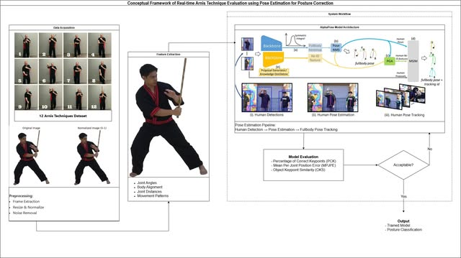
INSERT IMAGE HERE
Sample image size only.
May also change as needed.
For contents, bullets may be changed into paragraph form.

Slide 8
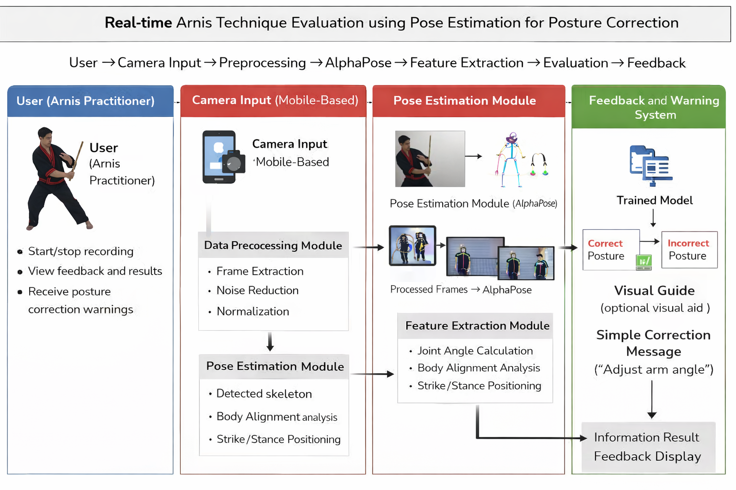
Sample image size only.
May also change as needed.
For contents, bullets may be changed into paragraph form.

Slide 9
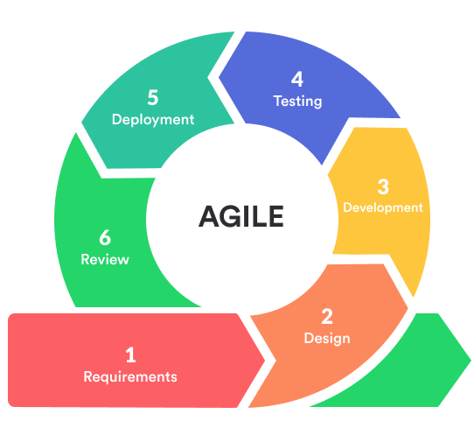
Initial Methodology
For contents, bullets may be changed into paragraph form.
Agile Development
Steps:
Data collection (image/video dataset)
System design
Implementation
Testing
Sample image size only.
May also change as needed.

Slide 10
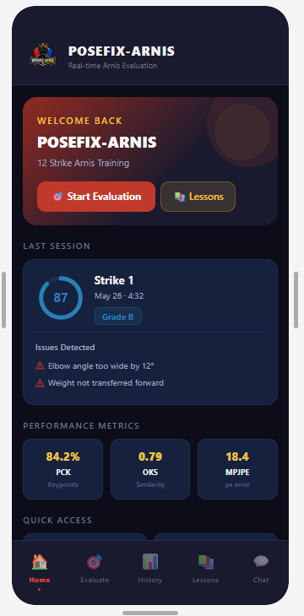
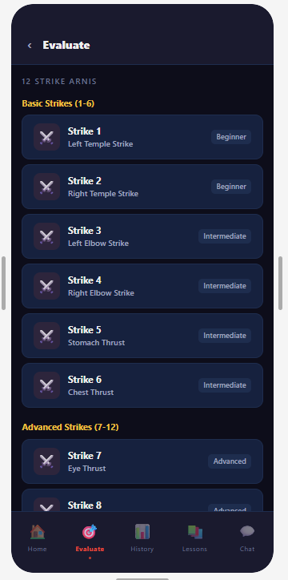
Story Board
For contents, bullets may be changed into paragraph form.
Sample image size only.
May also change as needed.
Figure 1: Welcome & Dashboard
Figure 2: Strike Selection

Slide 11
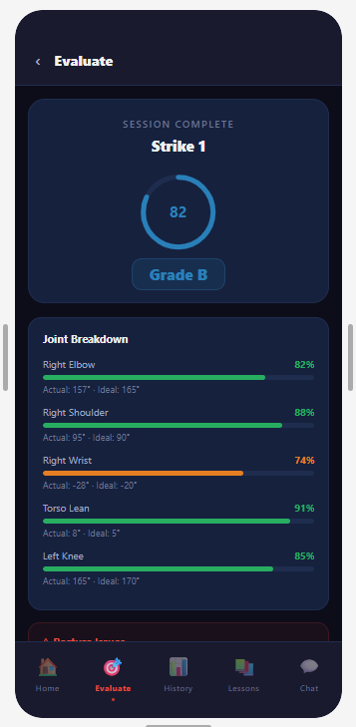
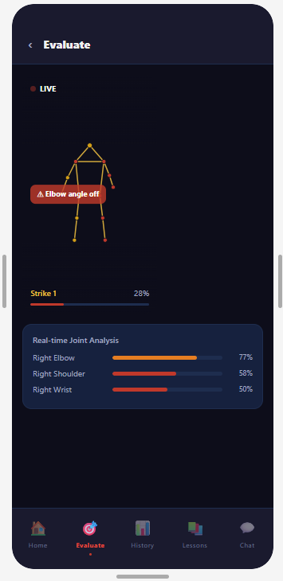
Story Board
For contents, bullets may be changed into paragraph form.
Sample image size only.
May also change as needed.
Figure 3: Live Evaluation
Figure 4: Session Results

Slide 12
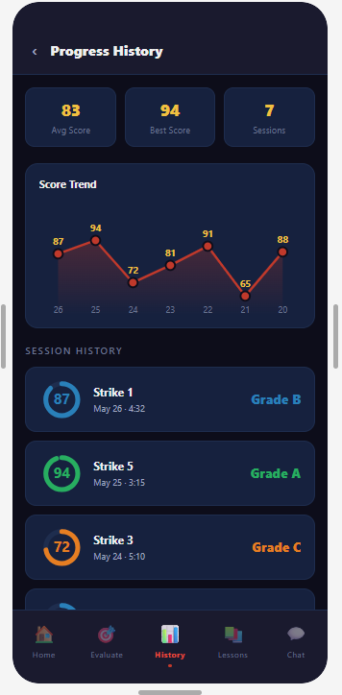
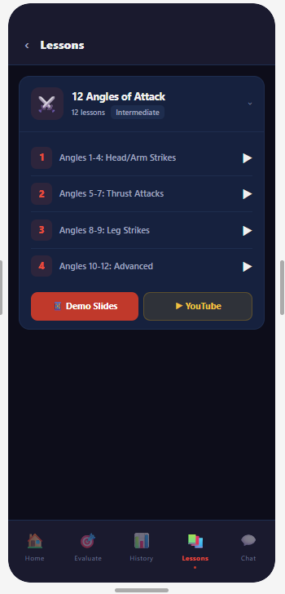
Story Board
For contents, bullets may be changed into paragraph form.
Sample image size only.
May also change as needed.
Figure 5: Progress History
Figure 6: Lessons

Slide 13
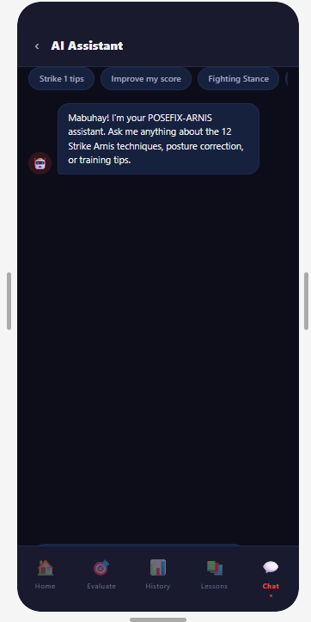
Story Board
For contents, bullets may be changed into paragraph form.
Sample image size only.
May also change as needed.
Figure 7: AI Assistant

Slide 14

FOR EXTERNAL PRESENTATIONS:
Keep this as
a STAPLE slide
at the end of the presentation.
A slide after this staple slide may be created for the personal contact information of the presenter.

