Slide 1

Customer Shopping Behavior Analysis
Uncovering insights into spending patterns, customer segments, product preferences, and discount usage to drive smarter business decisions.

Slide 2
Dataset Overview
3,900
18
37
Total Records
Data Columns
Missing Values
Comprehensive transactional data
Rich customer and purchase attributes
Only in Review Rating column
Customer Segments
Shopping Behavior
Age, Gender, Location
Previous Purchases
Subscription Status
Frequency & Review Rating
Shipping Type

Slide 3

Data Preparation Journey
01
Data Import & Inspection
Loaded dataset using pandas, analyzed structure with df.info() and df.describe()
02
Missing Data Handling
Imputed Review Rating with median by category to maintain consistency
03
Standardization
Converted columns to snake_case format for improved readability
04
Feature Engineering
Created age_group and purchase_frequency_days for deeper insights

Slide 4
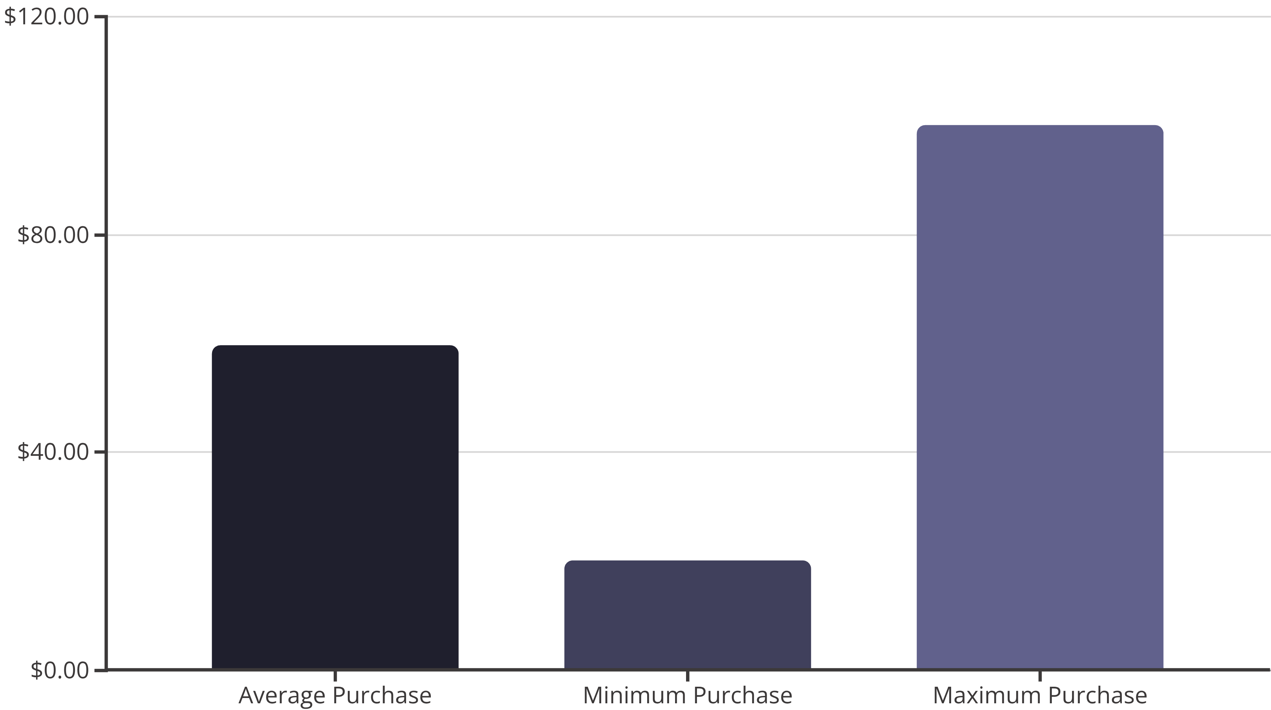
Key Statistical Insights
Customer Age
Review Ratings
Purchase History
Range: 18-70 years
Range: 2.5-5.0 stars
Range: 1-50 purchases
Average: 44 years
Average: 3.75 stars
Average: 25 purchases

Slide 5


Revenue Analysis by Gender
Male Customers
Female Customers
$157,890 total revenue
$75,191 total revenue
Significantly higher contribution to overall sales
Represents opportunity for targeted marketing
Male customers generated more than double the revenue of female customers, indicating a potential growth opportunity in female-focused marketing strategies.

Slide 6
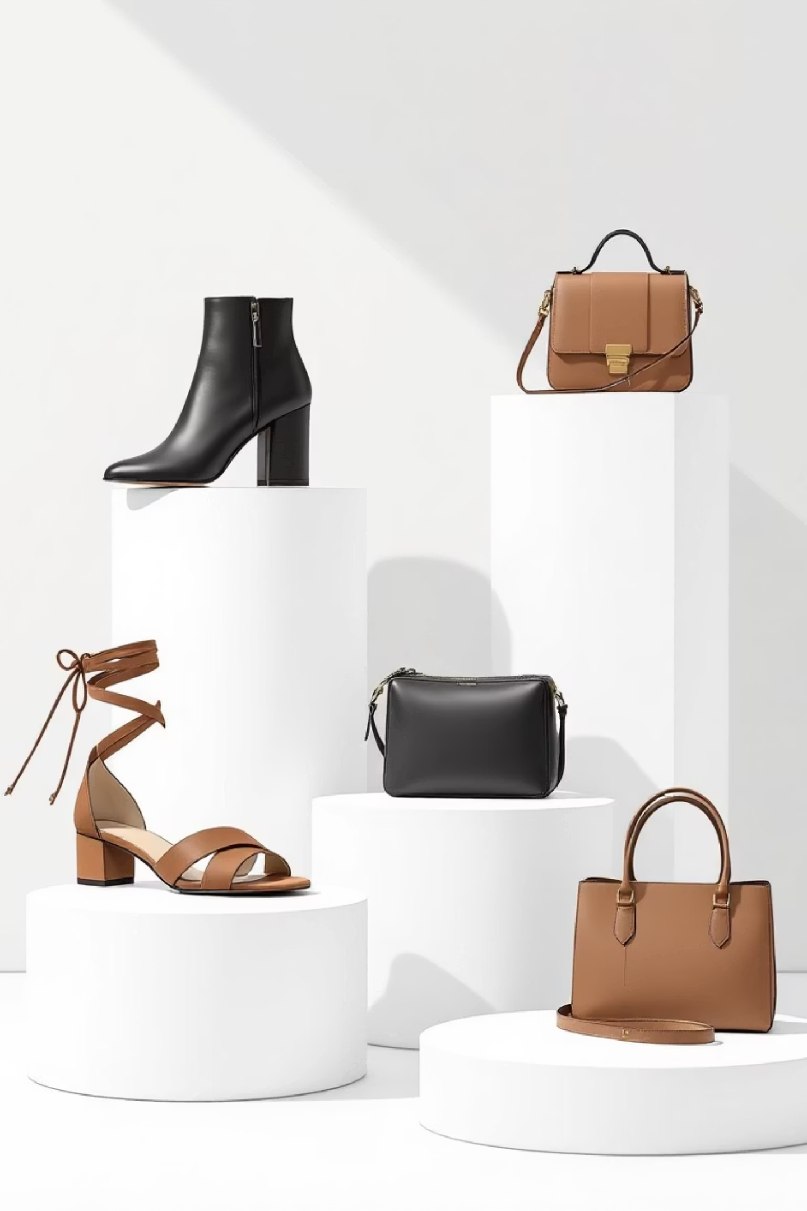
Top-Rated Products
1
Sandals
3.82 average rating
Highest customer satisfaction
2
Boots
3.79 average rating
Strong performance
3
Handbag
3.78 average rating
Consistent quality
4
Hat & Gloves
3.78 average rating
Tied for excellence

Slide 7

Shipping & Subscription Insights
Shipping Type Impact
Subscription Status
Express: $60.48 average
Non-subscribers: 2,847 customers
Standard: $58.46 average
$170,436 total revenue
Express customers spend slightly more per transaction
Subscribers: 1,053 customers
$62,645 total revenue
Non-subscribers contribute higher total revenue due to larger volume, while average spend remains similar at ~$60 across both groups.

Slide 8
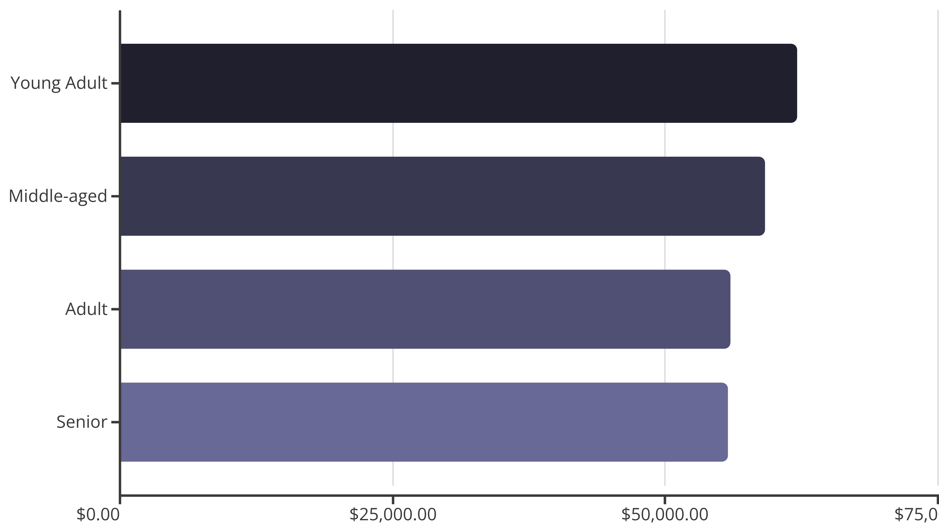
Age Group Spending Patterns
Young adults lead in total revenue, while middle-aged customers show higher per-transaction spending. This suggests different engagement strategies for each demographic.

Slide 9




Dashboard Highlights
4K
$233K
Total Customers
Total Revenue
$59.76
3.75
Avg Purchase
Avg Rating
Clothing dominates revenue at $104K, followed by Accessories ($74K), Footwear ($36K), and Outerwear ($19K). Revenue peaks in Fall and Winter seasons.

Slide 10

Strategic Recommendations
Targeted Discounts
Retention Focus
Replace blanket discounts with strategic offers to protect margins
Convert returning customers into loyal subscribers
Promote Top Products
Loyalty Programs
Feature high-rated items to boost trust and sales
Offer exclusive benefits like early access and special discounts
Express Incentives
Data-Driven Updates
Encourage premium orders with express shipping perks
Continuously monitor behavior and refine strategies

