Slide 1
FLE311 – Research Project Presentation
AI Across Campus:
Exploring Usage Differences in Academic Assignments Between METU Foreign Language Education and Engineering Students
Alperen Taha Bostancı - Emir Ekşi - İsmail Efe Top - Yiğit Duymaz

Slide 2
Aim of our project
We aim to to explore, compare, and discuss how undergraduate students in METU Foreign Language Education (FLE) department and METU Faculty of Engineering (ENG) students use AI for their academic life and assignments.
Significance of the topic
AI is a new phenomenon and it being a fresh occurrence, makes the research related to it all the more important. That is why this study is interested in a difference in spheres as small as a departmental difference, instead of something on a bigger scale like comparing countries.

Slide 3
Background research
How: Students use AI for planning, idea generation, and drafting (Chen et al., 2025; Duong & Chen, 2025).
Why: To save time, manage workload, and improve assignment quality (Donnell et al., 2024; Abbas et al., 2024).
Challenge: Many use AI text "as-is" without paraphrasing or attribution (Chen et al., 2025).
Perception: Students are generally open to AI but want institutional guidance and licenses (Chen et al., 2025).

Slide 4
Research Questions
How does the AI usage of METU FLE students differ compared to that of METU ENG students in academic assignments?
This study will employ twelve METU students. Six of them will be FLE students while the other six will be engineering students, both from various years.

Slide 5

What intimidates us?
Participant Recruitment
Interviewing Skills
Getting Honest Answers
Data Analysis

Slide 6
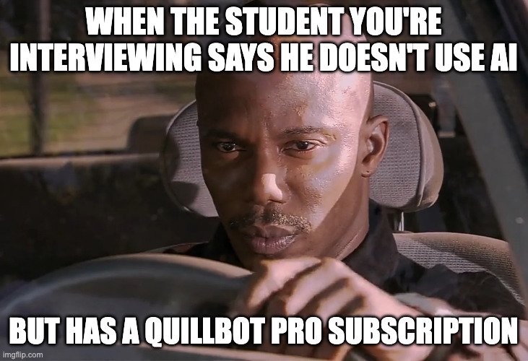
Thanks for listening!

Slide 7
References
Abbas, M., Jam, F. A., & Khan, T. I. (2024). Is it harmful or helpful? Examining the causes and consequences of generative AI usage among university students. International Journal of Educational Technology in Higher Education, 21(1), 10. https://doi.org/10.1186/s41239-024-00444-7
Chen, H., Van Reyk, D., & Oliver, B. G. (2025). The use of AI large language models by university students for assignment preparation. Advances in Physiology Education, 49(2), 517–525. https://doi.org/10.1152/advan.00181.2024
Donnell, F. O., Porter, M., & Fitzgerald, S. (n.d.). The Role of Artificial Intelligence in Higher Education: Higher Education Students use of AI in Academic Assignments. Irish Journal of Technology Enhanced Learning.
Duong, T.-N.-A., & Chen, H.-L. (2025). An AI Chatbot for EFL Writing: Students’ Usage Tendencies, Writing Performance, and Perceptions. Journal of Educational Computing Research, 63(2), 406–430. https://doi.org/10.1177/07356331241312363
Zeki, A. M., Tarshany, Y., Wasiq, S., Al-Taei, M. H. A., & Alhazmi, A. K. (2025). Exploring University Students’ Utilization of AI Tools in Academic Assignments: Benefits, Challenges, and Ethical Considerations. 2025 International Conference for Artificial Intelligence, Applications, Innovation and Ethics (AI2E), 1–6. https://doi.org/10.1109/AI2E64943.2025.10983650

