Slide 1

uSquam
Mobile Crowdsourcing platform
Group 3

Slide 2
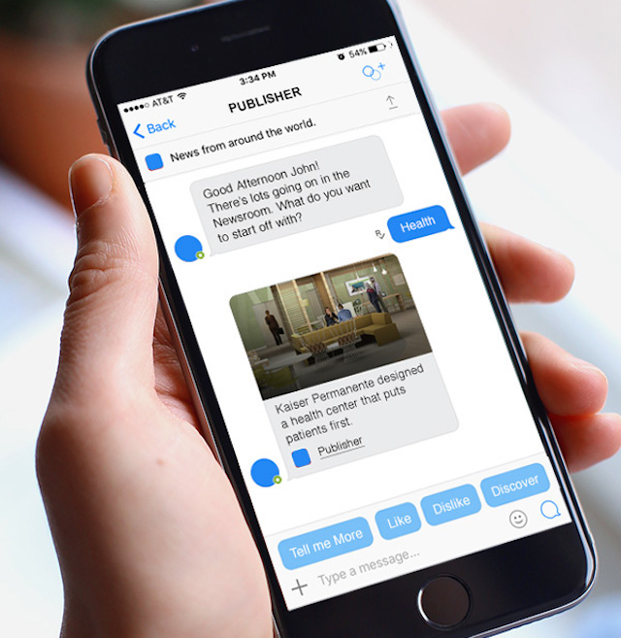
PROJECT IDEA
Design and develop a chatbot where users can perform microtasks anywhere and anytime (rather than a conventional UI in a browser on a desktop)
State of the art
Mobile-sensing: context-aware, situational and clear

Slide 3
Example: collect data for sentiment analysis
Task type 1
Chatbot shows the worker a tweet and asks if the message is expressed positively
Task type 2
Chatbot shows the worker an image of a group of people and asks him to describe the ambience
Task type 3
Chatbot asks the worker to take a selfie in a defined location and time (e.g. after watching a movie in the cinema)

Slide 4
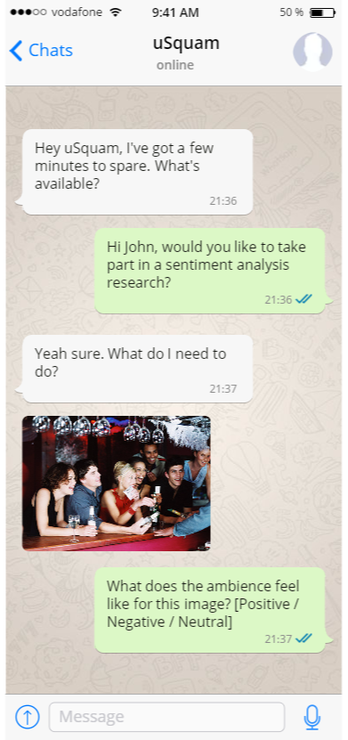
Example
Sentiment analysis

Slide 5
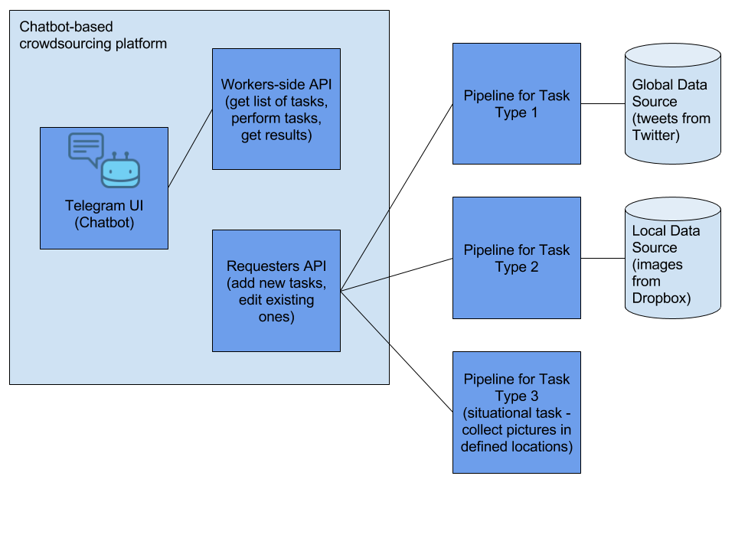
Requester designs a task
Task is shown to the worker (text, photo, an audio file, a map location etc)
Various questions are asked about this content
Worker answers the questions by interacting with the chatbot (click button, type text, send image, etc)

Slide 6
POTENTIAL
Exciting for workers
Perform simple tasks while commuting
Cover commuting expenses
Mea et al. showed that workers can perform some tasks via mobile devices faster than via desktop
Business potential
Collect data with situational awareness
Great way to access people (wide workforce audience)
A chatbot is easy to implement and thus easy to prototype

Slide 7
IR RELEVANCE
Apply IR techniques for quality control (agreement scheme, gold standard questions)
Apply a natural language processing technique
Gather data from a global source and sort it using an ElasticSearch instance

Slide 8


SIMILAR PROJECTS
Amazon Mechanical Turk
Microworkers
Clickworker
CrowdCafe
Notes:
Basic computing/ language skills, all tools/ info embedded into worker’s UI, tiny tasks

Slide 9
HOW TO EVALUATE SUCCESS
Worker side
Measure if people take less time to complete their tasks with the chatbot
Measure if people feel more attracted to performing tasks with a chatbot
Requester side
Flexibility: check if the platform supports varied tasks
Extensibility: check if a requester is able to easily add a fourth type of task

