Slide 1
AI-Powered Hate Content Moderation
Mahmoud El-Bahnasawi 202000985
Notes:
Good morning! My name is Mahmoud El-Bahnasawi, and today I’ll be presenting my graduation project, titled ‘AI-Powered Hate Content Moderation.

Slide 2
Table of Contents
Introduction
Literature Survey
Methodology
Results
Application
Conclusion

Slide 3
Introduction

Slide 4

The Problem
The rapid rise in internet usage has amplified the spread of hateful content.
Major platforms historically relied on human contractors for manual moderation.
Investigations reveal the mental health risks faced by these workers.
This has pushed the industry toward automated content moderation.
This project aims to extend that automation to end-users through practical tools.
Notes:
Since the dot-net boom, internet usage has skyrocketed—and we’ve seen this growth firsthand in Egypt. With more people online, there's also been a surge in toxic and hateful content.
Traditionally, companies like Facebook relied on external contractors for content moderation. These human moderators reviewed reported posts manually, often dealing with disturbing material.
This setup has had serious consequences. Documentaries like The Cleaners and investigations by outlets like CNBC have shown the mental toll this work takes on people.
In response, tech companies are starting to shift toward automated content moderation to reduce human exposure and improve scalability.
And that's exactly why I chose this project—to contribute to that transition. But I wanted to go one step further: not just automation for big tech companies, but giving users themselves tools for personalized, real-time moderation—through browser extensions and user-friendly UIs.

Slide 5
Towards Scalable Hate Speech Moderation
Design a multi-layer moderation system for identifying hate in short-form online text.
Deliver two user-facing applications:
A Streamlit-based UI for controlled testing and demonstrations
A browser extension for live, real-time content moderation

Slide 6
Literature Review

Slide 7
🏛️ Laws Supporting Content Moderation
📜 Digital Millennium Copyright Act (DMCA)
Focuses on copyright protection for online content.
Gives platforms legal protection if they remove harmful or illegal content when notified.
Encourages tools that remove hate or harmful content before it causes problems.
🛡️ Communications Decency Act (CDA) – Section 230
Protects platforms from being sued over what users post.
Allows platforms to moderate content without losing that protection.
Helps support systems like mine that detect and remove harmful content safely.

Slide 8
🤝 Ethics in Hate Speech Moderation
🧠 Responsibility
Hate detection systems must avoid false positives that silence free speech.
Equally, they must catch harmful content without hesitation.
⚖️ Fairness
Avoid bias toward specific groups or viewpoints.
Ensure that the model treats all users equitably, regardless of background or identity.
🔍 Transparency
Users deserve to know why content was flagged or blurred.
Rule-based and AI-based layers should have clear reasoning paths.
🔄 Human Oversight
Feedback system ensures users remain part of the loop.
Allows correction of unfair decisions and continuous improvement.

Slide 9
🧩 Standards in Content Moderation Systems
🛠️ Technical Standards
Dataset Handling: Follows ML protocols on data splitting, balancing, and preprocessing—aligned with ISO/IEC 20546:2019 (Big Data Standards).
Model Training: Utilized FP16 precision, gradient checkpointing, and LoRA—consistent with IEEE 7001-2021 (Ethical AI Design).
Evaluation Metrics: Relied on MCC, F1 Score, and confusion matrix—standard in NLP benchmark evaluations (e.g., GLUE, HateXplain).
🔐 Data & Privacy
No personal data collected; all feedback is anonymized and stored securely—reflects ISO/IEC 27001 (Information Security).
📏 Industry & Deployment Standards
Follows modular and auditable design, aligned with:
ISO/IEC TR 24028:2020 – Trustworthiness in AI
ML Ops best practices from Google/Meta documentation.
Deployment uses FastAPI, Supabase, and PostgreSQL, following modern cloud-native application standards (e.g., CNCF guidelines).

Slide 10
From Multimodal Curiosity to Textual Focus
Many hateful tweets combine text and images, making multimodal detection a logical starting point.
Multimodal AI is a rapidly growing research domain, with strong academic and industry momentum.
While reviewing existing models, I identified key limitations—and started exploring a possible workaround.
⇒ Eventually, I pivoted to textual models, which I’ll elaborate on later.

Slide 11
Facebook Dataset
Released in May 2020 by Facebook AI to study multimodal hate speech.
Contains 10,000+ labeled memes, where meaning emerges from text–image fusion.
Accompanied by baseline models and the $100K Hateful Memes Challenge (NeurIPS 2020).
Targeted cases where unimodal models fail—e.g., sarcasm, visual irony.
Serves as a milestone dataset for research in harmful multimodal content.

Slide 12
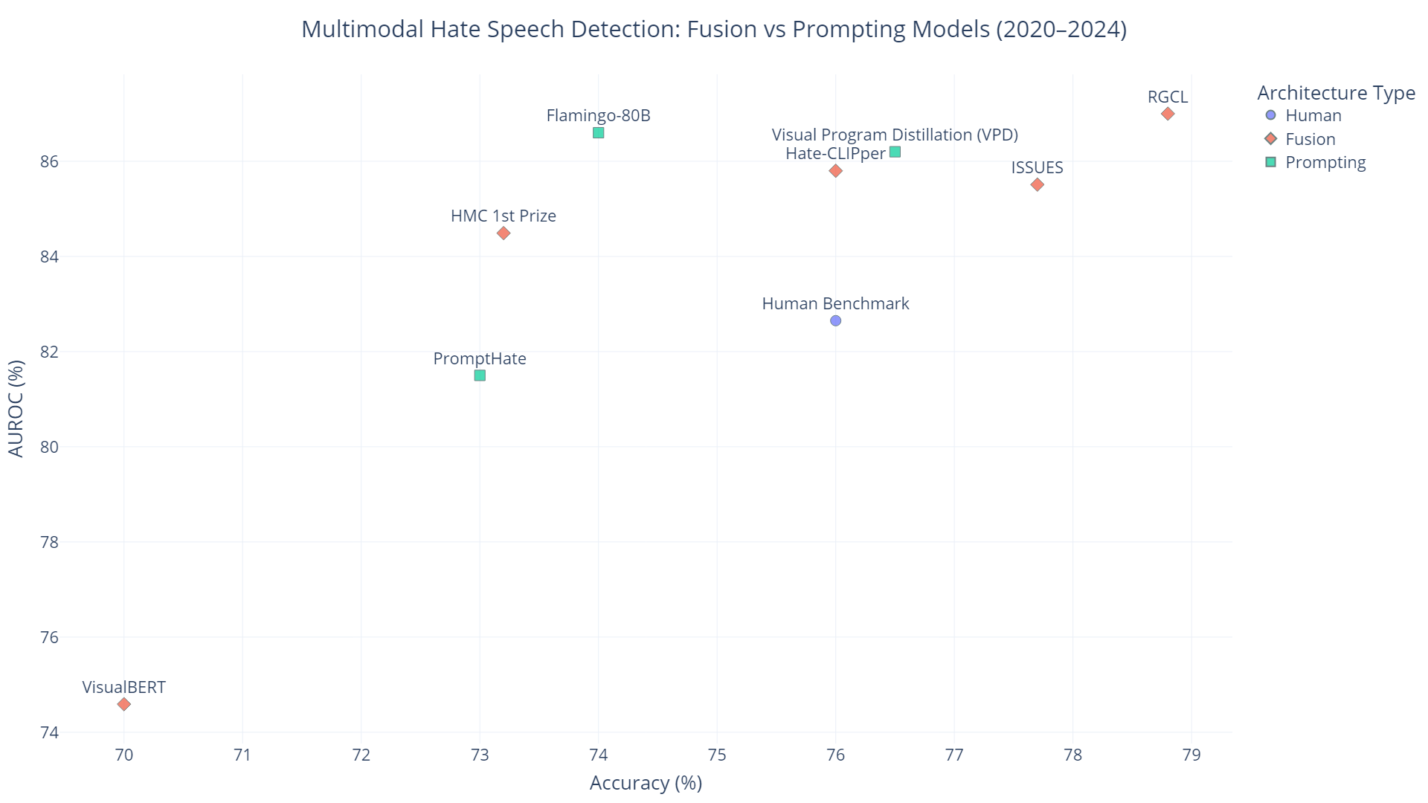

Slide 13
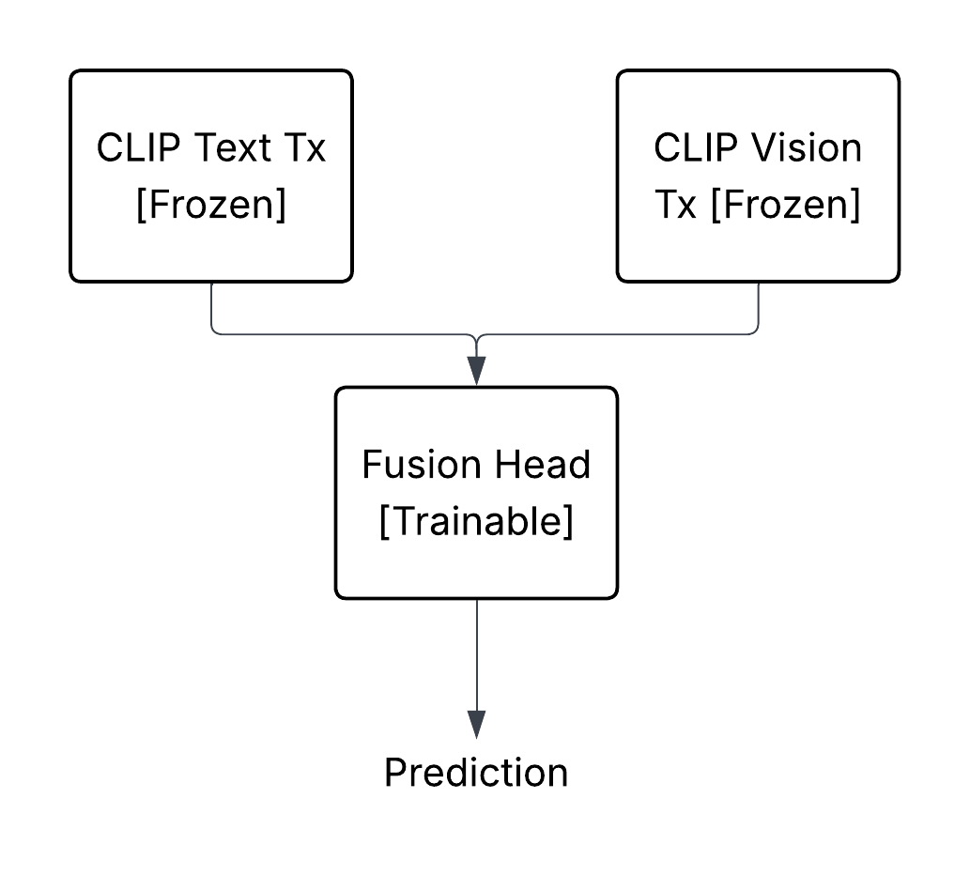
Why I Shifted from Fusion to Textual Core
Key Limitations of Current Multimodal Approaches:
Most models rely on frozen encoders (e.g., CLIP, BERT) with only a trained fusion head → fails to adapt to hate-specific cues.
Datasets like Facebook Hateful Memes (~10K) and even MMHS150k (~150K) are too small for stable multimodal training.
Result: Fragile performance, low generalization, and inability to scale to edge or production use.
My Strategic Pivot:
I proposed a hate-aware textual backbone (fine-tuned on hate speech).
Kept the CLIP vision encoder frozen, minimizing compute cost.
Retained a trainable fusion head—but empowered it with richer text embeddings.
Notes:
Instead of just gluing CLIP together and training a fusion head like many papers do, I asked—how do we make the language model aware of hate?
That’s when I pivoted to a stronger textual foundation: training or finetuning the text encoder on hate-specific data, and then building a fusion head on top.
It’s not about abandoning multimodality—it’s about anchoring it in a smarter core

Slide 14
Textual Data

Slide 15
Round 1: Data Fragmentation & First Discoveries
Initial survey revealed dozens of hate speech datasets—but highly fragmented and inconsistent.
Most datasets were small, noisy, or platform-specific (e.g., Reddit, Facebook, Twitter).
I shortlisted two large, relatively clean aggregated datasets: Hatebase and The Superset.
Combined, they offered ~530K tweets—but required significant cleaning and curation.

Slide 16
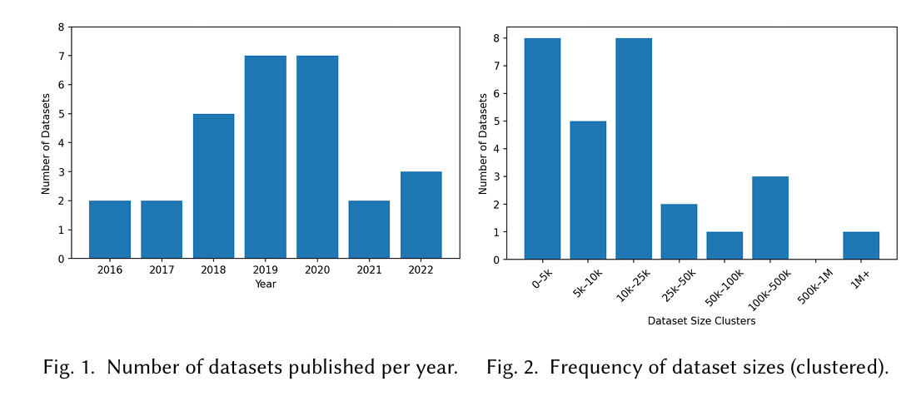
From a survey published in April 2025: Affirms Data Fragmentation

Slide 17
Round 2: Model Benchmarks Discovered After My Work
After building my model, I discovered two major works that support my design direction.
Cardiff University’s HateBERTweet (2023) reported a Macro F1 of 0.70, using a BERTweet backbone.
MetaHate (2024) introduced a 1.2M tweet dataset and showed that full-tuning BERT on hate data sets a new performance baseline.
More on that in: Results & Discussion Section

Slide 18
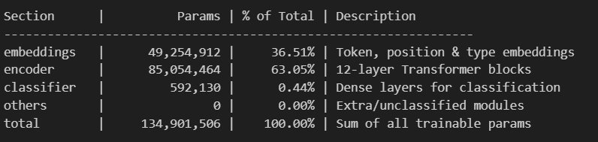
Why BERTweet Was the Right Foundation
On BERT (Base)
Originally trained on books and Wikipedia, making it less effective on tweet slang, hashtags, and informal tone.
On BERTweet
Pretrained on 850M English Tweets, using a RoBERTa-like tokenizer well-suited for short, noisy text
Outperforms BERT significantly on Twitter NLP tasks (as shown in Cardiff study).

Slide 19
Methodology and Implementation

Slide 20
The Multi-Layer Moderation Pipeline
Rule-based Pre-Filtering – lightweight checks for slurs and harmful patterns
2. Textual Model – fine-tuned BERTweet with LoRA for deep semantic understanding
3. Feedback Re-training (partially implemented) – learn from real-world user disagreement

Slide 21
Rule-based Pre-Filtering: A First Line of Defense
A lightweight, high-precision system to flag explicitly hateful content before invoking the AI model.
Text is lowercased and tokenized for consistent detection across variations.
Detects hate using curated lexicons: slurs, swear words, hate slogans, hashtags, emojis, and abbreviated hate forms (e.g., kys, n1gga, invaders, 🤬, ).
When triggered, it directly returns a Hate Score = 1 — making it clear to users and developers that blurring was rule-based, not AI-predicted.
Reduces latency and GPU usage, which is critical in real-time environments like browser extensions.

Slide 22
Textual Model

Slide 23
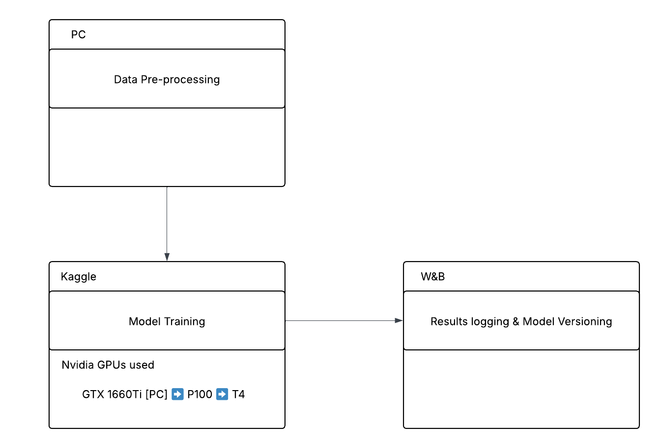

Slide 24
Data Pre-Processing
Raw Dataset (590K)
Remove Duplicates (14.7K)
Remove >60-word texts (35K)
Drop NaNs (300)
Textual Features:
Emojis [Removed]
Hashtags [kept]
Lowercased
Final Dataset: ~540K
Max_length padding: 70
Class balance: 67-33%
Dataset split:
Training: 494k
Val: 30k
Test: 10k

Slide 25
Training Setup & Optimization
Training Platform
Conducted all experiments using Kaggle Notebooks with free GPU access.
Setup Steps
Moved dataset to CUDA to eliminate CPU–GPU transfer delays.
Used LoRA Fine Tuning to update a small portion of the Model parameters
Conducted 4 Weights & Biases sweeps for hyperparameter tuning:
Batch size, learning rate, LoRA configs, gradient accumulation, etc.
Selected best-performing configuration:
🟩 MCC Score: 0.68
🟩 Macro F1 Score: 84.5%

Slide 26
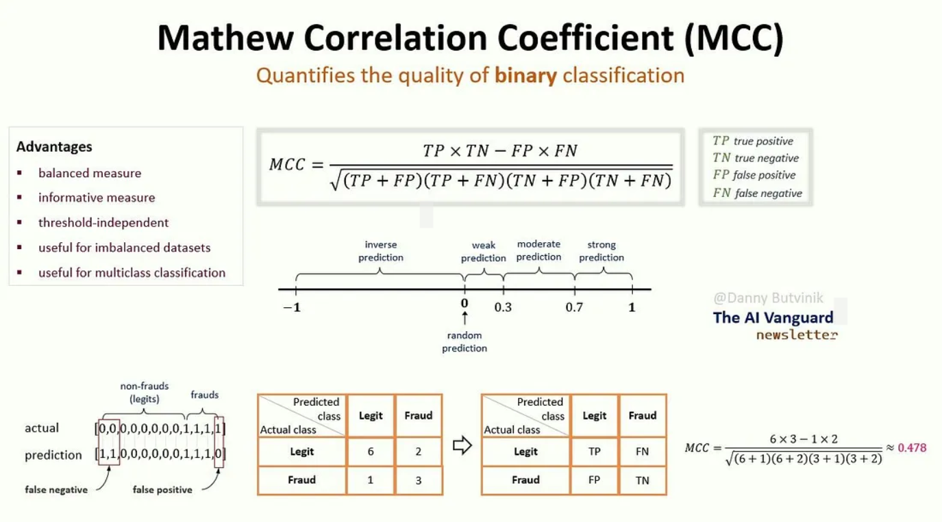
Notes:
It’s kinda similar to Macro F1, but I know I chose from psychological point of view. It starts from zero at the baseline, Macro F1 doesn’t.

Slide 27
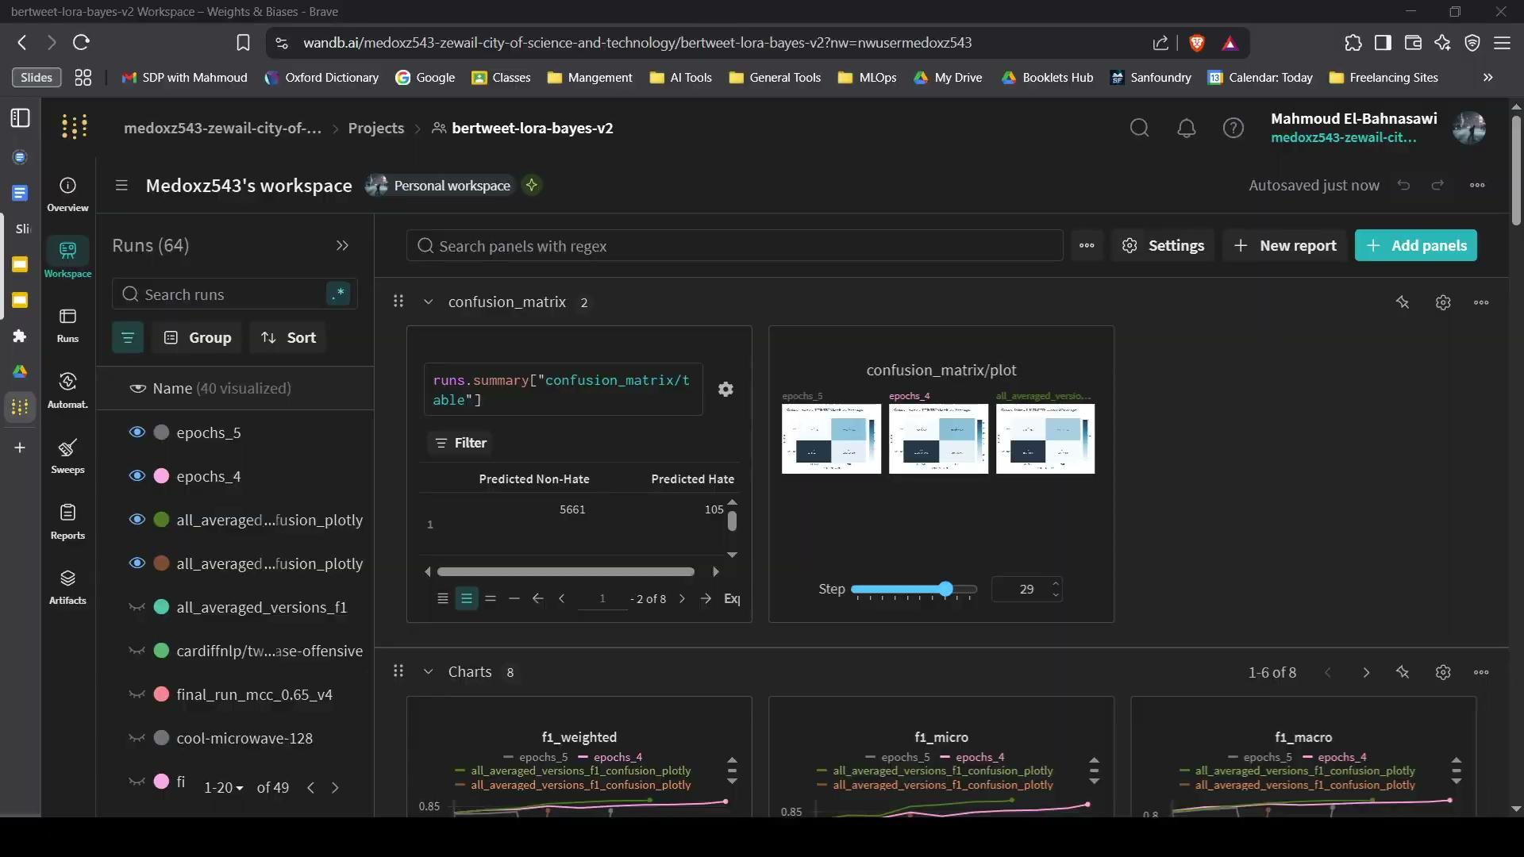
Weights & Biases

Slide 28
Final Hyperparameter Configuration
📦 Dataset & Batching
Train batch size: 512
Evaluation batch size: 256
Gradient accumulation: 2
FP16 training: Enabled
Gradient checkpointing: Enabled
Epochs: 3
🧠 LoRA Optimization
LoRA rank (r): 16
LoRA alpha: 12
Target modules: "query", "key", "value", "attention.output.dense"
Dropout: 0.1
Bias: "all"
Trainable modules: Classifier + LoRA adapters
🔧 Optimization Setup
Optimizer: adamw_torch_fused
Learning rate: 2e-3
Scheduler: Cosine
Weight decay: 0.01
Max grad norm: 1.0
Warmup ratio: 10%
🧮 Trainable Parameters 1.87M out of 136.6M (≈ 1.37%)
592K → Classifier
1.28M → LoRA adapters
🕒 Training Time: <2 hours

Slide 29
Feedback Re-Training

Slide 30
Feedback Re-Training
A. Key Challenges:
Catastrophic Forgetting: Fine-tuning on small or biased samples can overwrite core model knowledge.
Incompatible Methods: Techniques like RLHF/DPO are designed for decoder models, not BERTweet.
B. System Overview:
Users can click “Disagree” in the Streamlit UI when they believe content is not hateful.
Feedback includes: tweet, model score, user label (label = true → user says “not hateful”).
Logged to Supabase (PostgreSQL) in real time.
Weekly fine-tuning using LoRA-only updates, capped at 10% of training dataset size to prevent model drift.
Goal: Adapt to ambiguous hate (sarcasm, irony, denialism) while preserving base performance.

Slide 31
Results and Discussion

Slide 32
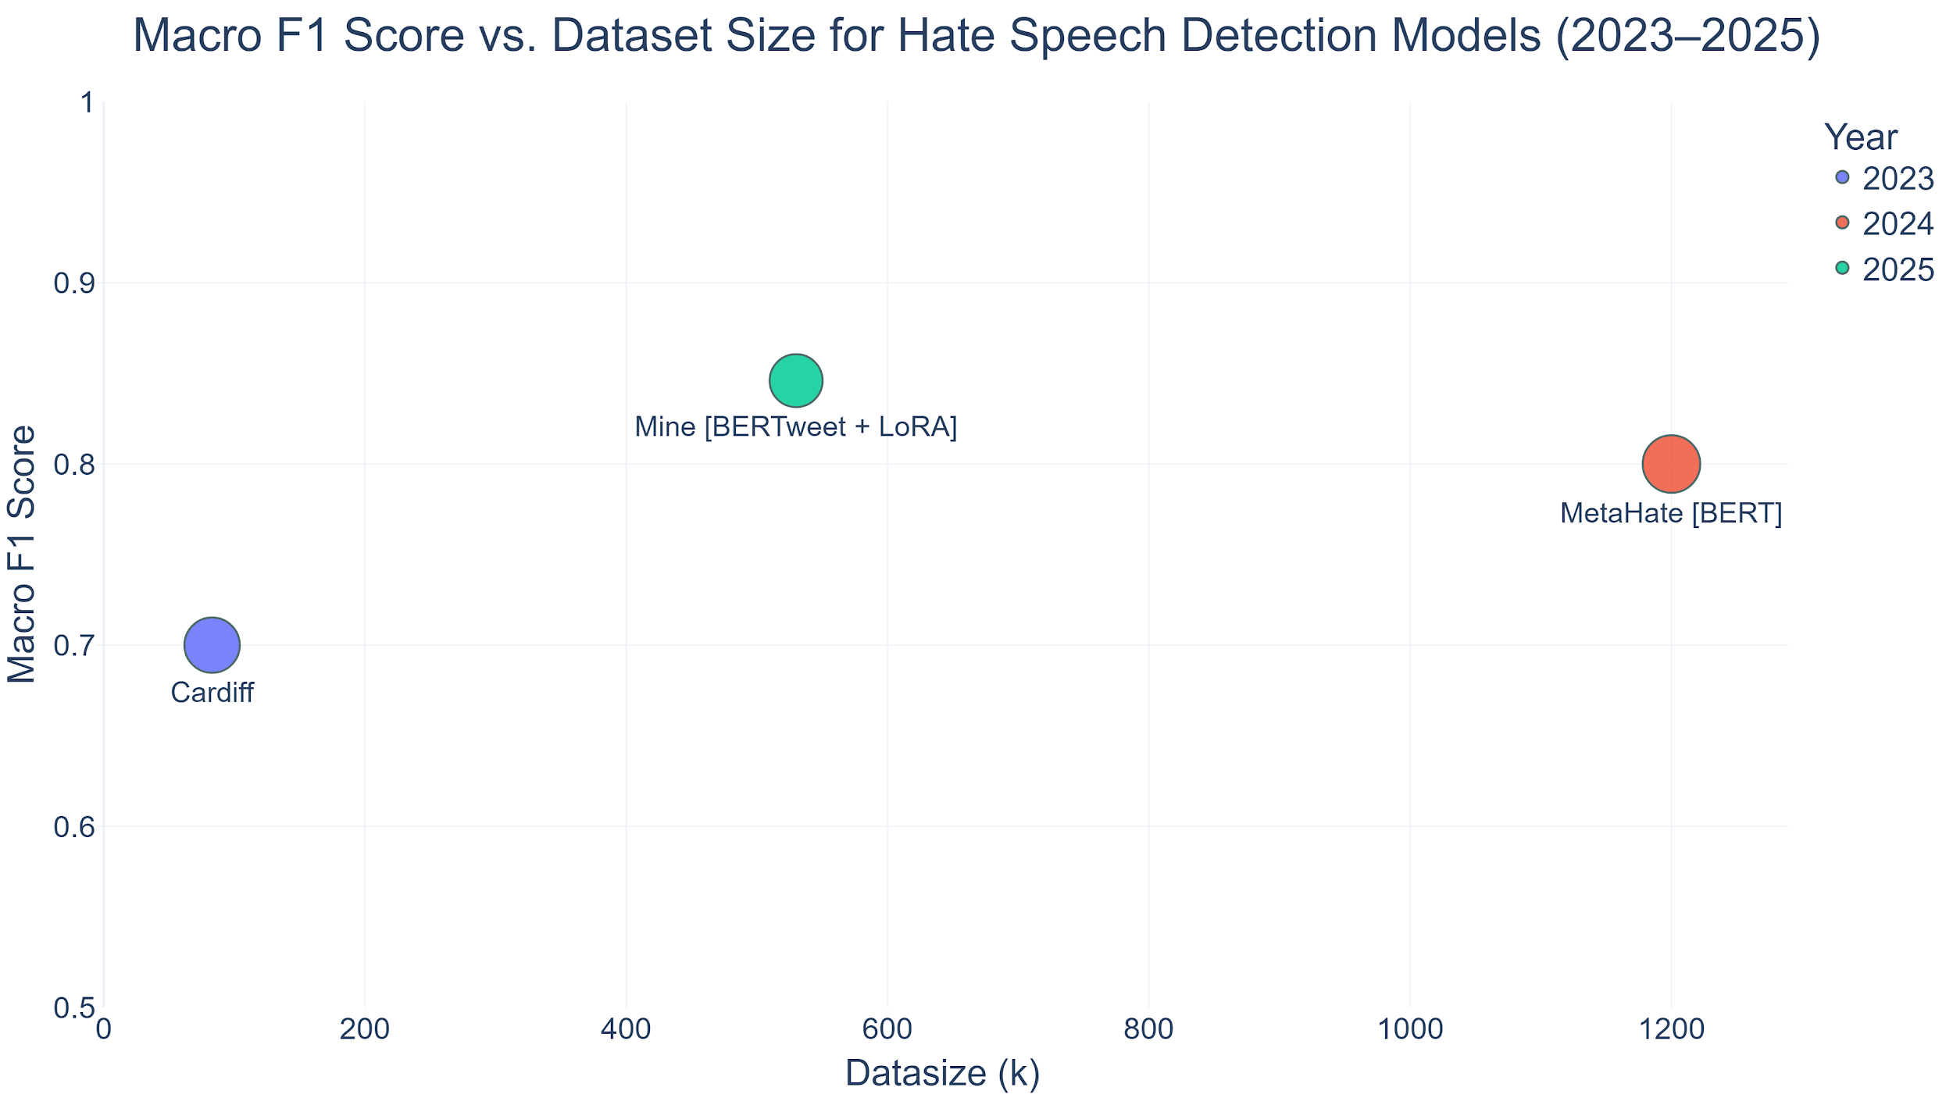

Slide 33
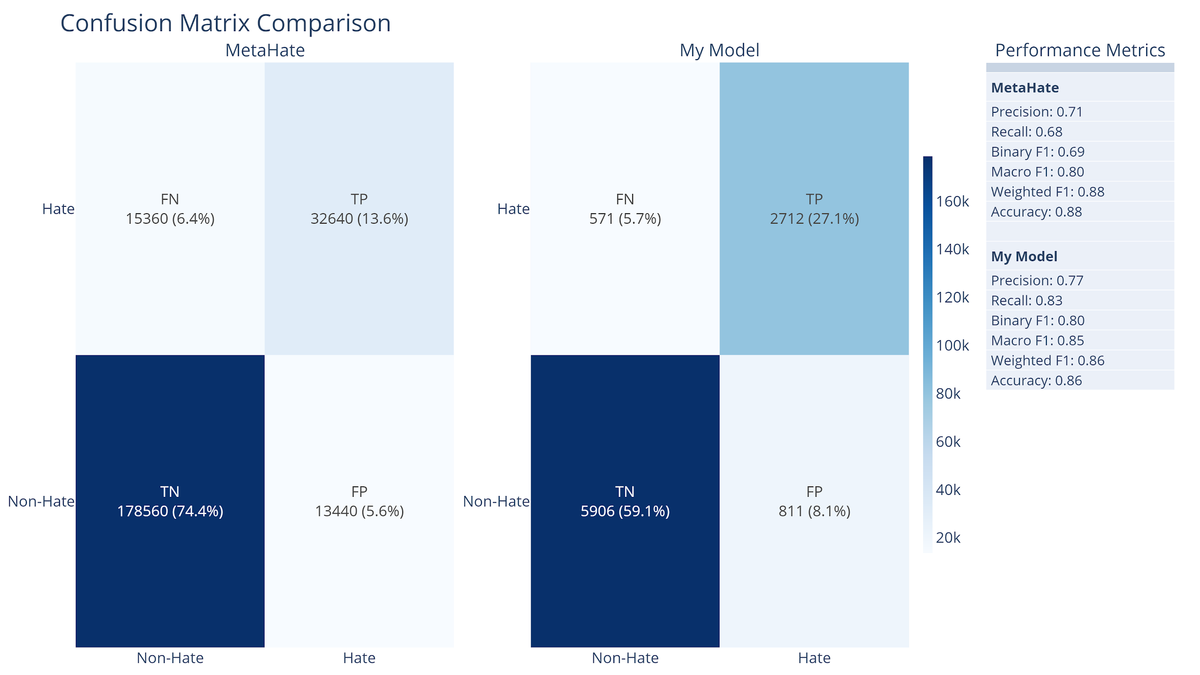

Slide 34
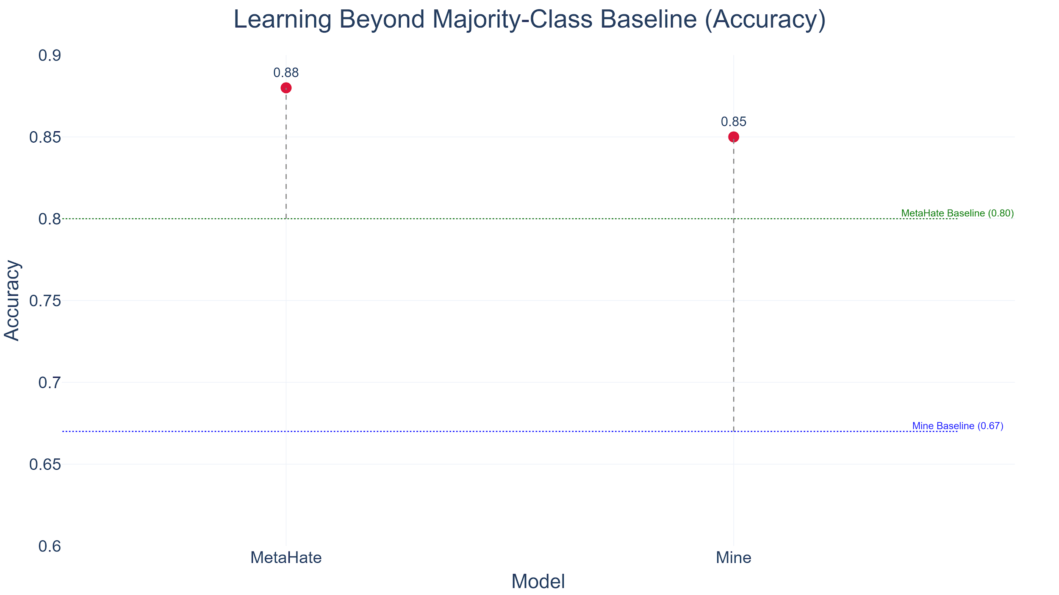

Slide 35
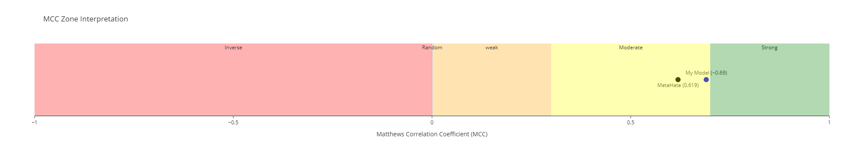
It’s get harder to raise MCC value in high ranges

Slide 36
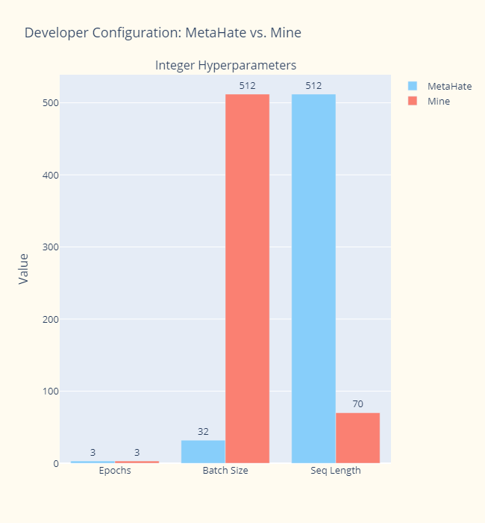
Training Configuration Comparison: MetaHate vs. This Work
Both Cardiff and MetaHate used default hyperparameter settings in their reported experiments.
Cardiff (2023) performed fine-tuning but didn’t disclose training details.
MetaHate (2024) used full-model tuning, which is computationally expensive.
In contrast, my model was optimized for efficiency:
LoRA-based fine-tuning
Only 3 epochs
Training time: ~2 hours on a single GPU
✅ Despite that, performance remained competitive — especially considering that MetaHate used 1.2M samples and full training.

Slide 37
🥇 Competitive Advantages
Area | What Makes It Stand Out
Dataset Scale | Among the first models to train on 540K+ real tweets using BERTweet with LoRA
SOTA Results | Outperformed MetaHate & Cardiff with Macro F1 = 84.5%, MCC = 0.68
Modern Training Strategy | Used W&B sweeps for hyperparameter tuning, batch size = 512, LR = 2e-3, cosine scheduler, etc. — not the outdated defaults
MLOps Integration | Integrated Weights & Biases, Supabase, FastAPI, and automated logging into workflow
Productization | Integrated into both a Streamlit UI and a Chrome browser extension
Low-Latency Design | Rule-based pre-filtering + LoRA = fast inference, low GPU usage, and real-time UX
User Feedback Loop | Real-time feedback stored in Supabase, enabling human-in-the-loop retraining

Slide 38
Application

Slide 39
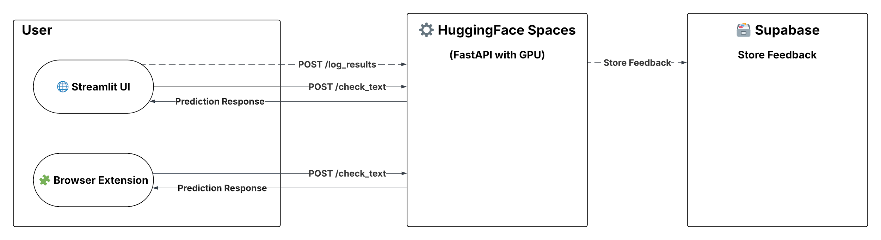

Slide 40


Streamlit UI

Slide 41
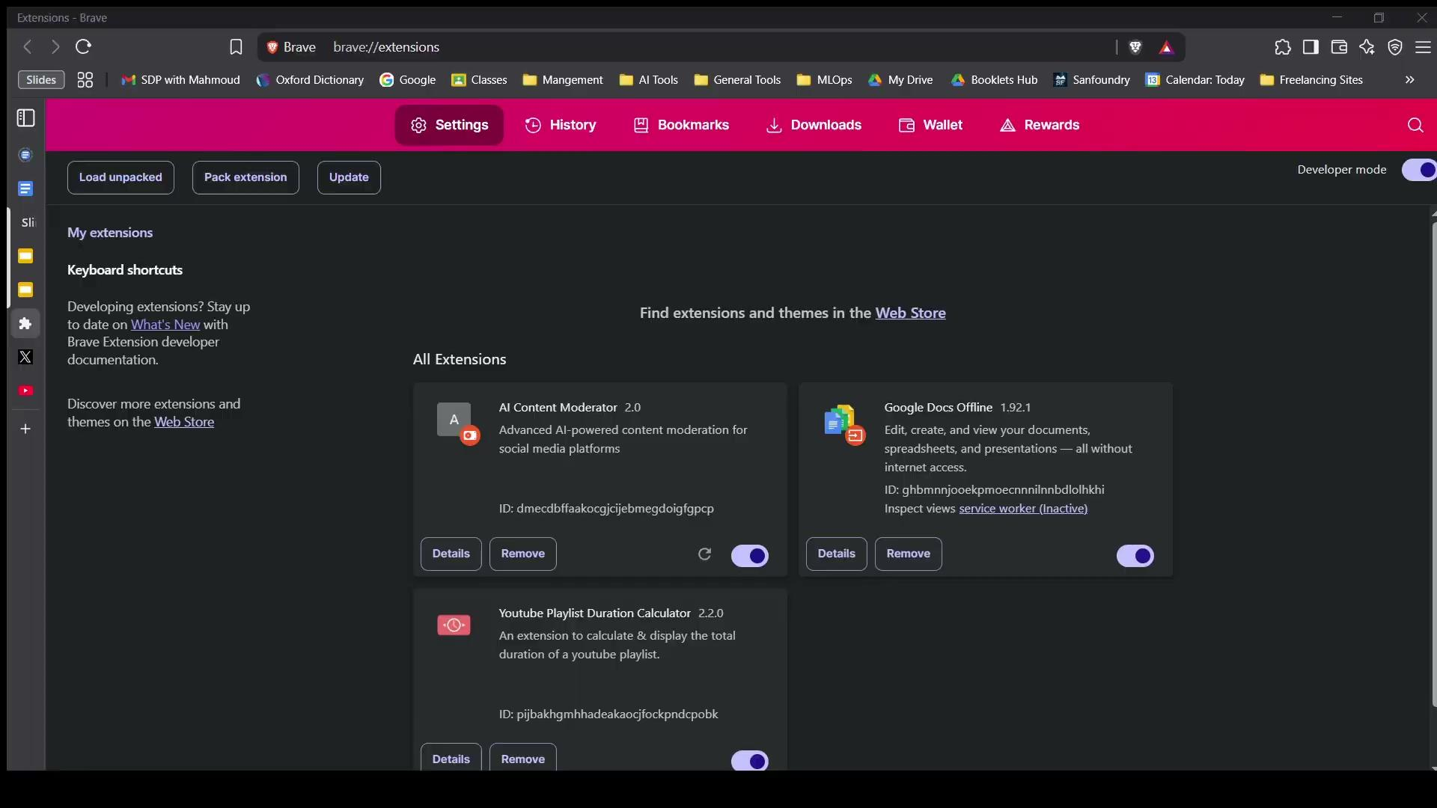
Browser Extension
You can download it from here: GitHub Repo

Slide 42
Conclusion

Slide 43
Summary & Limitations
Category | Description
System | - Real-time browser extension for hate speech moderation - Uses BERTweet + LoRA; Macro F1 ≈ 84.5%, MCC > 0.67 - Backend via FastAPI, logs user disagreement via Supabase
Limitations | - Weak on sarcasm & implicit hate - English-only - Requires internet/cloud - Fixed thresholds - No support for image/video-based hate

Slide 44
Vision for the Future
Area | Future Enhancements
Learning | - Integrate feedback into retraining
Scope | - Add multimodal detection (e.g., CLIP) - Add multilingual support (e.g., XLM-R)
Tech Stack | - Prompt-based models (few-shot adaptation) - Multi-GPU training (DeepSpeed, PL)
Beyond Browser | - Explore network-level moderation in cybersecurity contexts e.g. MiTM Proxy

Slide 45
References
AI content moderation services tool platform - CheckStep. (2025, April 22). Checkstep. https://www.checkstep.com/
Barman, N., & Das, D. (2022). Hate-CLIPper: Multimodal hate speech detection using CLIP. arXiv. https://arxiv.org/abs/2209.01811
Community Sift. (n.d.). Microsoft Game Dev. https://developer.microsoft.com/en-us/games/products/community-sift/
GDC 2024: Community Sift & the future of content moderation. (n.d.). Microsoft Game Dev. https://developer.microsoft.com/en-us/games/articles/2024/03/community-sift-and-the-future-of-content-moderation/
Hu, Y., Stretcu, O., Lu, C.-T., Viswanathan, K., Hata, K., Luo, E., Krishna, R., & Fuxman, A. (2024). Visual program distillation: Distilling tools and programmatic reasoning into vision-language models. arXiv. https://arxiv.org/abs/2312.03052
And so many more in the thesis

Slide 46
Thanks

