Slide 1
Exploring the Efficacy of Transformers in Colorectal Semantic Gland Segmentation
Radi Riyas - b00090044
RAAed Munshi - b00089354
Keshav Ramesh - b00088595
Anna Yakoub - g00089647

Slide 2
Introduction
Clinical Significance: Gland segmentation in colorectal tissues is critical for assessing cancer severity and staging, influencing treatment decisions and patient outcomes.
Diagnostic Accuracy: Accurate segmentation helps in determining gland morphology, a vital factor in histopathological grading of colorectal cancer.
Technical Challenges:
Variability in gland shapes and sizes within and across samples.
Overlapping tissues and inconsistencies in histological staining complicate image analysis.
Differentiation between cancerous and normal glands requires precise segmentation techniques.

Slide 3
Problem Statement
Despite the critical role of gland segmentation in colorectal cancer diagnosis, pathologists face significant challenges due to the complexity of pathological images. The inherent variability in gland morphology, coupled with technical limitations such as staining inconsistencies and overlapping tissue structures, makes accurate and efficient gland segmentation a major hurdle. These challenges necessitate the development of advanced, reliable, and user-friendly segmentation tools that can improve diagnostic accuracy and support personalized treatment strategies.

Slide 4
Literature Review
1. Current work on colorectal gland semantic segmentation
- MILD-Net: Minimal information loss dilated network for gland instance segmentation in colon histology images
2. Applications of Transformers in Medical Semantic Segmentation
- TransUNet: Transformers Make Strong Encoders for Medical Image Segmentation
Use of Attention-based models for colorectal gland semantic segmentation
- ALA-Net: Adaptive Lesion-Aware Attention Network for 3D Colorectal Tumor Segmentation

Slide 5
Literature Review
Paper Title | Key Contributions | Performance Metrics
MILD-Net: Minimal Information Loss Dilated Network | Utilizes dilated convolutions and spatial pyramid pooling for accurate gland instance segmentation in colon histology images. Includes uncertainty mapping for improved accuracy. | - F1 Score: 0.825 - Object Dice: 0.875 - Object Hausdorff: 160.14
TransUNet: Transformers Make Strong Encoders for Medical Image Segmentation | Proposes a hybrid CNN-Transformer architecture, integrating robust self-attention mechanisms of Transformers with high-resolution spatial information of U-Net for enhanced medical image segmentation. | - DSC: 89.71%
ALA-Net: Adaptive Lesion-Aware Attention Network | Features a global context encoder and lesion-aware attention modules for precise 3D colorectal tumor segmentation, emphasizing adaptability to tumor size variations. | - DSC: 82.20 ± 6.21 - Precision: 93.94 ± 6.20 - Recall: 93.11 ± 6.64

Slide 6
Methodology: Dataset Description
30,000 histopathological images of glands
Pixel Classes:
0 - Background
1 - Malignant Tumor
2 - Benign Tumor
The class distribution of the pixels are heavily imbalanced
Class 0 - 7 million
Class 1 - 2 million
Class 2 - 2 million

Slide 7
Methodology: Architectures Used
UNet – Used as a baseline to compare performance (new dataset, no benchmarks)
DeepLabv3 w/ ResNet 101 backbone – One of the best semantic segmentation models. Used as baseline
UNETR – Harnesses transformer architecture to analyze global dependencies within colorectal images.
Swin-UNETR – Integrates Swin Transformer to optimize local and global contextual learning in segmentation tasks.
SegFormer – Utilizes a transformer-based backbone for dynamic scale capture and efficient feature fusion.

Slide 8
Implementation
Employ image preprocessing techniques (resize, balance, etc.)
Split the Dataset into 60/20/20 train/val/test
Construct Dataset class and create DataLoaders
Set Batch Size to 16
Build Model
Train model for ~60 epochs with Focal Loss
Save training vs validation loss graph
Compute inference metrics - Dice, F1 score (average and classwise) and IoU

Slide 9
Results
 | UNet | DeepLabv3 w/ Resnet 101 backbone | SwinUNetR | UNetR | SegFormer
F1-score | 92.6% | 92.6% | 89.9% | 70.4% | 85.3%
AVG DICE Coefficient | 92.6% | 92.6% | 89.9% | 70.4% | 85.3%
IoU | 86.2% | 86.5% | 81.8% | 55.3% | 74.6%
Precision | 92.3% | 93.0% | 90.0% | 72.2% | 85.9%
Recall | 93.1% | 92.5% | 89.9% | 69.4% | 84.8%
Specificity | 96.2% | 96.9% | 94.5% | 85.0% | 92.2%

Slide 10
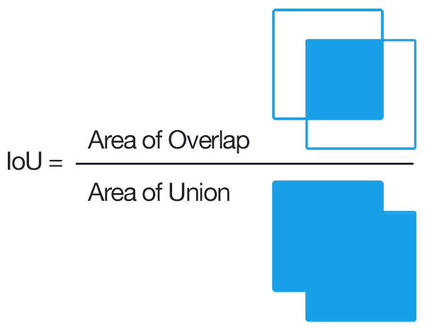
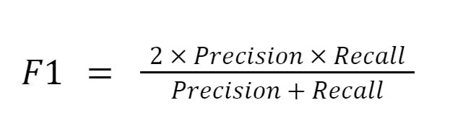
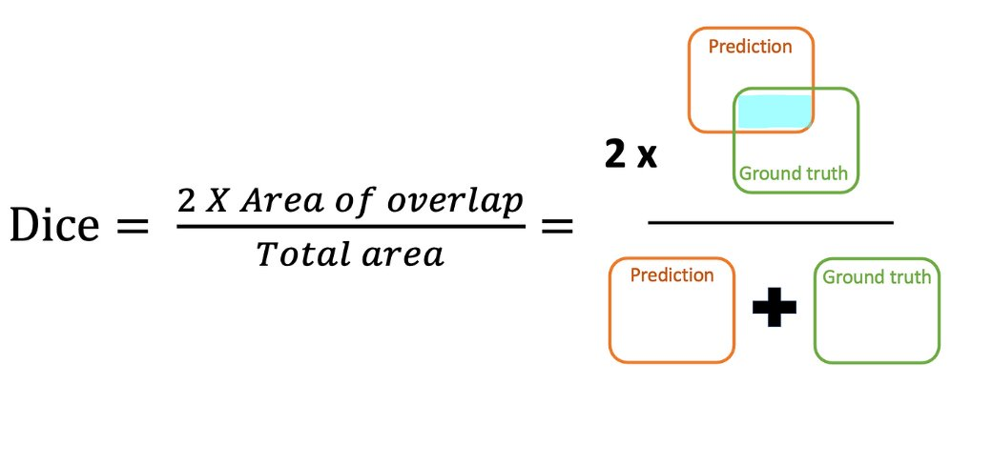
Evaluation Metrics
Classwise & Avg F1-score
AVG DICE Coeff.
IoU
Precision
Recall
Sensitivity
Specificity

Slide 11
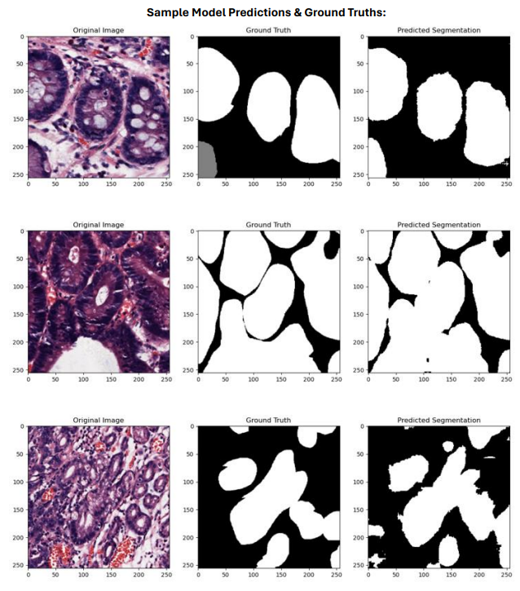
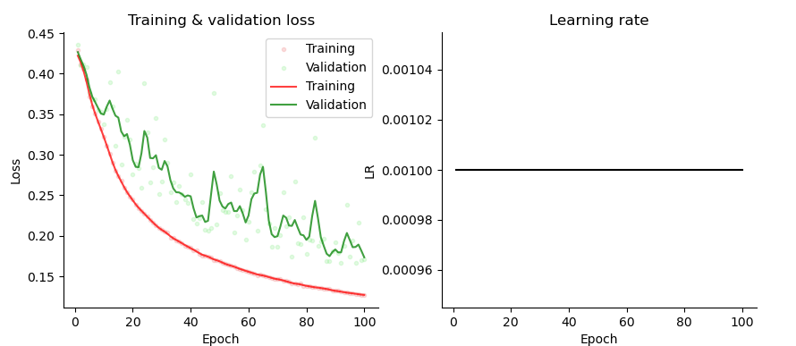
Performance evaluation

Slide 12
Work Division
Introduction and Literature Review – Keshav, Anna
Performance Evaluation and Discussion – Radi, Raaed
Models Run – split between the team

Slide 13
Demonstration
https://drive.google.com/file/d/1pybm3_FvJ2s-z3KA8OjWuxaosi72azL-/view?usp=sharing

