Slide 1
Course Syllabus
Color
Camera models, camera calibration
Advanced image pre-processing
Line detection
Corner detection
Maximally stable extremal regions
Mathematical Morphology
binary
gray-scale
skeletonization
granulometry
morphological segmentation
Scale in image processing
Wavelet theory in image processing
Image Compression
Texture
Image Registration
rigid
non-rigid
RANSAC

Slide 2
References
Books:
Chapter 11, Image Processing, Analysis, and Machine Vision, Sonka et al
Chapter 9, Digital Image Processing, Gonzalez & Woods

Slide 3
Topics
Basic Morphological concepts
Binary Morphological operations
Dilation & erosion
Hit-or-miss transformation
Opening & closing
Gray scale morphological operations
Some basic morphological operations
Boundary extraction
Region filling
Extraction of connected component
Convex hull
Skeletonization
Granularity
Morphological segmentation and watersheds

Slide 4
Introduction
Morphological operators often take a binary image and a structuring element as input and combine them using a set operator (intersection, union, inclusion, complement).
The structuring element is shifted over the image and at each pixel of the image its elements are compared with the set of the underlying pixels.
If the two sets of elements match the condition defined by the set operator (e.g. if set of pixels in the structuring element is a subset of the underlying image pixels), the pixel underneath the origin of the structuring element is set to a pre-defined value (0 or 1 for binary images).
A morphological operator is therefore defined by its structuring element and the applied set operator.
Image pre-processing (noise filtering, shape simplification)
Enhancing object structures (skeletonization, thinning, convex hull, object marking)
Segmentation of the object from background
Quantitative descriptors of objects (area, perimeter, projection, Euler-Poincaré characteristics)
binary image
structuring element

Slide 5
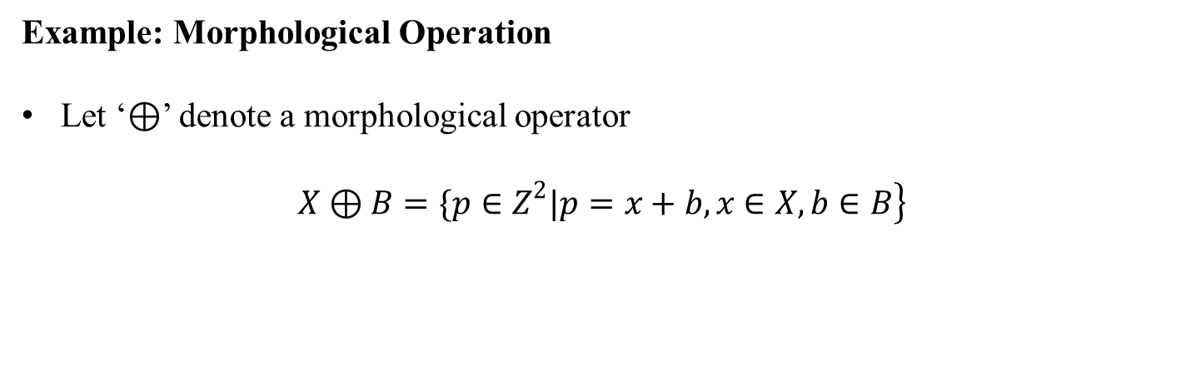
Example: Morphological Operation
Let ‘$⊕$’ denote a morphological operator
$$\left.X⊕B=\{p∈Z^{2}|p=x+b,x∈X,b∈B\right\}$$

Slide 6

Dilation
Morphological dilation ‘$⊕$’ combines two sets using vector of set elements
$$\left.X⊕B=\{p∈Z^{2}|p=x+b,x∈X,b∈B\right\}$$
Commutative: $X⊕B=B⊕X$
Associative: $X⊕\left(B⊕D\right)=\left(X⊕B\right)⊕D$
Invariant of translation: $X_{h}⊕B={\left(X⊕B\right)}_{h}$
$$\text{If} X⊆Y \text{then} X⊕B⊆Y⊕B$$

Slide 7
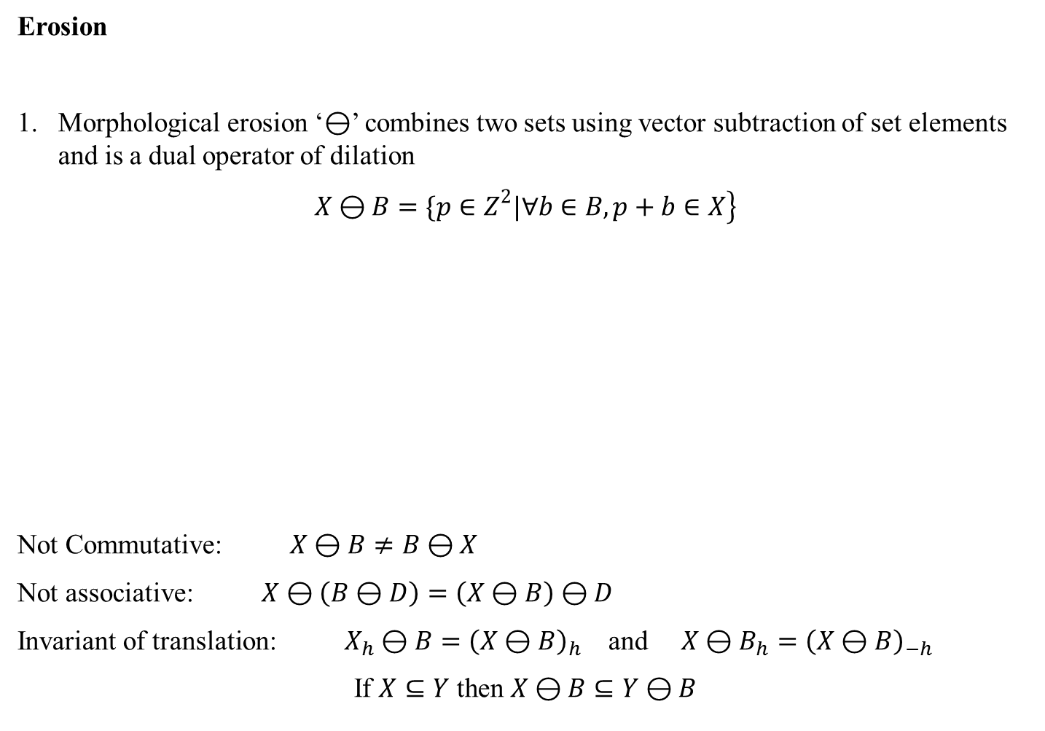
Erosion
Morphological erosion ‘$⊖$’ combines two sets using vector subtraction of set elements and is a dual operator of dilation
$$\left.X⊖B=\{p∈Z^{2}|∀b∈B,p+b∈X\right\}$$
Not Commutative: $X⊖B≠B⊖X$
Not associative: $X⊖\left(B⊖D\right)=\left(X⊖B\right)⊖D$
Invariant of translation: $X_{h}⊖B={\left(X⊖B\right)}_{h}$ and $X⊖B_{h}={\left(X⊖B\right)}_{−h}$
$$\text{If} X⊆Y \text{then} X⊖B⊆Y⊖B$$

Slide 8

Duality: Dilation and Erosion
Transpose Ă of a structuring element A is defined as follows
$$\left.\check{A}=\{−a|a∈A\right\}$$
Duality between morphological dilation and erosion operators
$${\left(X⊖B\right)}^{c}=X^{c}⊕\check{B}$$

Slide 9
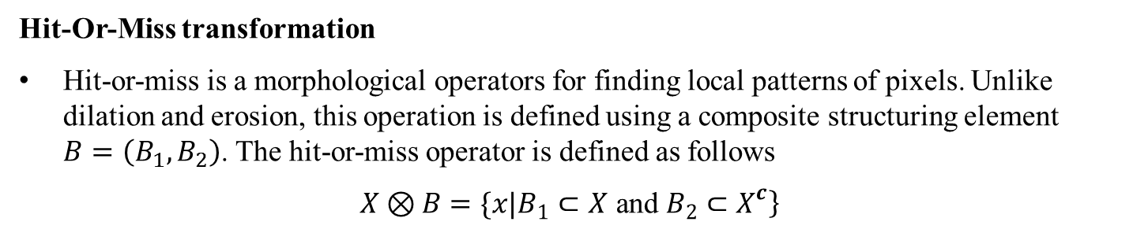
Hit-Or-Miss transformation
Hit-or-miss is a morphological operators for finding local patterns of pixels. Unlike dilation and erosion, this operation is defined using a composite structuring element $B=\left(B_{1},B_{2}\right)$. The hit-or-miss operator is defined as follows
$$\left.X⊗B=\{x|B_{1}⊂X \text{and} B_{2}⊂X^{c}\right\}$$

Slide 10

Hit-Or-Miss transformation: another example
Relation with erosion:
$$X⊗B=\left(X⊖B_{1}\right)∩\left(X^{c}⊖B_{2}\right)$$

Slide 11
Hit-Or-Miss transformation: yet another example

Slide 12
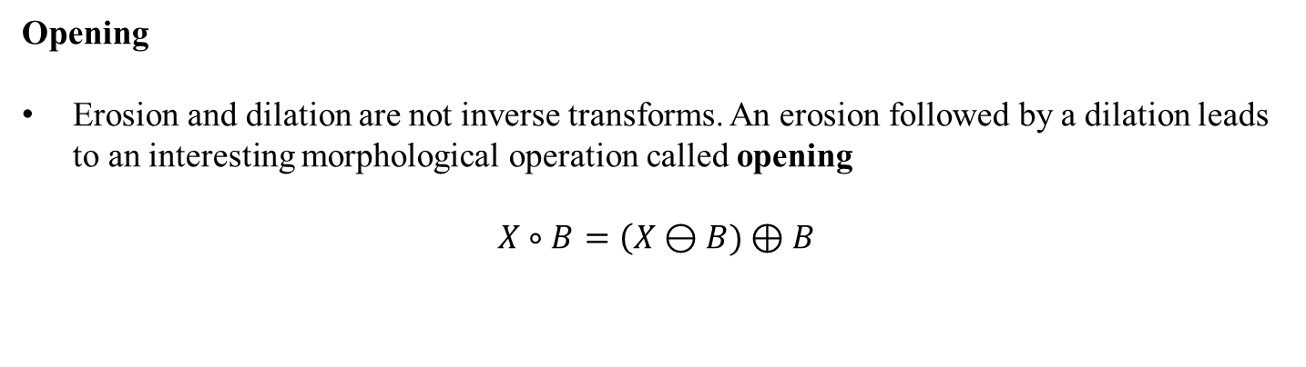
Opening
Erosion and dilation are not inverse transforms. An erosion followed by a dilation leads to an interesting morphological operation called opening
$$X∘B=\left(X⊖B)⊕B\right.$$

Slide 13
Opening
Erosion and dilation are not inverse transforms. An erosion followed by a dilation leads to an interesting morphological operation called opening
$$X∘B=\left(X⊖B)⊕B\right.$$

Slide 14
Opening
Erosion and dilation are not inverse transforms. An erosion followed by a dilation leads to an interesting morphological operation called opening
$$X∘B=\left(X⊖B)⊕B\right.$$

Slide 15
Opening
Erosion and dilation are not inverse transforms. An erosion followed by a dilation leads to an interesting morphological operation called opening
$$X∘B=\left(X⊖B)⊕B\right.$$

Slide 16
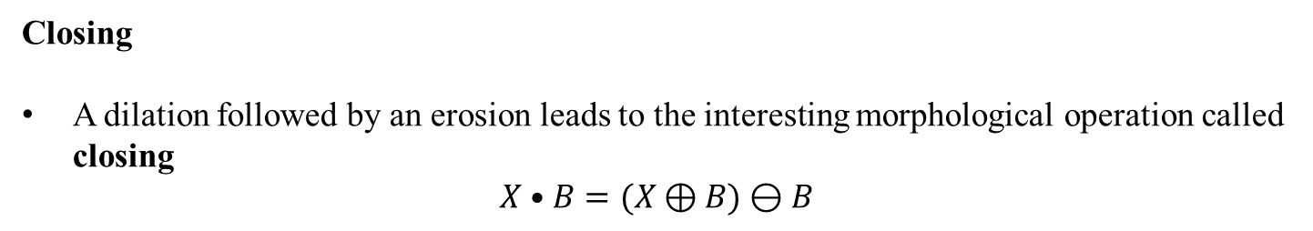
Closing
A dilation followed by an erosion leads to the interesting morphological operation called closing
$$X•B=(X⊕B)⊖B$$

Slide 17
Closing
A dilation followed by an erosion leads to the interesting morphological operation called closing
$$X•B=(X⊕B)⊖B$$

Slide 18
Closing
A dilation followed by an erosion leads to the interesting morphological operation called closing
$$X•B=(X⊕B)⊖B$$

Slide 19
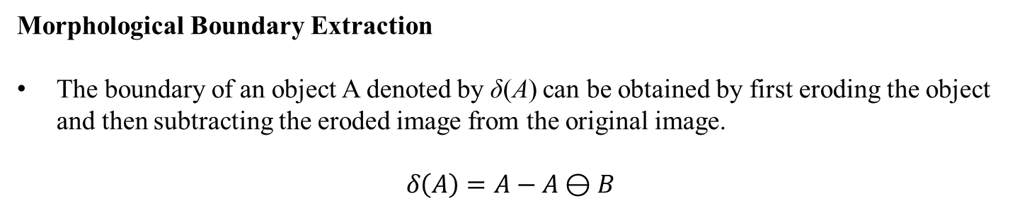
Morphological Boundary Extraction
The boundary of an object A denoted by δ(A) can be obtained by first eroding the object and then subtracting the eroded image from the original image.
$$δ\left(A\right)=A−A⊖B$$

Slide 20
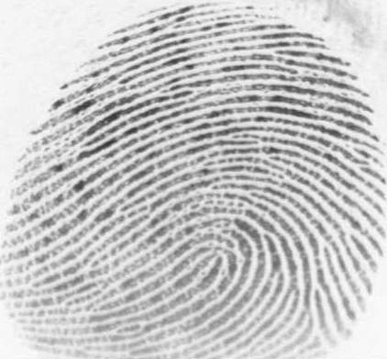
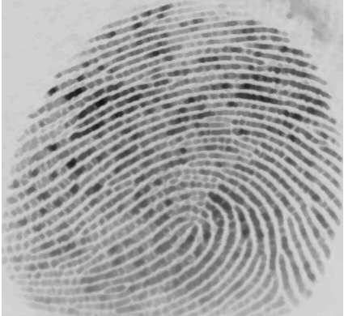
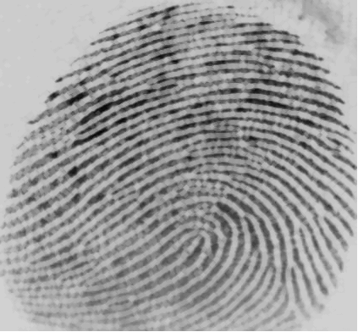
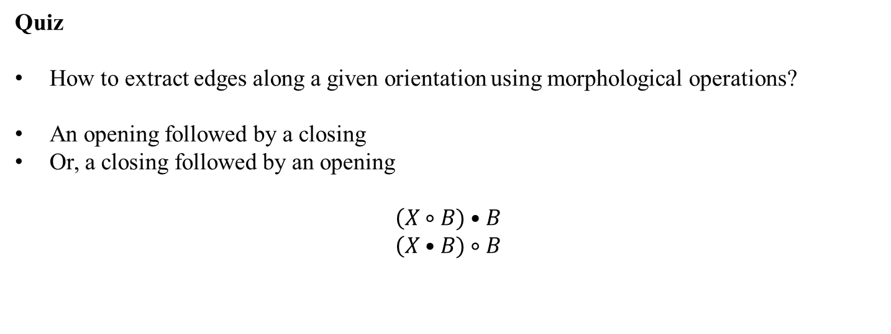
Quiz
How to extract edges along a given orientation using morphological operations?
An opening followed by a closing
Or, a closing followed by an opening
$$\left(X∘B)•B\right.$$
$$\left(X•B)∘B\right.$$

Slide 21
Gray Scale Morphological Operation
top surface T[A]
Set A
Support F

Slide 22
Gray Scale Morphological Operation
A: a subset of n-dimensional Euclidean space, A ⊂ R^{n}
F: support of A
Top hat or surface
A top surface is essentially a gray scale image f : F → R
An umbra U(f) of a gray scale image f : F → R is the whole subspace below the top surface representing the gray scale image f. Thus,

Slide 23
Gray Scale Morphological Operation
top surface T[A]
umbra
Support F

Slide 24
Gray Scale Morphological Operation
top surface T[A]

Slide 25
Gray Scale Morphological Operation
The gray scale dilation between two functions may be defined as the top surface of the dilation of their umbras
More computation-friendly definitions
Commonly, we consider the structure element k as a binary set. Then the definitions of gray-scale morphological operations simplifies to

Slide 26
Morphological Boundary Extraction
The boundary of an object A denoted by δ(A) can be obtained by first eroding the object and then subtracting the eroded image from the original image.

Slide 27
Quiz
How to extract edges along a given orientation using morphological operations?

Slide 28
Morphological noise filtering
An opening followed by a closing
Or, a closing followed by an opening

Slide 29
Morphological noise filtering
MATLAB DEMO

Slide 30
Morphological Region Filling
Task: Given a binary image X and a (seed) point p, fill the region surrounded by the pixels of X and contains p.
A: An image where only the boundary pixels are labeled 1 and others are labeled 0
A^{c}: The Complement of A
We start with an image X₀ where only the seed point p is 1 and others are 0. Then we repeat the following steps until it converges

Slide 31
Morphological Region Filling
A
A^{c}

Slide 32
Morphological Region Filling
The boundary of an object A denoted by δ(A) can be obtained by first eroding the object and then subtracting the eroded image from the original image.
A

Slide 33
Morphological Region Filling

Slide 34
Morphological Region Filling

Slide 35
Homotopic Transformation
Homotopic tree
r1
r2
h2
h1

Slide 36
Quitz: Homotopic Transformation
What is the relation between an element in the ith and i+1th levels?

