Slide 1
Morphological Image Processing
Robotics
Notes:
Department of Computer Engineering, CMU

Slide 2
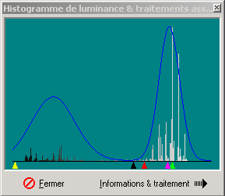
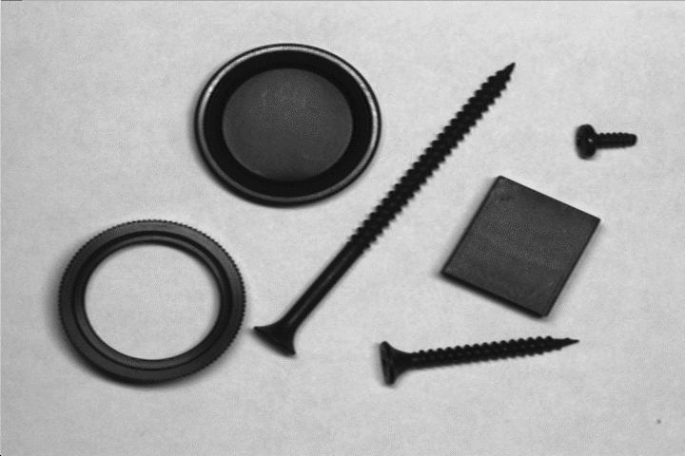
Remember from Lecture 12:
GRAY LEVEL THRESHOLDING
Objects
Set threshold here
Introduction to Machine Vision

Slide 3

BINARY IMAGE
Problem here
How do we fill “missing pixels”?
Introduction to Machine Vision

Slide 4
Mathematic Morphology
used to extract image components that are useful in the representation and description of region shape, such as
  boundaries extraction
  skeletons
  convex hull
  morphological filtering
  thinning
  pruning

Slide 5
Mathematic Morphology
mathematical framework used for:
pre-processing
  noise filtering, shape simplification, ...
enhancing object structure
  skeletonization, convex hull...
Segmentation
  watershed,…
quantitative description
  area, perimeter, ...

Slide 6
Z² and Z³
set in mathematic morphology represent objects in an image
  binary image (0 = white, 1 = black) : the element of the set is the coordinates (x,y) of pixel belong to the object  Z²
gray-scaled image : the element of the set is the coordinates (x,y) of pixel belong to the object and the gray levels  Z³

Slide 7
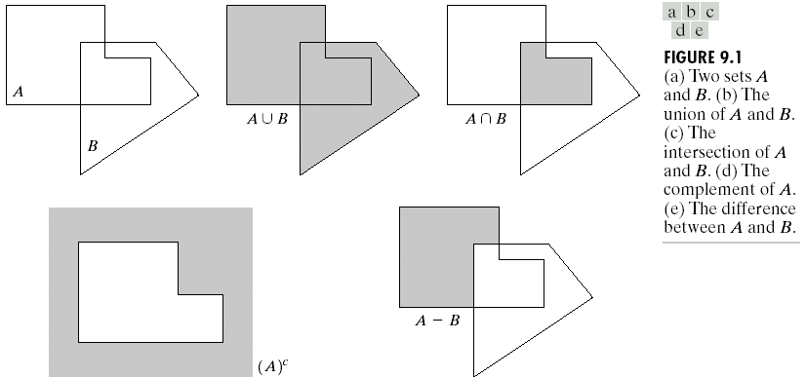
Basic Set Theory

Slide 8
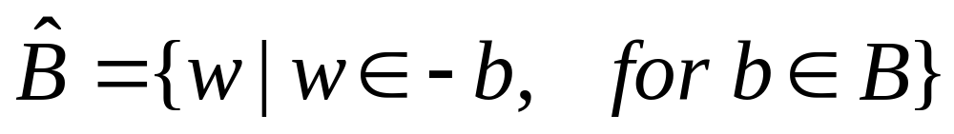
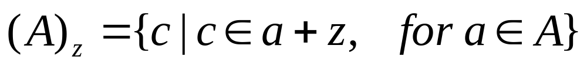
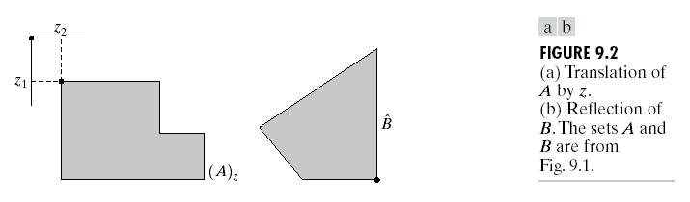
Reflection and Translation

Slide 9
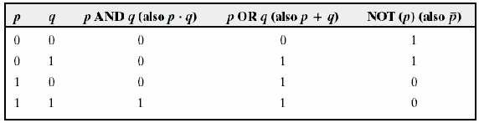
Logic Operations

Slide 10
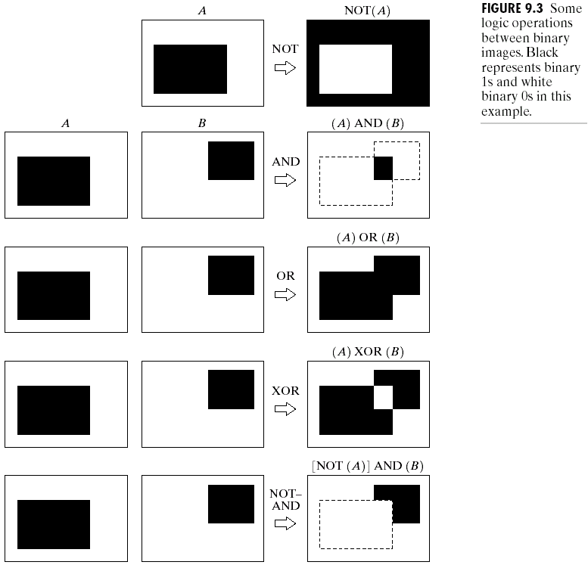
Example

Slide 11

Structuring element (SE)
small set to probe the image under study
for each SE, define origo
shape and size must be adapted to geometric
properties for the objects

Slide 12
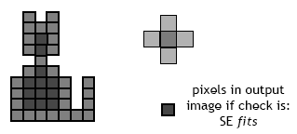
Basic idea
in parallel for each pixel in binary image:
  check if SE is ”satisfied”
  output pixel is set to 0 or 1 depending on used operation

Slide 13
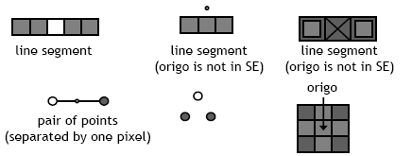
How to describe SE
many different ways!
information needed:
  position of origo for SE
  positions of elements belonging to SE

Slide 14


Basic morphological operations
Erosion
Dilation
combine to
  Opening object
  Closening background
keep general shape but smooth with respect to

Slide 15

Erosion
Does the structuring element fit the set?
erosion of a set A by structuring element B: all z in A such that B is in A when origin of B=z
shrink the object

Slide 16
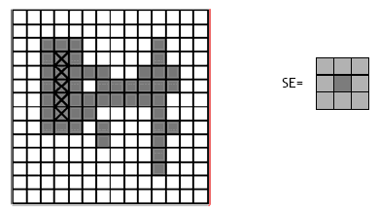
Erosion

Slide 17
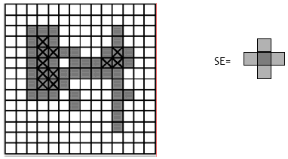
Erosion

Slide 18
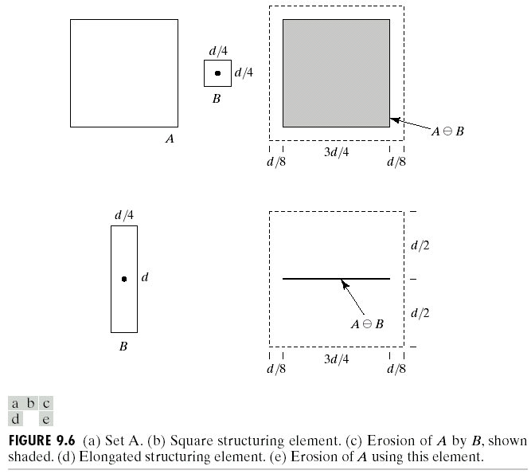
Erosion

Slide 19
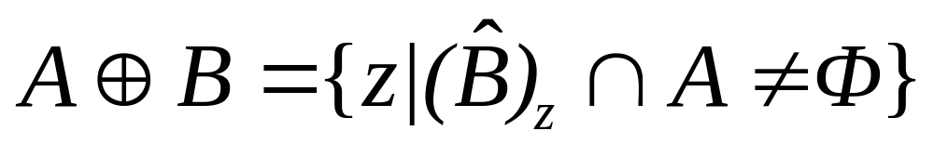
Dilation
Does the structuring element hit the set?
dilation of a set A by structuring element B: all z in A such that B hits A when origin of B=z
grow the object

Slide 20
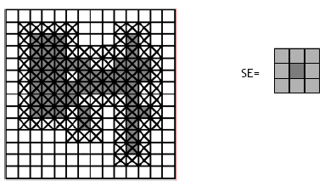
Dilation

Slide 21
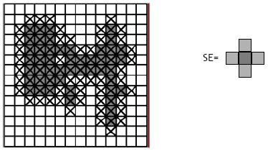
Dilation

Slide 22
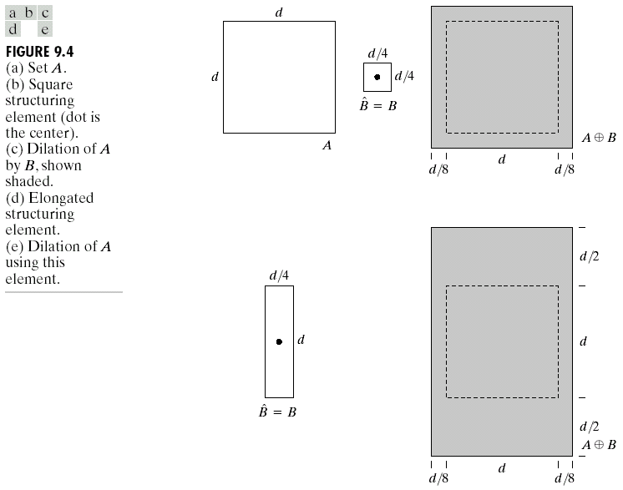
Dilation
B = structuring element

Slide 23
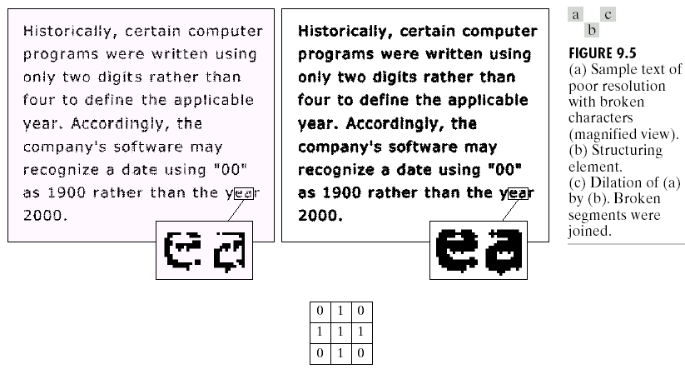
Dilation : Bridging gaps

Slide 24
useful
erosion
  removal of structures of certain shape and size, given by SE
Dilation
  filling of holes of certain shape and size, given by SE

Slide 25
Combining erosion and dilation
WANTED:
  remove structures / fill holes
  without affecting remaining parts
SOLUTION:
combine erosion and dilation
(using same SE)

Slide 26
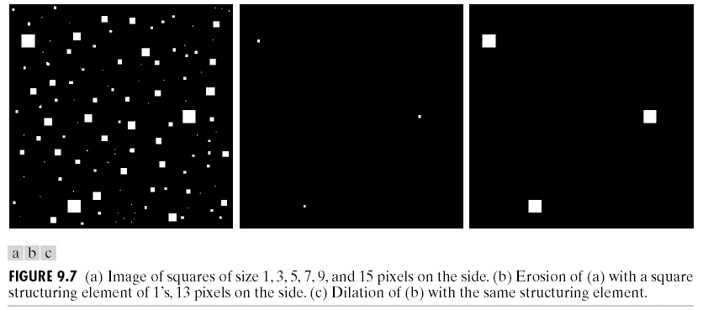
Erosion : eliminating irrelevant detail
structuring element B = 13x13 pixels of gray level 1

Slide 27
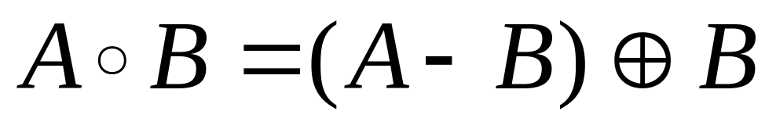
Opening
erosion followed by dilation, denoted ∘
eliminates protrusions
breaks necks
smoothes contour

Slide 28

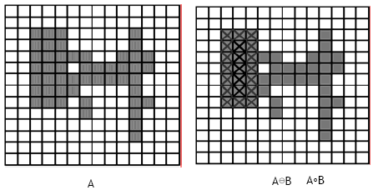
Opening

Slide 29

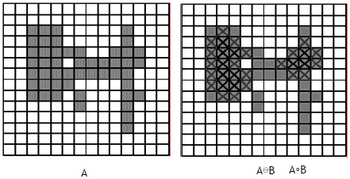
Opening

Slide 30
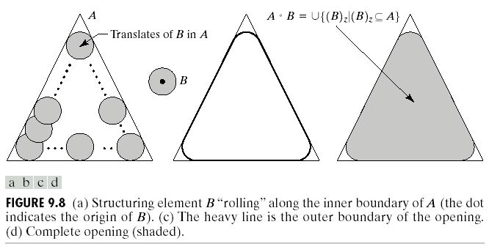

Opening

Slide 31
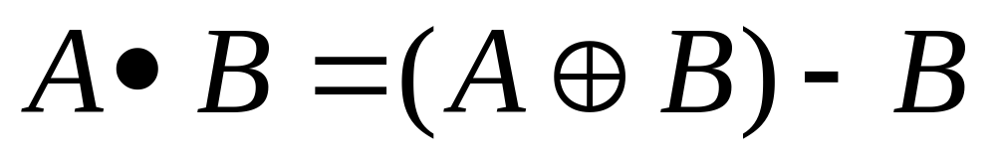
Closing
dilation followed by erosion, denoted •
smooth contour
fuse narrow breaks and long thin gulfs
eliminate small holes
fill gaps in the contour

Slide 32

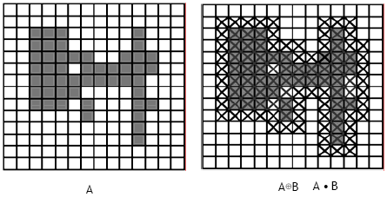
Closing

Slide 33

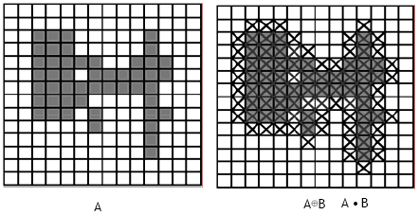
Closing

Slide 34
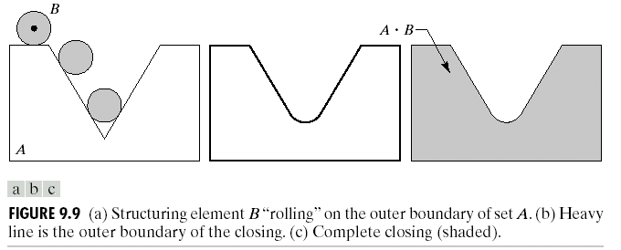
Closing

Slide 35
Properties
Opening
A°B is a subset (subimage) of A
If C is a subset of D, then C °B is a subset of D °B
(A °B) °B = A °B
Closing
A is a subset (subimage) of A•B
If C is a subset of D, then C •B is a subset of D •B
(A •B) •B = A •B
Note: repeated openings/closings has no effect!

Slide 36
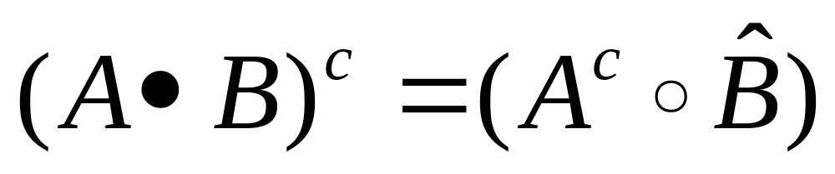
Duality
Opening and closing are dual with respect to complementation and reflection

Slide 37
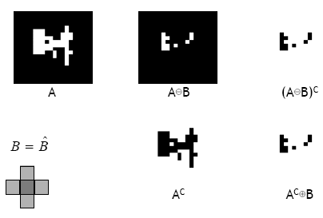

Slide 38
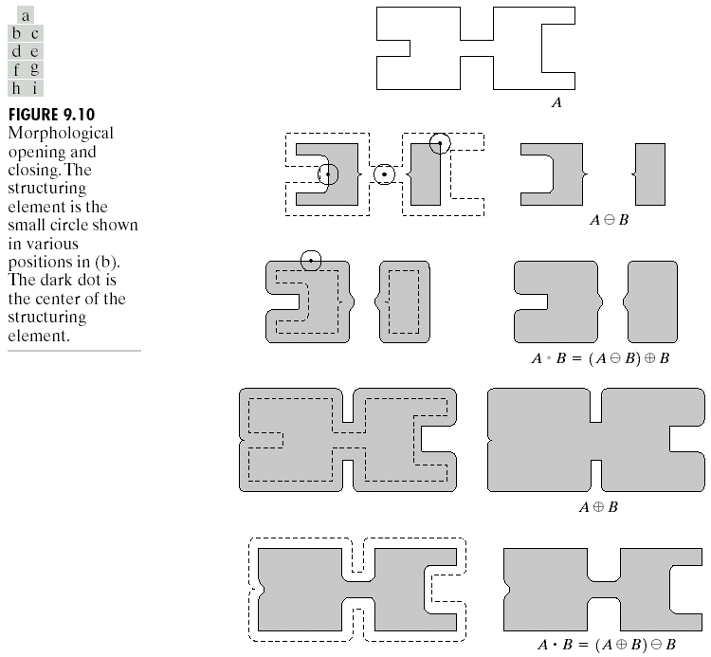

Slide 39

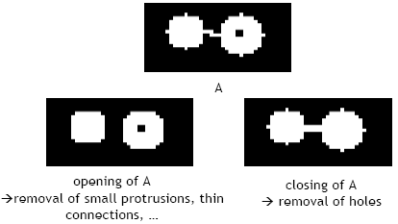
Useful: open & close

Slide 40
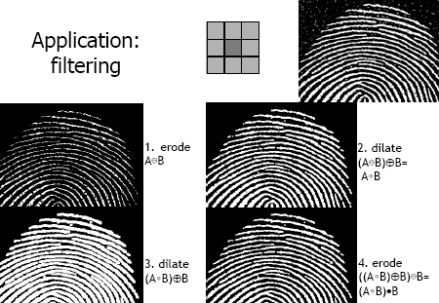
Application: filtering

Slide 41

Hit-or-Miss Transformation ⊛ (HMT)
find location of one shape among a set of shapes ”template matching
composite SE: object part (B1) and background part (B2)
does B1 fits the object while, simultaneously, B2 misses the object, i.e., fits the background?

Slide 42
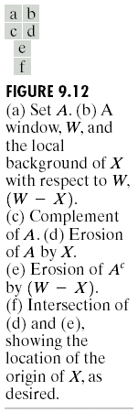
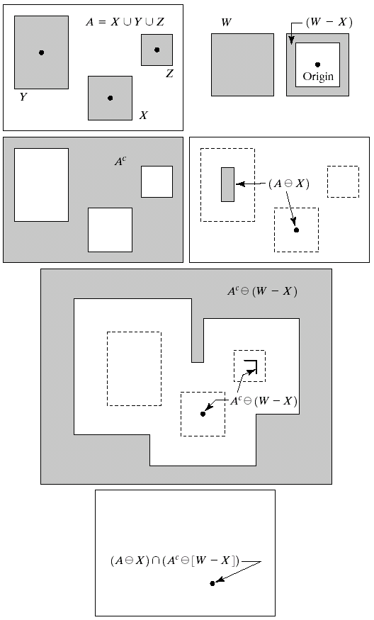
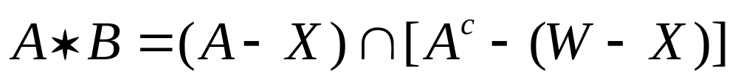
Hit-or-Miss Transformation

Slide 43
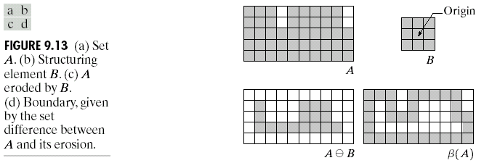
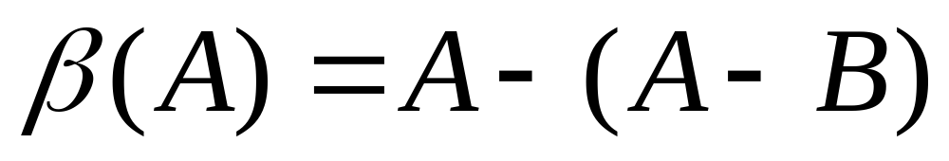
Boundary Extraction

Slide 44
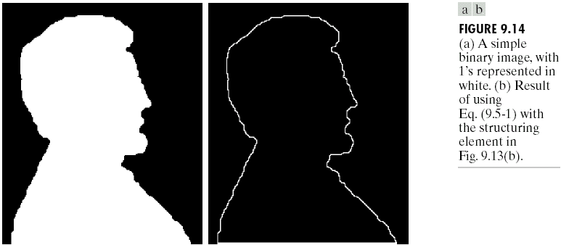
Example

Slide 45
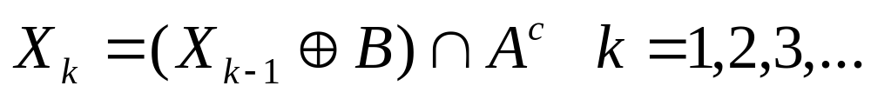
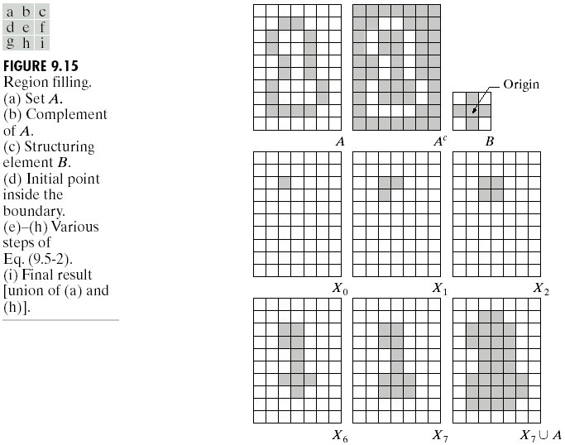
Region Filling

Slide 46
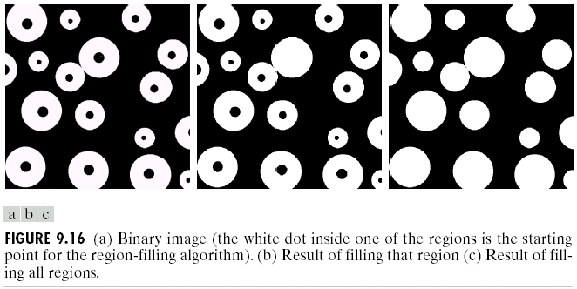
Example

Slide 47
End here

Slide 48
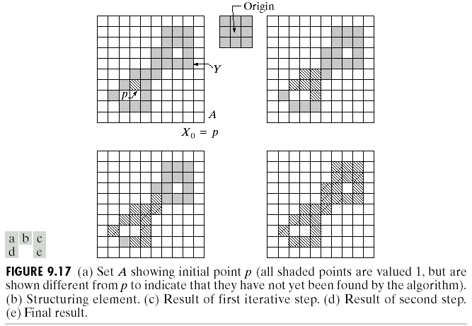
Extraction of connected components

Slide 49
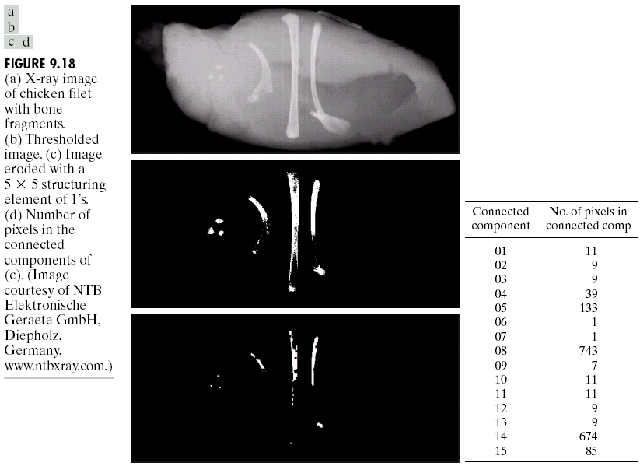
Example

Slide 50
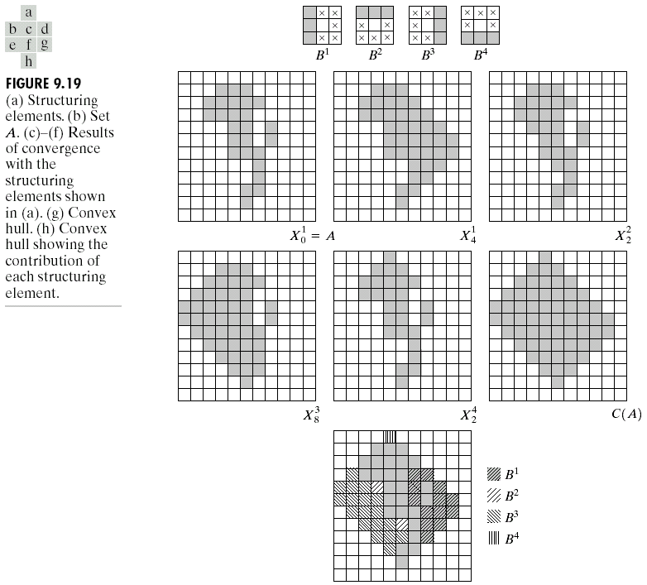
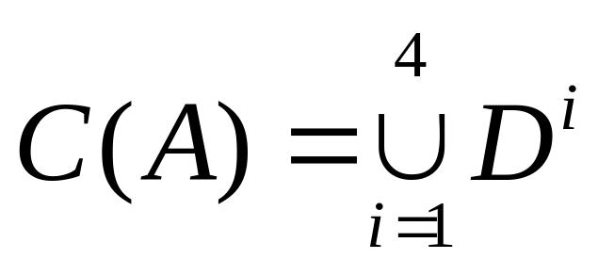
Convex hull
A set A is is said to be convex if the straight line segment joining any two points in A lies entirely within A.

Slide 51
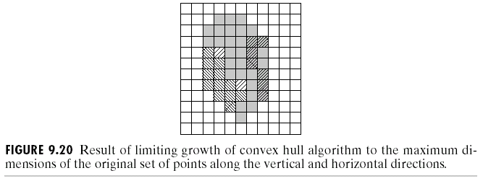

Slide 52
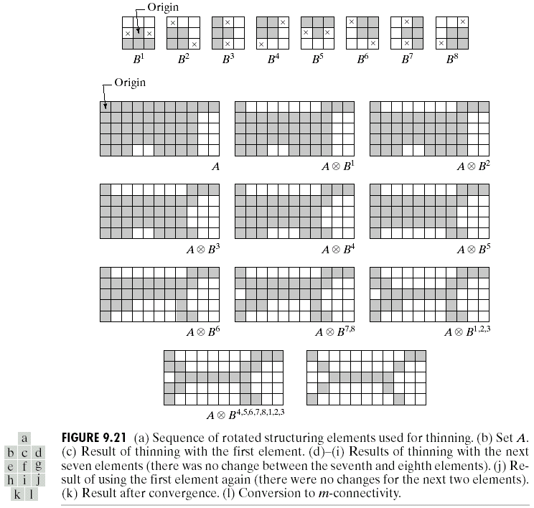
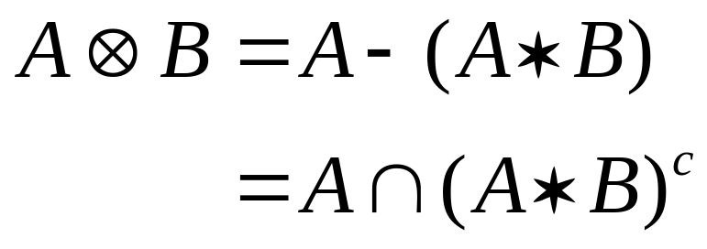
Thinning

Slide 53

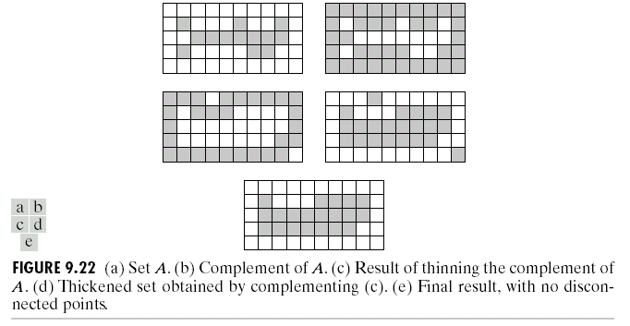
Thickening

Slide 54
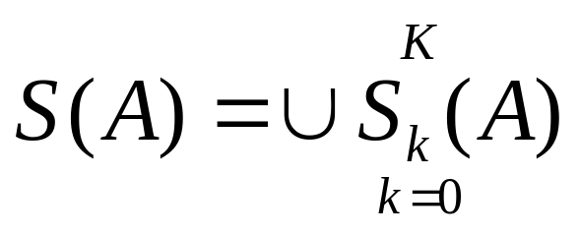




Skeletons

Slide 55


Slide 56





Pruning
H = 3x3 structuring element of 1’s

Slide 57


Slide 58


Slide 59


Slide 60


Slide 61

5 basic structuring elements

