Slide 1

Android Mobile Application
CA2 – McDonald's shop

Slide 2
Team Member
Nicholas Chinkire Chibuike-Eruba – 18630
Ana Karolina S. Dias - 20630

Slide 3
GitHub URL:
https://github.com/El-Nico/joint-oroject-takeaway-app-18630-20630.git

Slide 4
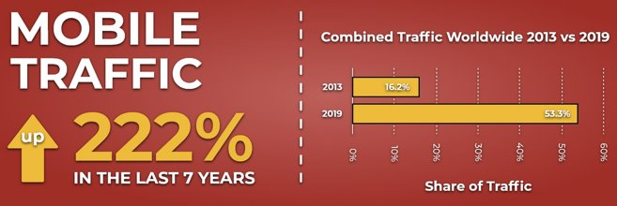
Introduction
During the 2020 Covid Pandemic, many are choosing to order food from restaurants and stay at home. To help keep Sales up, many restaurants are looking to get themselves online so that customers can still order from them from the safety and comfort of their own homes.
As we can see in the following graph, mobile devices have become increasingly popular for everyday tasks when compared to laptop/desktop devices. Therefore, we believe the best way for a restaurant to operate online is via a mobile application. Ths likes of Deliveroo, Just Eat & Uber for example take a % of each Sale so ideally it is best to develop your own app to maximise profits in the long run.

Slide 5
Key Features in product
Viewing Menu
Adding products to the cart
Removing products from the cart
Checking out
Paying

Slide 6
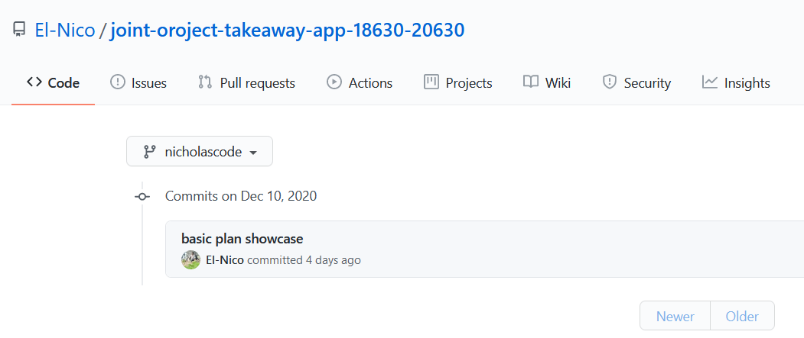
GitHub snapshot
Branch: nicholascode

Slide 7
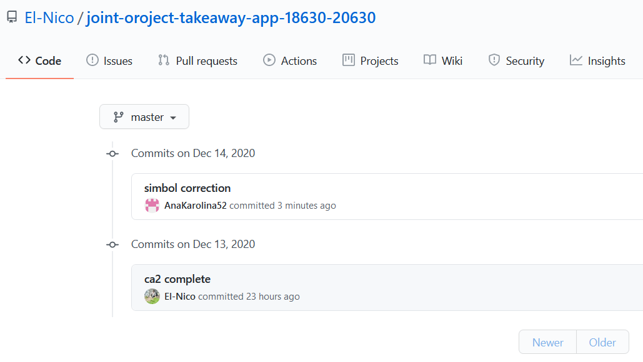
GitHub snapshot
Branch: master

Slide 8
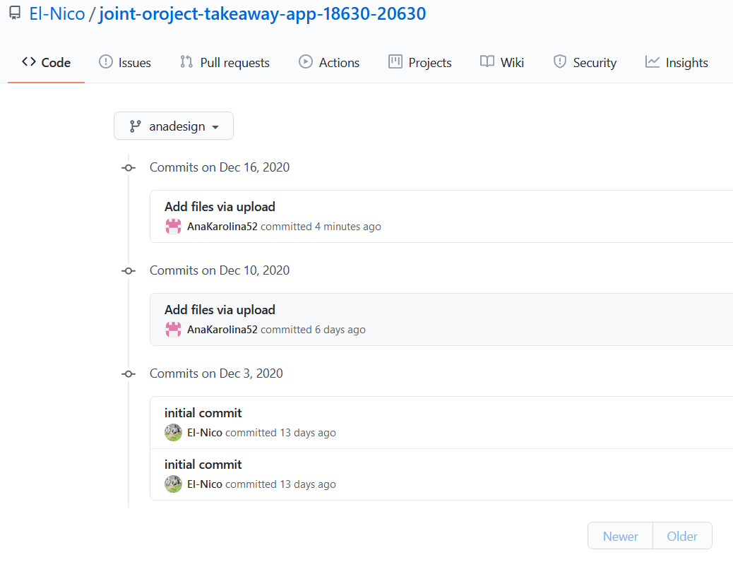
GitHub snapshot
Branch: anadesign

Slide 9
Key Learnings
Room Database
View Model
Usability
Design

Slide 10
Features not accomplished
Login
Item Quantities

Slide 11
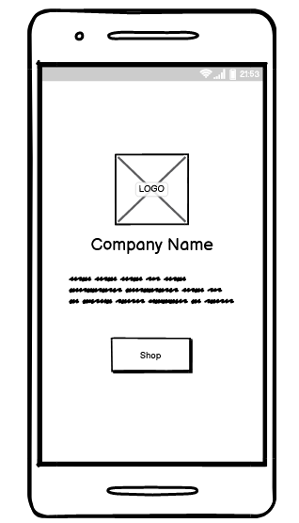
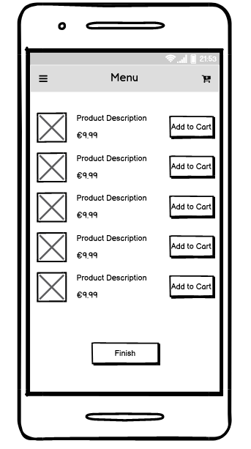
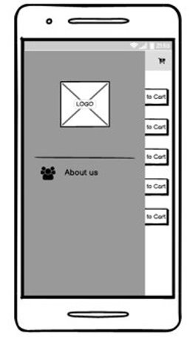
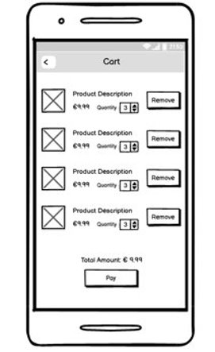
Screen Prototypes

Slide 12
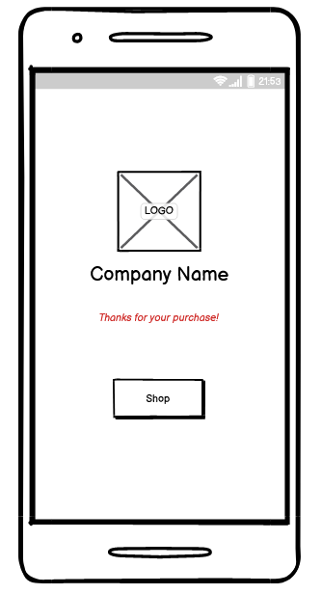
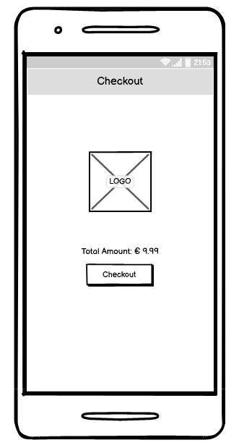
Screen Prototypes

Slide 13
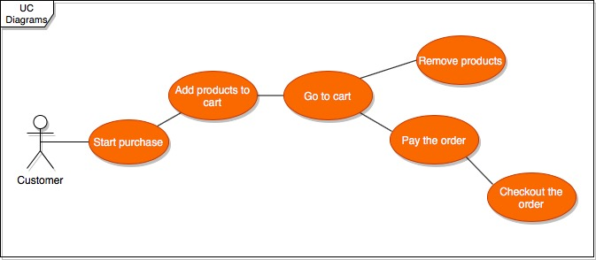
UML Diagram

Slide 14
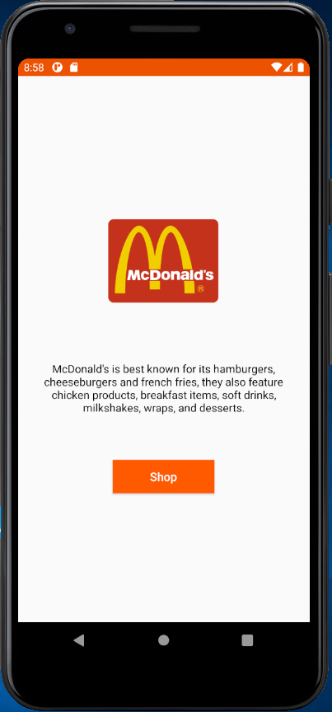
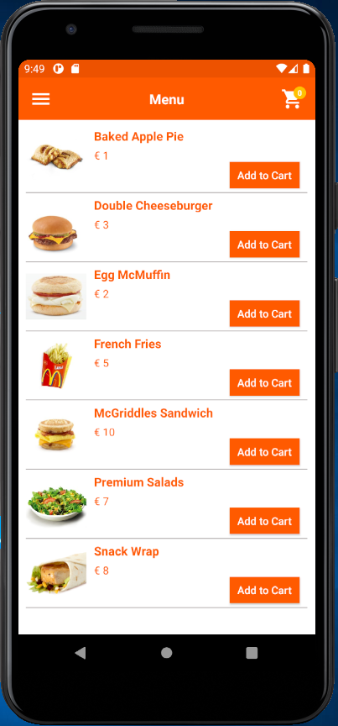
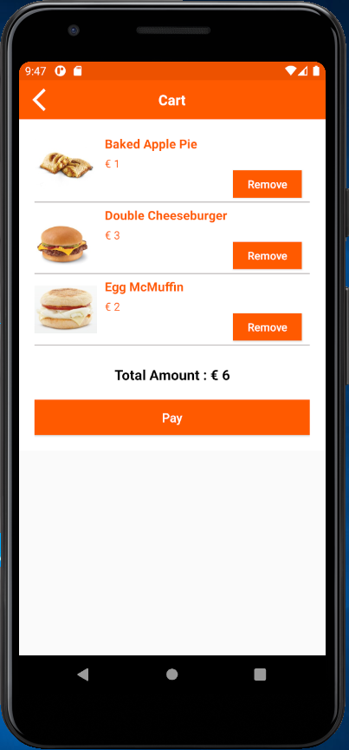
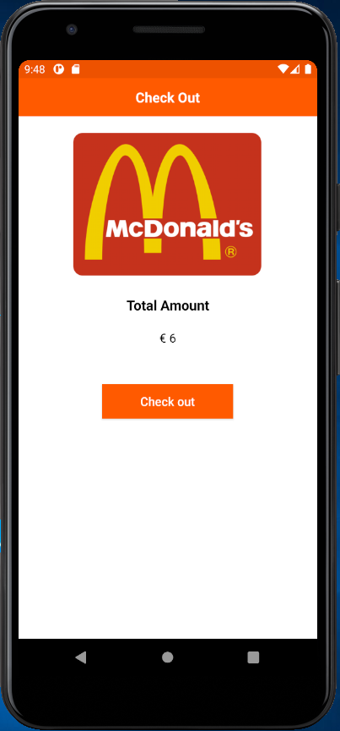

System Screenshots

Slide 15
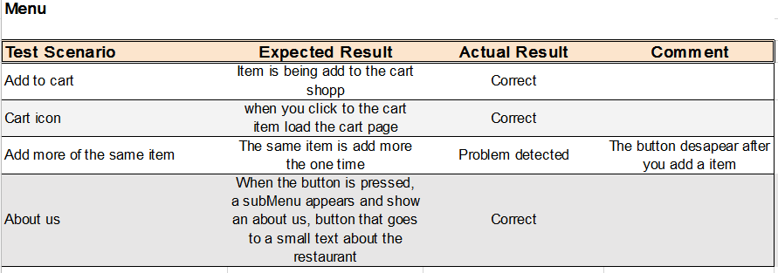
Testing

Slide 16
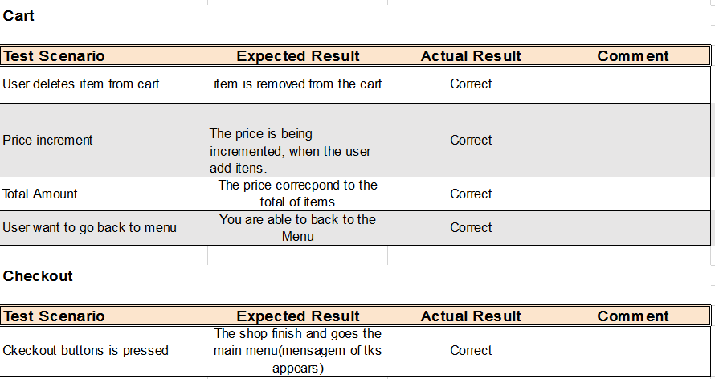
Testing

