Slide 1

Introduction
Proposed work
Conclusion
Future Scope
A Novel approach to Intrusion Detection in IoT Networks using Wavelet Transforms
BTP End Term Presentation
Vaibhav Sodhi : 112215192
Darpan Maurya: 112215054 Tabish Farooqui: 112215183 Harsh Singh : 112215070
Faculty Advisor: Dr. Pradeepkumar Bhale
Date: 6/11/2024

Slide 2

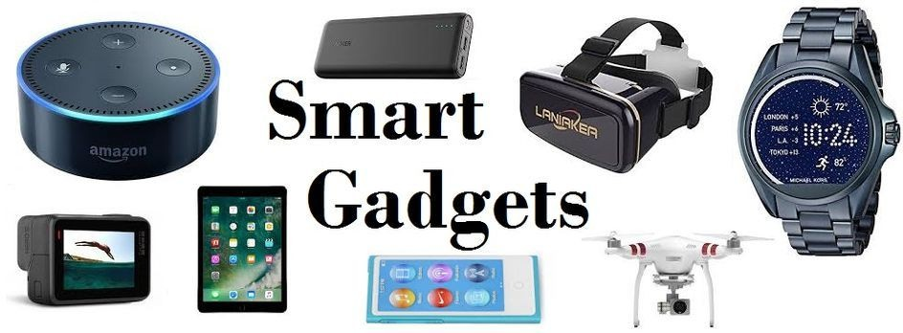
Introduction:
Internet of Things (IoT):
IoT refers to a network of physical objects that are embedded with sensors, software, and other technologies for the purpose of connecting and exchanging data with other devices and systems over the internet.

Slide 3
IOT Security Risk
Lack of Visibility: Limited ability to monitor, track, and understand the activity and status of devices
Limited security integration: Large number of IoT devices, difficult to synchronize
Open Source-code Vulnerabilities: Free code leads to exploitation by hackers
Large volume of data: Management and protection of data becomes difficult

Slide 4
Introduction
Proposed work
Conclusion
Future Scope
Problem Statement
Introduction to Problem Statement
The complexity and scale of networked systems are increasing, making traditional intrusion detection methods less effective.
Time-domain based approaches often miss the detailed and complicated patterns of network traﬃc, resulting in higher false positive rates.
This project aims to enhance intrusion detection by analyzing the data in both time domain as well as frequency domain.
By doing so, we can apply machine learning techniques to better identify and classify anomalous behaviors, leading to improved detection accuracy and system eﬃciency.

Slide 5
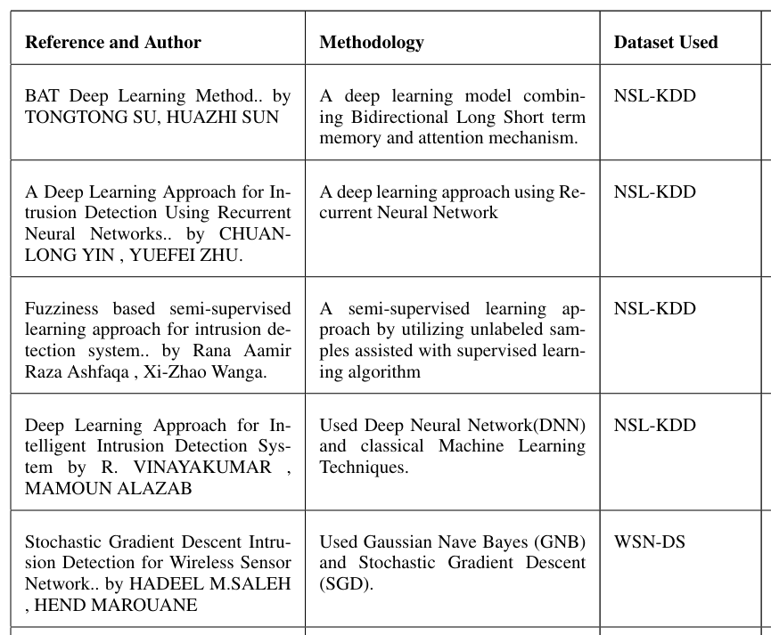
Introduction
Proposed work
Conclusion
Future Scope
Literature Review
Table 1 : Literature review
1
2
3
4
5

Slide 6
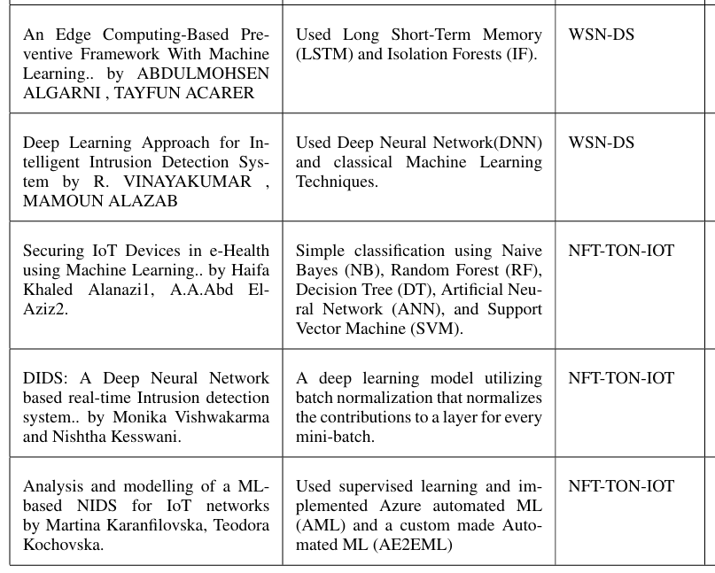
6
7
8
9
10

Slide 7
Research Gap
In all of the research papers that we have studied none of them are doing feature extraction of the frequency data , they are rather only analyzing the frequency amplitude pattern.
Our project focuses to continue the research after getting data from wavelet coefficients that is taking out various features from the generated frequency data and training our machine learning model on that features
Then after training we will be ready to deploy this model to predict anomalies from the real time network traffic.

Slide 8
Work Done In Research Paper :
A Novel Approach To Intrusion Detection In IOT Using Wavelet Transforms
We have almost completed out Draft 1 for the research paper .

Slide 9
Introduction
Proposed work
Conclusion
Future Scope
Research Objective
Research Objective
Develop and evaluate a Machine Learning-based Intrusion Detection System (IDS).
Apply Wavelet Transform to network traﬃc data to convert it into the frequency domain.
Compare the performance of various machine learning classiﬁers.
Test the model against real-time network attacks in a simulated environment.

Slide 10
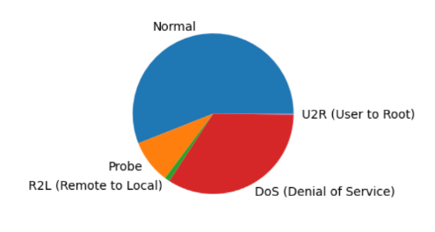
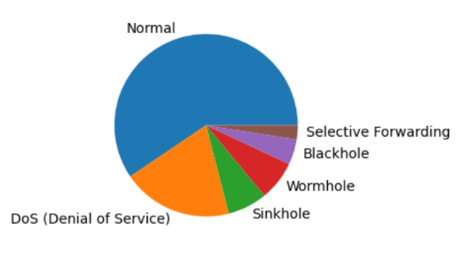
Introduction
Proposed work
Conclusion
Future Scope
PROPOSED WORK :
Dataset Description
NSL-KDD Dataset
NSL-KDD
A benchmark dataset used for evaluating intrusion detection systems, offering a reﬁned version of the KDD’99 dataset with reduced redundancy and improved data quality for identifying network intrusions.
WSN-DS
A dataset designed for evaluating intrusion detection systems in wireless sensor networks, focusing on attacks like Sinkhole, Blackhole and Wormhole with features related to node behavior and communication patterns.
WSN-DS

Slide 11
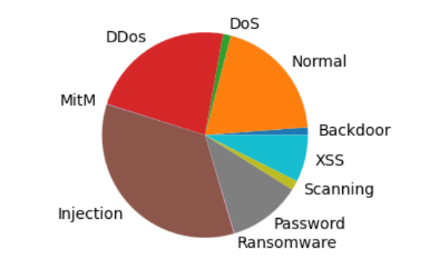
Introduction
Proposed work
Conclusion
Future Scope
Dataset Description(Cont.)
NF-TON-IOT
The NF-TON IoT dataset (Network Flow TON_IoT) is a comprehensive dataset designed specifically for research in cybersecurity within IoT environments. It contains network traffic data generated from an IoT testbed and captures a wide range of normal and malicious activities.
NF-TON-IOT Dataset

Slide 12
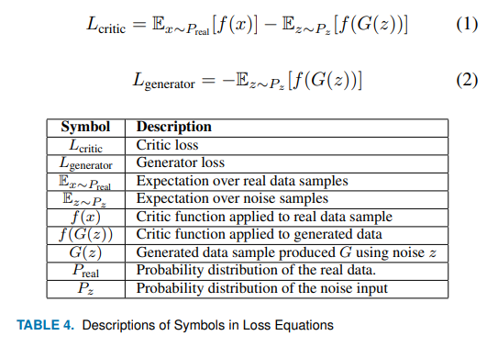
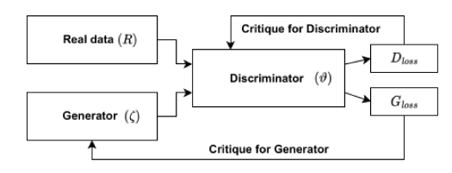
Dataset Generation
WGAN
GAN consists of two neural networks known as the generator (ζ)and the discriminator/critic (ϑ) . Wasserstein (Earth Mover’s) Distance used with GAN to increase the dataset .
Wasserstein Distance W(p,q)=∫​∣Fp​(y)−Fq​(y)∣dy
Table 2: Descriptions of Symbols in Loss Equations
WGAN

Slide 13
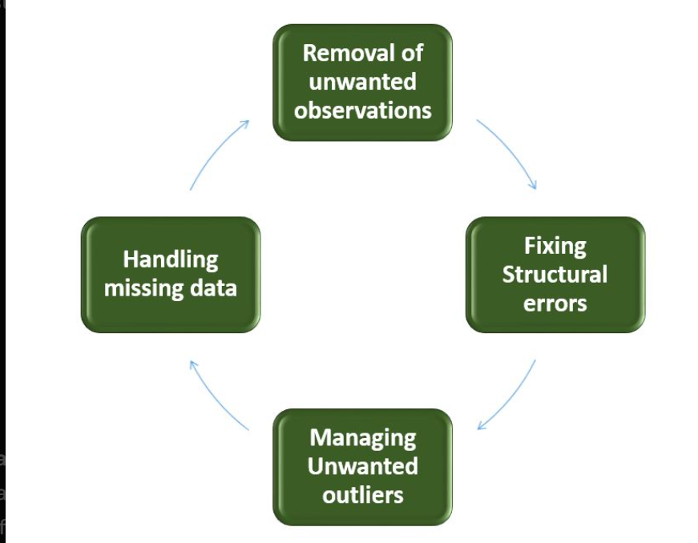
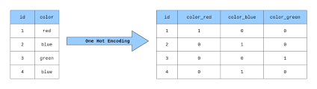
Introduction
Proposed work
Conclusion
Future Scope
DATA CLEANING
Data Cleaning is the process of identifying and fixing incorrect, incomplete, or irrelevant data in a dataset, table, or database
Data Cleaning
ENCODING CATEGORICAL VARIABLE
Categorical Data (Data in string format)
so in order to use such columns we first need to convert these columns into binary format.
Categorical encoding

Slide 14
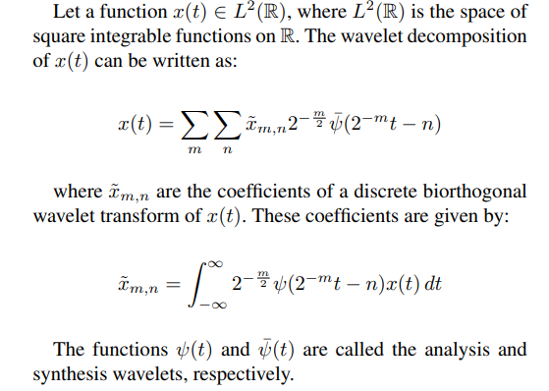
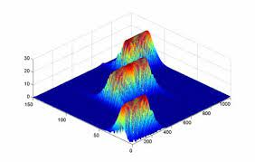
Wavelet Transform
Wavelet transforms are able to decompose signals into both time and
frequency domain.
A family of functions called wavelets are localized in both time and frequency. wavelets are scaled and shifted versions of a Mother wavelet ψ(t).
Wavelet Transforms

Slide 15
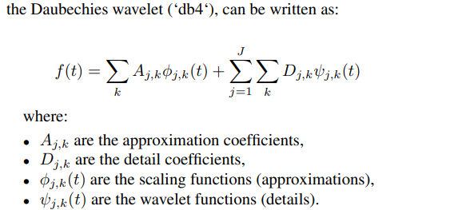
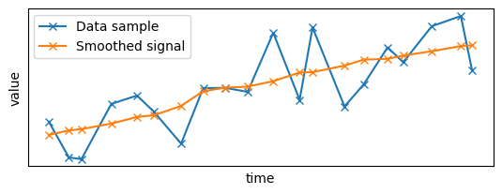
Wavelet Transform
For a record, a signal S(t) can be written as:
S(t) = [x1, x2, . . . , xn]
The wavelet family is denoted by ‘dbA‘, where A refers to the number of vanishing moments. In our case, we choose the Daubechies wavelet with 4 vanishing moments (i.e., ‘db4‘). A vanishing moment limits the wavelet’s ability to represent polynomial behavior or information in a signal.

Slide 16
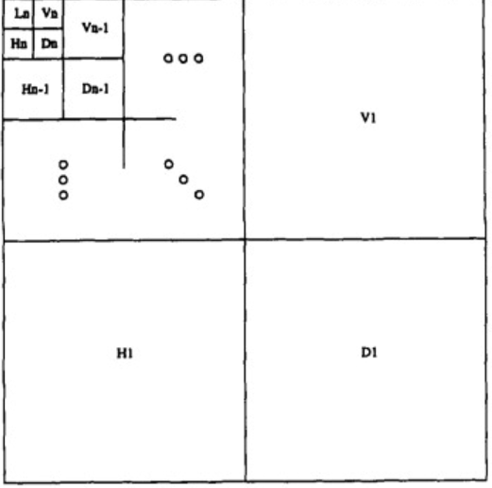
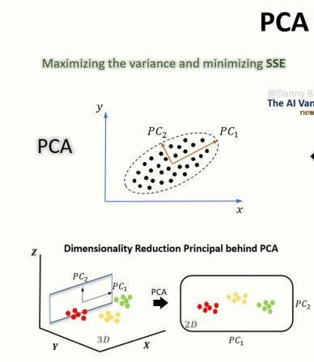
Feature Extraction
Feature Extraction After Wavelet Transforms:
Detail Coefficients along with mean, variance, standard deviation, entropy, skewness and kurtosis.
Principal Component Analysis
db4 wavelets
PCA can be effectively used to reduce dimensionality of the data to make pattern recognition easier and avoid curse of dimensionality

Slide 17
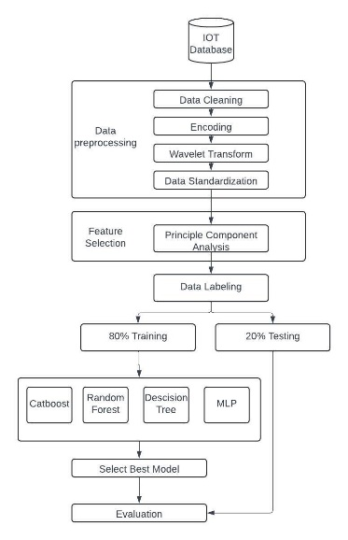
Introduction
Proposed work
Conclusion
Future Scope
Proposed Work
ML model ﬂow diagram

Slide 18
Overview of Classification Algorithms
CATBOOST (CATEGORICAL BOOSTING) is a gradient boosting algorithm designed for datasets with categorical features. It handles categorical variables efficiently without extensive preprocessing and can achieve high accuracy in many real-world classification problems .
ADABOOST(ADAPTIVE BOOSTING) combines multiple weak classifiers to create a robust model. By assigning higher weights to misclassified samples in each iteration, AdaBoost aims to minimize errors and improve model accuracy. It is frequently used with decision trees as base learners.
MLP(MULTI-LAYER PERCEPTRON) A type of neural network, the MLP consists of multiple layers and can capture non-linear relationships in complex datasets. However, it requires significant data and computational power and may not be ideal for small or simple datasets.
RANDOM FOREST This ensemble technique aggregates predictions from multiple decision trees, providing a robust and accurate model. Random Forest is highly effective for large datasets with multiple features and offers the added benefit of assessing feature importance.

Slide 19
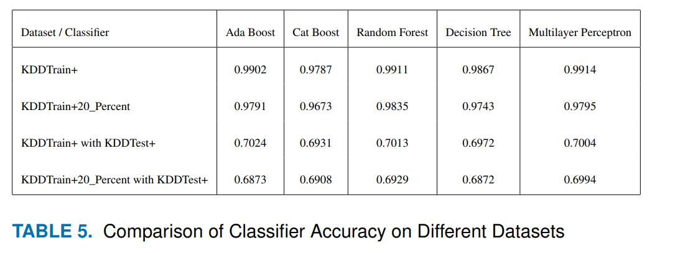
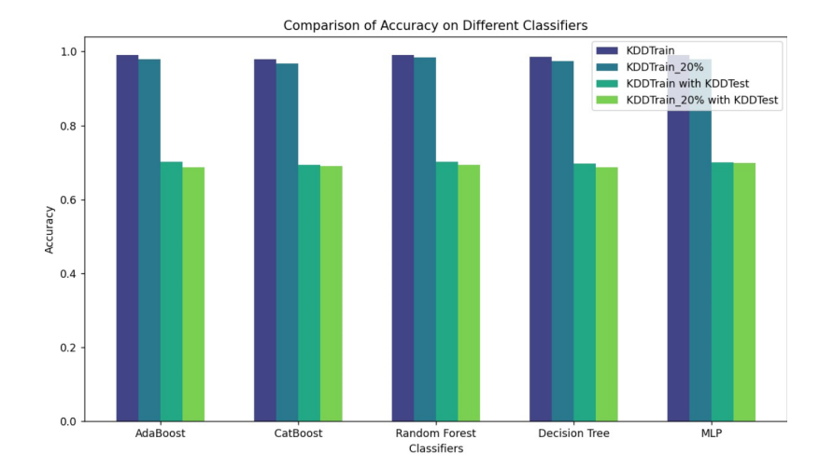
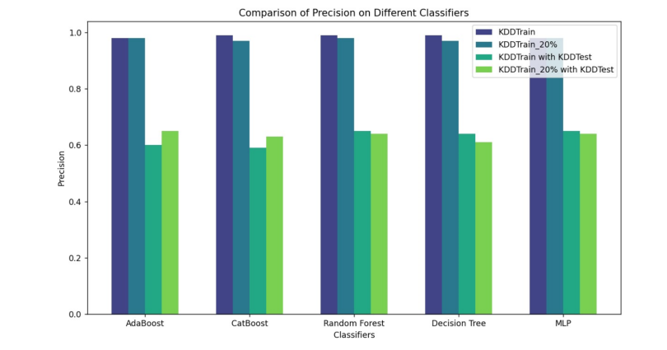
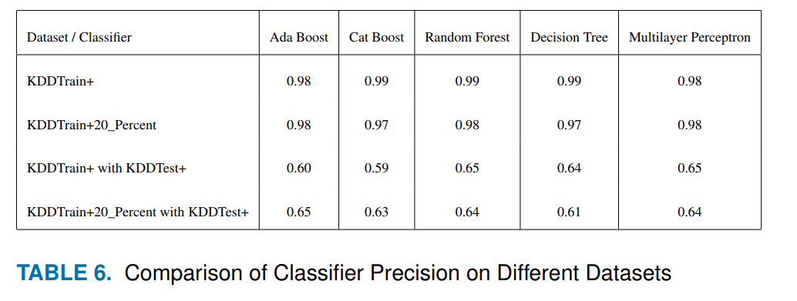
Introduction
Proposed work
Conclusion
Future Scope
Results
Results with NSL-KDD Dataset.
Table 3: Comparison of Classifier Accuracy on Different Datasets
Table 4: Comparison of Classifier Precision on Different Datasets

Slide 20
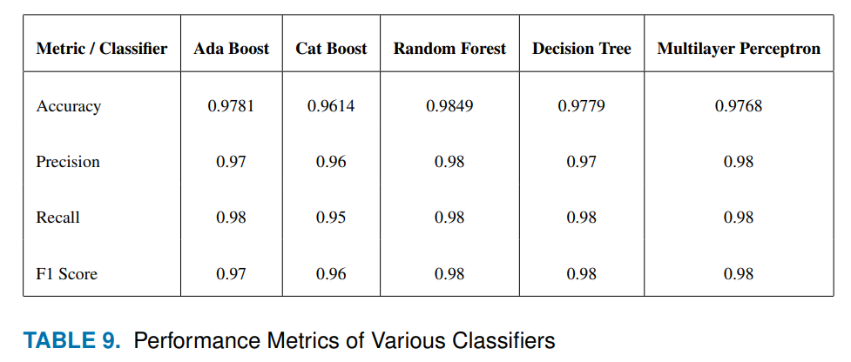
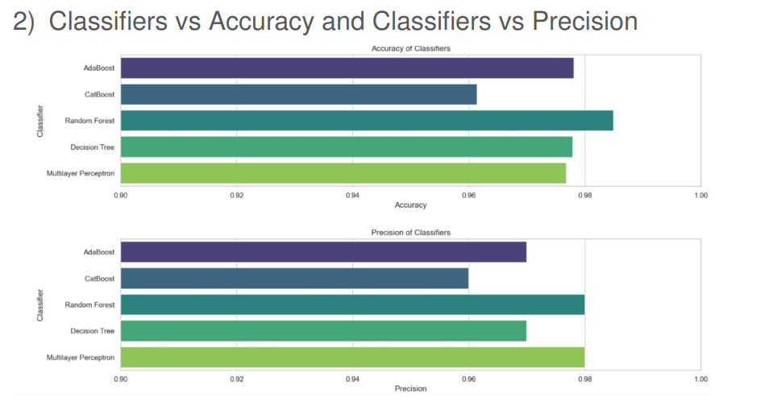
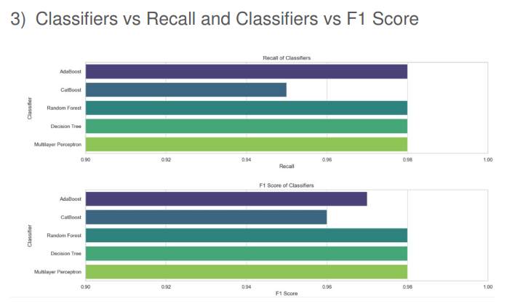
Results with WSN-DS Dataset.
Table 5: Performance Metrics on Various Classifiers

Slide 21
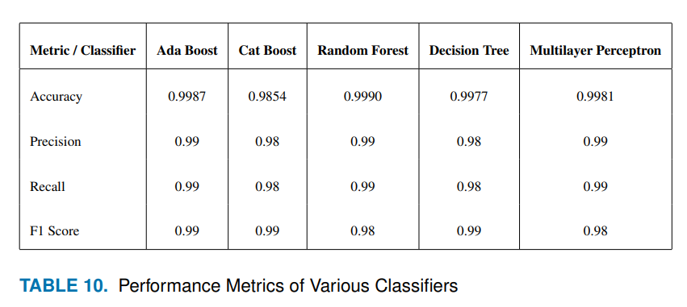
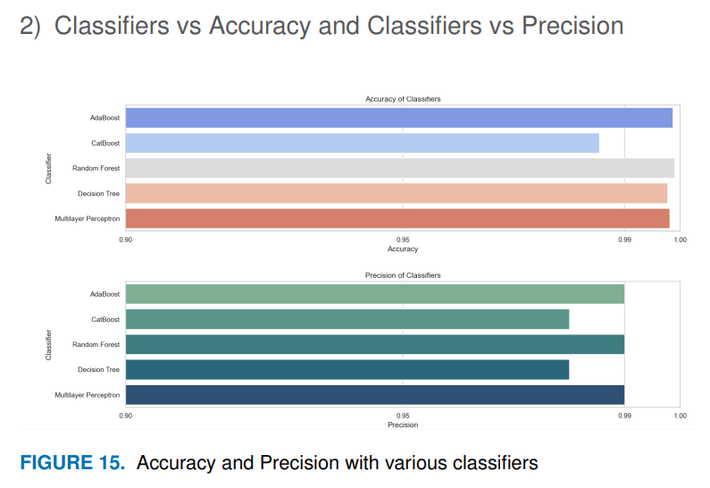
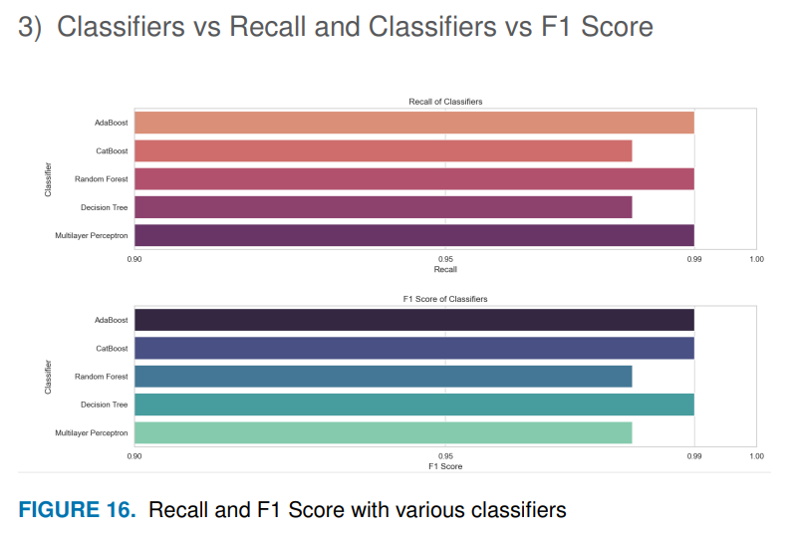
Results with NF-TON-IOT Dataset.
Table 6: Performance Metrics on Various Classifiers

Slide 22
Introduction
Proposed work
Conclusion
Future Scope
Discussions
We are moving from Time Domain Data to frequency domain as we believe that mapping our data into a frequency can help detect small attacks (possible threats) that might be ignored when using time domain data.
Independent of prior knowledge: It doesn’t depend on the prior knowledge of attack signatures, thus it has the potential to be a useful supplement to existing signature based IDS.

Slide 23
Future Scope
There are basically two major future scopes for this project now:
Real-Time Deployment and Simulation: Deploying the trained ML model on real-time network data and simulating a network using tools like Cooja for further validation and testing in controlled environments.
Further experimenting with wavelet coefficients: We have decided that in future we will convert the preprocessed wavelet coefficients into image and then perform time and frequency analysis on the converted image. We believe by using this image data, we can further improve the model’s accuracy.

Slide 24
References
BAT: Deep Learning Methods on Network Intrusion Detection Using NSL-KDD Dataset
https://ieeexplore.ieee.org/document/8988230
A Deep Learning Approach for Intrusion Detection Using Recurrent Neural Network
https://ieeexplore.ieee.org/document/8066291
Fuzziness based semi-supervised learning approach for intrusion detection system
h ttps://www.researchgate.net/publication/301747018_Fuzziness_based_semi-supervised_learning_approach_for_Intrusio n_Detection_System
Deep Learning Approach for Intelligent Intrusion Detection System
https://ieeexplore.ieee.org/document/8681044
5) Stochastic Gradient Descent Intrusions Detection for Wireless Sensor Network Attack Detection System
Using Machine Learning.
https://ieeexplore.ieee.org/abstract/document/10379637

Slide 25
6) An Edge Computing-Based Preventive Framework With Machine Learning Integration for Anomaly
Detection and Risk Management in Maritime Wireless Communications.
https://ieeexplore.ieee.org/document/10496686
7) Securing IoT Devices in e-Health using Machine Learning Techniques
https://thesai.org/Publications/ViewPaper?Volume=14&Issue=9&Code=IJACSA&SerialNo=49
8) DIDS: A Deep Neural Network based real-time Intrusion detection system for IoT
https://www.sciencedirect.com/science/article/pii/S277266222200073X
9) Analysis and modelling of a ML-based NIDS for IoT networks
https://www.sciencedirect.com/science/article/pii/S187705092200761X

Slide 26
Introduction
Proposed work
Conclusion
Future Scope
THANK YOU!

Slide 27
Any Questions?

