Slide 1

Introduction
Proposed work
Conclusion
Future Scope
Intrusion Detection System using frequency domain data.
BTP Mid Term Presentation
Vaibhav Sodhi : 112215192
Darpan Maurya : 112215054 Tabish Farooqui : 112215183 Harsh Singh : 112215070
Faculty Advisor: Dr. Pradeepkumar Bhale
Date: 25-09-2024

Slide 2
Overview
This project focuses on developing an Intrusion Detection System (IDS) that uses Wavelet Transform for effective detection of network attacks. By Using the wavelet transform's ability to analyze both time and frequency, the IDS can identify subtle and abrupt changes in network traffic patterns.
Trained with datasets like NSL-KDD and WSN-DS, it can detect a wide range of cyber threats, including denial-of-service (DoS) attacks, probing, and unauthorized access attempts. The system uses machine learning to quickly and efficiently spot threats, even in resource-constrained environments like IoT devices and wireless networks, ensuring robust protection against both known and new attacks.

Slide 3
Introduction
Proposed work
Conclusion
Future Scope
Literature Review
 | Research paper | Author | Insights from paper
1. | Intrusion Detection in Wireless Sensor Networks (WSNs) | Muawia A. Elsadig | WSN ‘s vulnerability to DOS attacks. It compares different Machine learning classifiers in terms of accuracy, computation power required and processing time.
2. | Intrusion Detection in Internet of Things (IoT) | Samir Fenanir | IoTs as resource constrained devices and vulnerable to various attacks. Datasets used are KDD99, NSL-KDD, and UNSW-NB15.
3. | Frequency-Based Intrusion Detection in Networks | Mian Zhou and Sheau-Dong Lang | Datasets transformed into frequency domain. Works better than traditional signature based IDS.

Slide 4
Research Gap
In all of the research papers that we have studied none of them are doing feature extraction of the frequency data , they are rather only analyzing the frequency amplitude pattern.
Our project focuses to continue the research after getting data from wavelet coefficients that is taking out various features from the generated frequency data and training our machine learning model on that features
Then after training we will be ready to deploy this model to predict anomalies from the real time network traffic.

Slide 5
Introduction
Proposed work
Conclusion
Future Scope
Introduction To Problem Statement
Introduction to Problem Statement
The complexity and scale of networked systems are increasing, making traditional intrusion detection methods less effective.
Time-domain based approaches often miss the detailed and complicated patterns of network traﬃc, resulting in higher false positive rates.
This project aims to enhance intrusion detection by converting network traﬃc data into the frequency domain.
By doing so, we can apply machine learning techniques to better identify and classify anomalous behaviors, leading to improved detection accuracy and system eﬃciency.

Slide 6
Introduction
Proposed work
Conclusion
Future Scope
Research Objective
Research Objective
Develop and evaluate a Machine Learning-based Intrusion Detection System (IDS).
Apply Wavelet Transform to network traﬃc data to convert it into the frequency domain.
Compare the performance of various machine learning classiﬁers.
Determine where to apply the IDS solution in real time.
Test the model against real-time network attacks in a simulated environment.

Slide 7
Introduction
Proposed work
Conclusion
Future Scope
Proposed Work
Problem Design
Dataset used: NSL-KDD, WSN
Data Preprocessing:
Encoder: One Hot Encoder
Standardization: StandardScaler
Wavelet Transform
Anomaly Detection: Linear Discriminant Analysis (LDA) to maximally separate data.
Feature Extraction: Principal Component Analysis (PCA) for dimensionality reduction.
Evaluation Metrics: Accuracy, false positives, false negatives, and energy consumption using CodeCarbon Tracker.

Slide 8
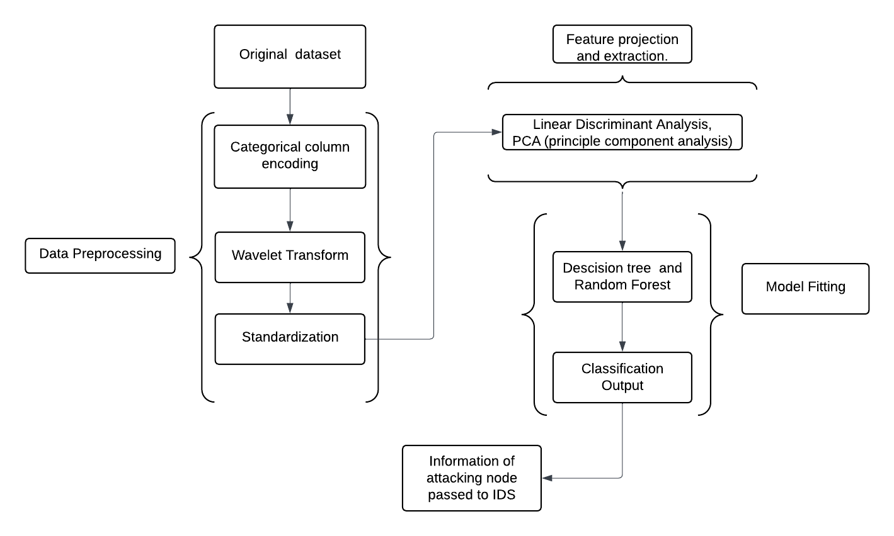
Introduction
Proposed work
Conclusion
Future Scope
Proposed Work
2. Methodology
Figure: ML model ﬂow diagram

Slide 9
Introduction
Proposed work
Conclusion
Future Scope
Proposed Work
Methodology
One Hot Encoder: Converts categorical columns into numerical form for machine learning models.
Standardization: Scales the data to a normal distribution using StandardScaler for better performance of classiﬁers.
Wavelet Transform: Converts time-domain network traﬃc data into the frequency domain to capture more complex patterns.
Anomaly Detection: Linear Discriminant Analysis (LDA) is used to maximally separate data classes based on variance.
Principal Component Analysis (PCA): Reduces dimensionality by projecting the data in the direction of eigenvectors corresponding to the largest eigenvalues.
We also implemented: SVM, KNN, Bagging of Decision Trees, AdaBoost, CatBoost, and MLP Boost.

Slide 10
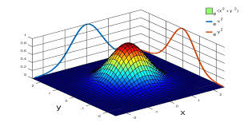
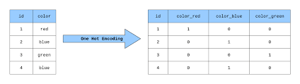
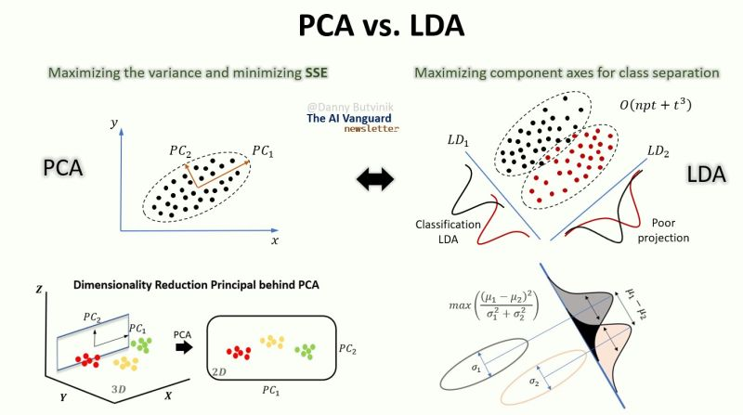
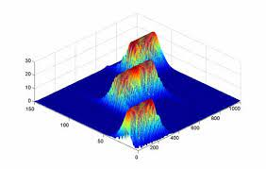

Slide 11
Introduction
Proposed work
Conclusion
Future Scope
Dataset Description
NSL-KDD
A benchmark dataset used for evaluating intrusion detection systems, offering a reﬁned version of the KDD’99 dataset with reduced redundancy and improved data quality for identifying network intrusions.
WSN-DS
A dataset designed for evaluating intrusion detection systems in wireless sensor networks, focusing on attacks like Sinkhole, Blackhole, and Grayhole, with features related to node behavior and communication patterns.

Slide 12
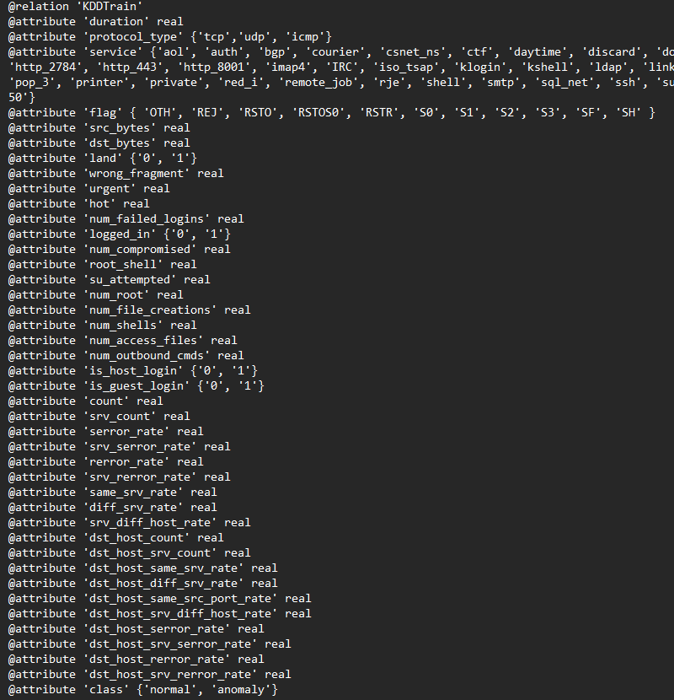
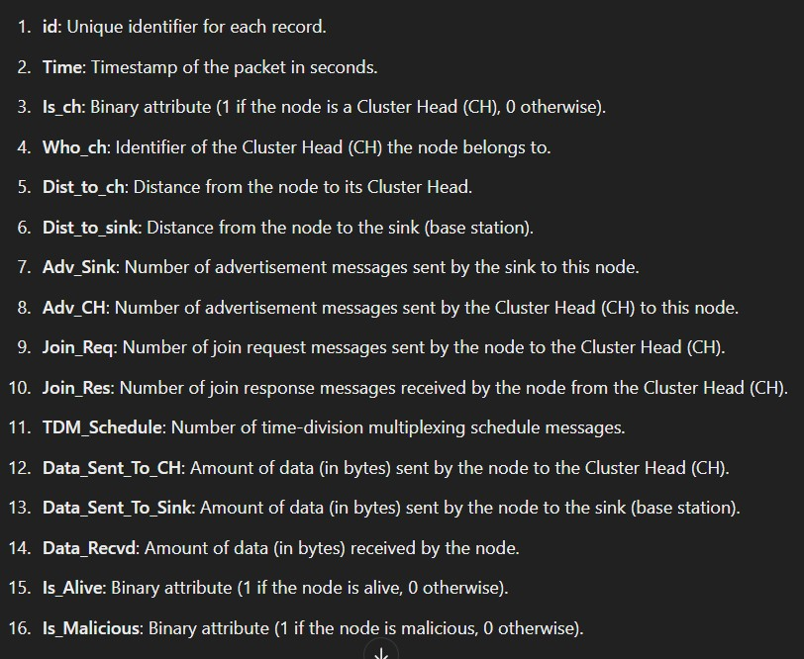
Introduction
Proposed work
Conclusion
Future Scope

Slide 13
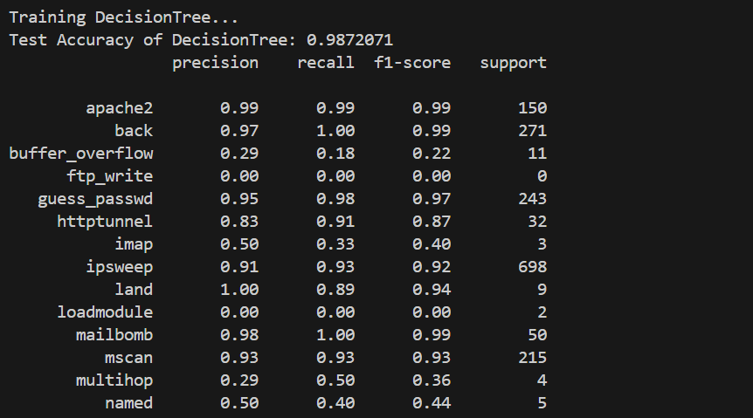
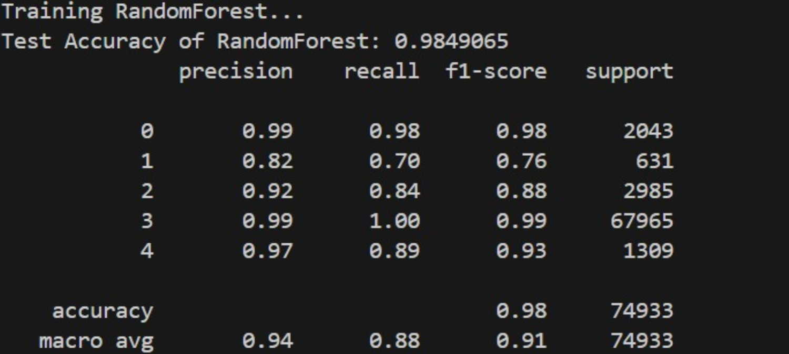
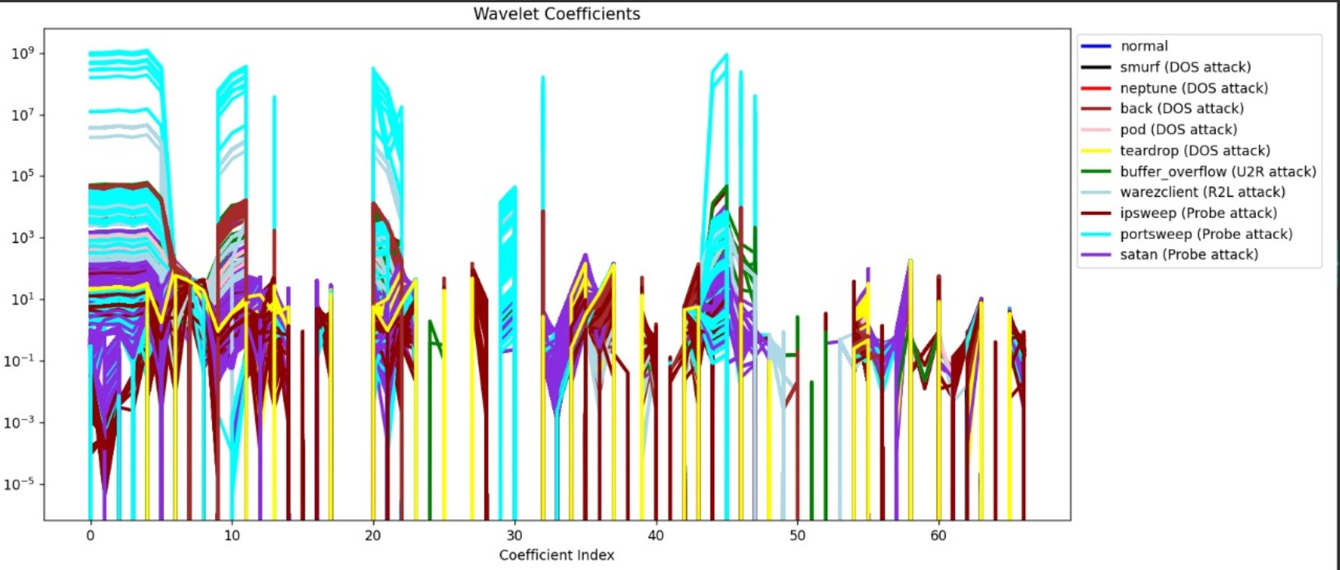
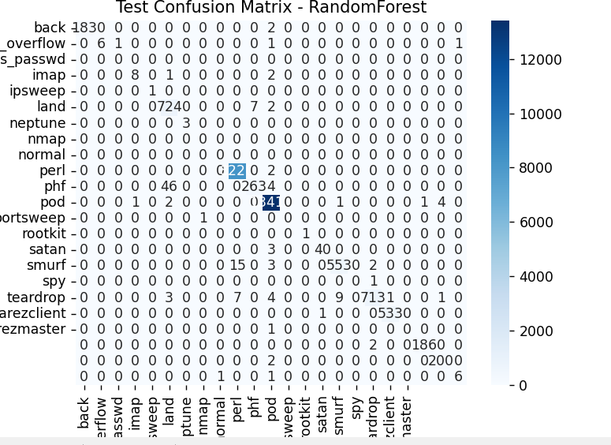
Introduction
Proposed work
Conclusion
Future Scope
Results
Till now we have got around 98% accuracy during training for the NSLKDD and WSN-DS Dataset for classiﬁers like Decision Tree and Random Forest.
The wavelet transform and the Confusion Matrix is as follows
Our ML model seems to be well trained, now we have to explore how to implement this model on real time network data.

Slide 14
Introduction
Proposed work
Conclusion
Future Scope
Discussions
We are moving from Time Domain Data to frequency domain as we believe that mapping our data into a frequency can help detect small attacks (possible threats) that might be ignored when using time domain data.
Independent of prior knowledge: It doesn’t depend on the prior knowledge of attack signatures, thus it has the potential to be a useful supplement to existing signature based IDS.

Slide 15

Introduction
Proposed work
Conclusion
Future Scope
Future Scope
There are basically three major future scopes for this project
Exploration of Modern Classiﬁers: Testing advanced classiﬁers such as AdaBoost, CatBoost, and techniques like bagging and boosting to analyse the model performance on real time data.
Real-Time Deployment and Simulation: Deploying the trained ML model on real-time network data and simulating a network using tools like Cooja for further validation and testing in controlled environments.
Using WGAN for Dataset Augmentation: Implementing WGAN to increase the dataset size for better model training when working on real time data.

Slide 16
References
Fenanir, S., Semchedine, F., Baadache, A. (2019). A machine learning-based lightweight intrusion detection system for the internet of things. Revue d'Intelligence Artificielle, Vol. 33, No. 3, pp. 203-211. https://doi.org/10.18280/ria.330306
Elsadig, Muawia A. "Detection of Denial-of-Service Attack in Wireless Sensor Networks: A lightweight Machine Learning Approach." IEEE Access (2023).
https://ieeexplore.ieee.org/stamp/stamp.jsp?arnumber=10210414
Zhou, Mian, and Sheau-Dong Lang. "A frequency-based approach to intrusion detection." Proc. of the Workshop on Network Security Threats and Countermeasures. 2003.
https://www.researchgate.net/publication/229035248_A_Frequency-

Slide 17
Introduction
Proposed work
Conclusion
Future Scope
THANK YOU!

Slide 18
Any Questions?

