Slide 1


Slide 2


Slide 3
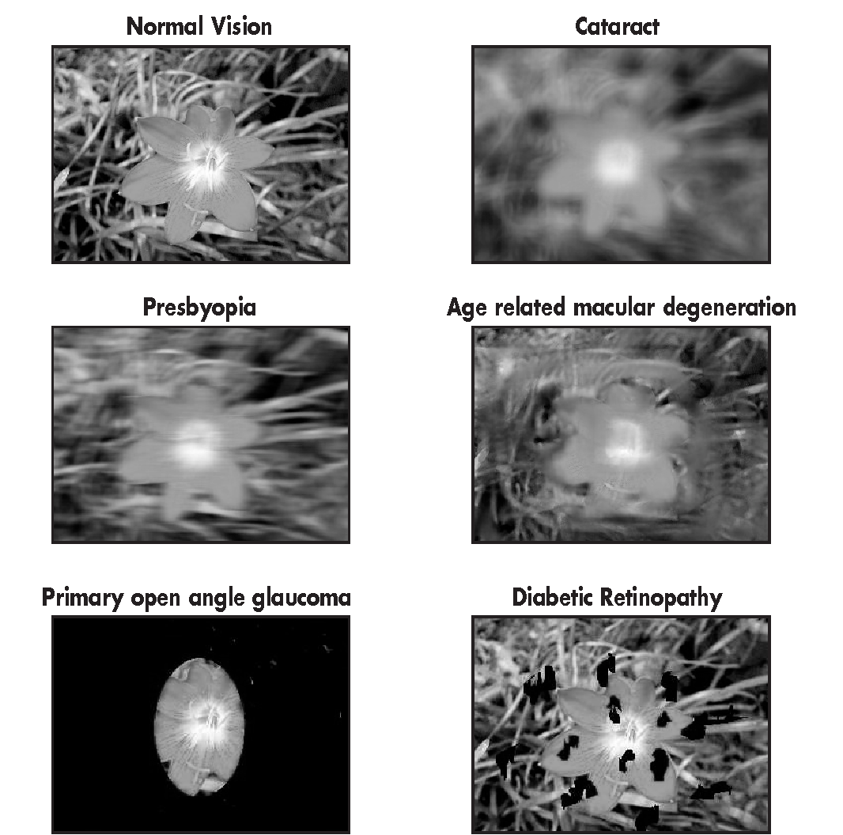

Slide 4
How can I find an object in a room?
Solution: Blind Assistance Systems

Slide 5
Object Search and Retrieval
People with visual impairments face difficulties in locating and retrieving objects
Limitation in independence by requiring a third party to help
Solution: Blind Assistant Systems

Slide 6
NaviSense: Motivation
Address weaknesses of existing systems:
  Dependency on Human Assistance (BeMyEyes)
  Dependency on Wearables (Ray-Ban MetaGlasses)
  Limited Object Categories (AIGuide)
  Lack of precise guidance (WorldScribe)
Goal: Provide open-world object detection pipeline that identifies and guides users to objects

Slide 7
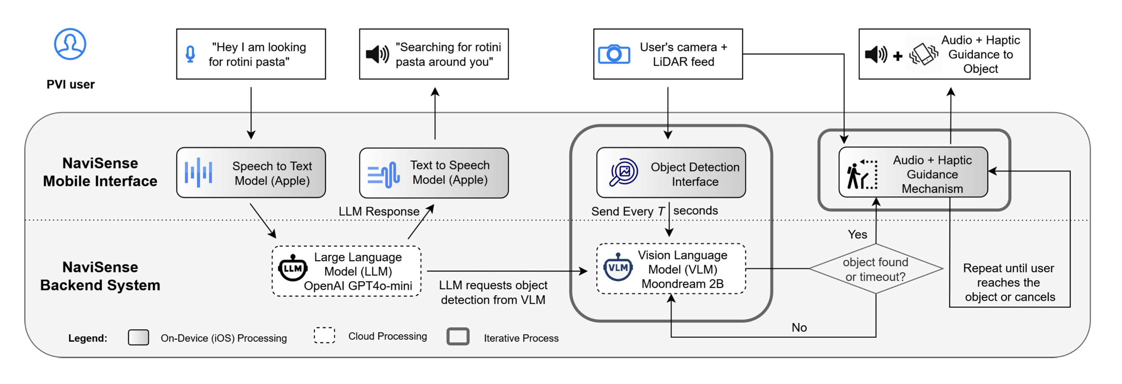
NaviSense
A conversational AI-based assistive mobile application designed to support independent, real-time object retrieval

Slide 8
NaviSense: Implementation
Conversational Voice Interface:
  Apple Speech-to-Text
  OpenAI GPT-4o-mini: interpreting user intent
3D Object Detection:
  Moondream 2B: an open-world VLM for 2D Object Detection
  ARKit and LiDAR depth data to convert 2D location into spatial point
    Continuously tracked and updated locally
Multimodal Guidance Feedback (Audio-Haptic):
  Audio Feedback: Directional voice prompts
  Haptic Feedback: Distance-based vibrations

Slide 9
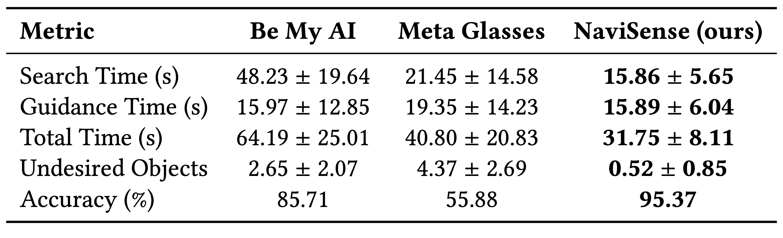
NaviSense: Evaluation
User Study: 12 PVI participants
Three target objects (3 trials per object), 4 tier shelf setup, 5 feet distance

Slide 10
NaviSense: Weaknesses
Initiating interactions verbally
  Not suitable for every environment
Usage of two LLMs: one for interpretation, other for Object Detection
Ios only
Long search time (15 seconds maximum)
Missing feature: Personal Object Retrieval

Slide 12
Goals
Providing a model:
  that operates real-time high-speed
  Combines Generic Object Detection and Personal Object Finding
  Provides Guidance via Audio Feedback

Slide 13
Implementation
Backend-Implementation:
  Generic Object Detector
  Object Scanner + Personal Object Finder
Frontend-Implementation

Slide 14
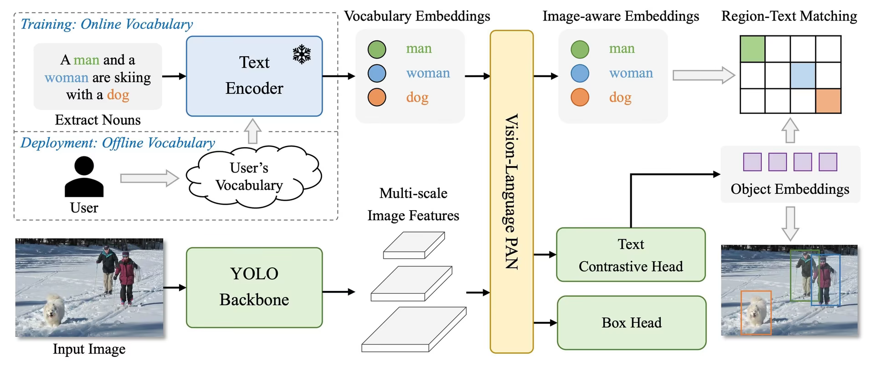
Generic Object Detector: OD Architecture
YOLO World: Open World Object Detector

Slide 15
Open World Object Detector: Depth Estimation + Guidance

Slide 16
Personal Object Finder
Goal: develop system that makes it possible for users to save their personal items and help them retrieve them later
Related Work:
  Recog: asks users to provide 10+ images of personal objects and trains CNN on those images
    No guidance provided to objects
    Requires blank background when taking images
    Training inefficient (3 hours), costly
How to improve this?

Slide 17
Personal Object Scanner: Models
SAMv2 (Segment Anything Model 2) for object segmentation
CSTR tracker to track object
DINOv2 for feature extraction of the object
FAISS database

Slide 18
Personal Object Scanner: Logical Flow

Slide 19
Personal Object Finder
FASTSAM for automatic mask proposal
Features of each mask get calculated and compared with feature vectors stored in FAISS of object
Cosine similarity: return object class of feature that it most similar if similarity>threshold

Slide 20
Frontend Implementation

Slide 21
Evaluation: Set up

Slide 22
Evaluation: Results

Slide 23
Comparison to other systems

Slide 24
Future Work
Warning when obstacles
Guidance in terms of directions
Precise Hand Guidance

Slide 25
Discussion

Slide 26
https://visionatlas.iapb.org
https://arxiv.org/html/2401.17270v2

