Slide 1
Shaping the Product Roadmap
Assignment 3 Guidance
Agile Software Development
MET CS 634

Slide 2
Assignment Overview
ASSIGNMENT COMPONENTS
SITE FLOWS (50 POINTS)
Start with your personas and refer to your vision statement. Consider the following:
What are the primary activities (capabilities) your users are performing on the site?
What are the steps your users are taking to complete those actions?
Create user flows (template provided)
BACKLOG & ROADMAP (50 POINTS)
From your user flows, create a backlog of capabilities.
Frame your capabilities in active voice.
Prioritize your backlog and organize into a product roadmap, showing items in the first 2-3 releases.
CONTENT MAP (extra credit: 5% of course grade)
Use a mind mapping tool to determine the type of content and assets needed to support your backlog (text, images, video, audio, graphics, etc.)
1
Create at least FIVE flows
In this assignment, you’ll identify the overall user flows for your site, set up an initial backlog and roadmap, and optionally, create a content map to highlight the assets you will want to gather in support of your design.
Set up a Trello board for your course project.
2
3

Slide 3
1
Create User Flows
1
Purchase tickets
Tip: Keep your capability & feature information action-oriented
Capability
2
Select event
Create user profile
Complete purchase
Steps
3
Align capabilities to our personas
List the Capability
Identify the Steps a user takes to complete the capability
Identify Activities for each step (if applicable)
Identify Enablers (technical “must-haves”)
Identify NFRs – non-functional requirements (the “ilities”)
Provide high-level Data needs for each step (as appropriate)
4
Search for event
Provide name
Agree to terms & conditions
Features
Select event
Provide email
Complete transaction
Activities
Provide address
Receive tickets
Provide payment method
Database for Transactions
Authentication
Enablers
5
Payment Processing
NFRs
6
Security
Scalability
Event Information
User Data
Transaction Data
Data
7

Slide 4
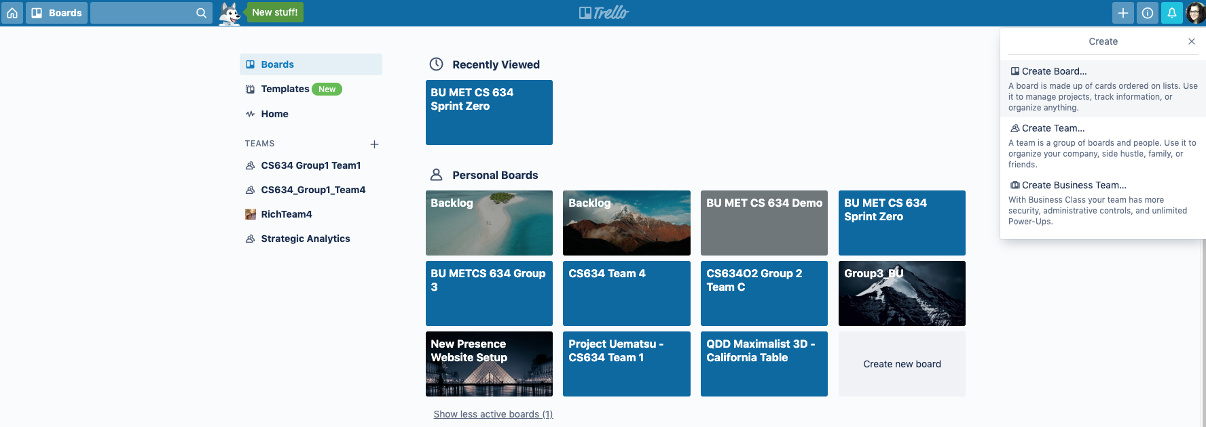
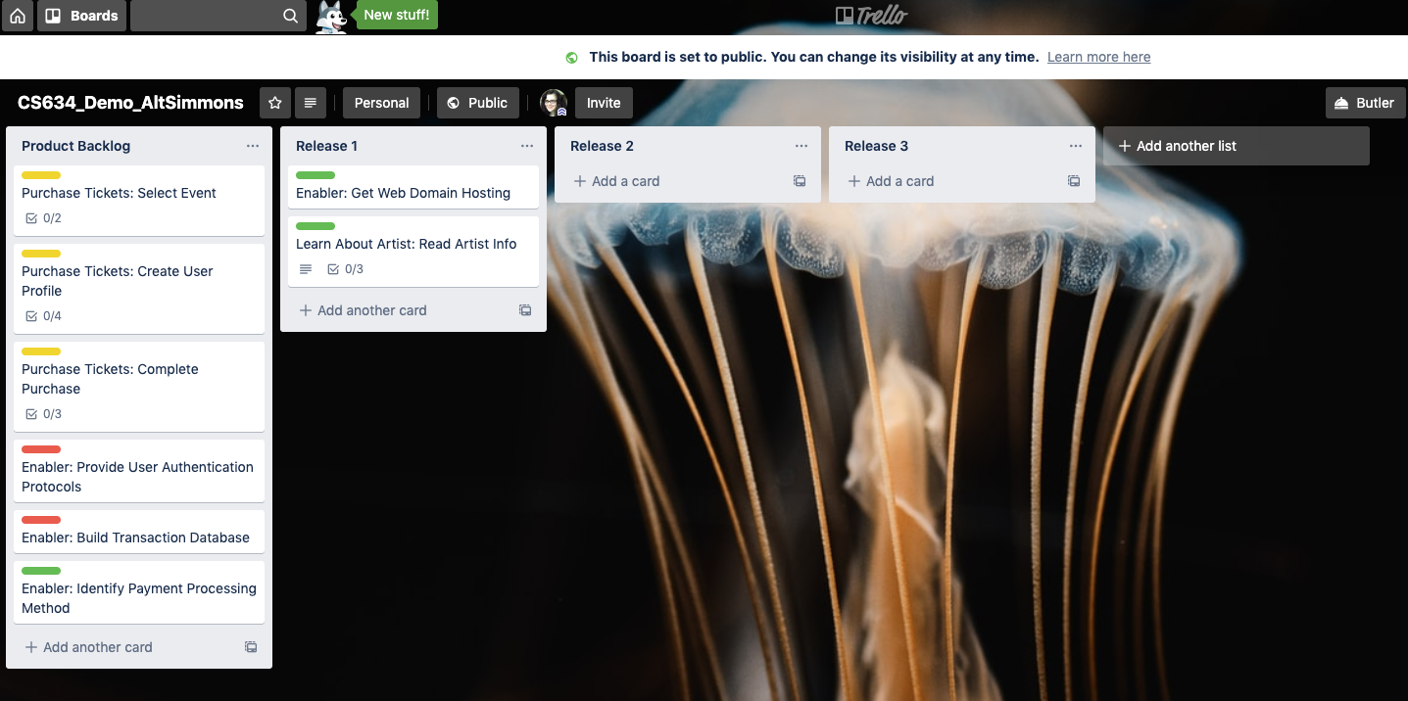
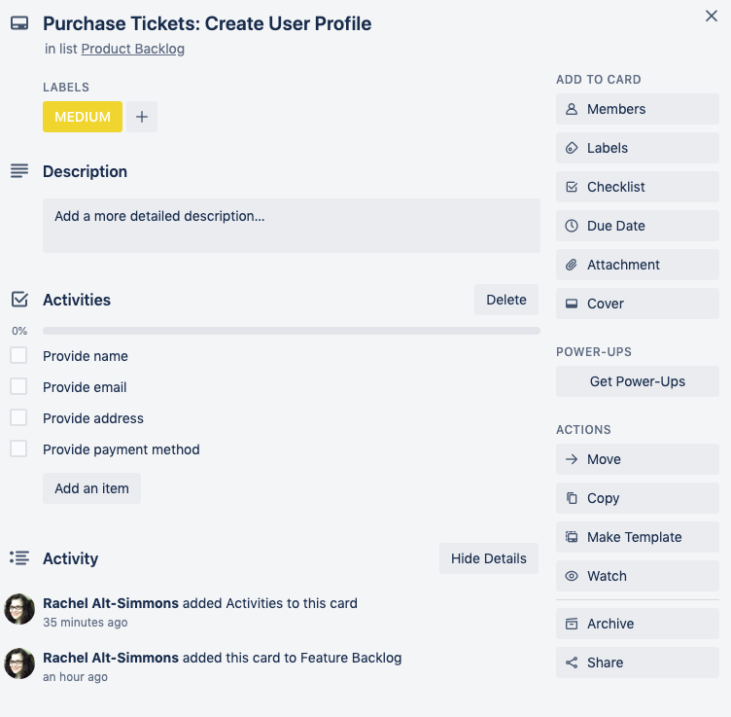
2
Establish & Order Backlog
Create a free Trello account
In Trello, create a new board for your backlog (call it CS634_UserName) (SET IT TO PUBLIC)
Create lists for Backlog and 2-3 Releases (Add items to Backlog and then move those to a slated release to show Roadmap)
Add your Features, Enablers, and Data into the Backlog (Note: You won’t need to enter your NFRs in Trello)
+Add a card
Give it a name (Capability:Feature, Enabler or Data)
Add a description
Note: In Assignment 4, you will add additional details
https://trello.com/b/Fg1OBULU/cs-634-example

Slide 5
Trello Guidance for Assignment 3
Create Board (it’s easier to not use a template)
Name the Board CS634_UserName
Set ‘Visibility’ to Public
Edit Lists to: Product Backlog, Release 1, Release 2, Release 3
Select ‘+ Add a Card’ to create a new item. Name it Template
Select ‘Checklist’ button and name it Activities
Select ‘Make template’ button
To use template for new items, select ‘Create card from template’
Add Capabilities and Steps (from your User Flows) to Product Backlog (Capability: Step)
Add brief description if needed
Add Activities from User Flows as checkboxes under Activities
Add Enablers and Data to Product Backlog
Decide which items will be in Release 1, 2, 3, or stay in Product Backlog (and move them accordingly)

Slide 6
Trello Guidance for Assignment 4
Create New List for Sprint 1
Select ‘+ Add a Card’ to create a new item. Name it Template User Story
Select ‘Labels’ button and create labels for story sizes (e.g., Small, Medium, Large, XL, XXL)
Select ‘Checklist’ button and name it Tasks
Select ‘Checklist’ button and name it User Acceptance Tests
Select ‘Make template’ button
Decide which Product Backlog items in Release 1 will be in Sprint 1
Write User Stories for Sprint 1
For each User Story, select size and add needed tasks and user acceptance tests
NOTE: This is not needed until Assignment 4!

Slide 7
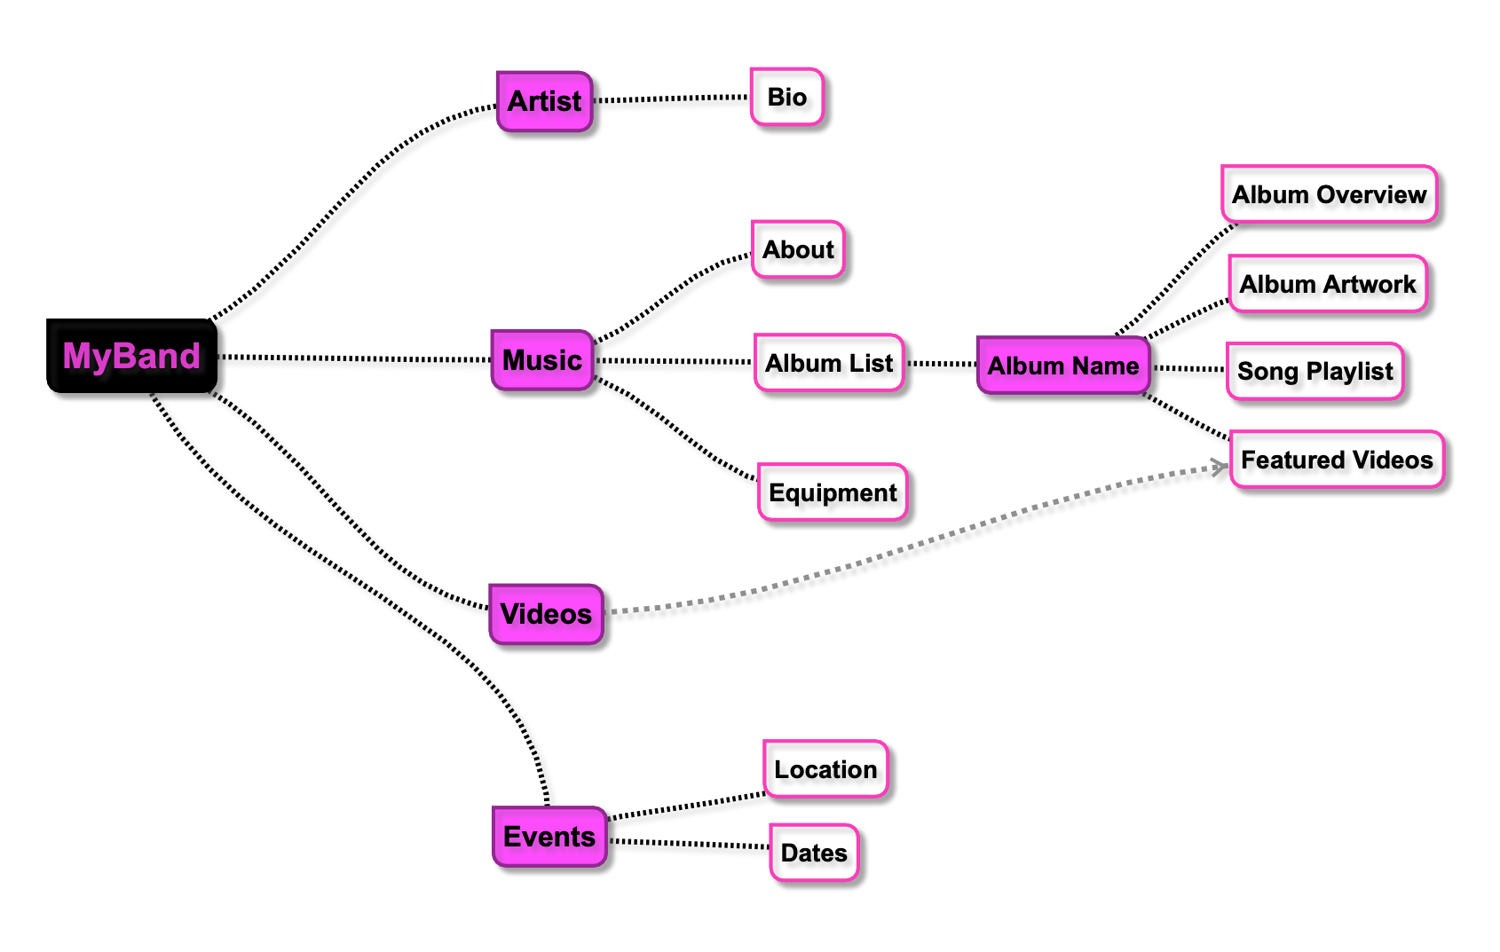
Optional: Create a Content Map for Your Site
3
Break down the data categories you identified in your five capabilities
Content maps are useful for exploring the content (data and information) that you will need for your site
It’s recommended that you use a mind-mapping tool for this portion of the assignment (FreeMind, SimpleMind), but you can also use PowerPoint or Visio

Slide 8
Handing It In
For reference, please include your personas and vision from Assignment 2
Five PowerPoint slides with your user flows
Link to your Trello backlog / roadmap
One PowerPoint slide with your content map (optional for extra credit)

Slide 9
Appendix

Slide 10
<>
Capability
<>
<>
<>
<>
<>
Steps
<>
<>
<>
<>
<>
Features
<>
<>
<>
<>
<>
Activities
Enablers
NFRs
Data

Slide 11
“Ility” Examples (Non-Functional Requirements)
Performance
How quickly must the system respond to interactive operations of different kinds?
Are there different classes of interactive operations that users have different tolerances / expectations for?
Is there a batch window? What runs in it?
Do the batches have their own performance constraints, e.g., to clear the batch window before it closes?
Does the batch load influence any interactive users running at the same time?
Is there data with a high read/write access ratio that can be cached in memory at different tiers in the architecture?
What are the expected performance bottlenecks?
CPU?
Memory on client, server or intermediate nodes?
Hard drive space on each node?
Communications links?
DB
Access
Searching
Complex joins
Interaction with other internal systems?
Interaction with systems in other departments?
Interaction with partner systems?
Interactions with public systems?
Scalability
Peak load of how many users doing what kinds of operations?
Ability to grow to how many records in which critical database tables without slowing down related operations by more than X
Avoiding saturating a communication link that cannot be upgraded to a higher speed?
What dimensions can be scaled, e.g., more CPUs, more memory, more servers, geographical distribution?
Is the primary scaling strategy to "scale up" or to "scale out" -- that is, to upgrade the nodes in a fixed topology, or to add nodes?
Availability
What is the required uptime percentage?
Does this vary by time of day or location?
What is the current schedule of controlled outages? Is this acceptable, or is there a goal to improve it?
Reliability
Are there components with reliabilities that are known to be less than the required reliability of the system?
What strategies are currently in place to build more reliable capabilities out of less reliable capabilities?
What is the expected mean time to failure by failure severity by operation?
How will reliability be assessed prior to deployment?
Security
What operations need to be secured?
How will users be administered?
How will users be given permissions to access secured operations?
What are the different levels of security and how do these map
Security by operation
Security by type of object
Security by instance of object
Maintainability
Are there concerns about the ability to hire appropriate technology skills, attract them to the area at reasonable prices?
What kinds of changes are anticipated in the first rounds of maintenance? What are their relative priority?
What sort of regression testing is required to ensure that maintenance changes do not degrade existing functionality?
What sort of maintenance documentation is expected to be produced? When?
Flexibility
Is there system behavior that needs to be changed regularly without program changes?
Can this be encoded in the database?
Are there run-time rules that can be handled using a rules interpretation engine?
Are there functions that should be user scripted? If so, how will these be QA-ed?
Configurability
What parameters need to be set on a machine-by-machine basis?
Personalizability
What aspects of the system can be customized on a per-user basis?
How does the user change these settings?
What is the strategy for defaults?
Usability
Are there operations that need to be done as quickly as possible, so that user gestures should be minimized?>
Are there difficult or occasional-user operations that require non-standard presentations to help the user perform correctly?
What is the balance between data integrity and the ability to stop in a "work in progress" state?
What styles of validation are used in what situations?
What metaphors from existing or parallel systems should be used?
What sort of training deliverables are expected?
What sort of on-board help system is expected?
Portability
Data portability between this system and other systems?
Portability across different versions of a single vendor's DB?
Ability to port to a different vendor's DB? Which one(s)? When?
Browser portability? What browser versions? Historical and future?
Operating system portability?
Conformance to standards
What legal standards apply?
What technical standards apply?
Other standards, e.g., 508.1 for disabled users?
What development standards apply?
Database naming standards
Existing internal architectural standards (e.g., everything goes in an Oracle database)
Language and coding standards
Testing and review standards
Presentation standards, e.g., use of standard colors, controls or other affordances?
Lifecycle models or methodologies
Internationalizability
What languages?
In what order?
How translated?
Single or multi byte character sets?
Efficiency -- space and time
Responsiveness
What are the expected and upper limit response times per operation in the system?
What is the trade-off between lower averages and wider variations in response time?
Interoperability
What systems will this system interoperate with immediately?
What other systems are anticpated?
What classes of internal and external systems might later be needed to interoperate with?
What functionality from this system needs to be exposed as a service in a service oriented architecture?
What functionality from this system needs to be exposed as a Web service or via a portal?
Upgradeability
Do the servers need to be upgraded while running?
How many client stations need to be upgraded, and what are the costs and mechanisms for upgrading them?
How often do different kind of fixes need to be distributed? Are there "hot fixes" that have to go out right away, but others that can wait? How often do each kind occur?
Auditability / traceability
What record of who did what when must be maintained?
For how long?
Who accesses the audit trails?
How?
Is archive to tape or other off-site storage media required?
Is "effective dating" required?
Transactionality
What are the important database and application transaction boundaries?
Is standard "optimistic" locking appropriate, or is something more complex required in some or all cases>
Is disconnected operation required by any node?
Administrability
What live usage information needs to be displayed?
To who? How? When?
What "live" interventions are required?
What ability to handle remote configurations are required?
Are there existing application management consoles that will be used to manage this application?
Lots of others -- what are your favorites?
http://www.softwarearchitecturenotes.com/architectureRequirements.html

Slide 12
Rubric
Criteria | D | C | B- (80-83%) | B (84-86%) | B+ (87-89%) | A- (90-93%) | A (94%+)
Organization & Clarity | Disorganized or hard-to-understand |  | Generally organized and clear | Very clear, organized and persuasive presentation of ideas and designs |  |  | Exceptionally clear, organized and persuasive presentation of ideas and designs
Thoroughness & Content | Little understanding of, or insight into material |  | Overall understanding of material | Very good overall understanding of technical material, with some real depth |  |  | Accurate and in depth information, sufficient amount of information, proper citing of resources. Excellent, deep understanding of material and its inter-relationships
Subject Knowledge | Hardly covers any of the major relevant issues |  | Reasonable coverage of the major relevant area | Thorough coverage of almost all of the major relevant issues |  |  | Exceptionally thorough coverage of all major relevant issues
Relevance | Mostly unfocused |  | Only some of the content is meaningful and on topic | All of the content is reasonably meaningful and on-topic |  |  | All of the content is entirely relevant and meaningful
Utilization of Resources | No useful use of notes, text(s), or research with incorrect details or applicability |  | Some useful use of notes, text(s), or research with mostly correct details or applicability | Very good use of notes, text(s), or research with correct details or applicability |  |  | Excellent use of notes, text(s), or research with entirely correct details or applicability
Overall Rating: Minimum Viable Assignment (MVA) | Does not meet MVA requirements |  |  | Meets MVA requirements |  |  | Above and beyond

