Slide 1
Replicating the Adam Optimizer
Kingma & Ba, ICLR 2015 — Figures 1 & 2
Experiment: L2 Logistic Regression (MNIST) + MLP with Dropout (MNIST)
Optimizers: Adam (hand-rolled) vs. SGD, SGD+Nesterov, AdaGrad, RMSprop
Seeds: 3 seeds, mean ± 1σ shown LR Schedule: αₜ = α / √t
MNIST Dataset · PyTorch · Custom Adam via torch.autograd

Slide 2
PAPER SUMMARY
Adam: A Method for Stochastic Optimization
What is Adam?
Key Claims
Algorithm Core
An adaptive learning-rate optimizer that maintains per-parameter first and second moment estimates of gradients. Combines the benefits of AdaGrad (sparse gradients) and RMSprop (non-stationary objectives).
Adam converges as fast as SGD+Nesterov on dense objectives. Adam matches AdaGrad on sparse features. Adam outperforms all baselines on non-convex MLP + dropout tasks.
mₜ = β₁mₜ₋₁ + (1−β₁)gₜ
vₜ = β₂vₜ₋₁ + (1−β₂)gₜ²
θₜ = θₜ₋₁ − α · m̂ₜ / (√v̂ₜ + ε)
Defaults: β₁=0.9, β₂=0.999, ε=1e-8

Slide 3
EXPERIMENTAL SETUP
Experiment Configuration
Experiment 1 — Logistic Regression
Experiment 2 — MLP + Dropout
Dataset: MNIST (784-dim pixel vectors) Model: Single linear layer, softmax Regularization: L2 weight decay (λ=1e-4) Batch size: 128 Epochs: 45 LR schedule: αₜ = α/√t (1-indexed epoch) Seeds: 3 (mean ± 1σ bands)
Dataset: MNIST Model: 784→128(ReLU,Drop)→128(ReLU,Drop)→10 Regularization: Dropout only (p=0.5), no L2 Batch size: 128 Epochs: 100 LR schedule: αₜ = α/√t (same as Ex1) Seeds: 3 (mean ± 1σ bands)
All optimizers share the same base LR (0.001). Adam implemented from scratch using only torch.autograd.

Slide 4
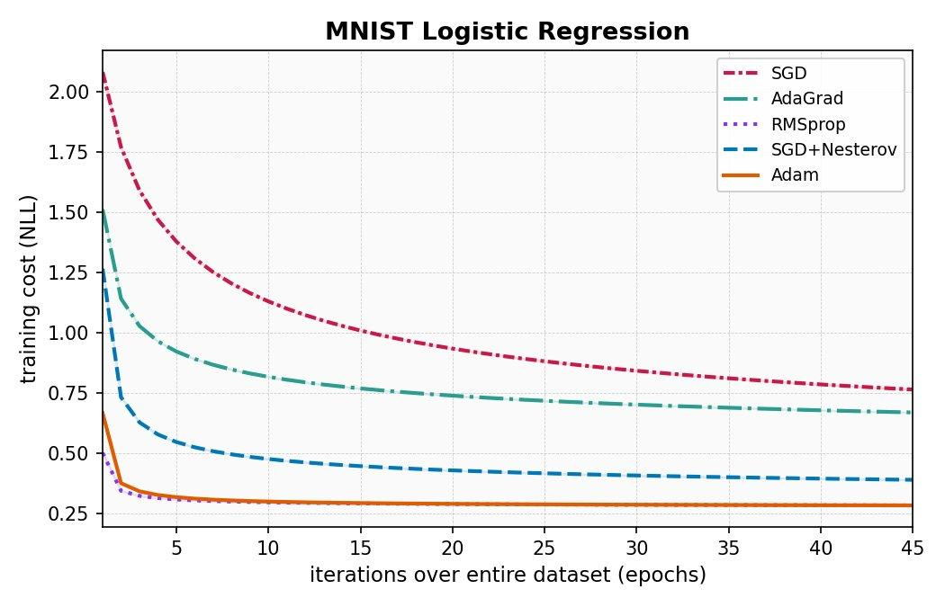
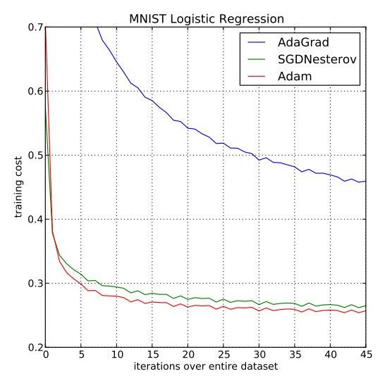
RESULTS
Experiment 1: Logistic Regression on MNIST
Our Replication
Original Paper (Kingma & Ba 2015)
Key finding: Adam and SGD+Nesterov converge faster than AdaGrad — qualitatively matches the paper. AdaGrad plateau and final cost levels differ (see Discrepancy Analysis).

Slide 5
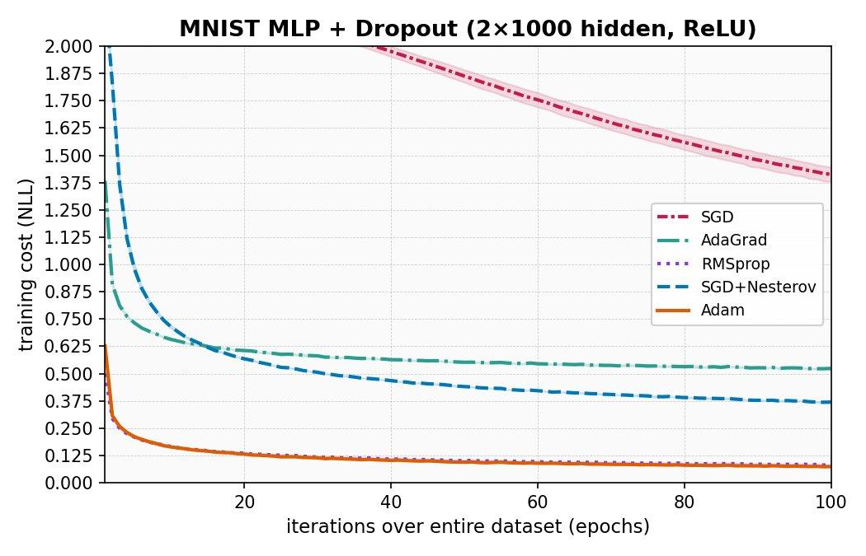
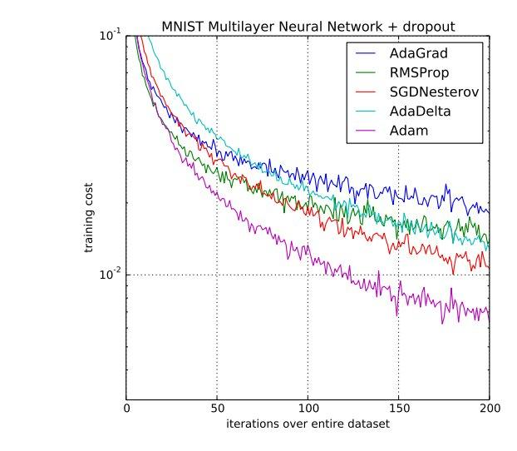
RESULTS
Experiment 2: MLP + Dropout on MNIST
Our Replication
Original Paper (Kingma & Ba 2015)
Key finding: Adam achieves the lowest training cost by a large margin. Paper uses 200 epochs; our linear-scale 100-epoch plot still shows the same ordering of optimizers.

Slide 6
DISCREPANCY ANALYSIS
Where The Results Differ From the Paper
Number of Nodes
Log vs Linear Scale — Ex2
The paper has 2 layers of 1000 nodes each - I only ha ve 128. This decision was made because having 1000 nodes in 2 layers was way too intensive for my hardware.
Paper plots on log scale (10⁻¹ to 10⁻²), hiding noise and compressing variance. Our linear plot shows the same relative ordering but looks qualitatively different due to scale choice.
Optimizer Lineup
Epoch Count — Ex2
Paper Figure 2 includes AdaDelta instead of plain SGD. We include SGD and RMSprop but not AdaDelta. This changes the visual density of the chart and removes one direct comparison.
Paper runs 200 epochs; we ran 100. Adam's advantage over other optimizers likely widens further with the additional training — our replication understates the gap.

Slide 7
ABLATION
Ablation: Difference in LR between ADAM and others
What We Tested
Expected Effect of Fix
Original: LR hyperparameter for other optimizer was 10x larger than Adam (0.01 vs 0.001) Change: All optimizers now have the same LR (0.001)
Why this matters: With LR difference, RMSProp and AdaGrad converge faster than Adam. It is important for all optimizers to work on the same field
Fairer Comparison - Convergence should match the paper
With all LRs matching, all of the loss curves should hold the same general shape. AdaGrad was converging faster because the larger LR was making it take larger steps, counteracting accumulating gradients.

Slide 8
REFLECTION
Reflection
01
Paper ambiguity
03
LR schedule interacts with adaptivity
The paper doesn't specify weight initialization, exact LR values per optimizer, or whether the y-axis is log scale. These silences force interpretive choices that directly affect reproducibility.
Applying 1/√t decay uniformly to adaptive methods (AdaGrad, Adam) double-decays their effective step size. The paper is ambiguous on whether this was intended for all optimizers.
02
Qualitative vs. quantitative match
The qualitative claim — Adam ≥ SGD+Nesterov > AdaGrad (Ex1), Adam >> all others (Ex2) — is reproduced. Exact loss values differ. This is the honest version of reproduction.

Slide 9
AI Use Disclosure
Code scaffolding
Claude (Anthropic) used to generate initial ex1.py and ex2.py structure, hyperparameters.yaml layout, and the pptx generation script.
Debugging assistance
AI used to identify the accumulator-reset bug in baseline optimizers and suggest the param_groups fix.
Not used for
All experimental results, plots, and numerical outputs are generated by running the scripts directly. No AI-generated numbers or figures were included.
Report writing
Handwritten report sections (Paper Summary, Results, Discrepancy Analysis, Reflection) written independently. AI consulted for clarification of concepts only.

