Slide 1
CHAPTER 1: Introduction
Java Software Structures:
Designing and Using Data Structures
Third Edition
John Lewis & Joseph Chase

Slide 2
Chapter Scope
Introduction to data structures
Aspects of software quality

Slide 3
Data Structure
Definition (very first one)
It is a specialized container for organize and store data values (several). These data values are related among them and their functionalities are carried out by operations (methods).
Examples
. . .

Slide 4
Software Development
Software Engineering is the study of the techniques and theory that support the development of high-quality software
The focus is on controlling the development process to achieve consistently good results
We want to:
satisfy the client – the person or organization who sponsors the development
meet the needs of the user – the people using the software for its intended purpose

Slide 5
Goals of Software Engineering
Solve the right problem
more difficult than it might seem
client interaction is key
Deliver a solution on time and under budget
there are always trade-offs
Deliver a high-quality solution
we must consider the needs of various stakeholders
Accomplish it all in an ethical manner

Slide 6
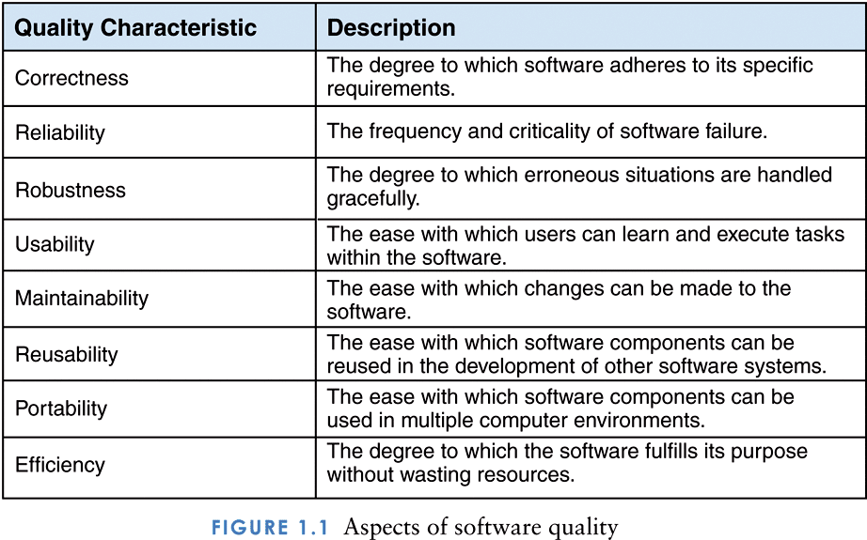
Aspects of software quality

Slide 7
Data Structures
The data structures to be examined in this book lay the foundation for developing complex software
Software Engineering techniques are needed as our software grows more complex
As we discuss data structures, we will also practice good software engineering

Slide 8
A Physical Example
Consider the problem of storage containers being unloaded at a dock
Containers could immediately be loaded onto waiting trains and trucks
Efficient for the dock workers but not very efficient for the railroad and trucking companies (because the trains and trucks have to wait)

Slide 9
Physical Example (continued)
What do we know about each container?
Same size and shape
Each has a unique ID
Dock workers do not need to know what is in each container

Slide 10
Physical Example: solution 1
Containers could simply be offloaded and stored on the dock as they are unloaded
Efficient for unloading
Not efficient for finding and loading storage containers onto trucks and trains
Requires a linear search of the entire storage area each time a container needs to be found

Slide 11
Physical Example: solution 2
What if we lay out a very large array so that each storage container is indexed by its ID?
ID is unique for all storage containers
Array would be very large
Array would mostly be empty
Significant waste of space

Slide 12
Physical Example: solution 3
What if we use that same solution but allow the list to expand and contract to eliminate empty slots?
Array would always be ordered by ID
Finding a container would be easier
However, would force containers to be moved multiple times as each new containers are added or removed

Slide 13
Physical Example: solution 4
Lets reconsider what we know about each container
The ID number also gives us the destination of each container
What if we create an array of destinations where each cell in the array is an array of containers?

Slide 14
Physical Example: solution 4 (cont.)
Now we can store the containers for each destination in a variety of ways
Store in the order they are unloaded with the first one unloaded being the first one shipped (Queue)
Store in the order they are unloaded with the last one unloaded being the first one shipped (Stack)
Store by ID order within each destination (Ordered List)

