Slide 1
Appendix B: Object-Oriented Design
Java Software Structures:
Designing and Using Data Structures
Third Edition
John Lewis & Joseph Chase

Slide 2
Method Overloading
In Java, as in other object-oriented languages, you can use the same method name with different parameter lists for multiple methods in the same class
This technique is called method overloading
A method’s name along with the number, type, and order of its parameters is called the method’s signature
Note that the return type is not part of the signature
As long as each method’s signature is unique, then the compiler can tell which method, among the overloaded, is being referenced

Slide 3
Method Overloading – example 1
The add method is an overloaded method as illustrated by this partial list of signatures:
public int add(int i1, int i2)- -}
public long add(long l1, lon l2)- -}
public float add(float f1, float f2)- -}
public double add(double d1, double d2)- -}

Slide 4
Method Overloading – example 2
The System.out.println method is a good example of an overloaded method as illustrated by this partial list of signatures:
-.println(String s)
-.println(int i)
-.println(double d)
-.println(char c)
-.println(boolean b)

Slide 5
INHERITANCE 1
Classes can also be created from other classes using inheritance
Inheritance means that the definition of one class (child) can be based on another existing class (parent)
A child class inherits all of the attributes and methods of the parent
Inheritance supports Class Hierarchy

Slide 6
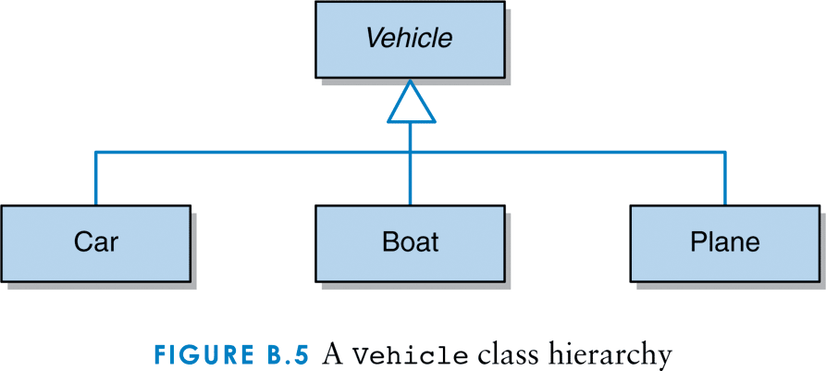
A Vehicle class hierarchy

Slide 7
Inheritance 2
In object-oriented programming, inheritance means to derive a class from the definition of another class
A class that inherits from or is derived from another class is said to be a child of that parent class
A child class may also declare its own attributes and methods

Slide 8
Inheritance 3
The original class that is used to derive a new one is called the parent class, superclass, or base class
The derived class is called the child class, or sub class
The derivation process establishes an is-a relationship between the two classes
For example, a Car is-a Vehicle , a Boat is-a Vehicle
Car c = new Car(); Boat b = new Boat();

Slide 9
Inheritance 4
A child class derived from one parent can be the parent of its own child class
Multiple child classes may also be derived from a single parent
Thus inheritance relationships often develop into class hierarchies

Slide 10
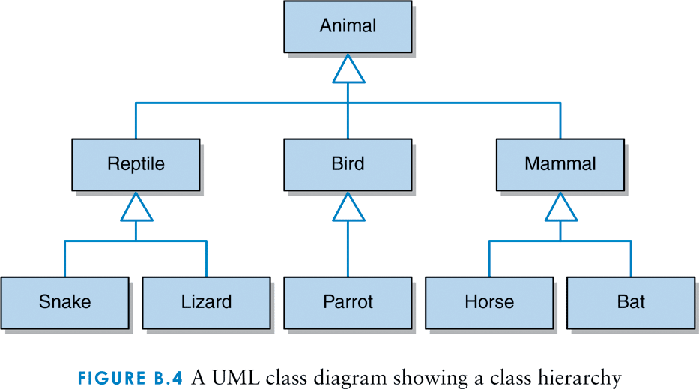
An Animal class hierarchy

Slide 11
Inheritance 5
The word class comes from the idea of classifying groups of objects with similar characteristics
For example, all Mammals share certain characteristics:
Warm blooded
Have hair
Bear live offspring

Slide 12
Inheritance 6
In software, a Mammal class would have attributes and methods that describe the state and behavior of Mammals
From that class, we could derive a Horse class
The Horse class would inherit all of the variables and methods of the Mammal class
The Horse class could also define additional variables and methods of its own

Slide 13
Inheritance 7 - Examples
Relationships between classes:
a Horse is-a Mammal
a Bat is-a Mammal
a Snake is-a Reptile
a Mammal is-an Animal
a Reptile is-an Animal

Slide 14
Inheritance 8 - Examples
Living objects:
a Horse object belongs-to-the Horse class
a Horse object belongs-to-the Mammal class
a Bat object belongs-to-the Mammal class
a Snake object belongs-to-the Reptile class
a Parrot object belongs-to-the Bird class
a Parrot object belongs-to-the Animal class
a Bird object does-not-exist in real life
a Mammal object does-not-exist in real life
an Animal object does-not-exist in real life

Slide 15
Inheritance 9
Common characteristics are defined in high-level classes
Specific differences are defined in derived classes

Slide 16
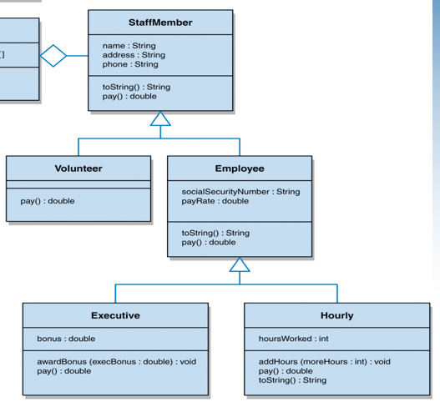
A UML diagram, class hierarchy of Staff-Member

Slide 17
Inheritance 10
What’s going on with attributes and methods in the objects of the inherited classes, for example:
Volunteer v = new Volunteer(); ____
Executive e = new Executive(); ____
Hourly h = new Hourly(); ____
In general, creating a new class via inheritance is faster, easier, and cheaper
Inheritance leads to reuse of existing solutions (attributes and methods)

Slide 18
Inheritance 11
Defining child classes derived from Employee class:
public class Executive extends Employee { - - - }
public class Hourly extends Employee { - - - }

Slide 19
Inheritance - Overriding Methods
A child class inherits all of the attributes and methods of the parent
A child class may also declare its own attributes and methods
Among these declarations, inside the child, may be methods with the same name and signature as those of the parent. This is called overriding
If a method is defined with the final modifier then a child class cannot override it

Slide 20
Inheritance - the Object Class
In Java, all classes are derived ultimately from the Object class
The Object class provides a toString method which is often overridden
The Object class provides an equals method that tests to see if two objects are aliases and is also often overridden

Slide 21
Inheritance - the super Reference
The reserved word super can be used in a child class to refer to its parent class
Like the this reference, what the word super refers to depends on the class in which it is used
Unlike the this reference which refers to a specific instance, inside the same object, super is a general reference to the members of the parent class
The super reference is often used to call the constructor of the parent class:
super();

Slide 22
Visibility Modifiers
If a member of a class has public visibility, then it can be accessed from outside of the class
If a member of a class has private visibility, then it can be used anywhere inside the class but cannot be referenced externally
A third visibility modifier, protected, is relevant only in the context of inheritance and will be discussed later

Slide 23
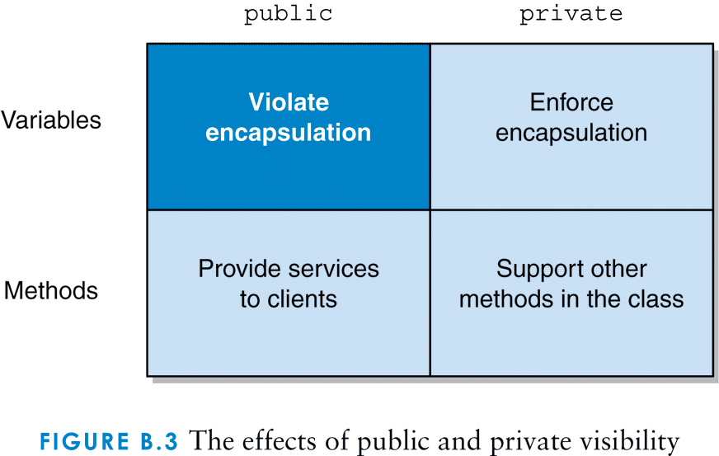
The effects of public and private visibility

Slide 24
Inheritance - the protected Modifier
The protected modifier allows the child class to inherit the variable or method but maintains some of the properties of encapsulation
Specifically, a variable or method declared with protected visibility may be accessed by any class in the same package

