Slide 1
Appendix B: Object-Oriented Design
Java Software Structures:
Designing and Using Data Structures
Third Edition
John Lewis & Joseph Chase

Slide 2
Polymorphism
The term polymorphism can be defined as “having many forms”
A polymorphic reference is a reference variable that can refer to different classes of objects at different points in time
The specific method invoked by a polymorphic reference can change from one invocation to the next
Polymorphism is a result of inheritance

Slide 3
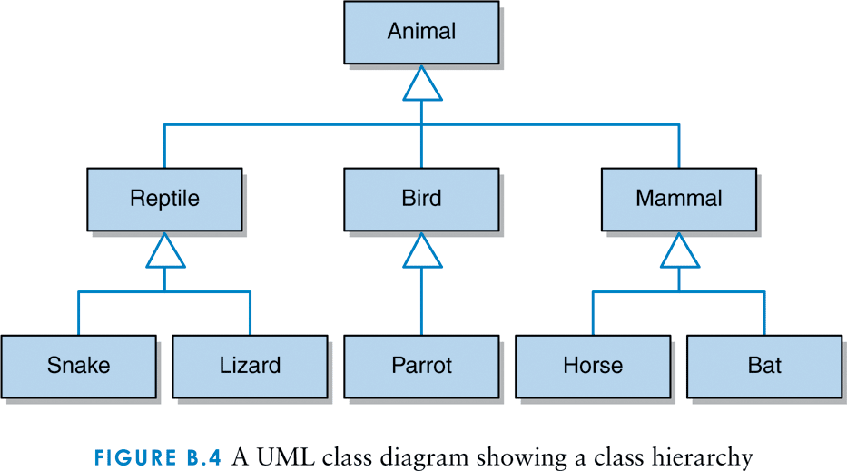
A UML class diagram showing a class hierarchy

Slide 4
Polymorphism
In Java, a reference that is declared to refer to an object of a particular class can also be used to refer to an object of any class related to it by inheritance
For example:
Mammal ma;
Horse ho = new Horse();
ma = ho; // a valid assignment
This is polymorphism as a result of inheritance

Slide 5
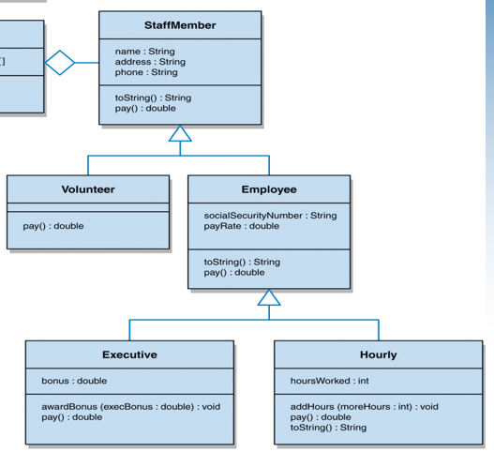
A UML diagram, class hierarchy of Staff-Member

Slide 6
Polymorphism
For example:
Employee emp1, emp5;
emp1 = new Executive();
emp5 = new Hourly();

Slide 7
Polymorphism
Methods to get class information:
Class cla; // Reference variable Class
cla = emp1.getClass(); // Inherited from Object
// c1 contents data about class Employee
String strC1 = cla.getName();
// returns a String of the class Employee
String strC2 = cla.getSimpleName();
// returns a String of the class Employee
String strC3 = cla.toGenericString();
// returns a String of the class Employee

Slide 8
Polymorphism
Operator instanceof:
if( emp1 instanceof Executive ) {
System.out.println(“emp1 is an Executive”);
}
if( emp5 instanceof Hourly ) {
System.out.println(“emp5 is an Hourly”);
}

Slide 9
Polymorphism
Polymorphism results in the need for dynamic binding
Usually binding of a call to the code occurs at compile time
Dynamic binding means that this binding cannot occur until run time

