Slide 1
Appendix B: Object-Oriented Design
Java Software Structures:
Designing and Using Data Structures
Third Edition
John Lewis & Joseph Chase

Slide 2
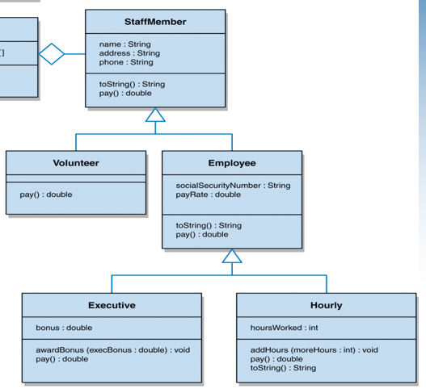
A UML diagram, class hierarchy of Staff-Member

Slide 3
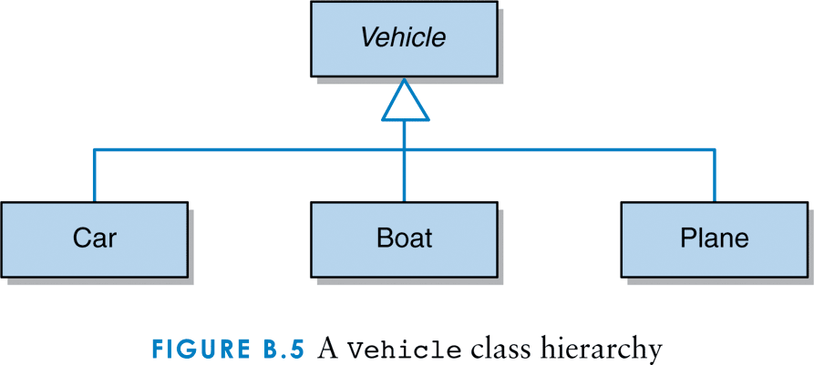
A vehicle class hierarchy

Slide 4
Inheritance - Abstract Classes 1
Some classes may be too conceptually abstract to be instantiated
Consider an StaffMember class and a Vehicle class
Without knowing what kind of StaffMember or Vehicle it is, what would it mean to instantiate one
It has to be a real one

Slide 5
Inheritance - Abstract Classes 2
What’s going on with he pay() method through all the inherited classes
In which classes the pay() method, had to be defined for real computation?
Why the classes StaffMember or Vehicle must be defined like abstract ones?

Slide 6
Inheritance - Abstract Classes 3
An abstract class represents a generic concept in a class hierarchy.
An abstract class cannot be instantiated
May contain fully implemented methods, like static (class) and instance ones
Can contain several abstract methods, which have no definition (no body or definition, only header)
An abstract class represents an abstract entity that is usually insufficiently defined to be useful by itself

Slide 7
Inheritance - Abstract Classes 4
A class / method is declared as abstract by including the abstract modifier in its header
// Abstract class
public abstract class Vehicle {
// Attributes
private double speed;
- - -
// Methods: headers and bodies
- - -
// Abstract method
public abstract double fuelConsumption ();
}

Slide 8
Inheritance - Abstract Classes 5
The child class defines the abstract method inherited from its parent
// Child class
public class Car extends Vehicle{
// Attributes
- - -
// Methods: headers and bodies
- - -
public double fuelConsumption () {
// Variable definitions and instructions
- - -
}
}

Slide 9
Inheritance - Abstract Classes 6
If a child class of an abstract class does not give a definition (body) for every abstract method that it inherits from its parent, then the child class is also considered to be abstract

Slide 10
Inheritance - Visibility Modifiers
The visibility modifiers (public, private, protected and blank) determine which members can be accessed and which can not (these modifiers apply to a class, attribute or method).
The subclass can access inherited attributes and methods declared public, and it can not access those declared private
If we declare an attribute with public visibility, in the parent class, so that a subclass can access it, we violate the principle of encapsulation

Slide 11
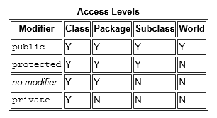
Inheritance - the protected Modifier
The protected modifier allows the subclass to access the inherited attribute or method but maintains some of the properties of encapsulation
Specifically, an attribute or method declared with protected visibility, in a class, may be accessed by any class in the same package

