Slide 1
Appendix B: Object-Oriented Design
Java Software Structures:
Designing and Using Data Structures
Third Edition
John Lewis & Joseph Chase

Slide 2
Exceptions
Problems that arise in a Java program (statements) may generate (throw) Exceptions or Errors
The Java Virtual Machine (JVM) throws the Exceptions and the Errors, when they happened because of the Java Program
An Exception defines an incorrect situation, e.g. Division by zero, Index out of bounds, File Not Found, . . .
An Error is similar to an Exception, except that represents an unrecoverable situation, e.g. Memory Error, Stack Overflow, Internal Error, . . .

Slide 3
Exceptions
An Exception can take place during the execution of a statement (instruction, operation)
When an Exception takes place, the JVM with the Java Program:
built an object and filled it with the description of the exception:
This object is of the class correspondent to that Exception
and then, the object is thrown, and could be caught and managed, in other part of the same Java Program

Slide 4
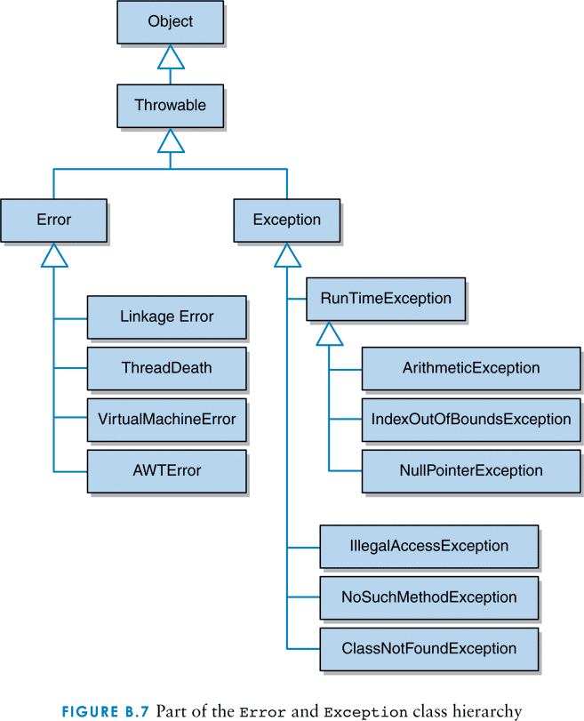
Part of the Error and Exception class Hierarchy

Slide 5
Exception & Error Class Hierarchy
Object
Throwable extends Object
Exception extends Throwable
ArithmeticException extends . . .
- - -
Error extends Throwable
- - -

Slide 6
Exception subclasses
Exception – is the superclass of the exceptions; some subclasses
ArithmeticException
NumberFormatException
NullPointerException
ArrayIndexOutOfBoundsException
IOException
FileNotFoundException
. . .

Slide 7
Exceptions
An Exception is an object, thrown, that defines an incorrect situation, and can be caught and managed
An Error is similar to an Exception, except that an error generally represents an unrecoverable situation, and can not be caught and managed

Slide 8
Process of Exceptions
A program can be designed to process an Exception in one of three ways:
Not handle (no catch) the exception object at all
Handle (catch and manage) the exception object where it occurs (it was thrown)
Handle (catch and mange) the exception at another point in the program: propagating the exception

Slide 9
Exceptions – A.1
If an Exception is not handled (not caught) at all by the Java Program, the JVM will catch the Exception object, and will manage the Exception with a politics of actions, by default:
prints out an Exception Message, and
terminates the Java Program

Slide 10
Exceptions – A.2
For example:
Exception in thread “main” java.lang.ArithmeticException: / by zero at Zero.main (Zero.java:17)
This message provides the name of the Exception (java.lang.ArithmeticException), description of the Exception (/ by zero), the class and method (Zero.main), as well as the filename and line number (Zero.java:17) where the Exception occurred (thrown)

Slide 11
Exceptions – B.1
To handle (catch and process) an exception around the place wh it is thrown, we use a try statement
A try statement consists of:
try
{ try block }
catch (ExceptionClass1 obj)
{ catch clause 1 }
catch (ExceptionClass2 obj)
{ catch clause 2 }
. . .
finally
{ finally block }

Slide 12
Exceptions – B.2
For example:
try {
// Statements in the try block
// An statement cause an Exception (object thrown)
}
catch (IOException exceptionObject) {
// Block of statements to manage
// the caught Exception object
}
catch (NumberFormatException exceptionObject) {
// TODO . . .

Slide 13
Exceptions – B.3
When a try statement is executed, the statements in the try block are executed
If no exception is thrown, processing continues with the statement following the try statement (excluding catch clause)
If an exception is thrown, control flow is immediately passed to the catch clause whose specified exception corresponds to the class of the exception that was thrown
If an exception is not caught and managed where it occurs, control flow is immediately returned to the method that invoked the method that produced the exception

Slide 14
Exceptions – C.
If the method does not handle the exception (via a try statement with an appropriate catch clause) then control flow returns to the method that called it
This process is called propagating the exception
Exception propagation continues until the exception is caught and handled or until it is propagated out of the main method, just into the JVM, resulting in the termination of the program
The method where some exceptions can occur, must declare the exceptions to be thrown:
throws Exception1, Exception2, …

Slide 15
Mandatory use Exceptions
There are Exceptions, that must be managed, can not be avoided. These kind of exceptions are named “checked by the compiler”
E.g. the method readline can throw the exception class IOException, and must be managed with a try statement (B) or throws (C).

Slide 16
Inheriting Exceptions
Java allows to inherit Exception classes.
Definition of a user subclass
class excepUser extends Exception
To throw the exception object use
throw objeto_class_excepUser
Example: Withdraw Exception
withdraw from a bank account, more money tan your balance

