Slide 1
CHAPTER 3: Generics
Java Software Structures:
Designing and Using Data Structures
Third Edition
John Lewis & Joseph Chase

Slide 2
Generic Types / Classes
Java enables us to define a class based upon a generic type
This means that we can define a class so that it stores, operates on, and manages objects whose type is not specified until the class is instantiated, maybe because polymorphism

Slide 3
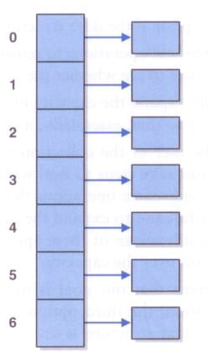
Array of Object references
Object [ ] objArr = new Object[7];

Slide 4
Array of Employee references
Employee [ ] empArr = new Employee[7];

Slide 5
Generics
Suppose we define an array that holds Object references, which would allow it to hold any object (because inheritance). Different, if the array holds Employee references.
But then we lose control over which types of elements are added to the array, and we'd have to cast elements to their proper type when removed
A better solution is to define a class that is based on a generic type
The type is referred to generically in the class, and the specific type is specified only when an object of that class is created

Slide 6
Generics
The generic type placeholder is specified in angle brackets in the class header:
public class UserArray<T> {
// declarations and code that refer to T
private T [] one;
public UserArray() {
one = (T)( new new Object[10]) }
public void addElem(T element, int pos) {
- - - }
public T remElem(int pos) {
T two; - - -; return two }
}
Any identifier can be used, but T (for Type/Class) or E (for element) have become standard practice

Slide 7
Generic Types / Classes
The type / class supplied at the time of instantiation replaces the type T wherever it is used in the declaration of the class
A generic type / class such as T cannot be instantiated; instead you have to type:
T ref = (T) ( new Object() ), or
T arrRef (T[ ]) ( new Object[15] )

Slide 8
Generics
Then, UserArray can be instantiated with a specific class instead of T, e.g. from main():
UserArray<Employee> empArr1 =
new UserArray<Employee>(- -);
empArr1 can only hold Employee or Employee subclassed objects
The compiler will issue errors if we try to add a non-Employee object to the UserArray
And when an object is removed from the UserArray, it is assumed to be a Employee

Slide 9
Generics
Using the same class, another object can be instantiated:
UserArray<Figure> figArr2 =
new UserArray<Figure>(- -);
The figArr2 object can only hold Figure objects
Generics provide better type management control at compile-time and simplify the use of the classes

