Slide 1
Import Class(es) from another Project
If you want to import, a class or several clases, contained in the package of another Project, is highly recommended to place the other Project inside the same directory (folder), in the Libraries folder of your current Project.

Slide 2
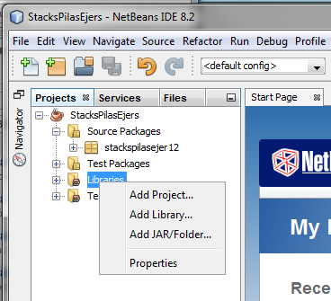
First step
Inside your Project, on Libraries, Right Click the mouse:
then select
Add Project…

Slide 3
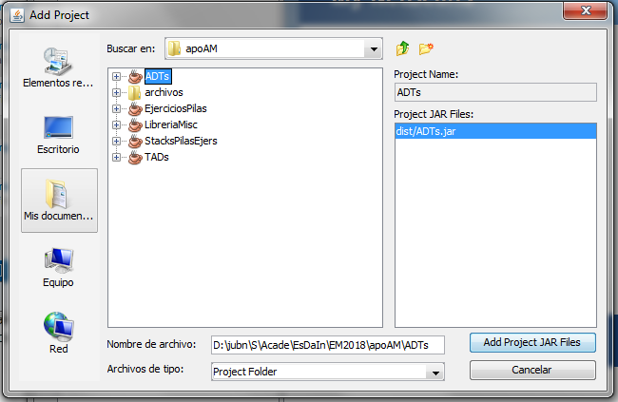
Second step
Select the another Project, e.g. ADTs, shows up an “ADTs.jar”
Now
Add
Project
Jar Files

Slide 4
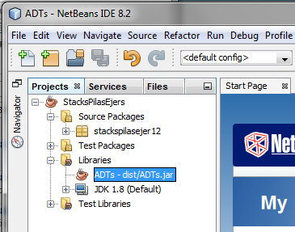
Third step
Open Libraries, and the aggregated Project shows up in a “.jar” file

Slide 5
Notes about “.jar” files
E.g. ADTs.jar is a JAR file:
JAR stands for Java ARchive
JAR is a package file format, typically used to aggregate many Java Class files
A JAR file stores resources (folders, text, .java files, images, .class files , etc) of the whole Project, and the information related, to keep all the pieces together
A JAR file is built on the ZIP format

Slide 6
Taking care of updatings
What’s going on if the other Project is modified, then compiled again, and you notice no change at all:
First of all, you must remove the “.jar” from Libraries
Then, you must repeat the three steps (first, second and third), to add a new updated versión of the Project, inside a “.jar” file

Slide 7
Last step
Inside your class:
Type the import statement including all the classes contained in the package
import packageName.*;
Type the import statement including one specific class from the package
import packageName.specificName;

