Slide 1
CHAPTER 3: Collections
Java Software Structures:
Designing and Using Data Structures
Third Edition
John Lewis & Joseph Chase

Slide 2
Using Stacks
Stacks are particularly helpful when solving certain types of problems

Slide 3
Using Stacks: Postfix Expressions
Let's see how a stack can be used to help us solve the problem of evaluating postfix expressions
A postfix expression is written with the operator following the two operands instead of between them:
15 8 -
is equivalent to the traditional (infix) expression
15 - 8

Slide 4
Using Stacks: Postfix Expressions
Postfix expressions eliminate the need for parentheses to specify the order of operations
We generally use infix notation, with parentheses to force precedence:
(3 + 12) * 2 or (3 * 10 - (2 + 5)) * 4 / 2
In postfix notation, this would be written
3 12 + 2 * or 3 10 * 2 5 + - 4 * 2 /

Slide 5
Evaluating Postfix Expressions
We'll use a stack as follows to evaluate a postfix expression:
scan from left to right, determining if the next token is an operator (“+”, “-”, “*”, “/”) or operand (3, 10, 12, …)
if it is an operand, push it on the stack
if it is an operator, pop the stack twice to get the two operands, perform the operation, and then push the result onto the stack
At the end, when the expression is exhausted, there will be one value on the stack, which is the value of the expression (final result)

Slide 6
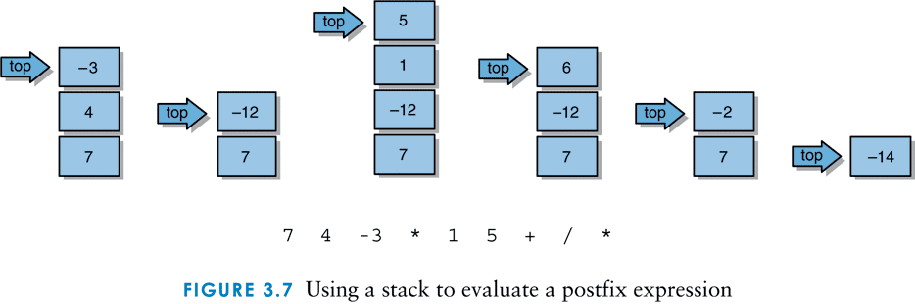
Using a stack to evaluate a postfix expression
Infix expression: 7*(4*(-3)/(1+5))
Postfix: here's how the stack changes as the following expression is evaluated: 7 4 -3 * 1 5 + / *
7 4 -3 * 1 5 + / *

Slide 7
Postfix Expressions
To simplify the example, let's assume the operands to the expressions are integer literals
Our solution uses an ArrayStack, though any implementation of a stack would suffice

Slide 8
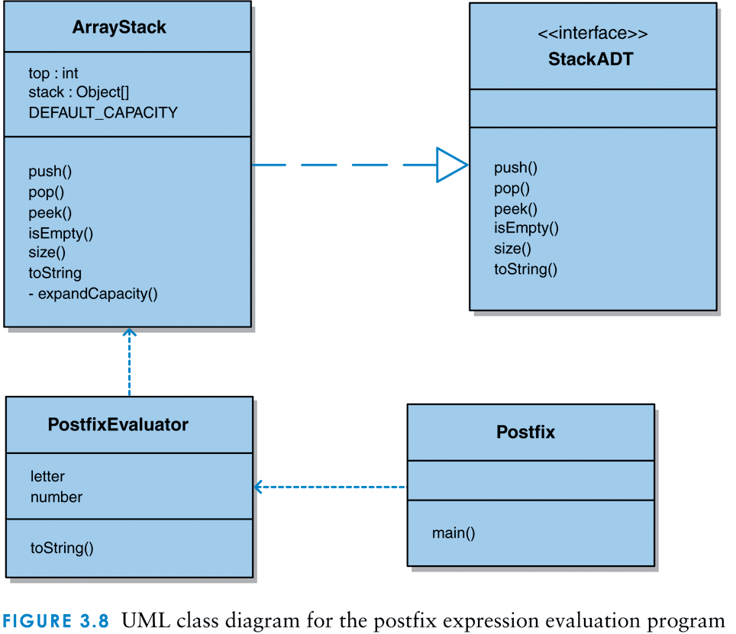
A UML class diagram for the postfix expression program

Slide 9
The Postfix class
/**
* @author Lewis and Chase
*
* Demonstrates the use of a stack to evaluate postfix expressions.
*/
import java.util.Scanner;
public class Postfix {
/**
* Reads and evaluates multiple postfix expressions.
*/
public static void main (String[] args) {
String expression, again;
int result;
try {
Scanner in = new Scanner(System.in);

Slide 10
The Postfix class (continued)
do {
PostfixEvaluator evaluator = new PostfixEvaluator();
System.out.println ("Enter a valid postfix expression one token: ");
expression = in.nextLine();
result = evaluator.evaluate (expression);
System.out.println();
System.out.println ("That expression equals " + result);
System.out.print ("Evaluate another expression [Y/N]? ");
again = in.nextLine();
System.out.println();
}
while (again.equalsIgnoreCase(“y"));
}
catch (Exception IOException) {
System.out.println("Input exception reported");
}
}
}

Slide 11
The PostfixEvaluator class
/**
* @author Lewis and Chase
*
* Represents an integer evaluator of postfix expressions. Assumes
* the operands are constants.
*/
import jss2.ArrayStack;
import java.util.Scanner;
public class PostfixEvaluator {
/** constant for addition symbol */
private final char ADD = '+';
/** constant for subtraction symbol */
private final char SUBTRACT = '-';
/** constant for multiplication symbol */
private final char MULTIPLY = '*';
/** constant for division symbol */
private final char DIVIDE = '/';
/** the stack */
private ArrayStack<Integer> stack;

Slide 12
The PostfixEvaluator class (continued)
/**
* Sets up this evaluator by creating a new stack.
*/
public PostfixEvaluator() {
stack = new ArrayStack<Integer>();
}
/**
* Evaluates the specified postfix expression. If an operand is
* encountered, it is pushed onto the stack. If an operator is
* encountered, two operands are popped, the operation is
* evaluated, and the result is pushed onto the stack.
* @param expr String representation of a postfix expression
* @return int value of the given expression
*/
public int evaluate (String expr) {
int op1, op2, result = 0;
String token;
Scanner parser = new Scanner(expr);

Slide 13
The PostfixEvaluator class (continued)
while (parser.hasNext()) {
token = parser.next ();
if (isOperator(token)) {
op2 = (stack.pop()).intValue();
op1 = (stack.pop()).intValue();
result = evaluateSingleOperator (token.charAt(0), op1, op2);
stack.push (new Integer(result));
}
else
stack.push (new Integer(Integer.parseInt(token)));
}
return result;
}

Slide 14
The PostfixEvaluator class (continued)
/**
* Determines if the specified token is an operator.
* @param token String representing a single token
* @return boolean true if token is operator
*/
private boolean isOperator (String token)
{
return ( token.equals("+") || token.equals("-") ||
token.equals("*") || token.equals("/") );
}
/**
* Peforms integer evaluation on a single expression consisting of
* the specified operator and operands.
* @param operation operation to be performed
* @param op1 the first operand
* @param op2 the second operand
* @return int value of the expression
*/
private int evaluateSingleOperator (char operation, int op1, int op2)
{
int result = 0;

Slide 15
The PostfixEvaluator class (continued)
switch (operation)
{
case ADD:
result = op1 + op2;
break;
case SUBTRACT:
result = op1 - op2;
break;
case MULTIPLY:
result = op1 * op2;
break;
case DIVIDE:
result = op1 / op2;
}
return result;
}
}

