Slide 1
Sets and ArraySets
Java Software Structures:
Designing and Using Data Structures
Third Edition
John Lewis & Joseph Chase

Slide 2
Chapter Objectives
Define set collection
Examine an array implementation of a set
Use a set collection to solve a problem

Slide 3
A Set Collection
Lets consider a collection based upon the idea of the set theory
A set is a collection of elements with no duplicates
No other relationship among the elements should be assumed
It's as if you threw them all in a box
You can reach into a box and pull out an element, and are equally likely to get any one

Slide 4
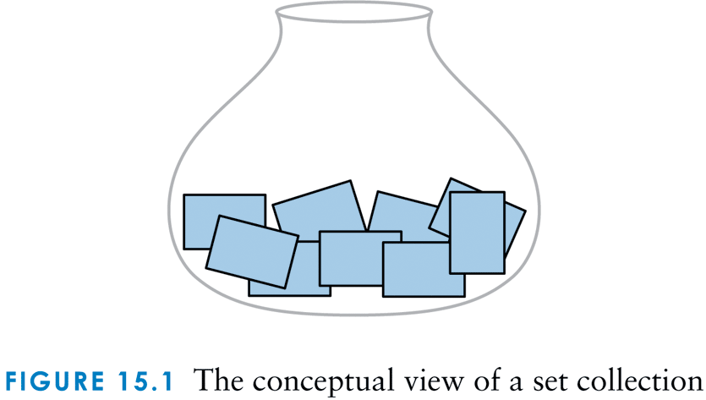
The conceptual view of a set collection

Slide 5
A Set Collection
A primary purpose of a set is to determine whether a particular element is a member
It is a nonlinear collection, but could be implemented with a linear data structure

Slide 6
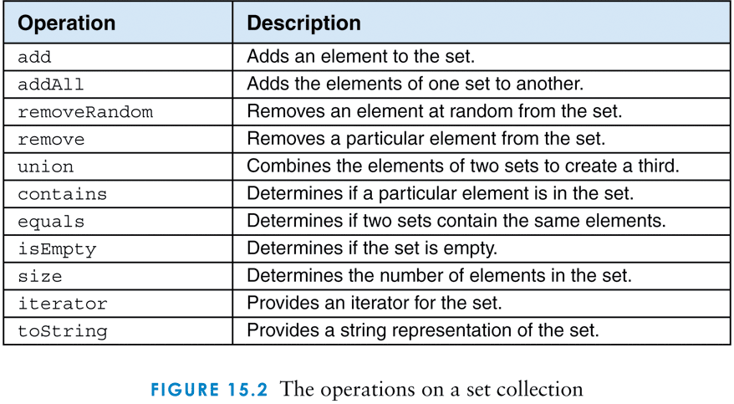
The operations on a set collection

Slide 7
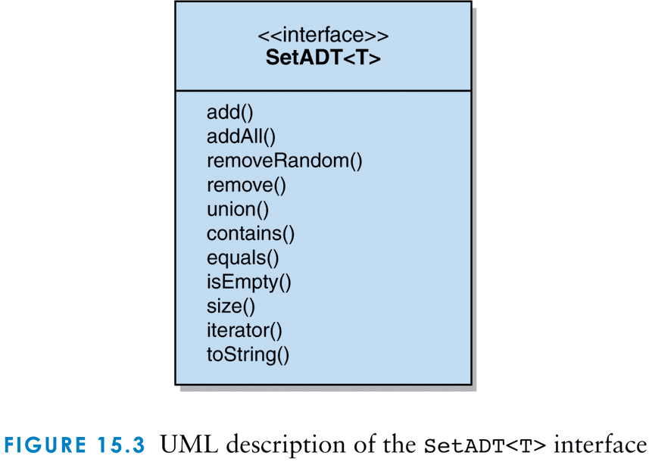
UML description of the SetADT<T> interface

Slide 8
A SetADT
/**
* SetADT defines the interface to a set collection.
*
* @author Dr. Lewis
* @author Dr. Chase
* @version 1.0, 9/21/2008
*/
package jss2;
import java.util.Iterator;
public interface SetADT<T>
{
/**
* Adds one element to this set, ignoring duplicates.
*
* @param element the element to be added to this set
*/
public void add (T element);

Slide 9
A SetADT (continued)
/**
* Removes and returns a random element from this set.
*
* @return a random element from this set
*/
public T removeRandom ();
/**
* Removes and returns the specified element from this set.
*
* @param element the element to be removed from this list
* @return the element just removed from this list
*/
public T remove (T element);
/**
* Returns the union of this set and the parameter
*
* @param set the set to be unioned with this set
* @return a set that is the union of this set and the parameter
*/
public SetADT<T> union (SetADT<T> set);

Slide 10
A SetADT (continued)
/**
* Returns true if this set contains the parameter
*
* @param target the element being sought in this set
* @return true if this set contains the parameter
*/
public boolean contains (T target);
/**
* Returns true if this set and the parameter contain exactly
* the same elements
*
* @param set the set to be compared with this set
* @return true if this set and the parameter contain exactly
* the same elements
*/
public boolean equals (SetADT<T> set);
/**
* Returns true if this set contains no elements
*
* @return true if this set contains no elements
*/
public boolean isEmpty();

Slide 11
A SetADT (continued)
/**
* Returns the number of elements in this set
*
* @return the interger number of elements in this set
*/
public int size();
/**
* Returns an iterator for the elements in this set
*
* @return an iterator for the elements in this set
*/
public Iterator<T> iterator();
/**
* Returns a string representation of this set
*
* @return a string representation of this set
*/
public String toString();
}

Slide 12
Implementing a set with arrays
The ArraySet class represents an array implementation of a set collection
Set elements are kept contiguously at one end of the array
An integer (count) represents:
the number of elements in the set
the next empty index in the array

Slide 13
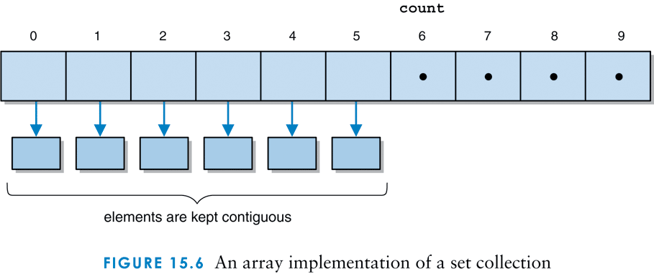
An array implementation of a set

Slide 14
The ArraySet class
/**
* ArraySet represents an array implementation of a set.
*
* @author Dr. Lewis
* @author Dr. Chase
* @version 1.0, 9/21/2008
*/
package jss2;
import jss2.exceptions.*;
import java.util.*;
public class ArraySet<T> implements SetADT<T>, Iterable<T>
{
private static Random rand = new Random();
private final int DEFAULT_CAPACITY = 100;
private final int NOT_FOUND = -1;
private int count; // the current number of elements in the set
private T[] contSet; // the container of the Set

Slide 15
The ArraySet class - constructors
/**
* Creates an empty set using the default capacity.
*/
public ArraySet()
{
count = 0;
contSet = ( T[])(new Object[DEFAULT_CAPACITY] );
}
/**
* Creates an empty set using the specified capacity.
*
* @param initialCapacity the initial capacity for the array set
*/
public ArraySet ( int initialCapacity )
{
count = 0;
contSet = ( T[])(new Object[initialCapacity] );
}

Slide 16
The ArraySet class - add
/**
* Adds the specified element to the set if it is not already
* present. Expands the capacity of the set array if necessary.
*
* @param element the element to be added to the set array
*/
public void add ( T element )
{
if ( !( contains(element) ) )
{
if ( size() == contSet.length )
expandCapacity();
contSet[count] = element;
count++;
}
}

Slide 17
The ArraySet class - addAll
/**
* Adds the contents of the parameter to this set.
*
* @param set the collection to be added to this set
*/
public void addAll ( SetADT<T> set )
{
Iterator<T> iter = set.iterator();
while ( iter.hasNext() )
add (iter.next() );
}

Slide 18
The ArraySet class - removeRandom
/**
* Removes a random element from the set and returns it. Throws
* an EmptyCollectionException if the set is empty.
*
* @return a random element from the set
* @throws EmptyCollectionException if an empty set exception occurs
*/
public T removeRandom() throws EmptyCollectionException
{
if (isEmpty())
throw new EmptyCollectionException("Stack");
int choice = rand.nextInt(count);
T result = contSet[choice];
contSet[choice] = contSet[count-1]; // fill the gap
contSet[count-1] = null;
count--;
return result;
}

Slide 19
The ArraySet class - remove
/**
* Removes the specified element from the set and returns it.
* Throws an EmptyCollectionException if the set is empty and a
* NoSuchElementException if the target is not in the set.
*
* @param target the element being sought in the set
* @return the element specified by the target
* @throws EmptyCollectionException if an empty set exception occurs
* @throws NoSuchElementException if a no such element exception occurs
*/
public T remove (T target) throws EmptyCollectionException,
NoSuchElementException
{
int search = NOT_FOUND;
if ( isEmpty() )
throw new EmptyCollectionException("Stack");

Slide 20
The ArraySet class – remove (cont.)
for ( int index=0; index < count && search == NOT_FOUND; index++ )
if ( contSet[index].equals(target) )
search = index;
if ( search == NOT_FOUND )
throw new NoSuchElementException();
T result = contSet[search];
contSet[search] = contSet[count-1];
contSet[count-1] = null;
count--;
return result;
}

Slide 21
The ArraySet class – union
/**
* Returns a new set that is the union of this set and the
* parameter.
*
* @param set the set that is to be unioned with this set
* @return a new that that is the union of this set and
* the parameter
*/
public SetADT<T> union ( SetADT<T> set )
{
ArraySet<T> both = new ArraySet<T>();
for (int index = 0; index < count; index++)
both.add ( contSet[index] );
Iterator<T> scan = set.iterator();
while ( scan.hasNext() )
both.add ( scan.next() );
return both;
}

Slide 22
The ArraySet class – contains
/**
* Returns true if this set contains the specified target
* element.
*
* @param target the element being sought within this set
* @return true if the set contains the target element
*/
public boolean contains ( T target )
{
int search = NOT_FOUND;
for ( int index=0; index < count && search == NOT_FOUND; index++ )
if ( contSet[index].equals(target) )
search = index;
return (search != NOT_FOUND);
}

Slide 23
The ArraySet class – equals
/**
* Returns true if this set contains exactly the same elements
* as the parameter.
*
* @param set the set to be compared with this set
* @return true if the parameter set and this set contain
* exactly the same elements
*/
public boolean equals ( SetADT<T> set ) {
boolean result = false;
ArraySet<T> temp1 = new ArraySet<T>();
ArraySet<T> temp2 = new ArraySet<T>();
T obj2;
if ( size() == set.size() ) {
temp1.addAll(this);
temp2.addAll(set);
Iterator<T> iter2 = set.iterator();

Slide 24
The ArraySet class – equals (cont.)
while ( iter2.hasNext() )
{
obj2 = iter2.next();
if ( temp1.contains(obj2) )
{
temp1.remove(obj2);
temp2.remove(obj2);
}
}
result = ( temp1.isEmpty() && temp2.isEmpty() );
}
return result;
}

