Slide 1
Sets - BINGO
Java Software Structures:
Designing and Using Data Structures
Third Edition
John Lewis & Joseph Chase

Slide 2
Using a Set: BINGO
The game of BINGO can be used to demonstrate the use of a set collection
Each player has a BINGO card with numeric values associated with the letters B-I-N-G-O
Letter / number combinations (on bingo balls) are picked at random, which the player marks on their card if possible
The first player to get five squares in a row wins

Slide 3
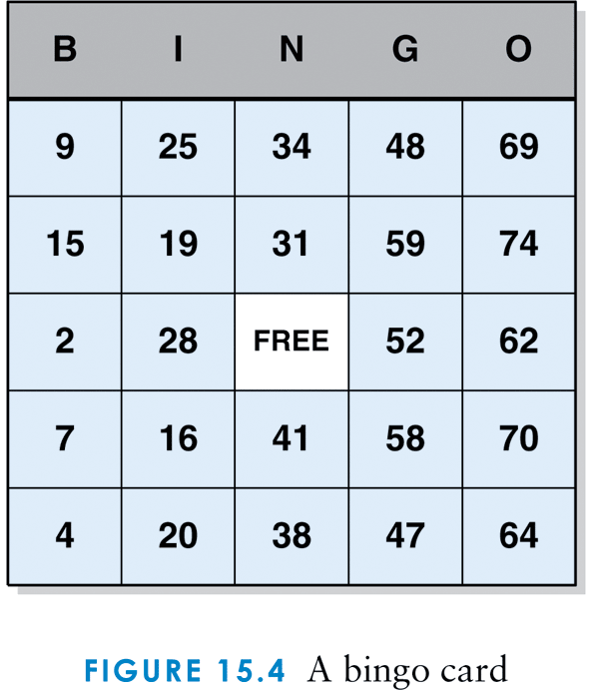
A BINGO card

Slide 4
BINGO
A set is an appropriate collection for BINGO, allowing the caller to pick numbers at random
We create an object of class BingoBall to represent one letter / number combination
The main() program creates the balls, stores them in a set, and draws them at random

Slide 5
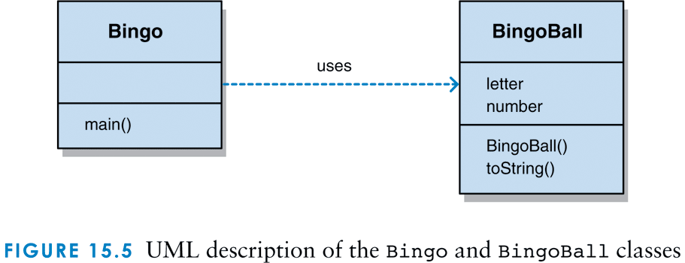
UML description of the Bingo and BingoBall classes

Slide 6
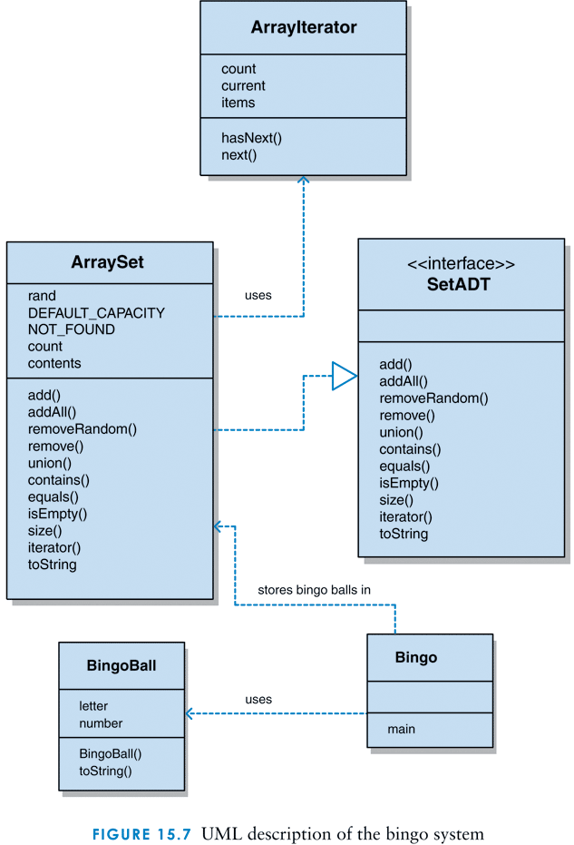
Complete UML description of the BINGO system

Slide 7
The BingoBall class
/**
* BingoBall represents a ball used in a Bingo game.
*
* @author Dr. Lewis
* @author Dr. Chase
* @version 1.0, 9/21/2008
*/
public class BingoBall
{
private char letter;
private int number;
/**
* Sets up this Bingo ball with the specified number and the
* appropriate letter.
*
* @param num the number to be applied to the new bingo ball
*/

Slide 8
The BingoBall class (continued)
public BingoBall (int num)
{
number = num;
if (num <= 15)
letter = 'B';
else
if (num <= 30)
letter = 'I';
else
if (num <= 45)
letter = 'N';
else
if (num <= 60)
letter = 'G';
else
letter = 'O';
}

Slide 9
The BingoBall class (continued)
/**
* Returns a string representation of this bingo ball.
*
* @return a string representation of the bingo ball
*/
public String toString ()
{
return (letter + " " + number);
}
}

Slide 10
The Bingo class
/**
* Bingo demonstrates the use of a set collection.
*
* @author Dr. Lewis
* @author Dr. Chase
* @version 1.0, 9/21/2008
*/
import jss2.ArraySet;
public class Bingo
{
/**
* Creates all 75 Bingo balls and stores them in a set. Then
* pulls several balls from the set at random and prints them.
*/
public static void main (String[] args)
{
final int NUM_BALLS = 75, NUM_PULLS = 10;
ArraySet<BingoBall> bingoSet = new ArraySet<BingoBall>();
BingoBall ball;

Slide 11
The Bingo class (continued)
for (int num = 1; num <= NUM_BALLS; num++)
{
ball = new BingoBall (num);
bingoSet.add (ball);
}
System.out.println ("Size: " + bingoSet.size());
System.out.println ();
for (int num = 1; num <= NUM_PULLS; num++)
{
ball = bingoSet.removeRandom();
System.out.println (ball);
}
}
}

