Slide 1
CHAPTER 7: Recursion
Java Software Structures:
Designing and Using Data Structures
Third Edition
John Lewis & Joseph Chase

Slide 2
Chapter Objectives
Explain the underlying concepts of recursion
Examine recursive methods and unravel their processing steps
Define infinite recursion and discuss ways to avoid it
Explain when recursion should and should not be used
Demonstrate the use of recursion to solve problems

Slide 3
Recursive Thinking
Recursion is a programming technique in which a method can call itself to solve a problem
A recursive definition is one which uses the word or concept being defined in the definition itself
In some situations, a recursive definition can be an appropriate way to express a concept
Before applying recursion to programming, it is best to practice thinking recursively

Slide 4
Recursive Definitions
Consider the following list of numbers:
24, 88, 40, 37
Such a list can be defined recursively:
A LIST is a: number
or a: number comma LIST
That is, a LIST can be a number, or a number followed by a comma followed by a LIST
The concept of a LIST is used to define itself

Slide 5
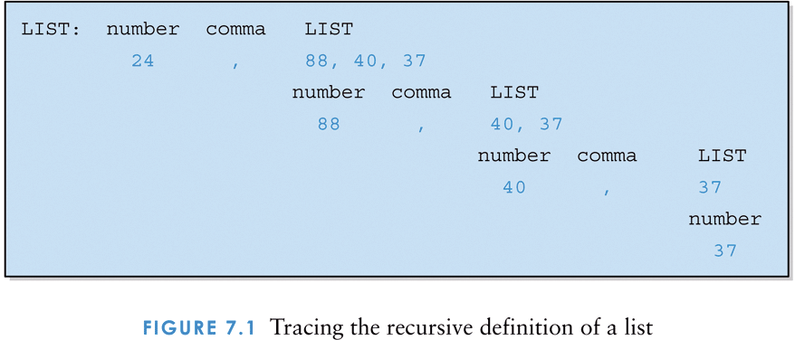
Tracing the recursive definition of a list

Slide 6
Infinite Recursion
All recursive definitions must have a non-recursive part
If they don't, there is no way to terminate the recursive path
A definition without a non-recursive part causes infinite recursion
This problem is similar to an infinite loop -- with the definition itself causing the infinite "looping“ (for, while, do-while, …)
The non-recursive part often is called the base case

Slide 7
Recursive Definitions
Mathematical formulas are often expressed recursively
N!, for any positive integer N, is defined to be the product of all integers between 1 and N inclusive
This definition can be expressed recursively:
0! = 1;
N! = N * (N-1)!
A factorial is defined in terms of another factorial until the base case of 0! is reached

Slide 8
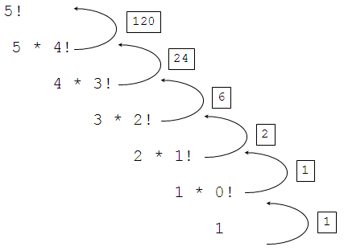
Factorial Example

Slide 9
Recursive Programming
A method in Java can invoke itself; if set up that way, it is called a recursive method
The code of a recursive method must be structured to handle both the base case and the recursive case
Each call sets up a new execution environment, with new parameters and new local variables
As always, when the method completes, control returns to the method that invoked it (which may be another instance of itself)

Slide 10
Recursive Programming
Consider the problem of computing the sum of all the numbers between 1 and N
If N is 4, the sum is
1 + 2 + 3 + 4
This problem can be expressed recursively as:
The sum of 1 to N is N plus the sum of 1 to N-1

Slide 11
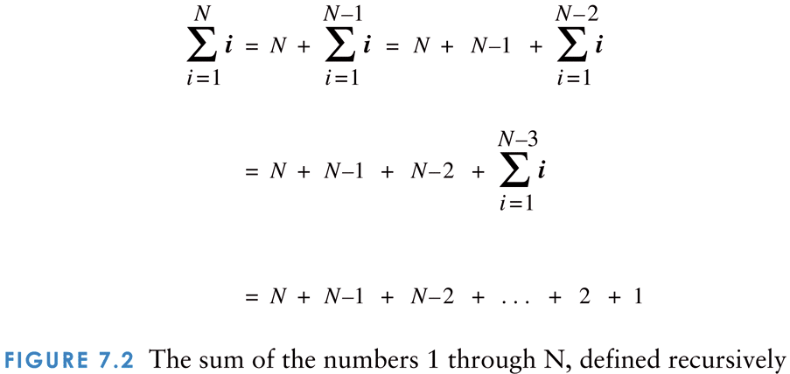
The sum of the numbers 1 through N, defined recursively

Slide 12
Recursive Programming
public int sum (int num)
{
int result;
if (num == 1)
result = 1;
else
result = num + sum(num-1);
return result;
}

Slide 13
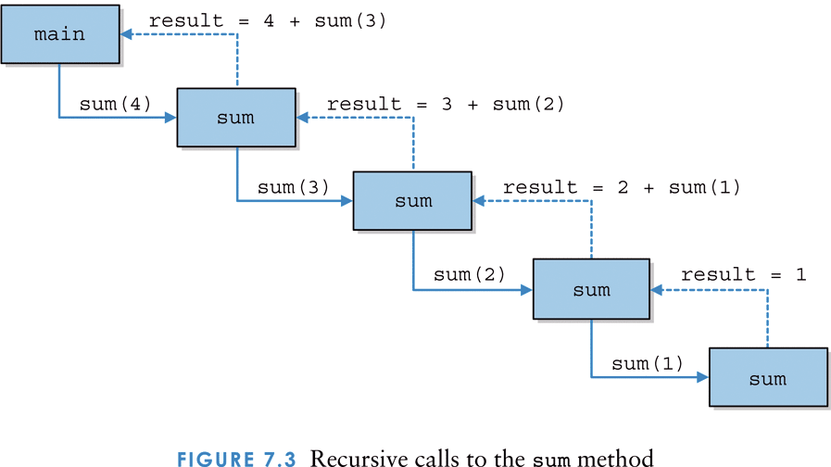
Recursive calls to the sum method

Slide 14
Recursion vs. Iteration
Just because we can use recursion to solve a problem, doesn't mean we should
For instance, we usually would not use recursion to solve the sum of 1 to N
The iterative version is easier to understand
You must be able to determine when recursion is the correct technique to use

Slide 15
Recursion vs. Iteration
Every recursive solution has a corresponding iterative solution
For example, the sum of the numbers between 1 and N can be calculated with a loop
Recursion has the overhead of multiple method invocations
However, for some problems recursive solutions are often more simple and elegant than iterative solutions

Slide 16
Indirect Recursion
A method invoking itself is considered to be direct recursion
A method could invoke another method, which invokes another, etc., until eventually the original method is invoked again
For example, method m1 could invoke m2, which invokes m3, which invokes m1 again
This is called indirect recursion
It is often more difficult to trace and debug

Slide 17
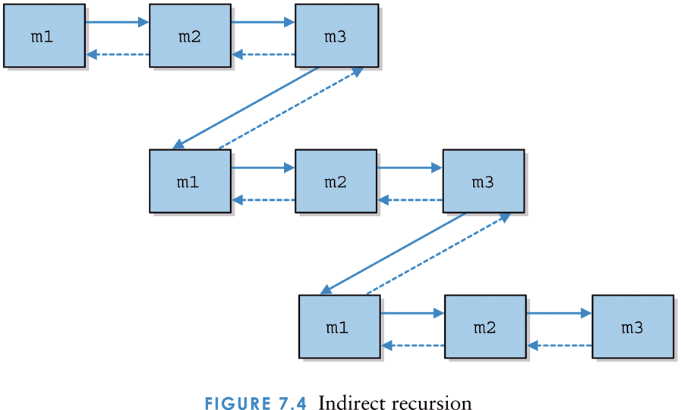
Indirect recursion

Slide 18
Analyzing Recursive Algorithms
When analyzing a loop, we determine the order of the loop body and multiply it by the number of times the loop is executed
Recursive analysis is similar
We determine the order of the method body and multiply it by the order of the recursion (the number of times the recursive definition is followed)

