Slide 1
RECURSION – Study Cases
Demonstrate the use of RECURSION to solve problems

Slide 2
1)- Maze Traversal
Let's use recursion to find a path through a maze
The maze is a grid (matrix) filled with 1’s and 0’s, with the 1’s showing the path (starting up in [0][0] and finishing up in [grid.length-1][grid[0].length-1])
A path can be found through a maze from location x, if a path can be found from any of the locations neighboring y

Slide 3
Sample 1
Initial Maze 1 1 1 1 0 1 0 0 1 | ===>>> | Traversed Mazed 7 7 7 3 0 7 0 0 7
Traverses from one position to the next one, checking out in the order: down, right, up or left.

Slide 4
Maze Traversal
Recursion will be used to keep track of the path through the maze using the run-time stack
We mark a location as "visited“, with a 3 or 7, and try to continue along the path
The base cases are
a prohibited (blocked) move, or
arrival at the final destination

Slide 5
Sample 2
Initial Maze 1 1 1 0 1 1 0 0 0 1 1 1 1 1 0 1 1 1 0 1 1 1 1 0 0 1 0 0 0 0 1 0 1 0 1 0 1 0 0 1 1 1 0 1 1 1 0 1 0 1 1 1 1 0 1 0 0 0 0 1 1 1 0 0 1 1 0 1 1 1 1 1 1 0 1 1 1 1 1 0 0 0 0 0 0 0 0 0 0 0 0 1 1 1 1 1 1 1 1 1 1 1 1 1 | ===>>> | Traversed Mazed 7 7 7 0 1 1 0 0 0 1 1 1 1 3 0 7 7 7 0 7 7 7 1 0 0 1 0 0 0 0 7 0 7 0 7 0 3 0 0 7 7 7 0 7 7 7 0 7 0 3 3 3 7 0 7 0 0 0 0 7 7 3 0 0 3 7 0 7 7 7 7 7 7 0 3 3 3 3 7 0 0 0 0 0 0 0 0 0 0 0 0 7 7 7 7 7 7 7 7 7 7 7 7 7

Slide 6
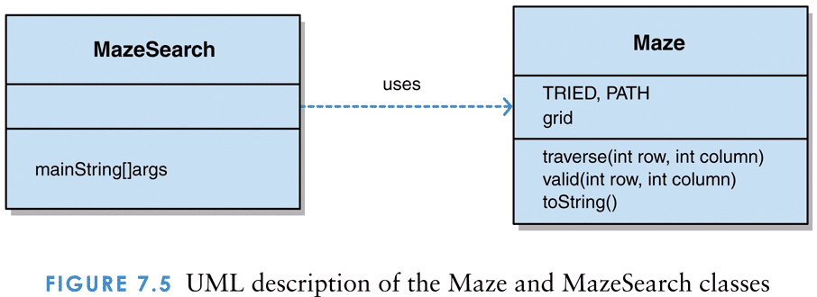
UML description of the Maze and MazeSearch classes

Slide 7
2)- The Towers of Hanoi (TofH)
The Towers of Hanoi is a puzzle made up of three vertical pegs and several disks that slide onto the pegs
The disks are of varying size, initially placed on one peg with the largest disk on the bottom and increasingly smaller disks on top
The goal is to move all of the disks from one peg to another following these rules:
Only one disk can be moved at a time
A disk cannot be placed on top of a smaller disk
All disks must be on some peg (except for the one in transit)

Slide 8
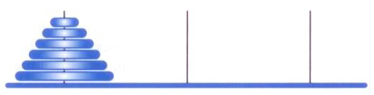
The Towers of Hanoi puzzle, initial state
T0 T1 T2

Slide 9
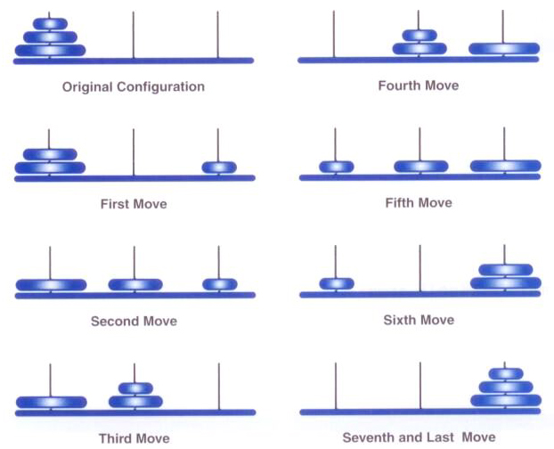
A solution to the three-disk TofH puzzle

Slide 10
Towers of Hanoi
A solution to TofH can be expressed recursively
To move a stack of N disks from the original peg to the destination peg:
Move the topmost N-1 disks from the original peg to the extra peg
Move the largest disk from the original peg to the destination peg
Move the N-1 disks from the extra peg to the destination peg
The base case occurs when:
a "stack" contains only one disk

Slide 11


UML description of the TorresDeHanoiMain and TorresDeHanoi classes

Slide 12
Towers of Hanoi
The number of moves increases exponentially as the number of disks increases
The recursive solution is simple and elegant to express and program, but is very inefficient
However, an iterative solution to this problem is much more complex to define and program
To solve a problem of N disks, we make 2^{N}-1 disk moves:
1 disk - 1 move
2 disks - 3 moves
3 disks - 7 moves
4 disks – 15 moves
…

