Slide 1
CHAPTER 5: Queues
Java Software Structures:
Designing and Using Data Structures
Third Edition
John Lewis & Joseph Chase

Slide 2
Chapter Objectives
Examine queue processing
Define a queue abstract data type
Demonstrate how a queue can be used to solve problems
Examine various queue implementations
Compare queue implementations

Slide 3
Queues
A queue is a collection whose elements are added on one end, and removed from the other
Therefore a queue is processed in a FIFO fashion: First In, First Out
Elements are removed from a queue, in the same order they arrived (or were placed)
Any waiting line is a queue:
the check out line at a grocery store
the cars at a stop light
a customers’ waiting line at a bank
an assembly line

Slide 4
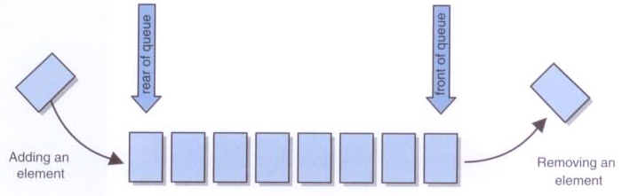
A conceptual view of a queue

Slide 5
Queues
A queue is usually depicted horizontally
One end of the queue is the rear (or tail), where elements are added
The other end is the front (or head), from which elements are removed
A queue operates on both ends
Unlike a stack:
which operates on one end of the collection (the top)
Operates in a LIFO manner: Last In, First Out

Slide 6
Queue Operations
The term enqueue is used to refer to the process of adding an element to a queue
Likewise, dequeue is the process of removing an element
Like a stack, a pure queue does not allow the user to access the elements in the middle of the queue (collection)
enqueue, dequeue and first correspond to the stack operations push, pop and peek
We include a toString() method for convenience, is not a classic operation on a queue neither on a stack

Slide 7
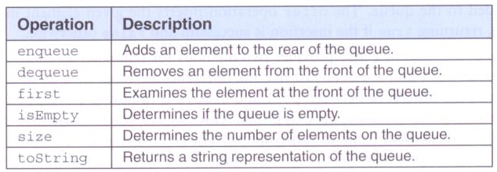
Standard queue operations

Slide 8
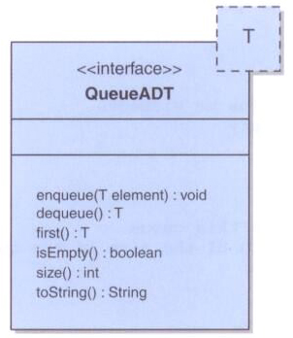
The QueueADT<T> interface in UML

Slide 9
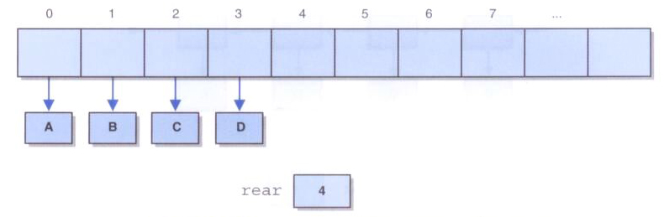
Implementing a Queue with an Array
If we implement a queue as we did the stack (ArrayStack) one end would be fixed at index 0
But, a queue, operates on both ends, forcing the shifting of elements, when enqueue or dequeue
To be efficient, we must avoid shifting elements

Slide 10
The CircularArrayQueue Class
A better approach is to use a conceptual circular array and not fix either end of the queue
A circular array is an implementation of a queue using a regular Array that conceptually loops around on itself
E.g., index run: 0, 1, 2, … , n-2, n-1, 0, 1, 2, …
It uses two integers to keep track where the front and rear of the queue are at any given time

Slide 11
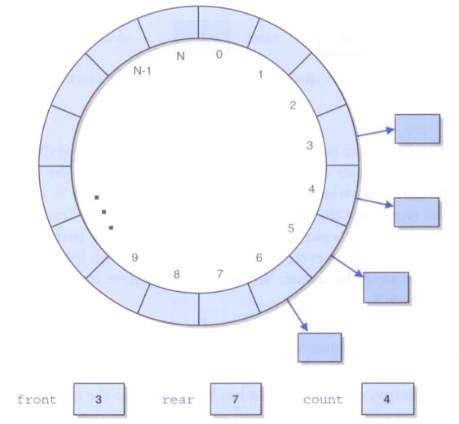
A Circular Array implementing a queue

Slide 12
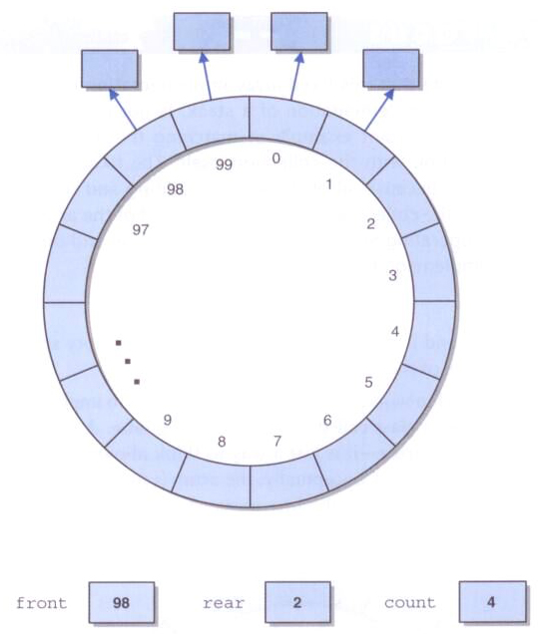
A queue done with a Circular Array
At some point, the elements of the queue may straddle the end of the Array:

Slide 13
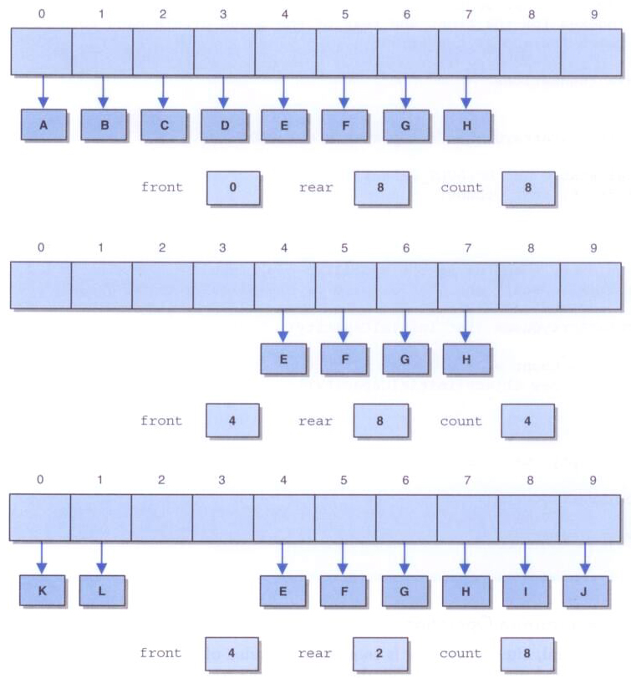
Changes in a Circular Array of a queue
After A-H have been enqueued:
After A-D have been dequeueed:
After I, J, K, and L have been enqueued:

Slide 14
Circular Queues - enqueue
When an element is enqueued, the value of rear is incremented
But it must take into account the need to wrap back to 0:
queue[rear] = element;
rear = (rear+1) % queue.length;
Note that this array implementation can also reach capacity and may need enlarging

Slide 15
Circular Queues - dequeue
When an element is dequeueed, the value of front is incremented
Also must take into account the need to wrap back to 0:
result = queue[front];
queue[front] = null;
front = (front+1) % queue.length;

Slide 16
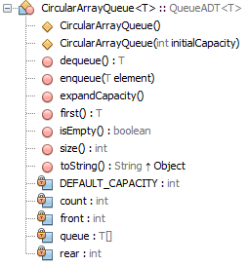
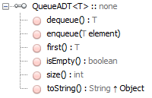
UML of CircularArrayQueue Class

