Slide 1
CHAPTER 4: Linked Structures
Java Software Structures:
Designing and Using Data Structures
Third Edition
John Lewis & Joseph Chase

Slide 2
Linked Structures
A linked structure consists of a collection of objects linked together and organized according to the data structure that supports.

Slide 3

References as Links
An alternative to array-based implementations are linked structures
The linked structures use object references to create links between objects
Recall that an object reference variable holds the address of an object , or the place (@numericAddress) where the object is stored in memory
Object obj = new Object();

Slide 4
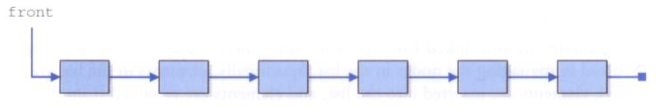
Linked Structures
A Person object is the data object
A Person object, for instance, could contain a reference to another Person object
A list of Person objects could be implemented with a linked structure of Persons:

Slide 5
Preparing a Linked Structure
A Person object, for instance, could contain a reference variable (link) to another Person object:
public class Person
{
private String name;
private String address;
private Person next; // A link to another Person object
// whatever else it is
public Person(String na, String addr) {
name = na; address = addr;
}
public void setNext(Person link) {
next = link;
}
public Person getNext() {
return next;
}
}

Slide 6
Starting a Linked Structure
public static void main (String [] args)
{
Person front, uno, dos, tres;
uno = new Person(“Juan”, “Rio Hondo”);
dos = new Person(“Maria”, “Avenida Obregon”);
tres = new Person(“Alberto”, “Reforma”);
uno.setNext(dos); // uno >>> dos
dos.setNext(tres); // uno >>> dos >>> tres
front = uno;
}
front always points out to? _____
Where to, in this example, must tres point out? _____
The Person objects are no stored contiguously.

Slide 7
Linked Structures
Self-Referential Objects: are data objects that contains a referential variable, that allows a first data object to link with a second data object, the second to link with a third one, and so on.

Slide 8
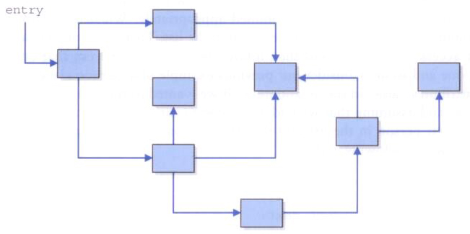
Complex Linked Structures
Links could also be used to form more complicated, non-linear linked structures
By this time, will use linear linked structures

Slide 9
Linked Structure with Nodes
A Linked Structure with Nodes is a linear data structure where each element is node and is a separate object. ALSO known are linked lists.
Linked Structure with Node elements are not stored at contiguous location, the elements are linked using references.
Each element (or node) of a list is made up of two items:
the data object, and
a reference to the next node
The last node has a reference to null

Slide 10
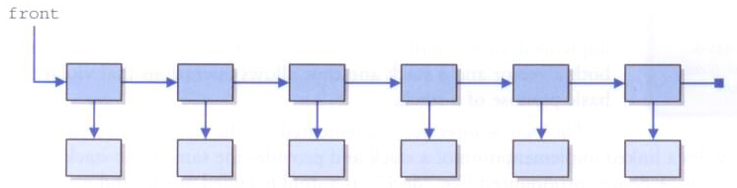
Linked Structures with Nodes
Each object in a linked structure with Nodes is often generically called a node, in which one node object refers to the next node, which refers to the next, etc.
This linked structure wN is implemented as a Linked Structure.
Then, there are two classes: Node and Data.
Node
Data

Slide 11
Linked Structure with Nodes
Node
Data
Then the linked structure wN contains nodes that are self-referential (Node points to a Node)
But the Data objects are not self-referential
A linked structure wN is a dynamic data structure in that its size grows and shrinks as needed, unlike an array whose size is static.

Slide 12
Heap
Java objects are created dynamically when they are instantiated, inside a part of memory called system heap
DATA (static variables)
CODE (class, static methods)
HEAP (objects)
STACK (parameters, instance variables, returns)

Slide 13
Linear Node
public class LinearNode<T> {
private LinearNode<T> next;
private T element;
public LinearNode(T elem) {
next = null; element = elem;
}
public LinearNode<T> getNext() {
return next;
}
public void setNext(LinearNode<T> node) {
next = node;
}
public T getElement() {
return element;
}
public void setElement(T elem) {
element = elem;
}
}

Slide 14
Linked Structures with Nodes
There are no index values built into linked structures wN
To access each node in the linked structure wN you must follow the references from one node to the next, traversing the nodes
Person aux;
LinearNode<Person> current = front;
while (current != null) {
aux = current.getElement();
System.out.println(aux.toString());
current = current.getNext();
}

Slide 15
Managing Linked Structures wN
Consider inserting and deleting nodes in various positions within the linked structures wN (or linked lists)

Slide 16
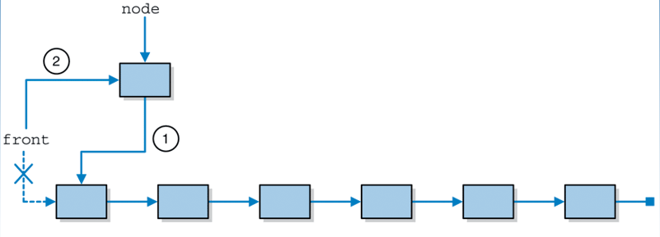
Inserting a node at the front of a linked structure wN

Slide 17
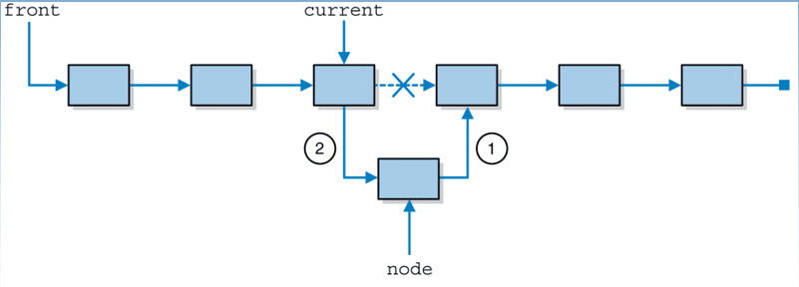
Inserting a node in the middle of a linked structure wN

Slide 18
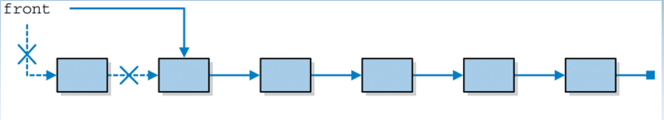
Deleting the first node in a linked structure wN

Slide 19
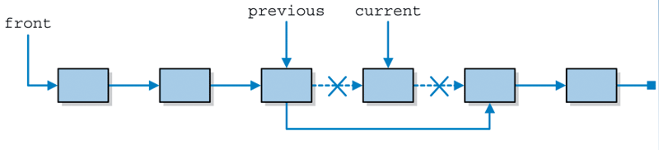
Deleting an interior node from a linked structure wN

Slide 20
Accesing node elements
First example, traversing the nodes:
LinearNode<Person> current = front;
for (int i = 0; i < 3; i++)
current = current.getNext();
Second example, looking for a node:
String cad = “Maria”;
LinearNode<Person> current = front;
while ( !(current.getElement().equals(cad)) &&
(current.getNext() != null) )
current = current.getNext();

Slide 21
Implementing NODEs with LINKs
First, however, we will need to create a LinearNode class to represent a node in the linked structure wN (or linked list)

Slide 22
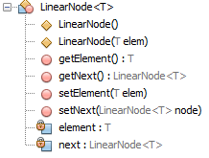
Linked Node operations

Slide 23
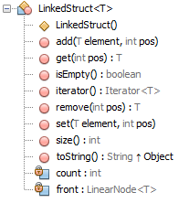
Linked Structure wN operations

Slide 24
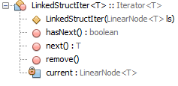
Linked Structure wN Iterator operations

Slide 25
Doubly Linked Structures wN
Another useful variation is a doubly linked structure wN or doubly linked list
In a doubly doubly linked structure wN each node has a reference to both the next and previous nodes in the linked structure
This makes traversing the linked structure easier

Slide 26
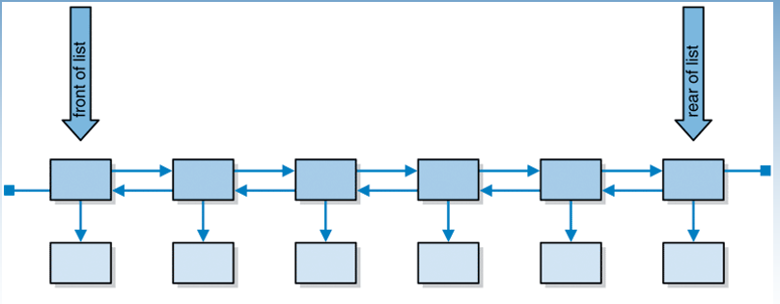
A doubly linked structure wN

