Slide 1
Data Elements without Links
The problem with self-referential objects is that they must "know" they are part of a linked structure
A better approach is to manage a separate node class that serves to link the elements together, and that also reference the objects stored in the linked structure wN (see Figure next slide)
The linked structures wN is still managed using the same techniques
The objects stored in the linked structures wN need no special implementation to be part of the linked structure
A generic linked structure wN can be used to store any kind of object

Slide 2
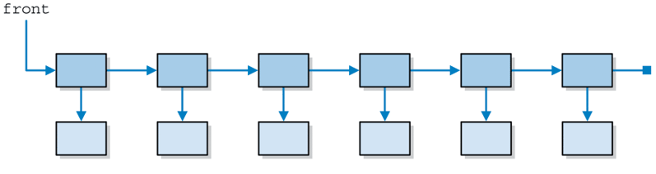
Using separate Linear-Node objects to link Data Elements, & other Linear-Node
A Linked-Structure wN object (implemented with a Linked-Structure)
Linked Linear-Nodes
LinearNode
LinearNode
Data Element
Data Element
Using separate Linear-Node objects to store and link Data Elements

Slide 3
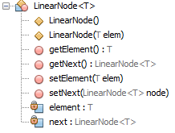
Linear-Node operations

Slide 4
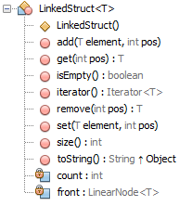
Linked-Structure operations

Slide 5
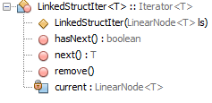
Linked-Structure-Iterator operations

Slide 6
References
Some original slides were modified and new ones were added up, to the material of the book and authors Lewis and Chase

