Slide 1
CHAPTER 6:
Lists
Java Software Structures:
Designing and Using Data Structures
Third Edition
John Lewis & Joseph Chase

Slide 2
Chapter Scope
Types of LIST collections
Using LISTs to solve problems
Various LIST implementations
Comparing LIST implementations
1-<number>

Slide 3
Lists
Lists are linear collections, like Stacks and Queues, but are more flexible
Adding and removing elements in Lists can occur at either end, or anywhere in the middle
We will examine three types of lists:
  ordered lists
  unordered lists
  indexed lists
1-<number>

Slide 4
Ordered Lists
The elements in an ordered list are ordered by some inherent characteristic of the elements
  names in alphabetical order
  scores in ascending order
Therefore, the elements themselves determine where they are stored in the list
1-<number>

Slide 5
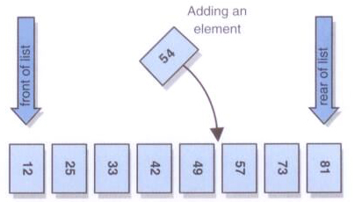
A conceptual view of an Ordered List
1-<number>

Slide 6
Unordered Lists
There is an order to the elements in an unordered list, but that order is not based on element characteristics
The user of the list determines the order of the elements
A new element can be put on the front or the rear of the list, or it can be inserted after a particular element already in the list
1-<number>

Slide 7
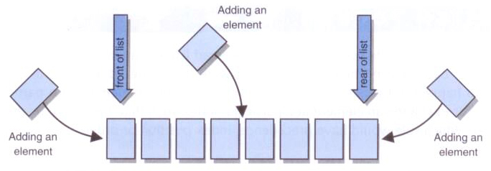
A conceptual view of an Unordered List
1-<number>

Slide 8
Indexed Lists
In an Indexed List, elements are referenced by their numeric position in the list
Like an Unordered List, there is no inherent relationship among the elements
The user can determine the order
Every time the List changes, the indexes are updated
1-<number>

Slide 9
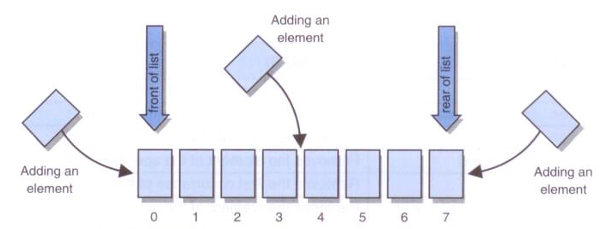
A conceptual view of an Indexed List
1-<number>

Slide 10
List Operations
There are several operations common to all three list types
These include removing elements in various ways and checking the status of the list
The key differences between the list types involve the way elements are added
1-<number>

Slide 11
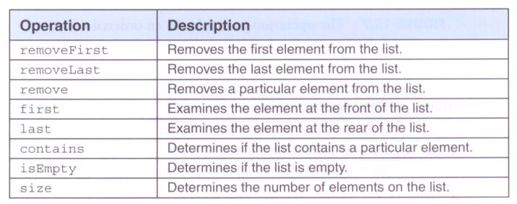
Common operations to all types of Lists
1-<number>

Slide 12

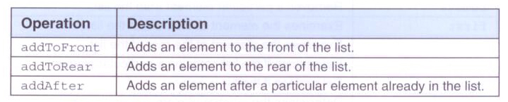
Operations in Ordered / Unordered Lists
Operation particular to an Ordered List:
Operations particular to an Unordered List:
1-<number>

Slide 13
List Operations
As with other collections, we use Java interfaces to define the collection operations
Recall that interfaces can be defined via inheritance (derived from other interfaces)
We define the common List operations in one interface, then derive three others from it that define the interfaces of the three list types
1-<number>

Slide 14
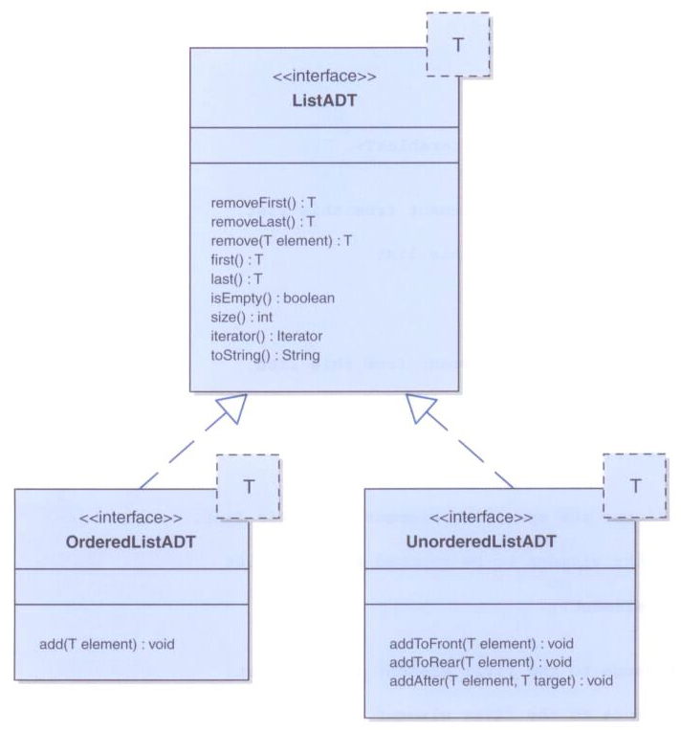
The various list interfaces
1-<number>

Slide 15
Implementing Lists with Arrays
An array implementation of a list could follow strategies similar to those used for a queue
We could fix one end of the list at index 0 and shift as needed when an element is added or removed
Or we could use a circular array to avoid the shift at one end
However, there is no avoiding a shift when an element in the middle is added or removed
1-<number>

Slide 16
Implementing Lists with Links
As with Stack and Queue, we can implement a List Collection with an underlying Linked Structure
All operations can be accomplished using techniques similar to ones we've already explored
The LinearNode class is reused here
However, we alter the underlying representation to manage the collection
Both head and tail references are maintained, as well as an integer count
1-<number>

