Slide 1
Doubly Linked Lists
A doubly linked list has two references in each node, one to the next element in the list and one to the previous element
This makes moving back and forth in a list easier, and eliminates the need for a previous reference in particular algorithms
There is, however, a bit more overhead when managing the list
1-<number>

Slide 2
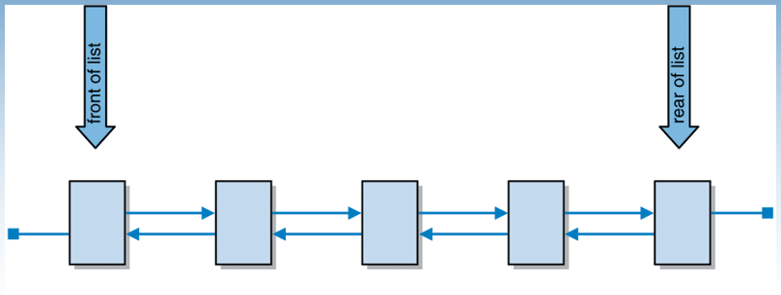
A doubly linked list
1-<number>

Slide 3
The DoubleNode class
/**
* DoubleNode represents a node in a doubly linked list.
*
* @author Dr. Lewis
* @author Dr. Chase
* @author Davis
*/
package jss2;
public class DoubleNode<E>
{
private DoubleNode<E> next;
private E element;
private DoubleNode<E> previous;
/**
* Creates an empty node.
*/
public DoubleNode()
{
next = null;
element = null;
previous = null;
}
1-<number>

Slide 4
The DoubleNode class (continued)
/**
* Creates a node storing the specified element.
*
* @param elem the element to be stored into the new node
*/
public DoubleNode (E elem)
{
next = null;
element = elem;
previous = null;
}
/**
* Returns the node that follows this one.
*
* @return the node that follows the current one
*/
public DoubleNode<E> getNext()
{
return next;
}
1-<number>

Slide 5
The DoubleNode class (continued)
/**
* Returns the node that precedes this one.
*
* @return the node that precedes the current one
*/
public DoubleNode<E> getPrevious()
{
return previous;
}
/**
* Sets the node that follows this one.
*
* @param dnode the node to be set as the one to follow the current one
*/
public void setNext (DoubleNode<E> dnode)
{
next = dnode;
}
1-<number>

Slide 6
The DoubleNode class (continued)
/**
* Sets the node that precedes this one.
*
* @param dnode the node to be set as the one to precede the current one
*/
public void setPrevious (DoubleNode<E> dnode)
{
previous = dnode;
}
/**
* Returns the element stored in this node.
*
* @return the element stored in this node
*/
public E getElement()
{
return element;
}
1-<number>

Slide 7
The DoubleNode class (continued)
/**
* Sets the element stored in this node.
*
* @param elem the element to be stored in this node
*/
public void setElement (E elem)
{
element = elem;
}
}
1-<number>

Slide 8
Doubly Linked Lists
Lets revisit the remove method for linked implementation of a list, this time using a doubly linked list
Notice how much more elegant the code in this version is compared to our earlier version
The cost of this elegance is the overhead associated with storing and managing additional links
1-<number>

Slide 9
DoubleList - the remove Operation
/**
* Removes and returns the specified element.
*
* @param element the element to be removed and returned
* from the list
* @return the element that has been removed from
* the list
* @throws ElementNotFoundException if an element not found exception occurs
*/
public T remove (T element)
{
T result;
DoubleNode<T> nodeptr = find (element);
if (nodeptr == null)
throw new ElementNotFoundException ("list");
result = nodeptr.getElement();
1-<number>

Slide 10
DoubleList - the remove Operation (continued)
/** check to see if front or rear */
if (nodeptr == front)
result = this.removeFirst();
else if (nodeptr == rear)
result = this.removeLast();
else
{
nodeptr.getNext().setPrevious(nodeptr.getPrevious());
nodeptr.getPrevious().setNext(nodeptr.getNext());
count--;
}
return result;
}
1-<number>

