Slide 1
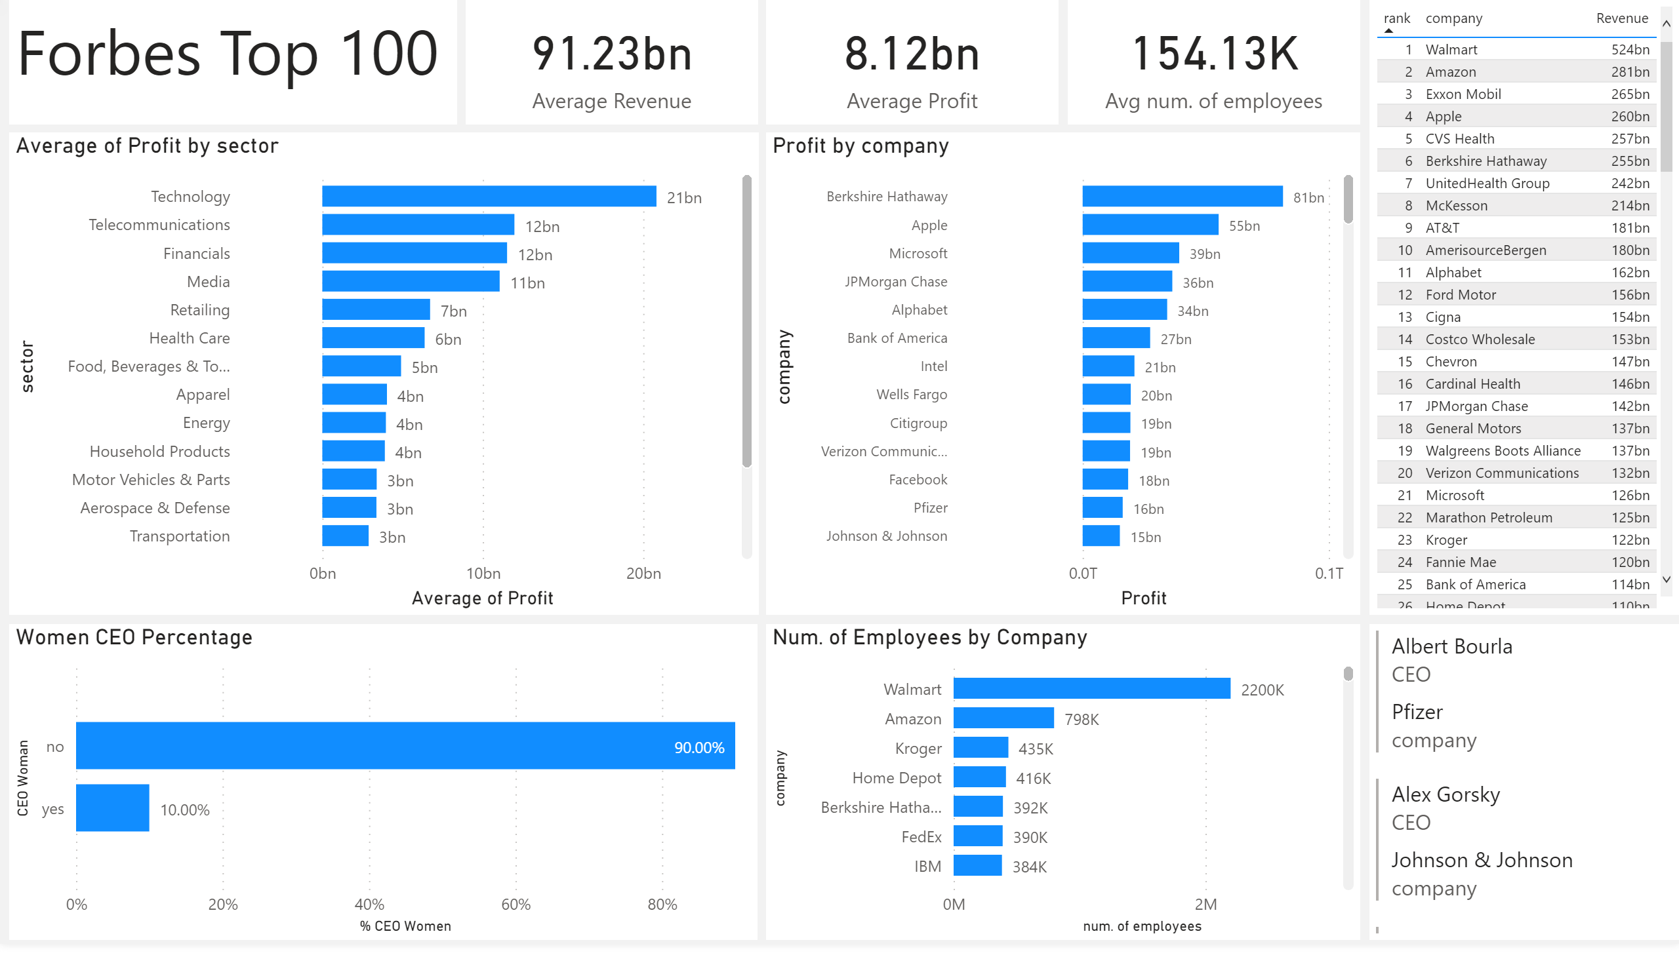
Notes:
textbox
No alt text provided.
card
No alt text provided.
card
No alt text provided.
card
No alt text provided.
barChart
No alt text provided.
barChart
No alt text provided.
tableEx
No alt text provided.
Women CEO Percentage
No alt text provided.
Num. of Employees by Company
No alt text provided.
multiRowCard
No alt text provided.

Slide 2
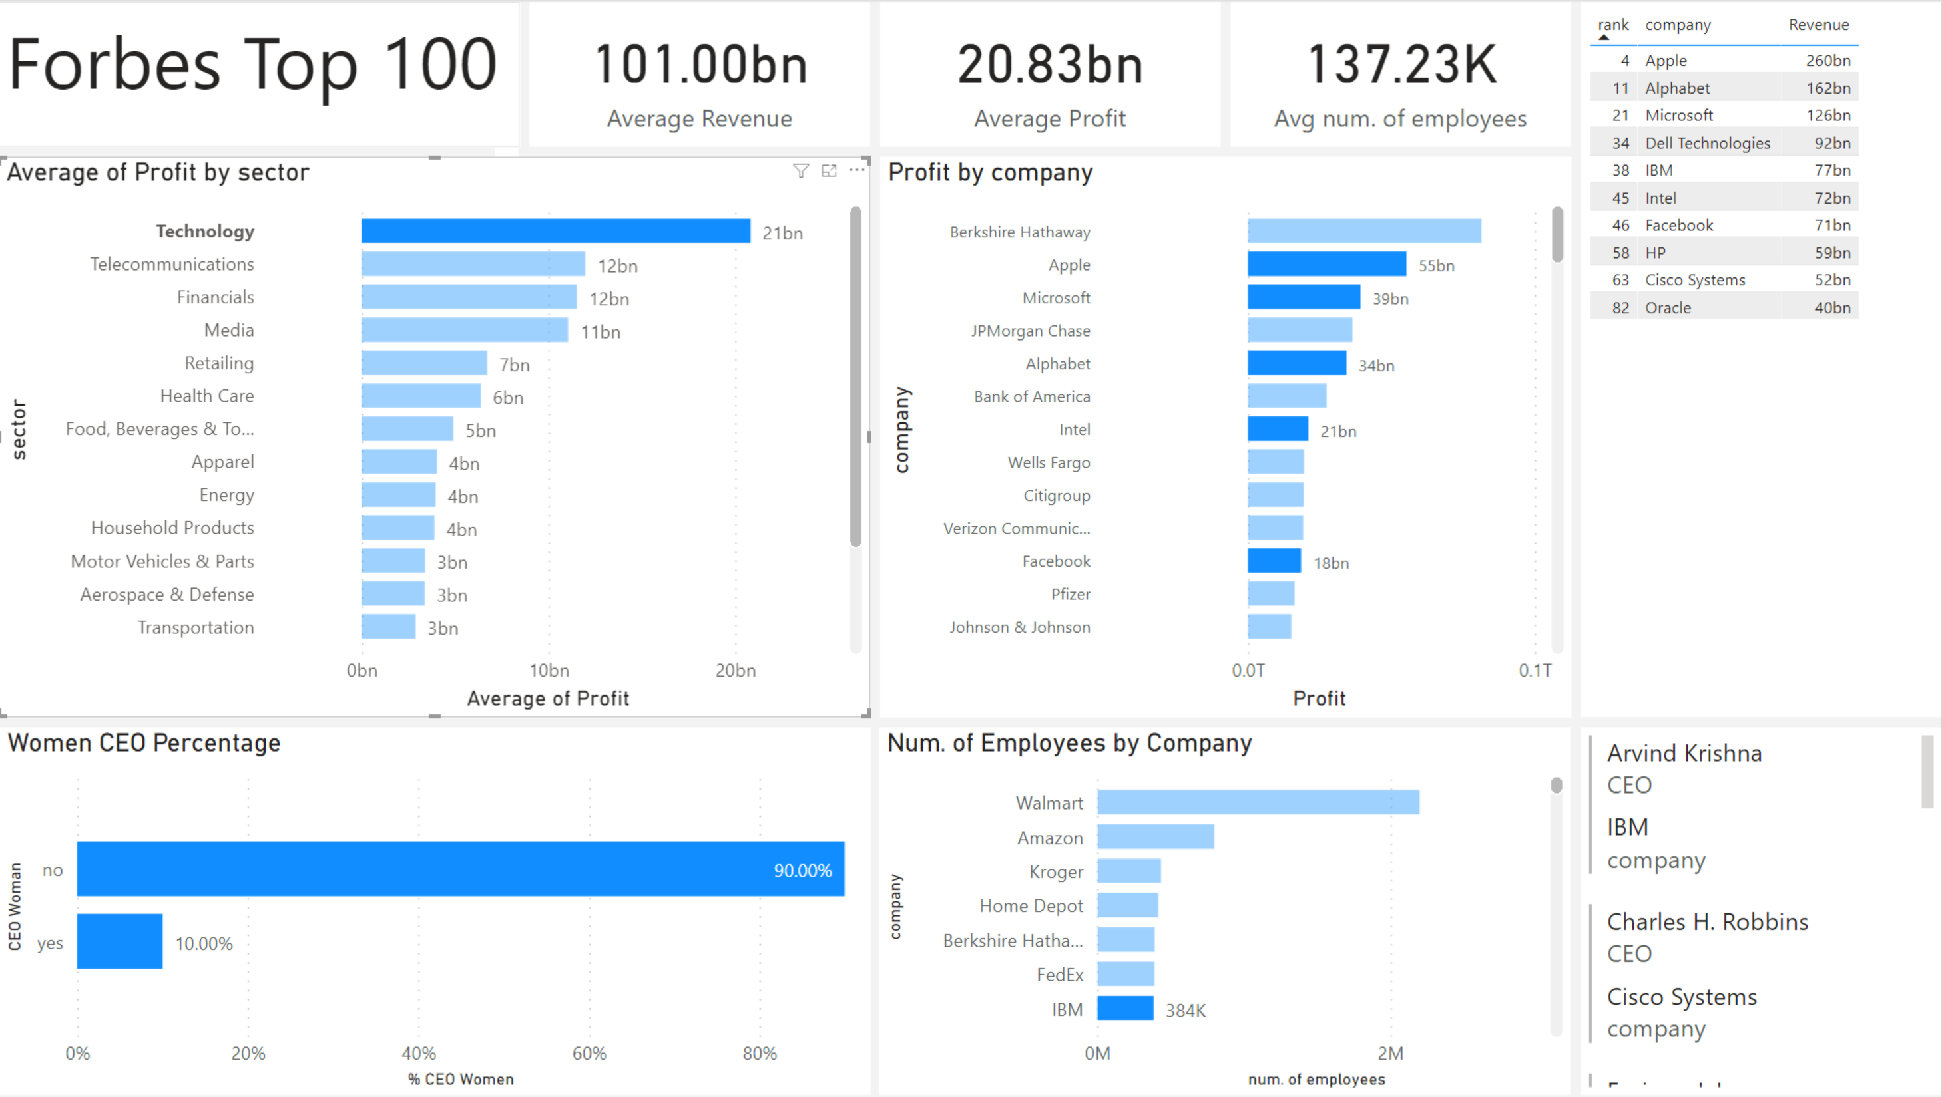

Slide 3
