Slide 1

Real-Time Embedded Systems @ UniMORE presents
Antonio Solida
313356@studenti.unimore.it
Davide Palma
311394@studenti.unimore.it
Out 2023.09.12

Slide 2

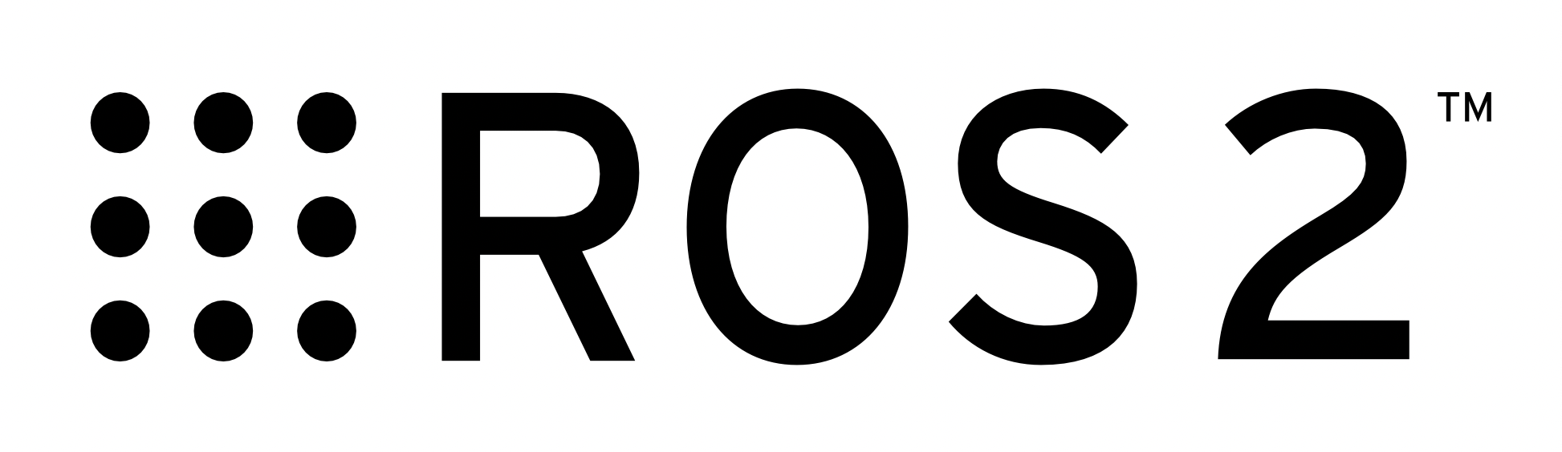


Introduction (Software)
ROS2 is a set of frameworks for robotic development
Low level device control
Package management
Broker-free message-passing between processes
… with all the related utilities.
Development status: Very fast and active with regular releases
ZeroMQ ( or 0mq or zmq ) is a lightweight and versatile message passing library. Its API is designed to be similar to sockets, but with features like auto-reconnection.
Development status: Mature and stable, low activity
PlotJuggler can collect and show real-time data from 0mq and ROS2 data sources alike.

Slide 3
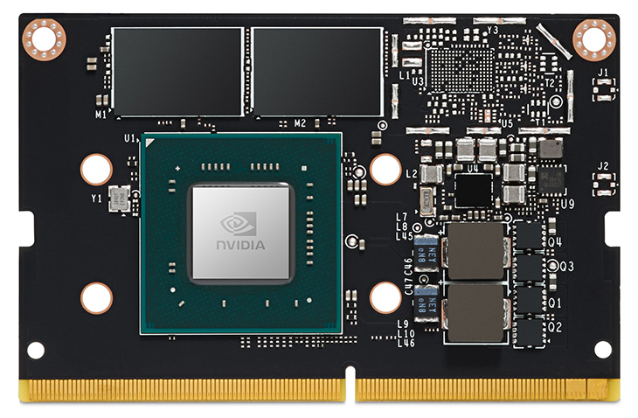
NVIDIA Jetson Nano Dev Kit
GPU | Maxwell 128 core
CPU | ARM A57 4 core @ 1.43 GHz
RAM | 4 GB 64-bit LPDDR4 25.6 GB/s
Ubuntu version | Ubuntu 20.04.6 LTS
ROS2 Version | Foxy Fritzroy
0mq Version | 4.3.2 (latest)

Slide 4
Goal of the project
Does ZeroMQ have less or more average and maximum latency?
Can ZeroMQ replace ROS?

Slide 5


Used patterns
Publisher/Subscriber pattern
Majordome pattern

Slide 6
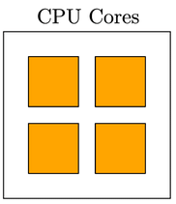
CPU policies
OS
all other tasks
Client
Worker
Broker
OS
all other tasks
Broker
All
tasks
Client
Worker
Condensed (same)
All tasks in one core
Static (diff)
Every task in a different core
Normal (nois)
OS Decides

Slide 7
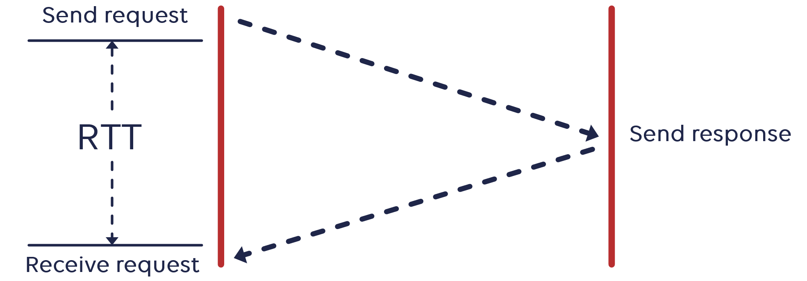
What has been measured?
Generate a random message of n bytes
Start measuring time
Send message
Receive response
Stop measuring time
Increase n by 1000
Go to 1)

Slide 8
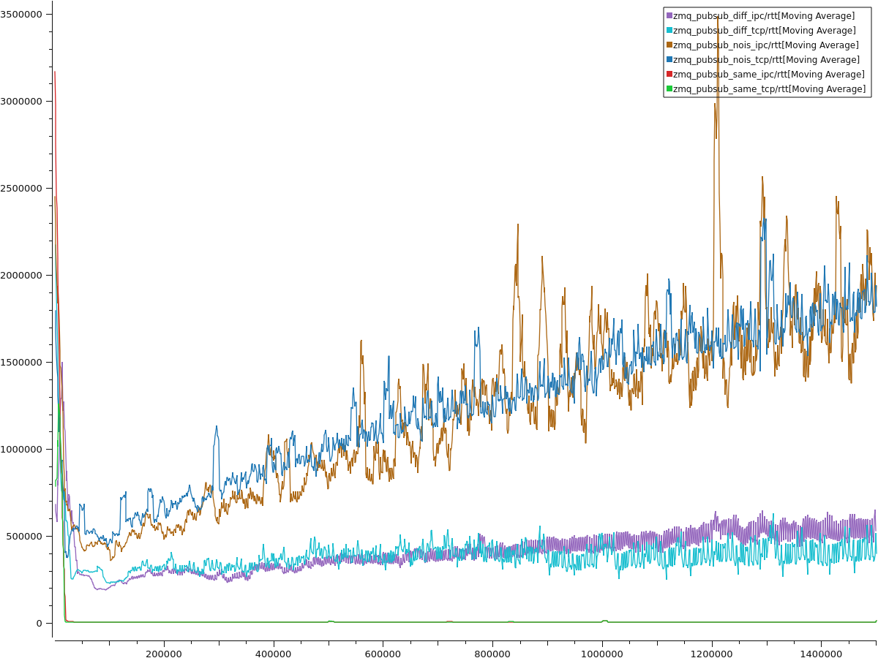
0mq CPU policy bench
IPC and TCP mean latency is the same, but TCP is more stable (!)
0mq greatly benefits from core isolation
With single-core pinning, RTT is almost zero
ns
Message size in bytes

Slide 9
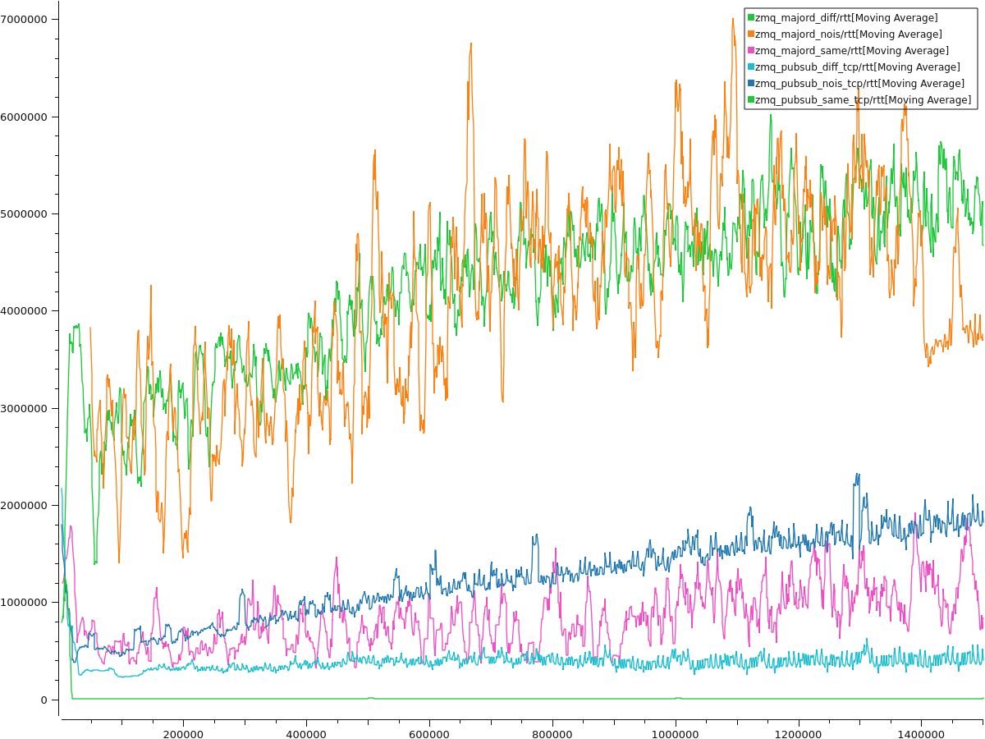
0mq patterns bench
Majordomo is generally slower than pub_sub
Single-core majordomo is faster than no-isolation pub_sub
ns
Message size in bytes

Slide 10
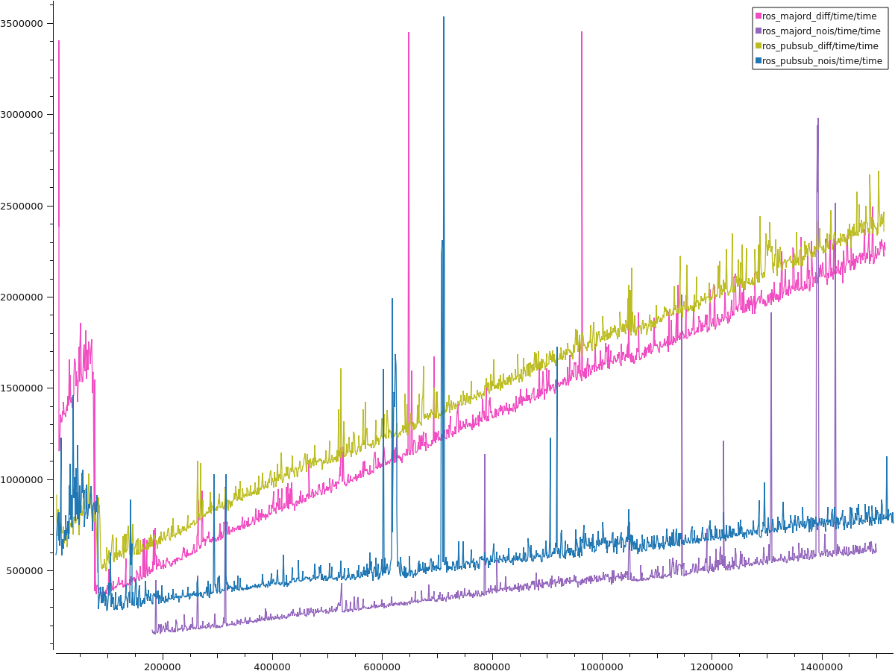
ROS patterns bench
Majordomo is slower than pub_sub
Single-core majordomo is faster than no-isolation pub_sub
Nasty peaks, but less frequent than 0mq
ns
Message size in bytes

Slide 11
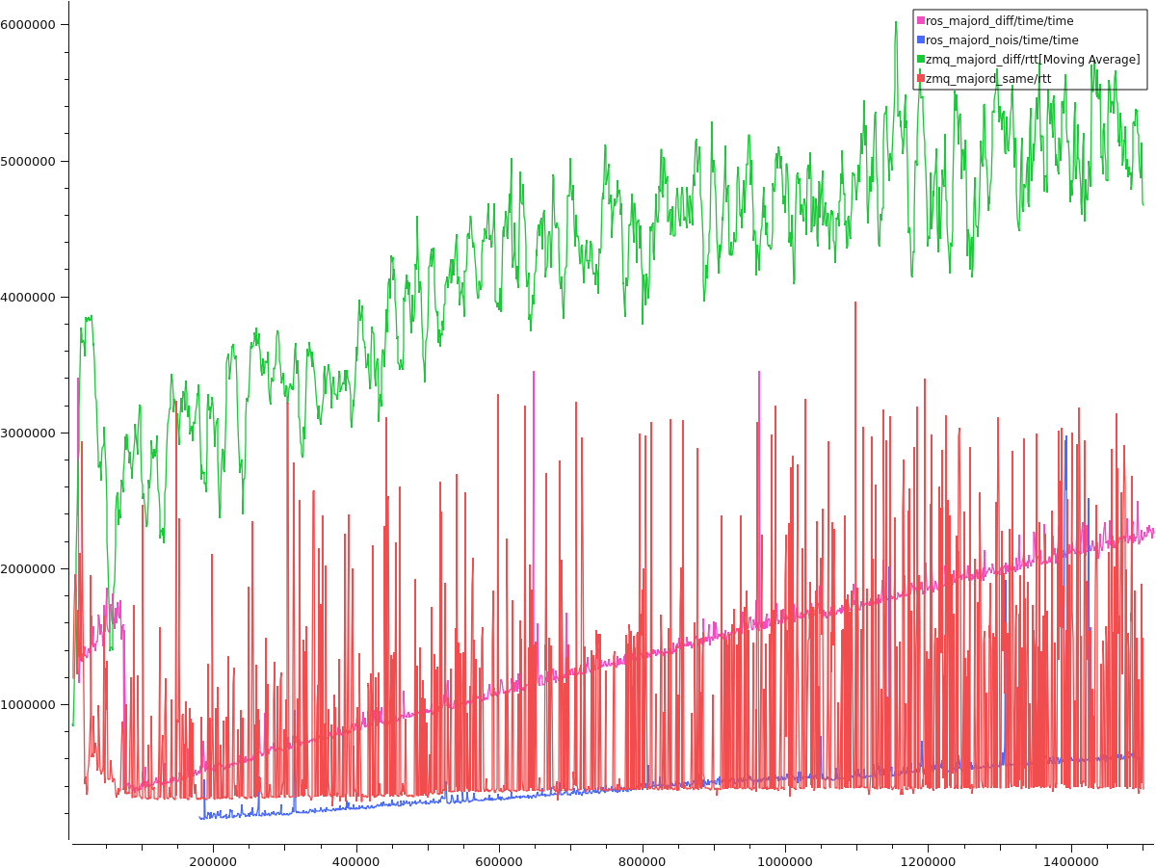
Majordomos bench
0mq slower and less stable than ROS
ns
Message size in bytes

Slide 12
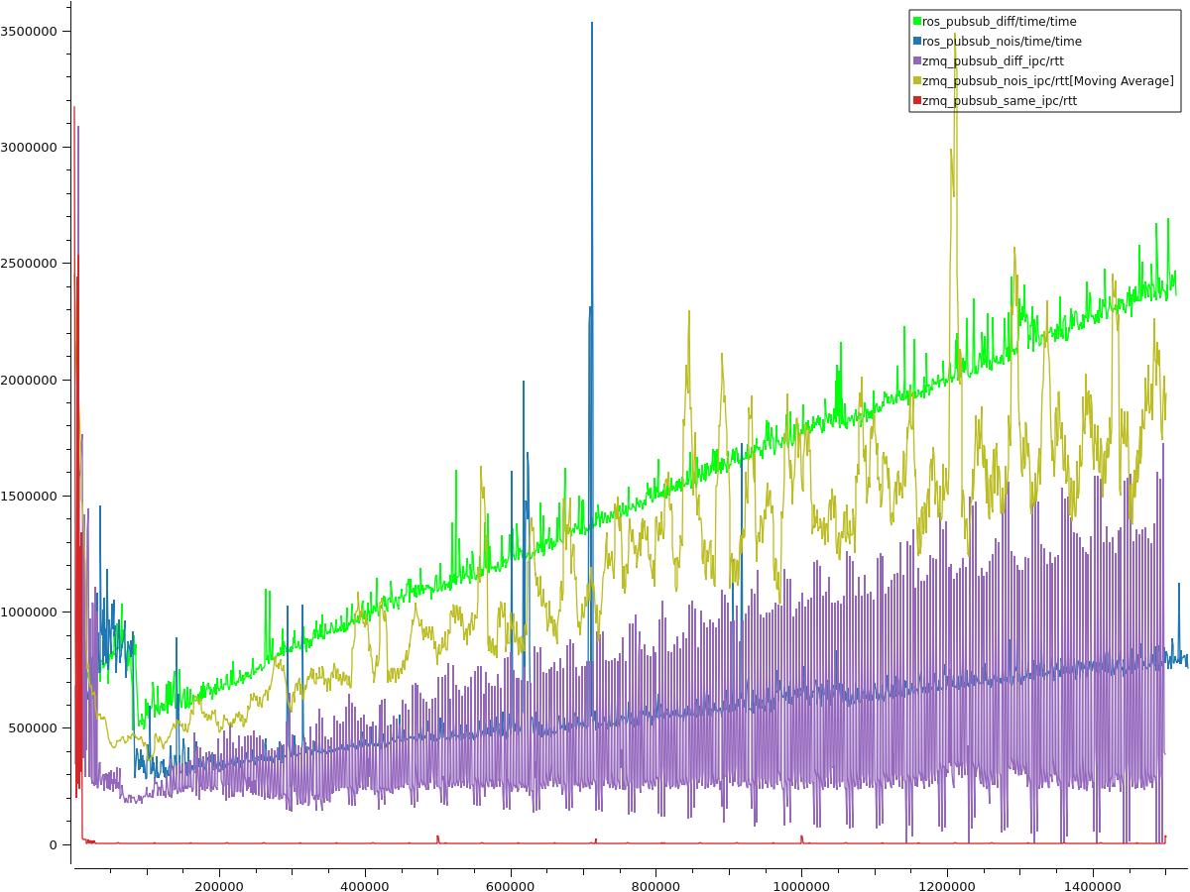
pub_sub bench
On single-core, zmq will significantly outperform everything else
On constrained policy,
zmq will be similar to normal ROS, but less stable
Normal zmq will only be better than constrained ROS
ns
Message size in bytes

Slide 13
Conclusion
Can ZeroMQ replace ROS?
Not really
0mq is always slower
Only faster in single-core pub/sub
0mq can only be considered if a constrained CPU policy takes place in which many actions execute sequentially on one core, following a pub/sub model.

Slide 14



QUESTIONS?
( Show me the code? )

