Slide 1
ML and Shapley-Based prediction of resistance mechanisms in pathogenic bacteria
CBP (CS61060) Project Presentation
Group-15
Ram Sundaram (20BT10026), Vishal Ravipati (20CS10076), Giri Nikhil Rajendra (20BT10036)

Slide 2
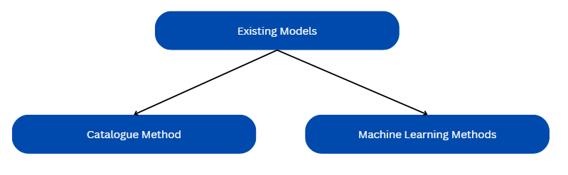
Motivation
Drug resistance is a critical issue where infectious organisms, or pathogens, develop resistance to commonly used drugs in treatment
Accuracy vs interpretability tradeoff

Slide 3
Objective
Development of a novel pipeline for prediction and identification of resistance mechanisms
Enhancing clinical utility of designed pipeline through enhanced interpretability

Slide 4
How do we achieve interpretability
Machine learning models are able to “learn” which mutations cause resistance just by looking at the data
ML Models lack interpretability making it difficult to “extract” that “learned information”
Particularly, for mutations and phenotypes, which have non-linear relationships
Shapley values enable us to extract information from the trained ML model
Assign every mutation a quantitative score

Slide 5
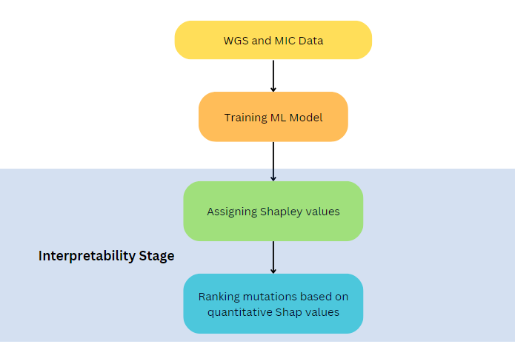
Pipeline Overview

Slide 6
Data Used
Maela Dataset
3,085 Streptococcus pneumoniae isolates
Mutations represented by SNPs
Antibiotic resistance available for penicillin
Cryptic Dataset
12,289 Mycobacterium tuberculosis isolates
Mutations represented by SNPs and indels
Antibiotic resistance available for 13 antibiotics including MXF, INH, AMI, LEV

Slide 7
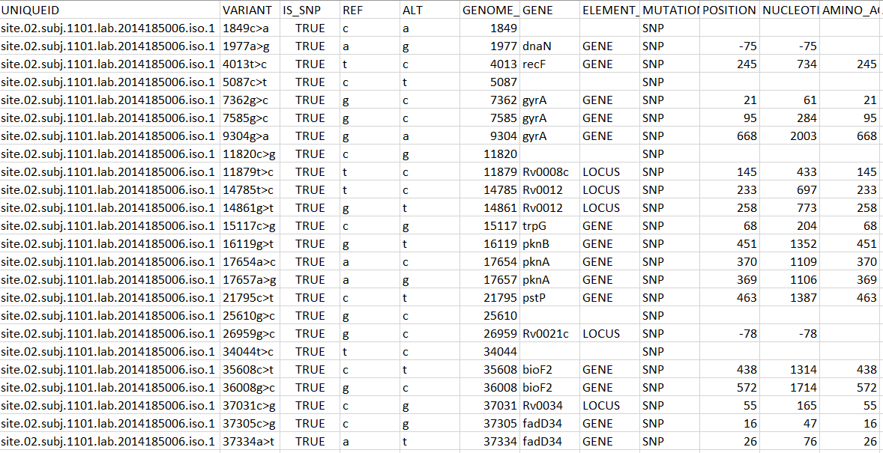
Sample Data

Slide 8
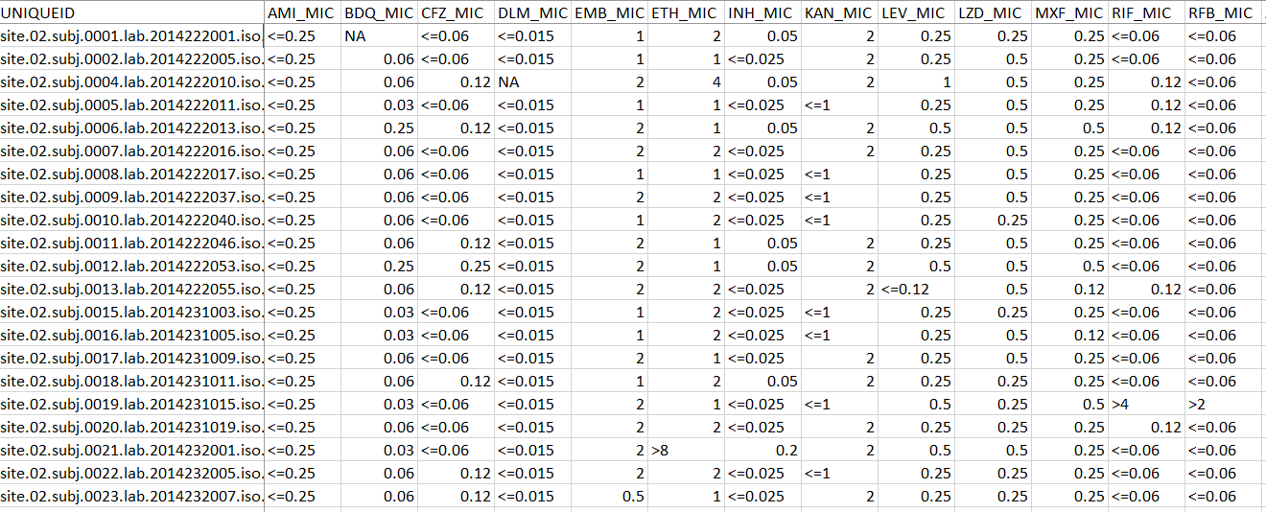
Sample Labels

Slide 9
Required Data Format
Isolate No. | Mutation 1 | Mutation 2 | Mutation 3 | Mutation 4
Sample X | 0 | 1 | 0 | 1
Sample Y | 1 | 0 | 0 | 0
Sample Z | 0 | 0 | 1 | 0
Binary variable to indicate presence or absence of a mutation

Slide 10
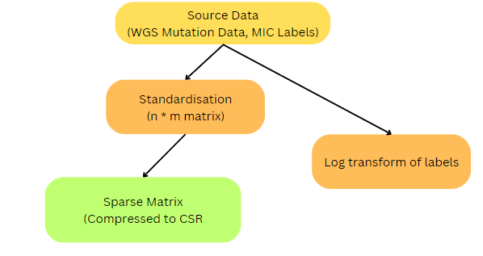
Data Preprocessing

Slide 11
Feature Selection
Genomic data has millions of features/mutations and ~1,000 samples
Causes computational inefficiency and model inaccuracy
We must reduce feature space to select only mutations relevant to resistance
Reduced ~800,000 features to roughly 2,000

Slide 12
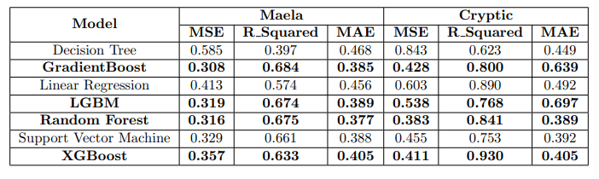
Model Fitting
Models selected on basis of simplicity, accuracy and compatibility with TreeShap
XGBoost and Random Forest selected for results and efficiency, Decision Trees selected to balance out complex models with simplicity

Slide 13
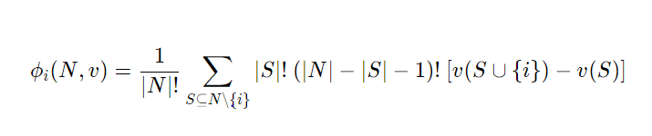
Shapley Values
Method of explaining the contribution to every feature to the final prediction
i = Mutation i
Φi = Shap value of mutation i
N = Set of all features
S = A specific subset of mutation
v(S) = Prediction error of model on subset S

Slide 14
Shapley Values
Method of explaining the contribution to every feature to the final prediction
Isolate No. | Mutation 1 | Mutation 2 | Mutation 3 | Mutation 4
Sample X | 0 | 1 | 0 | 1
Sample Y | 1 | 0 | 0 | 0
Sample Z | 0 | 0 | 1 | 0

Slide 15
Shapley Values
Method of explaining the contribution to every feature to the final prediction
Works by iteratively retraining the model on every subset of mutations
Calculates the marginal contribution of each mutation to the prediction
Marginal contribution of mutation = Prediction Error of subset with mutation - Prediction Error of subset without mutation

Slide 16
Shapley Values
Method of explaining the contribution to every feature to the final prediction
Isolate No. | Mutation 1 | Mutation 2 | Mutation 3 | Mutation 4
Sample X | 0 | 1 | 0 | 1
Sample Y | 1 | 0 | 0 | 0
Sample Z | 0 | 0 | 1 | 0

Slide 17
Shapley Values
Method of explaining the contribution to every feature to the final prediction
Isolate No. | Mutation 1 | Mutation 2 | Mutation 3 | Mutation 4
Sample X | 0 | 1 | 0 | 1
Sample Y | 1 | 0 | 0 | 0
Sample Z | 0 | 0 | 1 | 0

Slide 18
Shapley Values
Method of explaining the contribution to every feature to the final prediction
Isolate No. | Mutation 1 | Mutation 2 | Mutation 3 | Mutation 4
Sample X | 0 | 1 | 0 | 1
Sample Y | 1 | 0 | 0 | 0
Sample Z | 0 | 0 | 1 | 0

Slide 19
Shapley Values
Method of explaining the contribution to every feature to the final prediction
i = Mutation i
Φi = Shap value of mutation i
N = Set of all features
S = A specific subset of mutation
v(S) = Prediction error of model on subset S

Slide 20
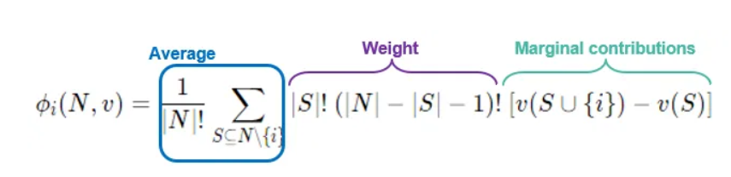
Shapley Values
Method of explaining the contribution to every feature to the final prediction
i = Mutation i
Φi = Shap value of mutation i
N = Set of all features
S = A specific subset of mutation
v(S) = Prediction error of model on subset S

Slide 21
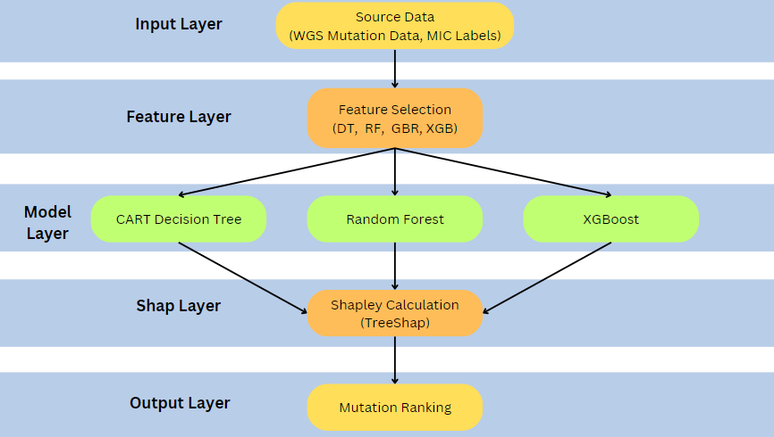
Final model pipeline

Slide 22
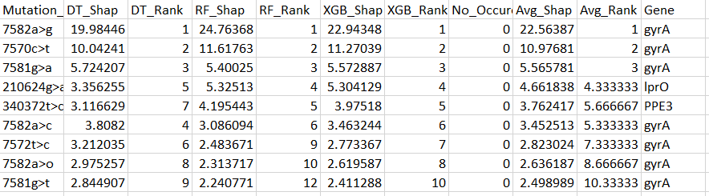
Sample Results (M. tuberculosis, MXF)

Slide 23
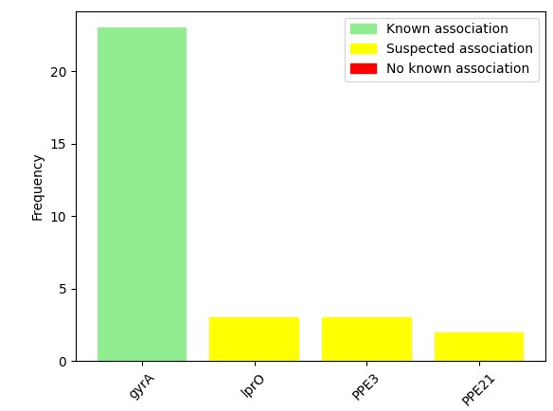
Results

Slide 24
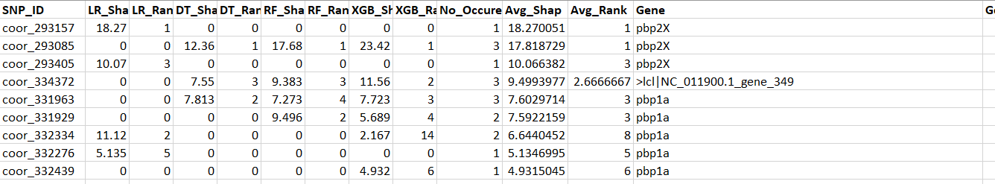
Results (S. Pneumoniae, penicillin)

Slide 25
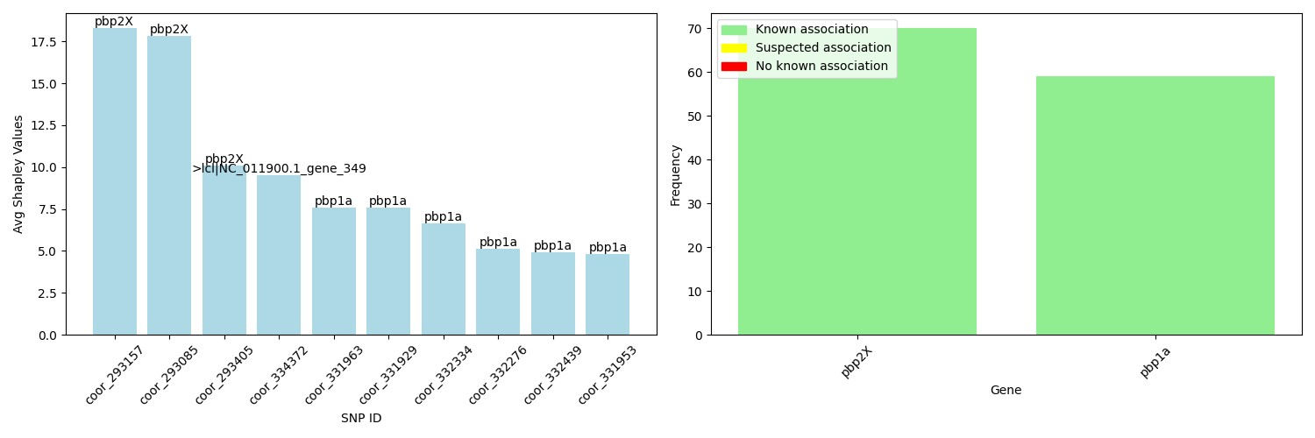
Results (S. Pneumoniae, penicillin)

Slide 26
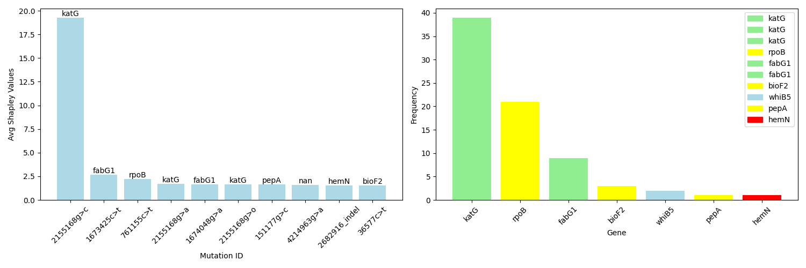
Results (M. tuberculosis, isoniazid)

Slide 27
Discussion/Conclusion
Could serve as a guide for future wet lab endeavours into resistance to rarely-used antibiotics or resistance mechanisms across pathogens that are not well-researched
Our pipeline is theoretically applicable to any combination of a genotypic feature set and a phenotypic label across all species
Future considerations include analysis of pairwise resistance, multi-drug resistance

Slide 28
Thank You!

