Slide 1
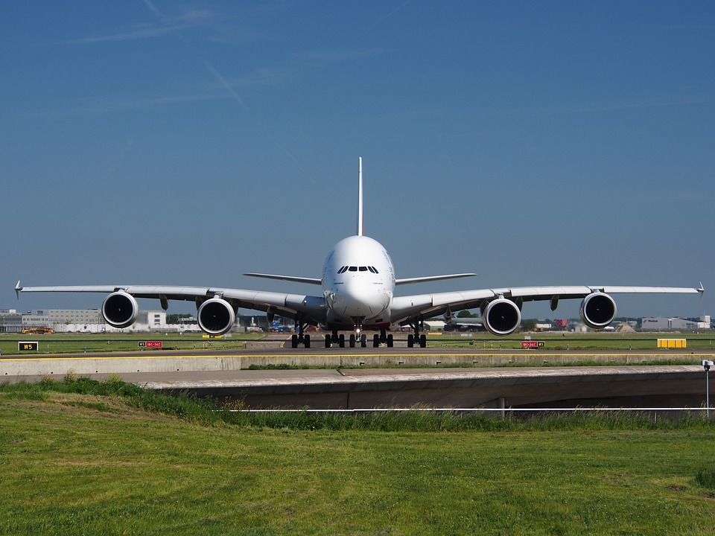
Airline Sentiment Analysis
By Patrick Miller & Ganesh Ramcharan

Slide 2

Problem Statement(s)
What are the most common complaints that customers have with the airport industry?
What are the chances of these issues resurfacing with different airlines?

Slide 3

What was contained in the data?
This Photo by Unknown Author is licensed under CC BY

Slide 4

Brief overview of the dataset
Our dataset, obtained from Kaggle.com, consists of over 14,000 tweets from February 2015 mentioning major US airlines. Stored in an SQLite database, it includes fifteen columns providing information about each tweet. The "airline_sentiment" column categorizes tweets as positive, negative, or neutral, while "airline_sentiment_confidence" measures confidence in the assigned sentiment label.

Slide 5
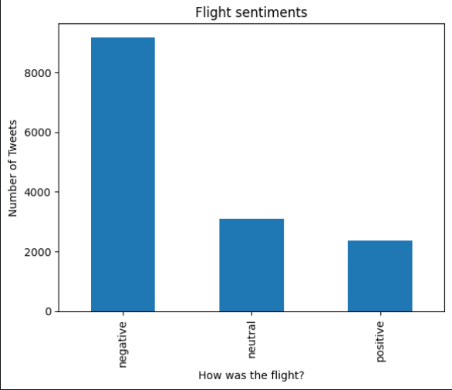
EDA/Data Cleaning/Preprocessing
To begin the exploratory data analysis (EDA) process, we first displayed the columns of the untouched data to get an overview of the available information. Then, we used the tweetsDf.head() function to display the first 5 rows and all 15 columns of the dataset.
Next, we filtered the data and selected the 'airline_sentiment' column to get the unique counts for each sentiment category (positive, negative, neutral). This allowed us to understand the distribution of sentiments in the dataset.

Slide 6
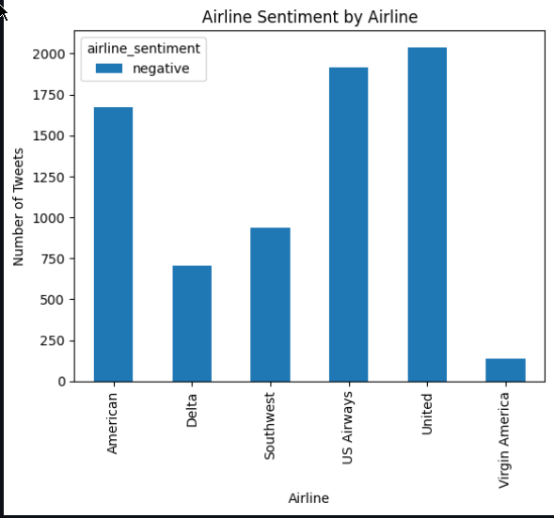
Afterwards, we focused specifically on the negative sentiments and selected the rows that corresponded to negative sentiment tweets. We further grouped the data by airline and sentiment to visualize the distribution of negative sentiments across different airlines using a histogram.

Slide 7
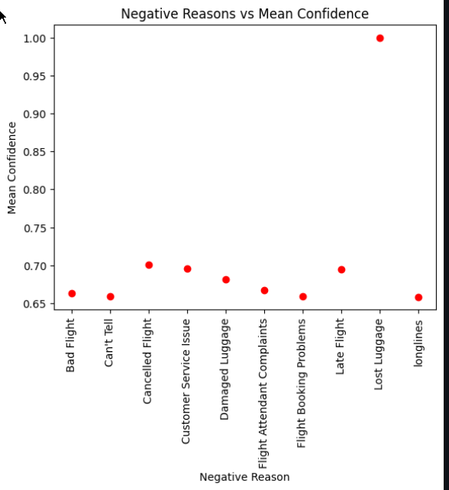
Moving on, we grouped the data by negative reason and computed the median confidence for each negative reason. This information was then displayed in a scatter plot, allowing us to analyze the relationship between the negative reasons and the confidence level in assigned sentiment labels.

Slide 8
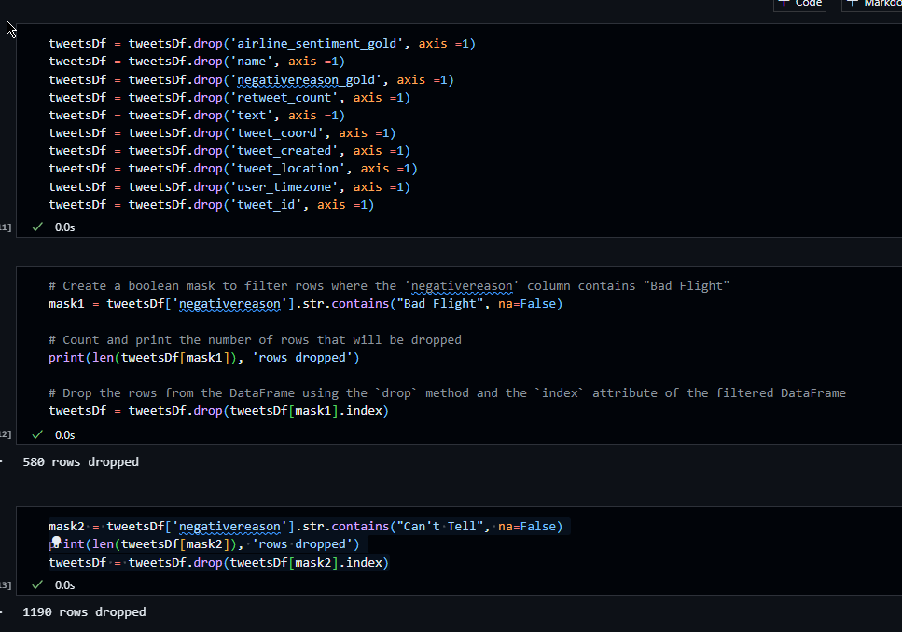
As part of the data cleaning process, we dropped the columns and rows that were not needed for our analysis. This helped streamline the dataset and remove unnecessary information. After making these changes, we displayed the dataframe again to observe the resulting modifications.

Slide 9
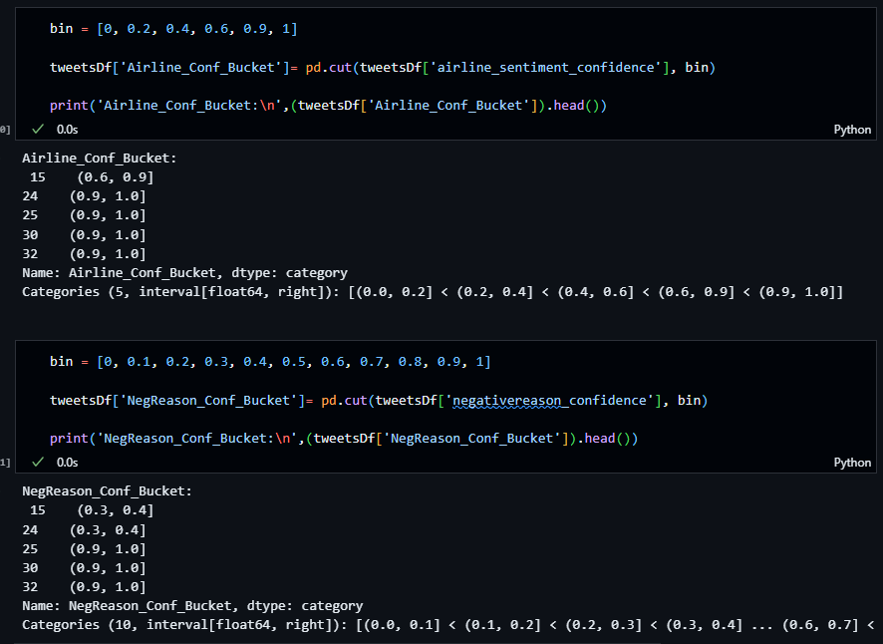
Next, we bucketized the cleaned data and displayed scatter plots and histograms to visualize the distributions of 'negativereason_confidence' and 'airline_sentiment_confidence'. These visualizations provided insights into the confidence levels associated with different negative reasons and sentiment labels.

Slide 10
Next, we bucketized the cleaned data and displayed scatter plots and histograms to visualize the distributions of 'negativereason_confidence' and 'airline_sentiment_confidence'. These visualizations provided insights into the confidence levels associated with different negative reasons and sentiment labels.

Slide 11
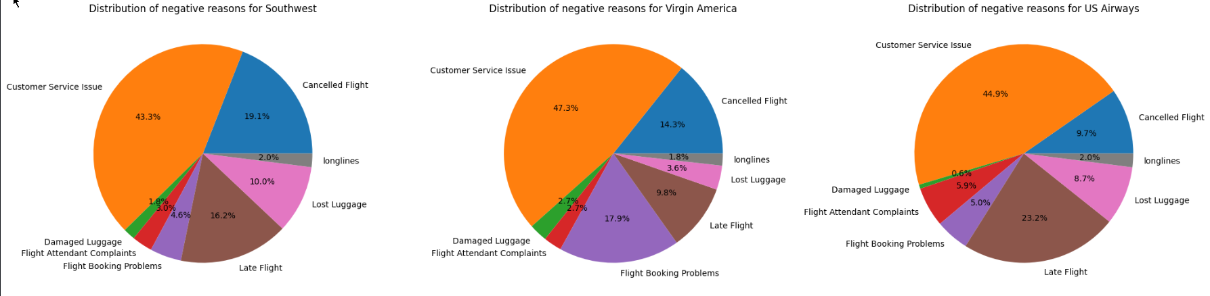
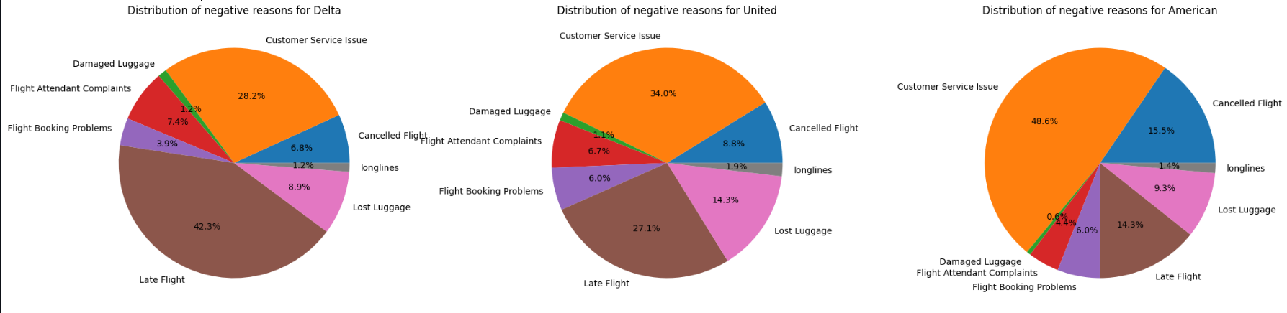
To provide a comprehensive view of the negative sentiments by airlines, we created six pie charts to display the distribution of negative reasons for each airline. This allowed for a visual comparison of the prevalent issues faced by different airlines.

Slide 12
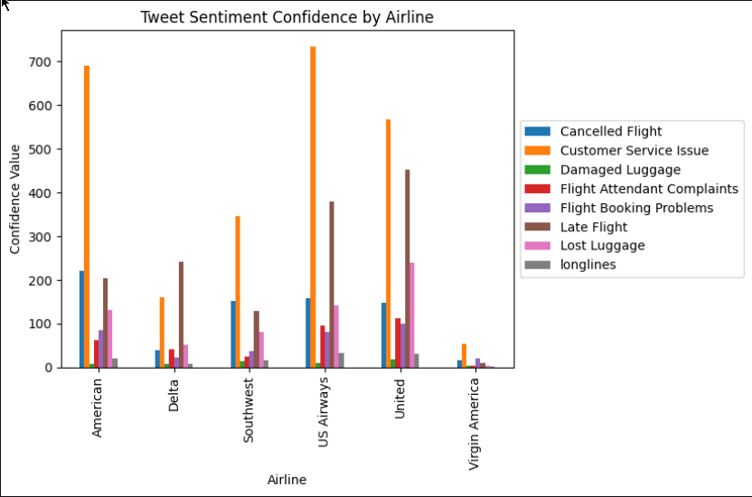
Additionally, we displayed a histogram of all the tweets to identify the most frequent negative reasons based on 'negativereason_confidence'. This helped us understand which issues were more commonly mentioned in the dataset

Slide 13
What algorithms did we use?
In the data modeling phase, we employed various clustering and classification algorithms to analyze the sentiment data. For clustering, we utilized K-means, Agglomerative Clustering, and DBSCAN algorithms, focusing on the 'negativereason_confidence' and 'airline_sentiment_confidence' columns. The evaluation of these clustering algorithms was based on metrics such as the Silhouette Score, Calinski-Harabasz Score, and Davies-Bouldin Index.

Slide 14
Quick Definitions
The Silhouette Score measures how well each data point fits its assigned cluster and ranges from -1 to 1, where a higher score indicates better clustering.
Calinski-Harabasz is a clustering evaluation metric that measures the ratio between the within-cluster dispersion and the between-cluster dispersion. The metric compares the variance between the clusters to the variance within the clusters and seeks to maximize the former while minimizing the latter. A higher Calinski-Harabasz score indicates a better clustering performance, meaning that the clusters are well-separated and compact.
The Davies-Bouldin index is a clustering validation metric that measures the average similarity between each cluster and its most similar cluster, compared to the distance between the clusters. It is defined as the ratio of the sum of the within-cluster distances to the between-cluster distances. A lower Davies-Bouldin index indicates better clustering, with a value of 0 indicating perfectly separated clusters. It is similar to the Calinski-Harabasz index but does not depend on the assumption of spherical clusters and is less sensitive to outliers.

Slide 15
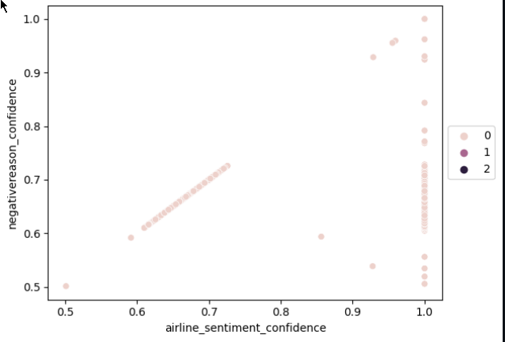
We utilized K-means clustering and Agglomerative clustering algorithms to group the data based on the columns 'negativereason_confidence' and 'airline_sentiment_confidence’.
Silhouette score: 0.38037570402412285
Calinski-Harabasz index: 8.959027968644058
Davies-Bouldin index: 0.37708544494911567

Slide 16
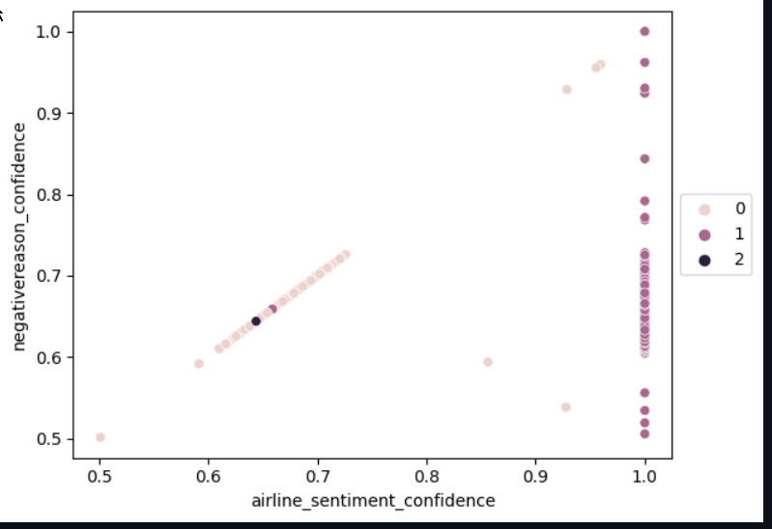
We utilized DBSCAN clustering algorithms to group the data based on the columns 'negativereason_confidence' and 'airline_sentiment_confidence’.
Silhouette score: 0.5342796567233222
Calinski-Harabasz index: 10.706572091829083
Davies-Bouldin index: 11.834786944071963

Slide 17
Multinomial Naïve bayes
Accuracy: 1.0
Classification report:
precision recall f1-score support
negative 1.00 1.00 1.00 1240
accuracy 1.00 1240
macro avg 1.00 1.00 1.00 1240
weighted avg 1.00 1.00 1.00 1240
The classification model, multinomial naive Bayes, achieved a remarkable accuracy of 1.0 on the test dataset. This means that it correctly predicted the class label for all instances, showcasing the effectiveness of these models in sentiment prediction. The classification report provided detailed information on the precision, recall, and f1-score for each class, with all metrics yielding a value of 1.0 for the "negative" sentiment class. The support column indicated that there were 1240 instances of negative sentiment in the test dataset.

Slide 18
Decision Tree
Accuracy: 1.0
Classification report:
precision recall f1-score support
negative 1.00 1.00 1.00 1240
accuracy 1.00 1240
macro avg 1.00 1.00 1.00 1240
weighted avg 1.00 1.00 1.00 1240
The classification model, Decision Tree , achieved a remarkable accuracy of 1.0 on the test dataset as well. This means that it correctly predicted the class label for all instances, showcasing the effectiveness of these models in sentiment prediction. The classification report provided detailed information on the precision, recall, and f1-score for each class, with all metrics yielding a value of 1.0 for the "negative" sentiment class. The support column indicated that there were 1240 instances of negative sentiment in the test dataset.

Slide 19


Which Algorithm(s) was the best?
Based on the results Multinomial NB and DecisionTreeClassifier produces the same Precison, Recall, F1-Score, and Support. We think Multinomial NB may be a better algorithm to use first because there are many features that are independent of one another. Which means each Feature provides unique and distinct information about the data.

Slide 20
Problem statement(s)
What are the most common complaints that customers have with the airport industry?
What are the chances of these issues resurfacing with different airlines?
Customer Service issue is the most common issue with the airport industry. The next most common Issue is Late Flight, and cancelled flight.
According to the algorithms used, There is approximately 100% chance that these issues will reappear with different airline.
According to the clustering used, there is a chance that customer service issue, late flight, and cancelled flight are most likely to happen again

Slide 21
references
https://realpython.com/k-means-clustering-python/
https://www.mygreatlearning.com/blog/multinomial-naive-bayes-explained/
https://www.w3schools.com/python/python_ml_decision_tree.asp
https://www.kaggle.com/datasets/crowdflower/twitter-airline-sentiment
https://chat.openai.com/

