Slide 1

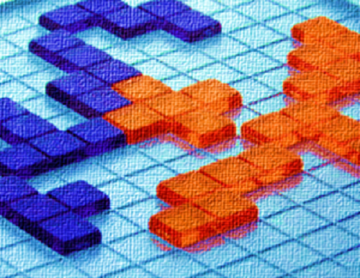




BLOKUS DUO AI STRATEGY
XVI Jornadas sobre Sistemas Reconfiguráveis
Instituto Superior Técnico, Lisboa
10 Fevereiro 2020
Competição BlokusDuo’20
Current board state
….
….
1st Layer of Plays
2nd Layer of Plays
The AI is going to scan every possible play from the current board state and to each of them, do the same again 3 more times.
….
After doing so, it’s going to backpropagate a value.
Before the match, an algorithm determined what are the best coordinates on the board to each player.
Each play found will have a value corresponding to how many optimal coordinates the latter has occupied.
After analysing and trimming some unnecessary plays, the AI makes the play that will, in the future, put the player in the best position. (In the image, green is the general direction in which are the best coordinates while red is the opposite)
Organização: Patrocínios:

