Slide 1
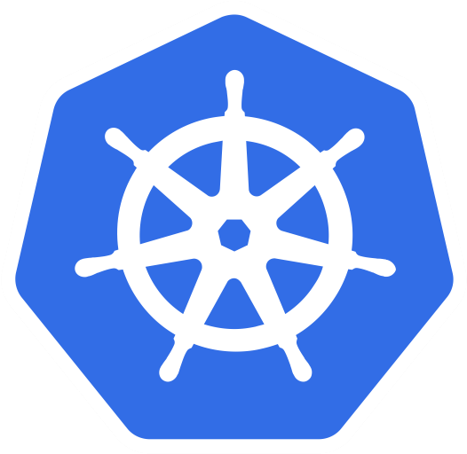
Cloud-native App
Web
Indexer
Auth
RBAC
Store
Kubernetes
Infrastructure
(On-premises/cloud)

Slide 2







App
K8s
K8s
K8s
Cloud A
On-prem
Cloud B

Slide 3
App
K8s
K8s
K8s
Cloud A
On-prem
Cloud B

Slide 4
App
K8s
K8s
K8s
Cloud A
On-prem
Cloud B

Slide 5
App
K8s
K8s
K8s
Cloud A
On-prem
Cloud B

Slide 6
App
K8s
K8s
K8s
Cloud A
On-prem
Cloud B

Slide 7
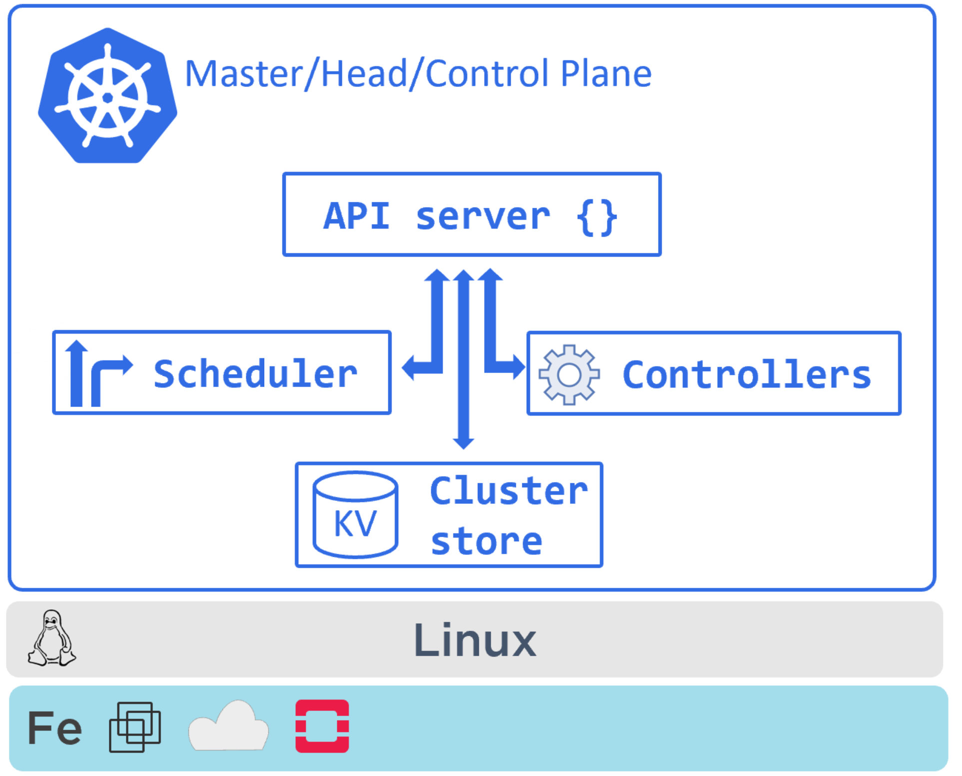

Slide 8
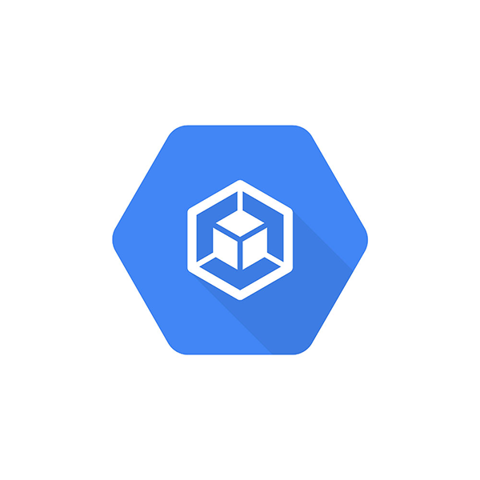


Hosted K8s services
Azure AKS
Google GKE

Slide 9
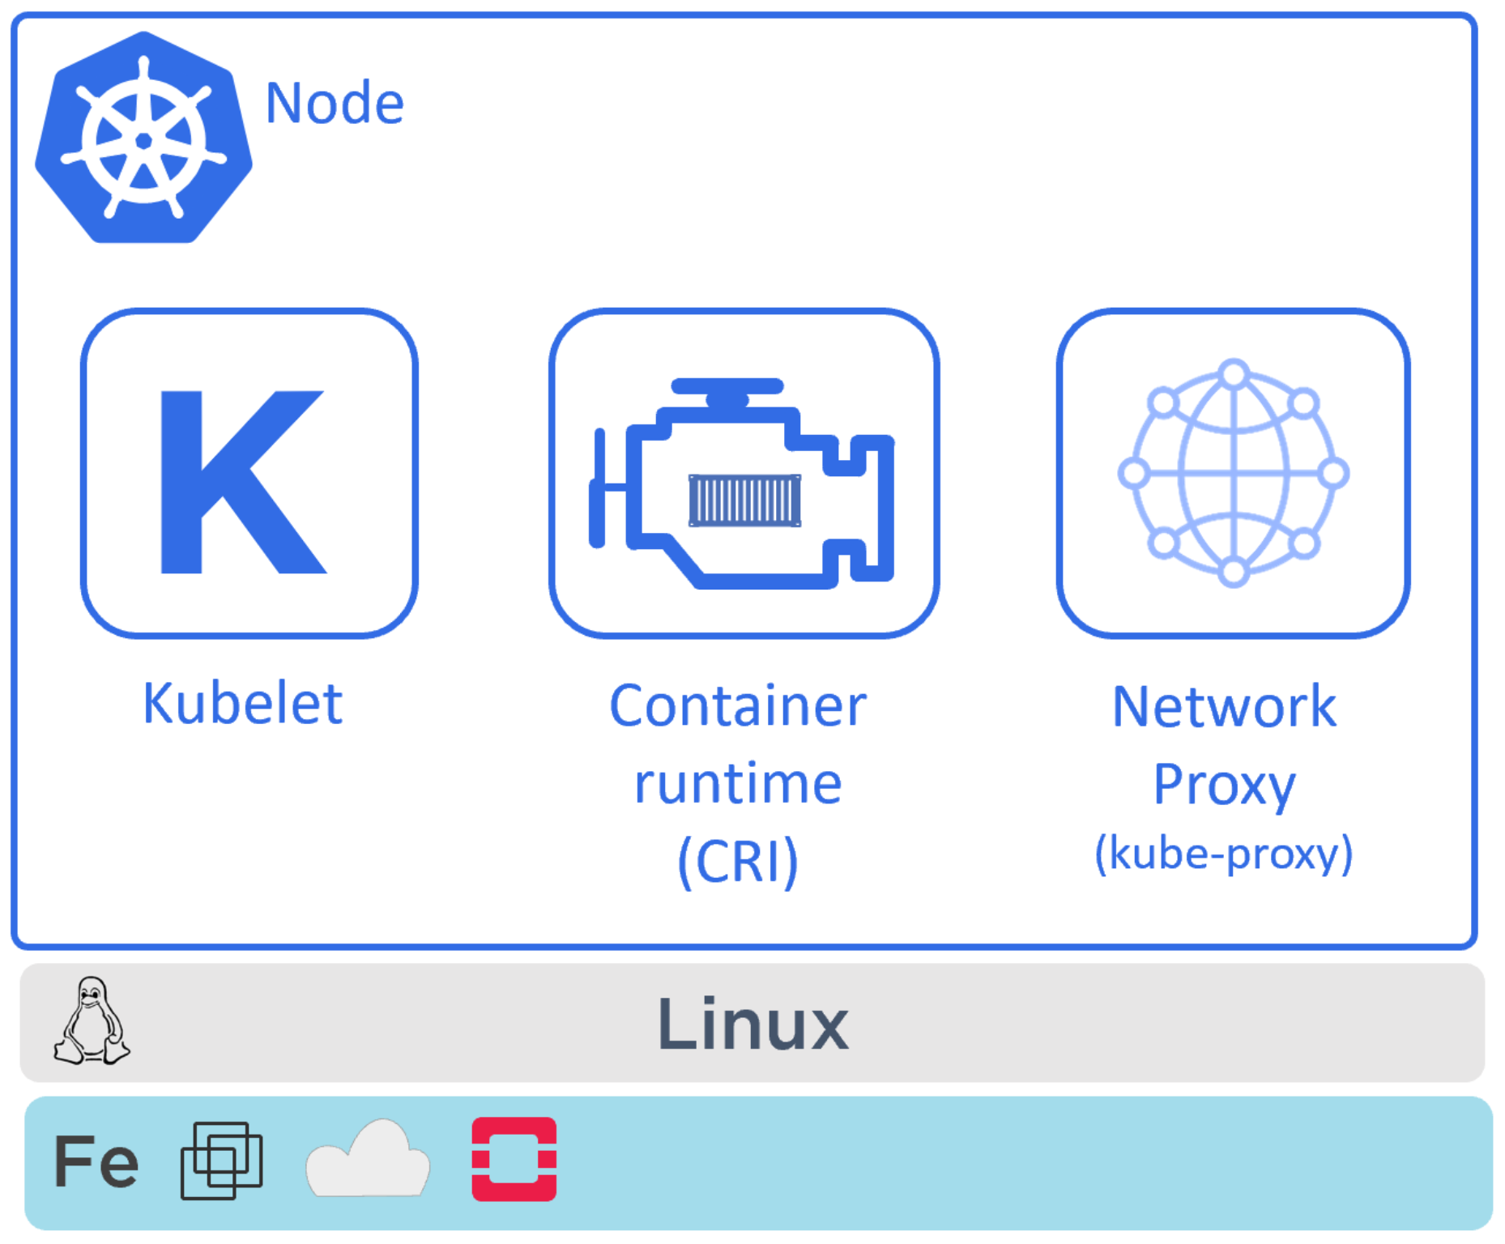

Slide 10
The Big Picture
From Code to Kubernetes
Idea
[Container registry]
package main
import (
"fmt"
"reflect"
)
func main() {…
Business
requirement

Slide 11
The Big Picture
From Code to Kubernetes
[Container registry]
package main
import (
"fmt"
"reflect"
)
func main() {…

Slide 12

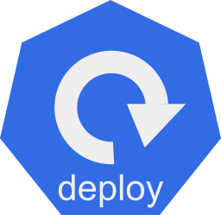
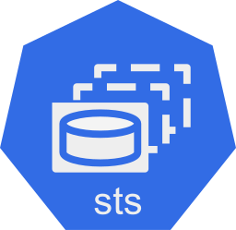
The Big Picture
From Code to Kubernetes
[Container registry]
package main
import (
"fmt"
"reflect"
)
func main() {…

Slide 13
The Big Picture
From Code to Kubernetes
[Container registry]
package main
import (
"fmt"
"reflect"
)
func main() {…
Coding
Docker
Kubernetes

Slide 14
spec:
selector:
matchLabels:
app: web
replicas: 10
strategy:
type: RollingUpdate
template:
metadata:
labels:
app: web
zone: prod
version: v1
spec:
containers:
- image: nigelpoulton/k8sbook:latest
name: web-ctr
ports:
- containerPort: 8080

Slide 15
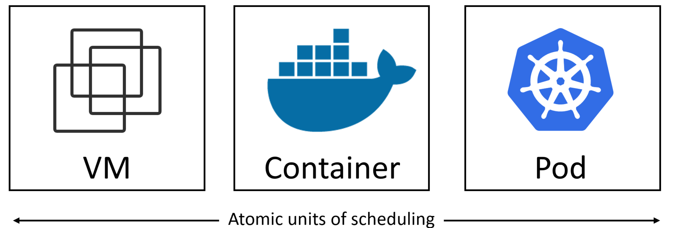

Slide 16
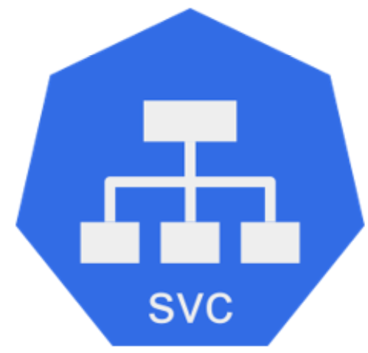
Node:port
(node1:30001)
apiVersion: v1
kind: Service
metadata:
name: svc-np
labels:
app: web
spec:
type: NodePort
ports:
- port: 8080
nodePort: 30001
selector:
app: web
Port: 8080
Pods: All with `app=web`

Slide 17
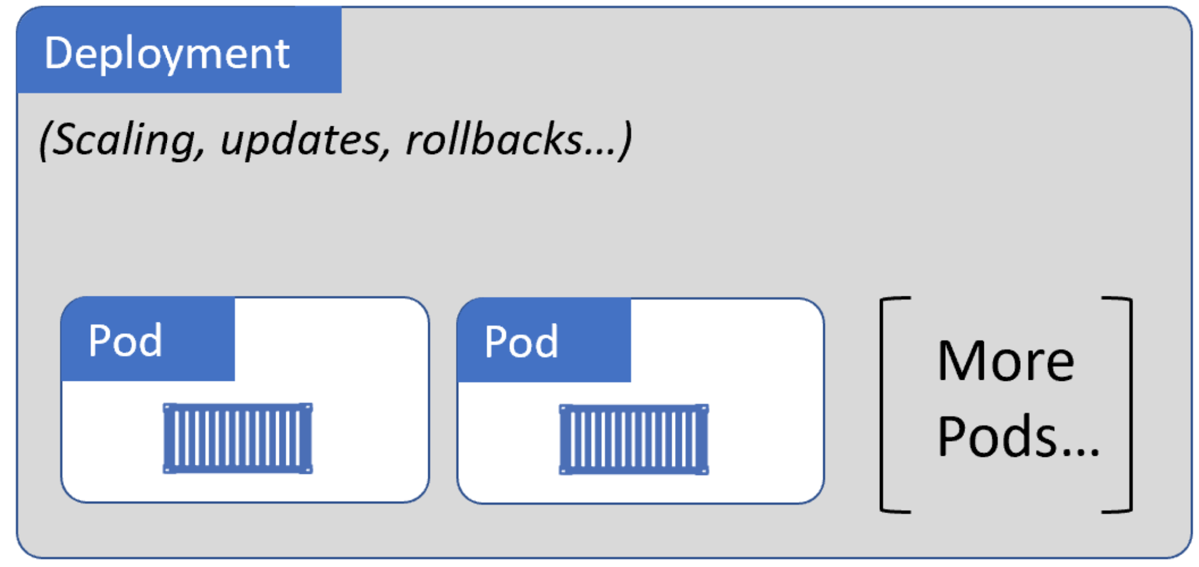

Slide 18

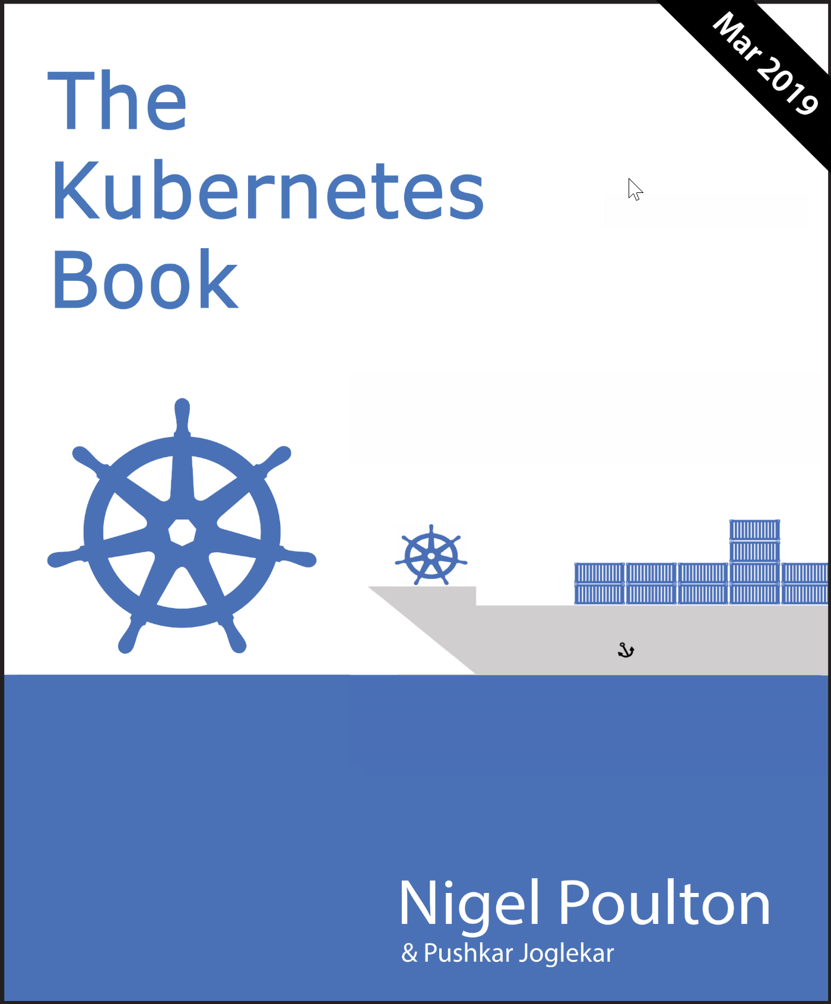

Amazon paperback
Amazon Kindle
Audible audiobook
Leanpub eBook
@nigelpoulton
Getting Started with Kubernetes - pluralsight.com
Kubernetes Deep Dive - acloud.guru
Courses

