Slide 1
Modern Jukebox
Maeva butaye
Pauline monteil
Camille schwarz
lÉo galassi
Quentin rimet

Slide 2
Outline
Problematic
Presentation of our tutored project
What is our project composed of ?
Demonstration

Slide 3
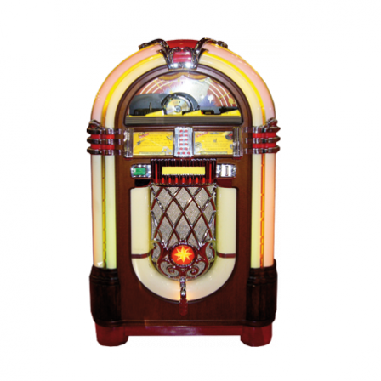
Problematic
Jukebox → a public device who play automatically music.
Goal of our project → improve capacity of a classical jukebox by introducing modern technologies.
Some problems with an old Jukebox (limited content, few interactions between the people who are in the same place).

Slide 4



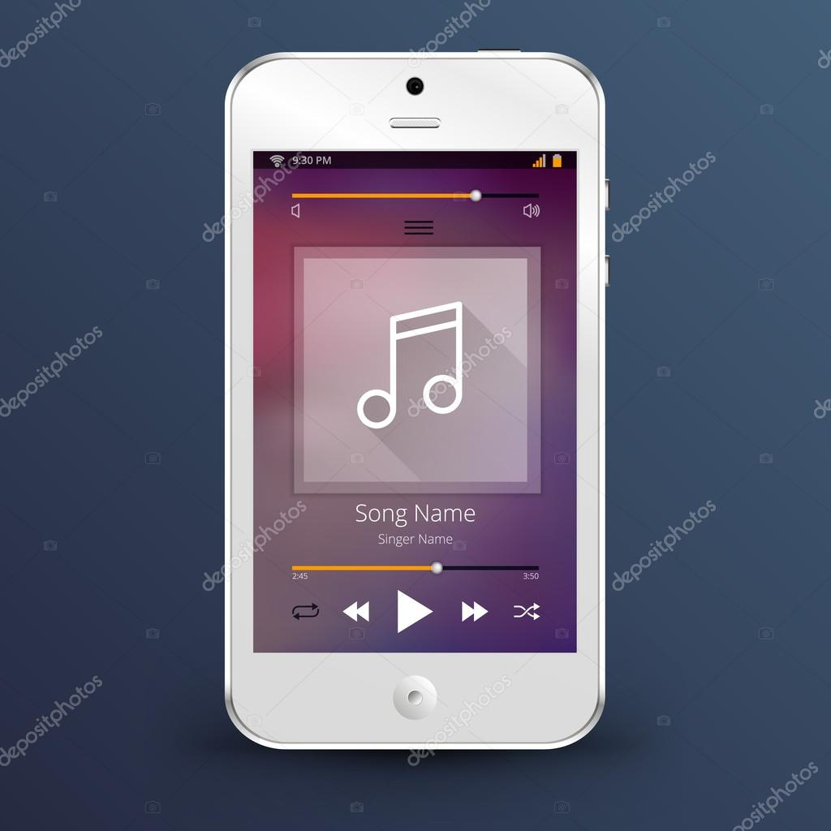

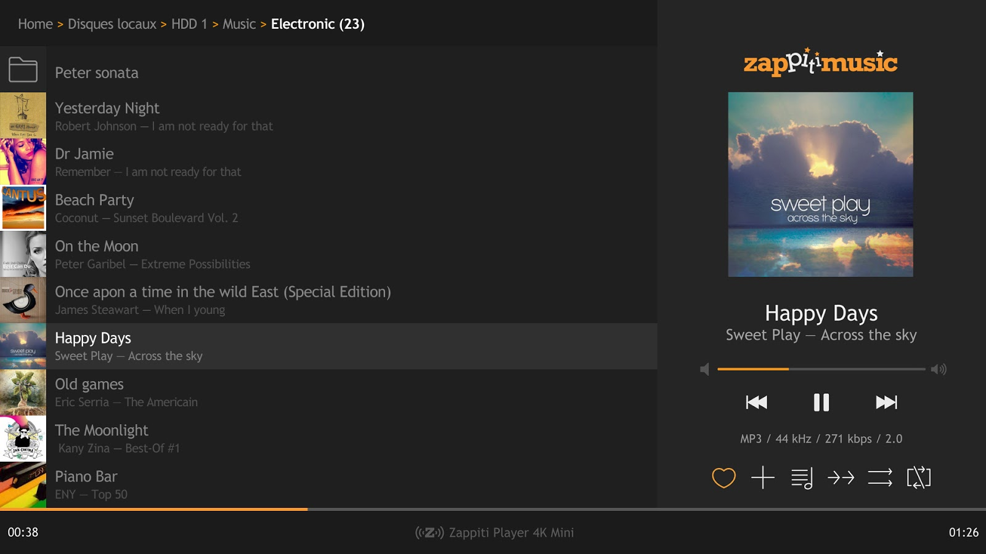
Presentation of our tutored project
Admin
Bartender application
Jukebox
Service
Customer application

Slide 5
What is our project composed of ?
Web application : the jukebox.
Programmed with electron on a Raspberry Pi and the front-end use vuejs.
Jukebox → connected to loudspeakers.
It collects all music in the queue to play them one by one. At the end of each music, it delete the first one to go to the next music.
On the screen of the jukebox we can find all data on the current music and the following music.

Slide 6
What is our project composed of ?
2 mobile applications : one for bartenders and one for customers.
Programmed with cordova and the front-end use vuejs.
Bartender application → the bartender can manage his jukebox library by adding or removing music. He can also check music in the queue.
To connect the customer application with the jukebox you have to flash a QR Code which is on the screen of the jukebox.
On this application, we can see the data of the current music and all music in the queue.
In the near future, we will be able to vote to go to the next music or to replay the current music.

Slide 7
What is our project composed of ?
All these applications use a server which is on Quentin’s webetu.
Developed with Slim3, which is a PHP micro framework.
We have a database programmed with MySQL, which contains all data that we need.
If the server is down, then all of our applications do not work anymore.

Slide 8
Demonstration

Slide 9
Thanks for listening!

