Slide 1

COVID-19
David Holley

Slide 2
Data Cleansing and Analysis
Grouping
Sorting
Cleansing

Slide 3
Analysis by Coastal Region
I wanted to analyze the Covid-19 pandemic by geographical region
Initially, I planned to compare countries and continents (Thank God for Agile)
Assessing the United States was much more telling in terms of what should possibly be done moving forward
From the data we can see that NY did well in combatting the crisis and states with less populated major cities and little activity within its metropolitan areas did well in combatting the virus as well
Metrics to be examined: Fatality ratio based on region, death increase rate, hospitalization rate

Slide 4
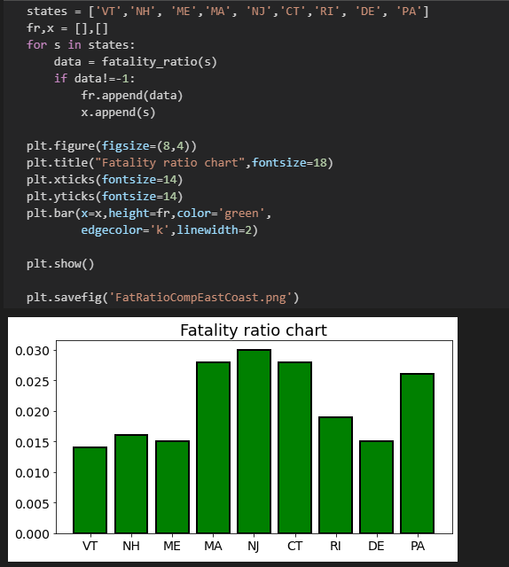
Notes:
The fatality ratio for the East coast. Places like Vermont, New Hampshire, Deleware, and Maine where the population is vastly different from NJ and NY the fatality ratio is very good in comparison to their east coast bredren NY, PA, CT, NJ.

Slide 5
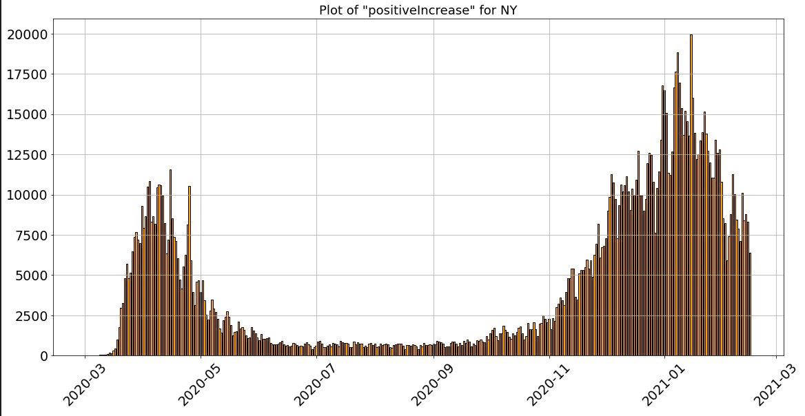
Notes:
Positive increase for NY – You can see throughout the summer and into November NY made great strides against the virus.
A sudden peek came about when the holiday season hit and the new year began. Its almost like were going backwards in NY

Slide 6
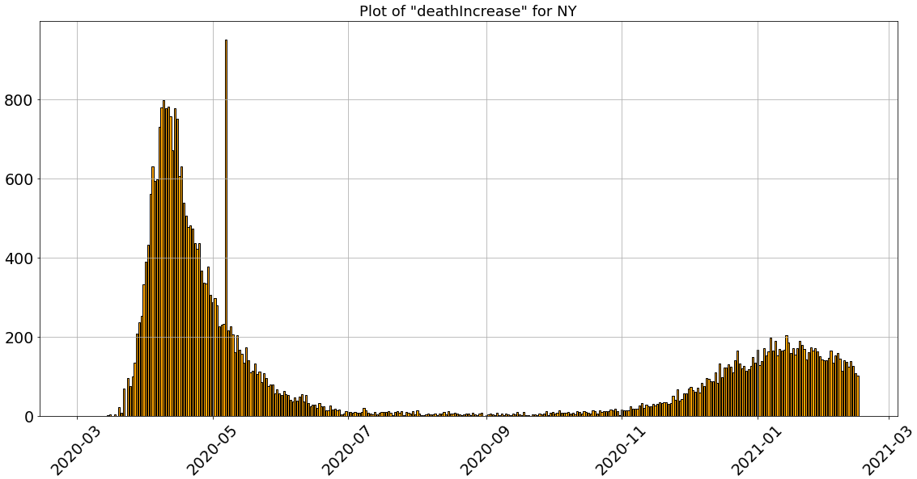
Notes:
The death increase in NY is not as alarming as the rise in cases. In comparison to last year the death rate is expected to be dismal in comparison to last April vs. this April.

Slide 7
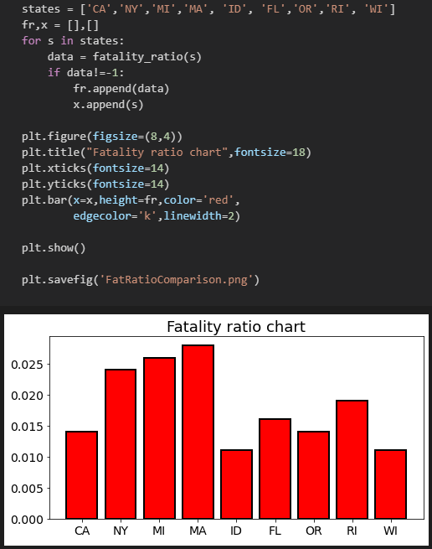
Notes:
I wanted to compare some of the more known states and larger metro areas. In terms of fatality, it is my estimation that the weather plays a role and the states likelihood to have multiple metropolitan areas. NY, MI, MA are among the highest for this graph. Granted Wisconsin is very cold. Yet, the metro area of Milwaukee has not experienced the same fatality rate of MA, MI, NY or even PA.

Slide 8
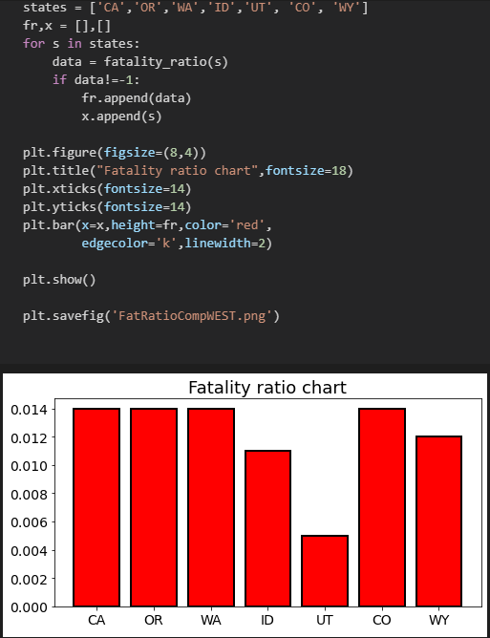
Notes:
West coast = High Covid Fatality

Slide 9
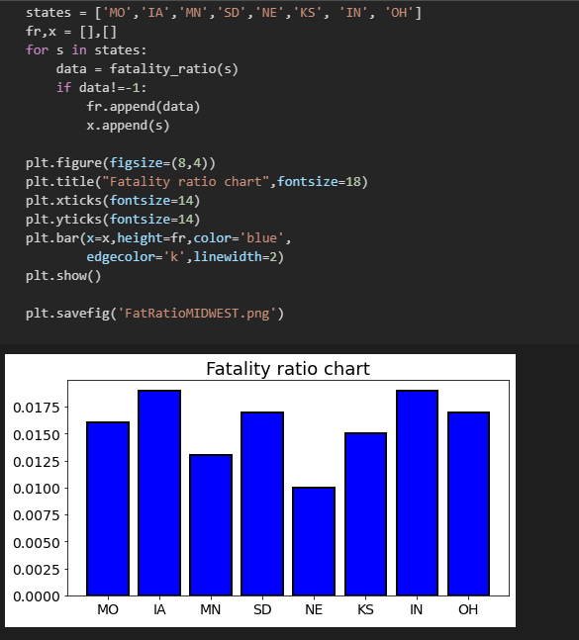
Notes:
Mid west Fatality rate is high in comparison to the east coast, and the west coast. Places like Iowa, South Dakota, and Indiana are alarmingly high

Slide 10
Summary
COVID-19 has taken a great number of lives
Social distancing and systematic combative approaches are obviously helping in many cases
In particular, NY with making such great strides to only revert back to high case numbers and growing fatality rates
Based on region, the west coast has it bad, some metropolitan areas are prime for systematic approaches to combat the virus, but social distancing may not be enough

