Slide 1
Requirements for Analysis
Population Distribution Raster
All-Season Roads
Differentiation between rural and urban areas
→ ghspop raster + OSM data via ohsomeAPI

Slide 2
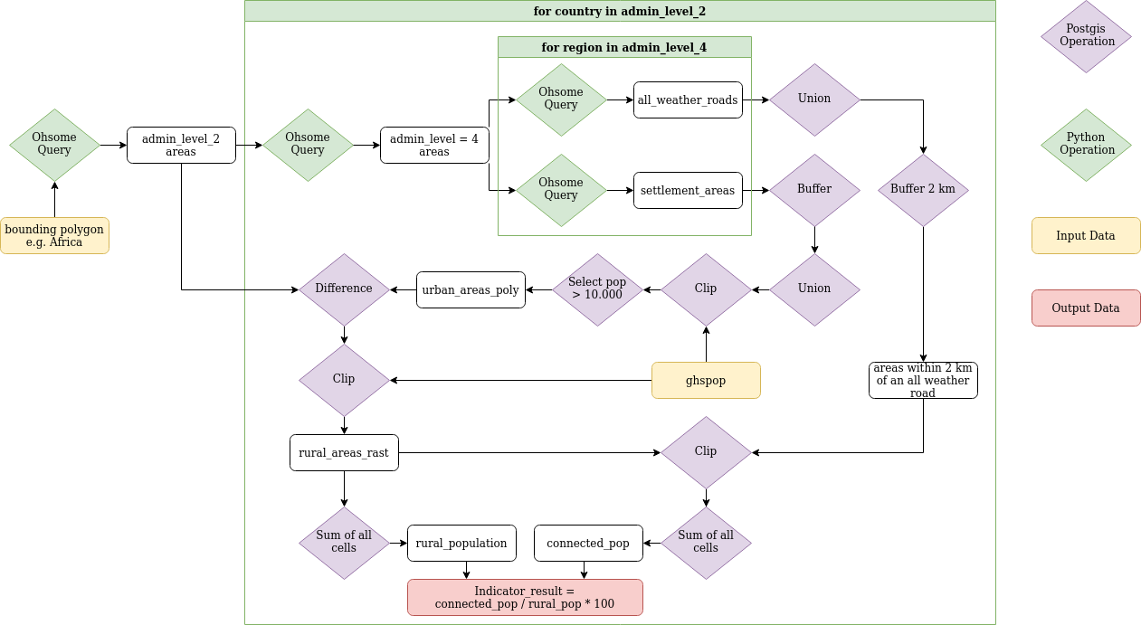
Infrastructure Workflow

Slide 3
Infrastructure Workflow
→ Queries in Python to ohsomeAPI
all_weather_roads query:
geometry:line
and highway=* and highway!=footway and highway!=bridleway and highway!=steps and highway!=path and highway!=sidewalk and highway!=cycleway and seasonal!=yes and surface in (paved, asphalt, concrete, paving_stones, sett, cobblestone, unhewn_cobblestone, metal, wood) and smoothness!=bad and smoothness!="very bad" and smoothness!=horrible and smoothness!="very horrible" and smoothness!=impassable
settlement_areas:
(
leisure = park
or landuse in (residential, commercial, industrial, retail)
)
and geometry:polygon

Slide 4
Infrastructure Workflow
→ SQL Queries in Postgis

Slide 5
Infrastructure Workflow
→ SQL Queries in Postgis

Slide 6
Infrastructure Workflow

Slide 7

Final Solution (for Australia)
39,48%

Slide 8
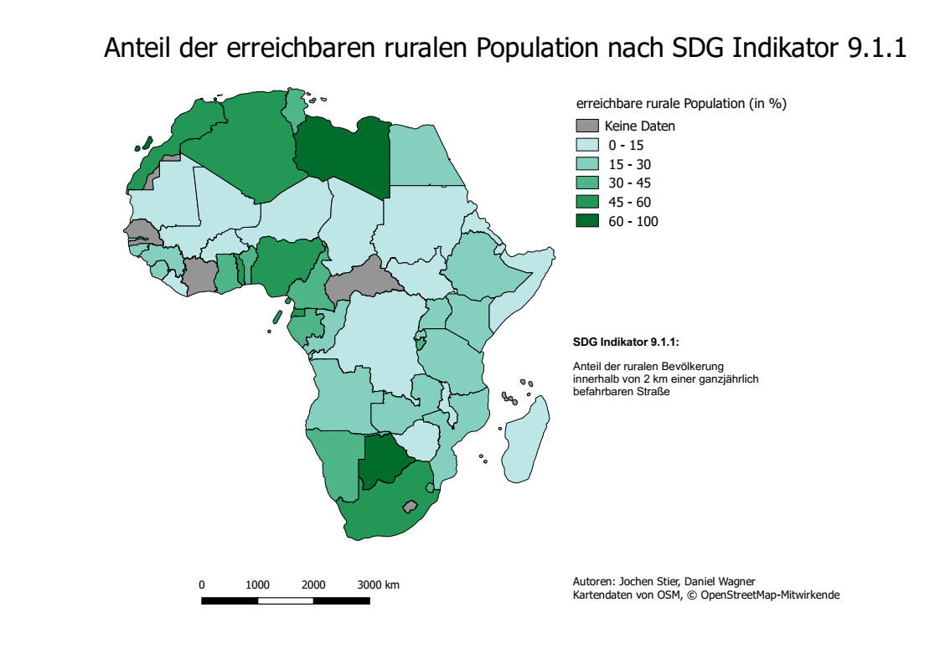

Slide 9
Issues
No tag for all-weather-roads
Features not existing vs. Features not mapped
Accuracy of base data

