Slide 1
GIS analysis with free and open source software
Group 2 – Final Presentation
Czizewski Philippé | Stier Jochen
WS 18/19
Ruprecht – Karls Universität Heidelberg
Instructors: Bruns Julian, Ludwig Christina

Slide 2

What is the task?
Connectivity analysis for public transportation
„How fast can you reach the civic center from the rest of the city by public transportation?“

Slide 3
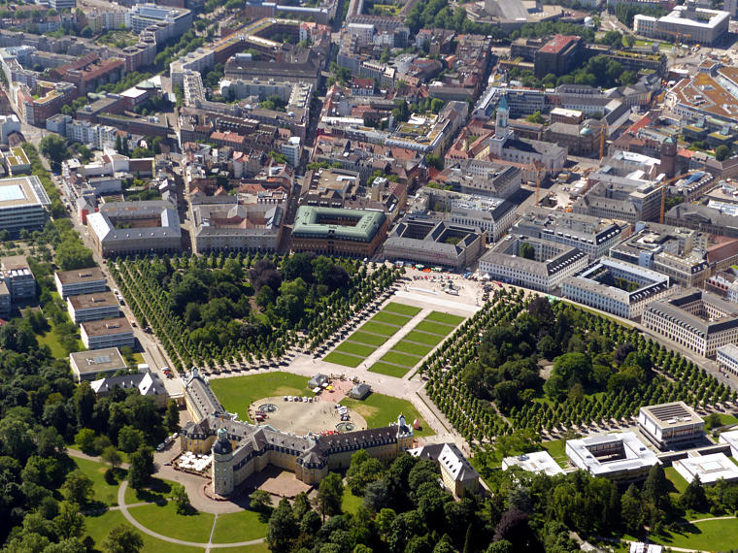
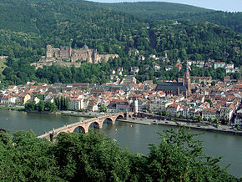
Primary study areas:
Tested for ‚Karlsruhe‘ and ‚Heidelberg‘
Pros:
    Both are mapped with great detail
    Both have a solid infrastructure
    Familiarity with the study area (at least partially for Karlsruhe)

Slide 4
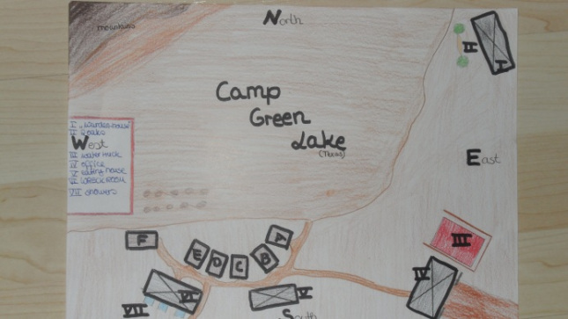

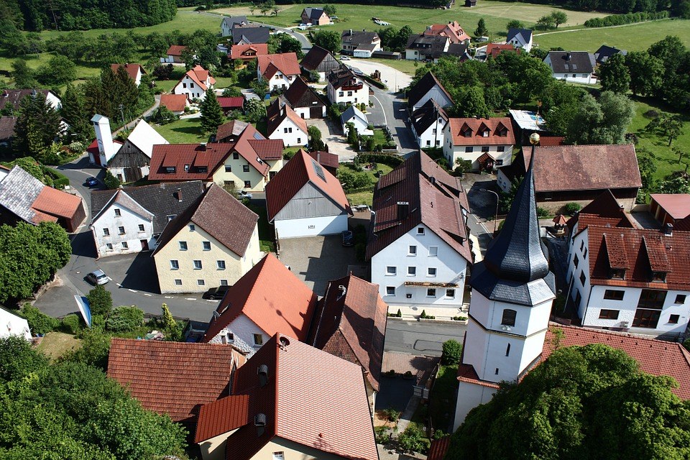


Important factors:
Quality of input data in general (completeness, accuracy)
Quality of public transport (rhythm, range, average speed)
Size of City (Subways and trains currently not included in script)
Location of Central point

Slide 5
Data Sources:
Data Sources:
OSM-Data (acquired through Overpass-Turbo, pre-prepared with QGIS):
  Streets
  Busstops/lines
  Tramstops/lines
Digitization
  Central Point
Wikipedia-Knowledge (acceptable in test-scenario)
  Average speed of tram/bus lines and speed while walking

Slide 6
Most important steps of the analysis:
Tool: Grass-GIS
with Simple Python Editor
speed
*3
Routes
cleaning
iso-net
Network 1
Central Point
Stops
*3

Slide 7
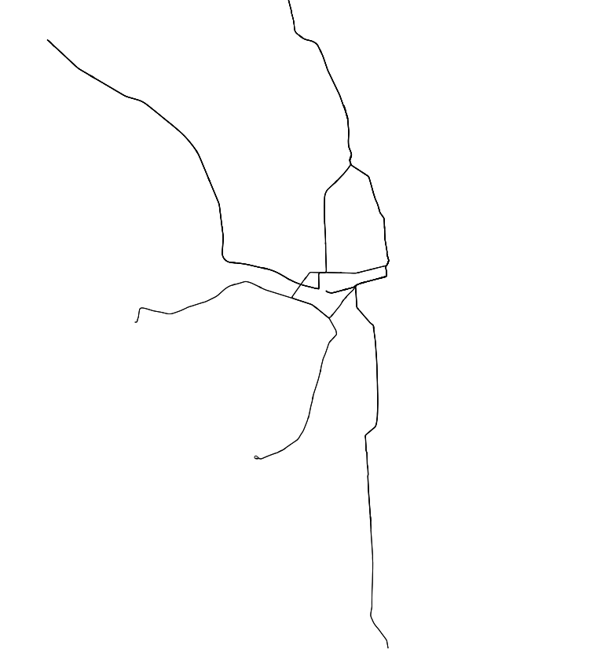
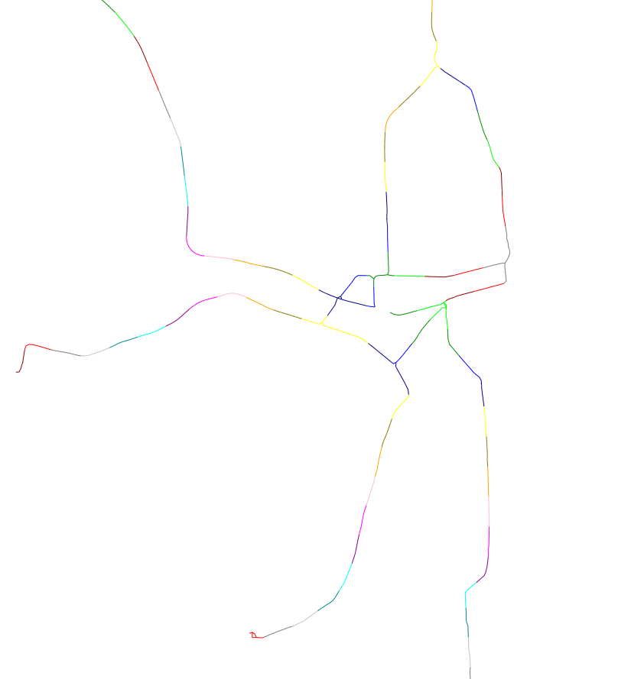
Tram → Network1_Tram
speed
*3
Routes
cleaning
iso-net
Central Point
Extracting costs
Stops
*3
adding costs
rhythm

Slide 8
speed
*3
Routes
cleaning
iso-net
Network 1
Central Point
Extracting costs
stored here
Stops
*3
Streets
cleaning
iso-net
Network 2

Slide 9
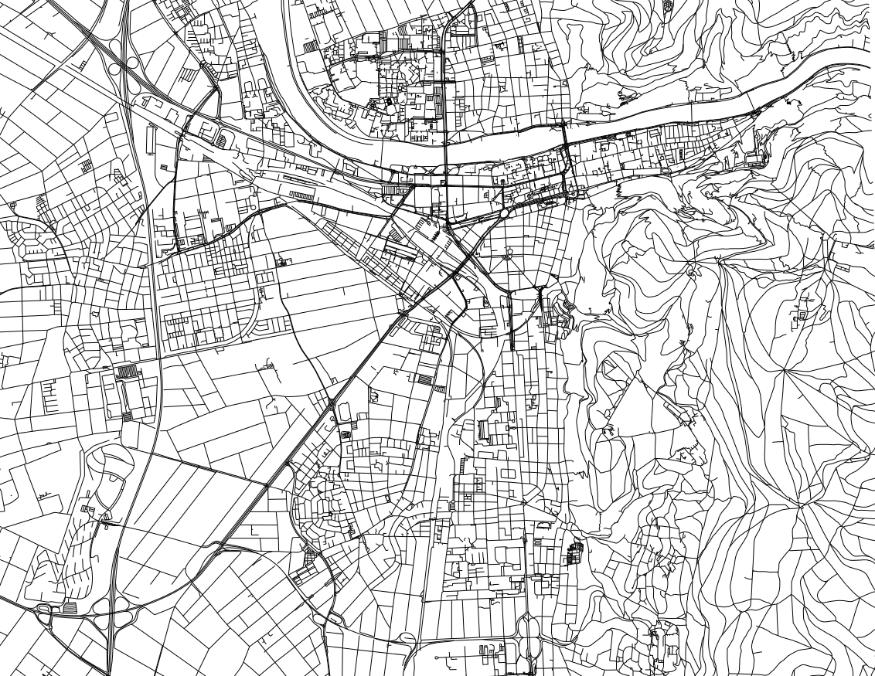
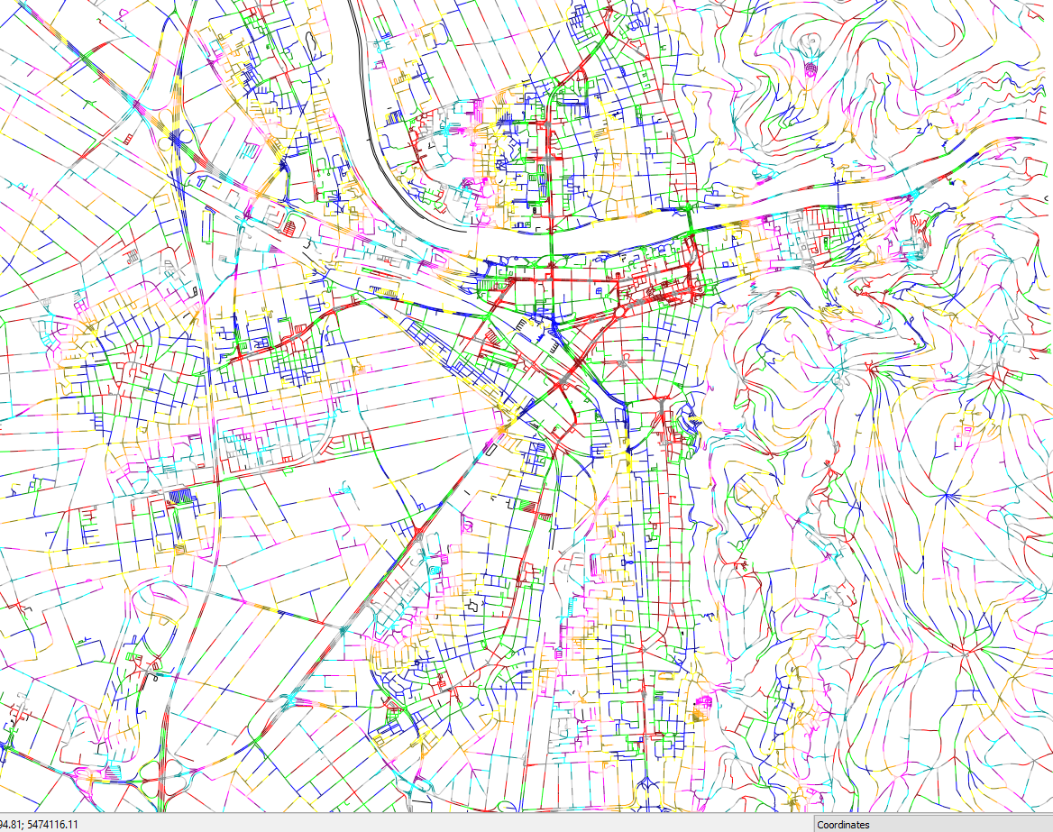
Streets → Network2_Tram
speed
*3
Routes
cleaning
iso-net
Network 1
Central Point
Extracting costs
Stops
*3
stored here
adding costs
rhythm
Streets
cleaning
iso-net
Network 2

Slide 10
speed
*3
Routes
cleaning
iso-net
Network 1
Central Point
Extracting costs
Stops
*3
stored here
adding costs
rhythm
Streets
cleaning
iso-net
Network 2

Slide 11
Adding costs → connecting both networks
speed
*3
Routes
cleaning
iso-net
Network 1
Central Point
Extracting costs
Stops
*3
stored here
adding costs
rhythm
Streets
cleaning
iso-net
Network 2

Slide 12
speed
*3 (bus, tram, both)
Routes
cleaning
iso-net
Network 1
Central Point
Extracting costs
streets with
lowest costs
Stops
*3
stored here
adding costs
calculating
lowest value
rhythm
Streets
cleaning
iso-net
Network 2

Slide 13
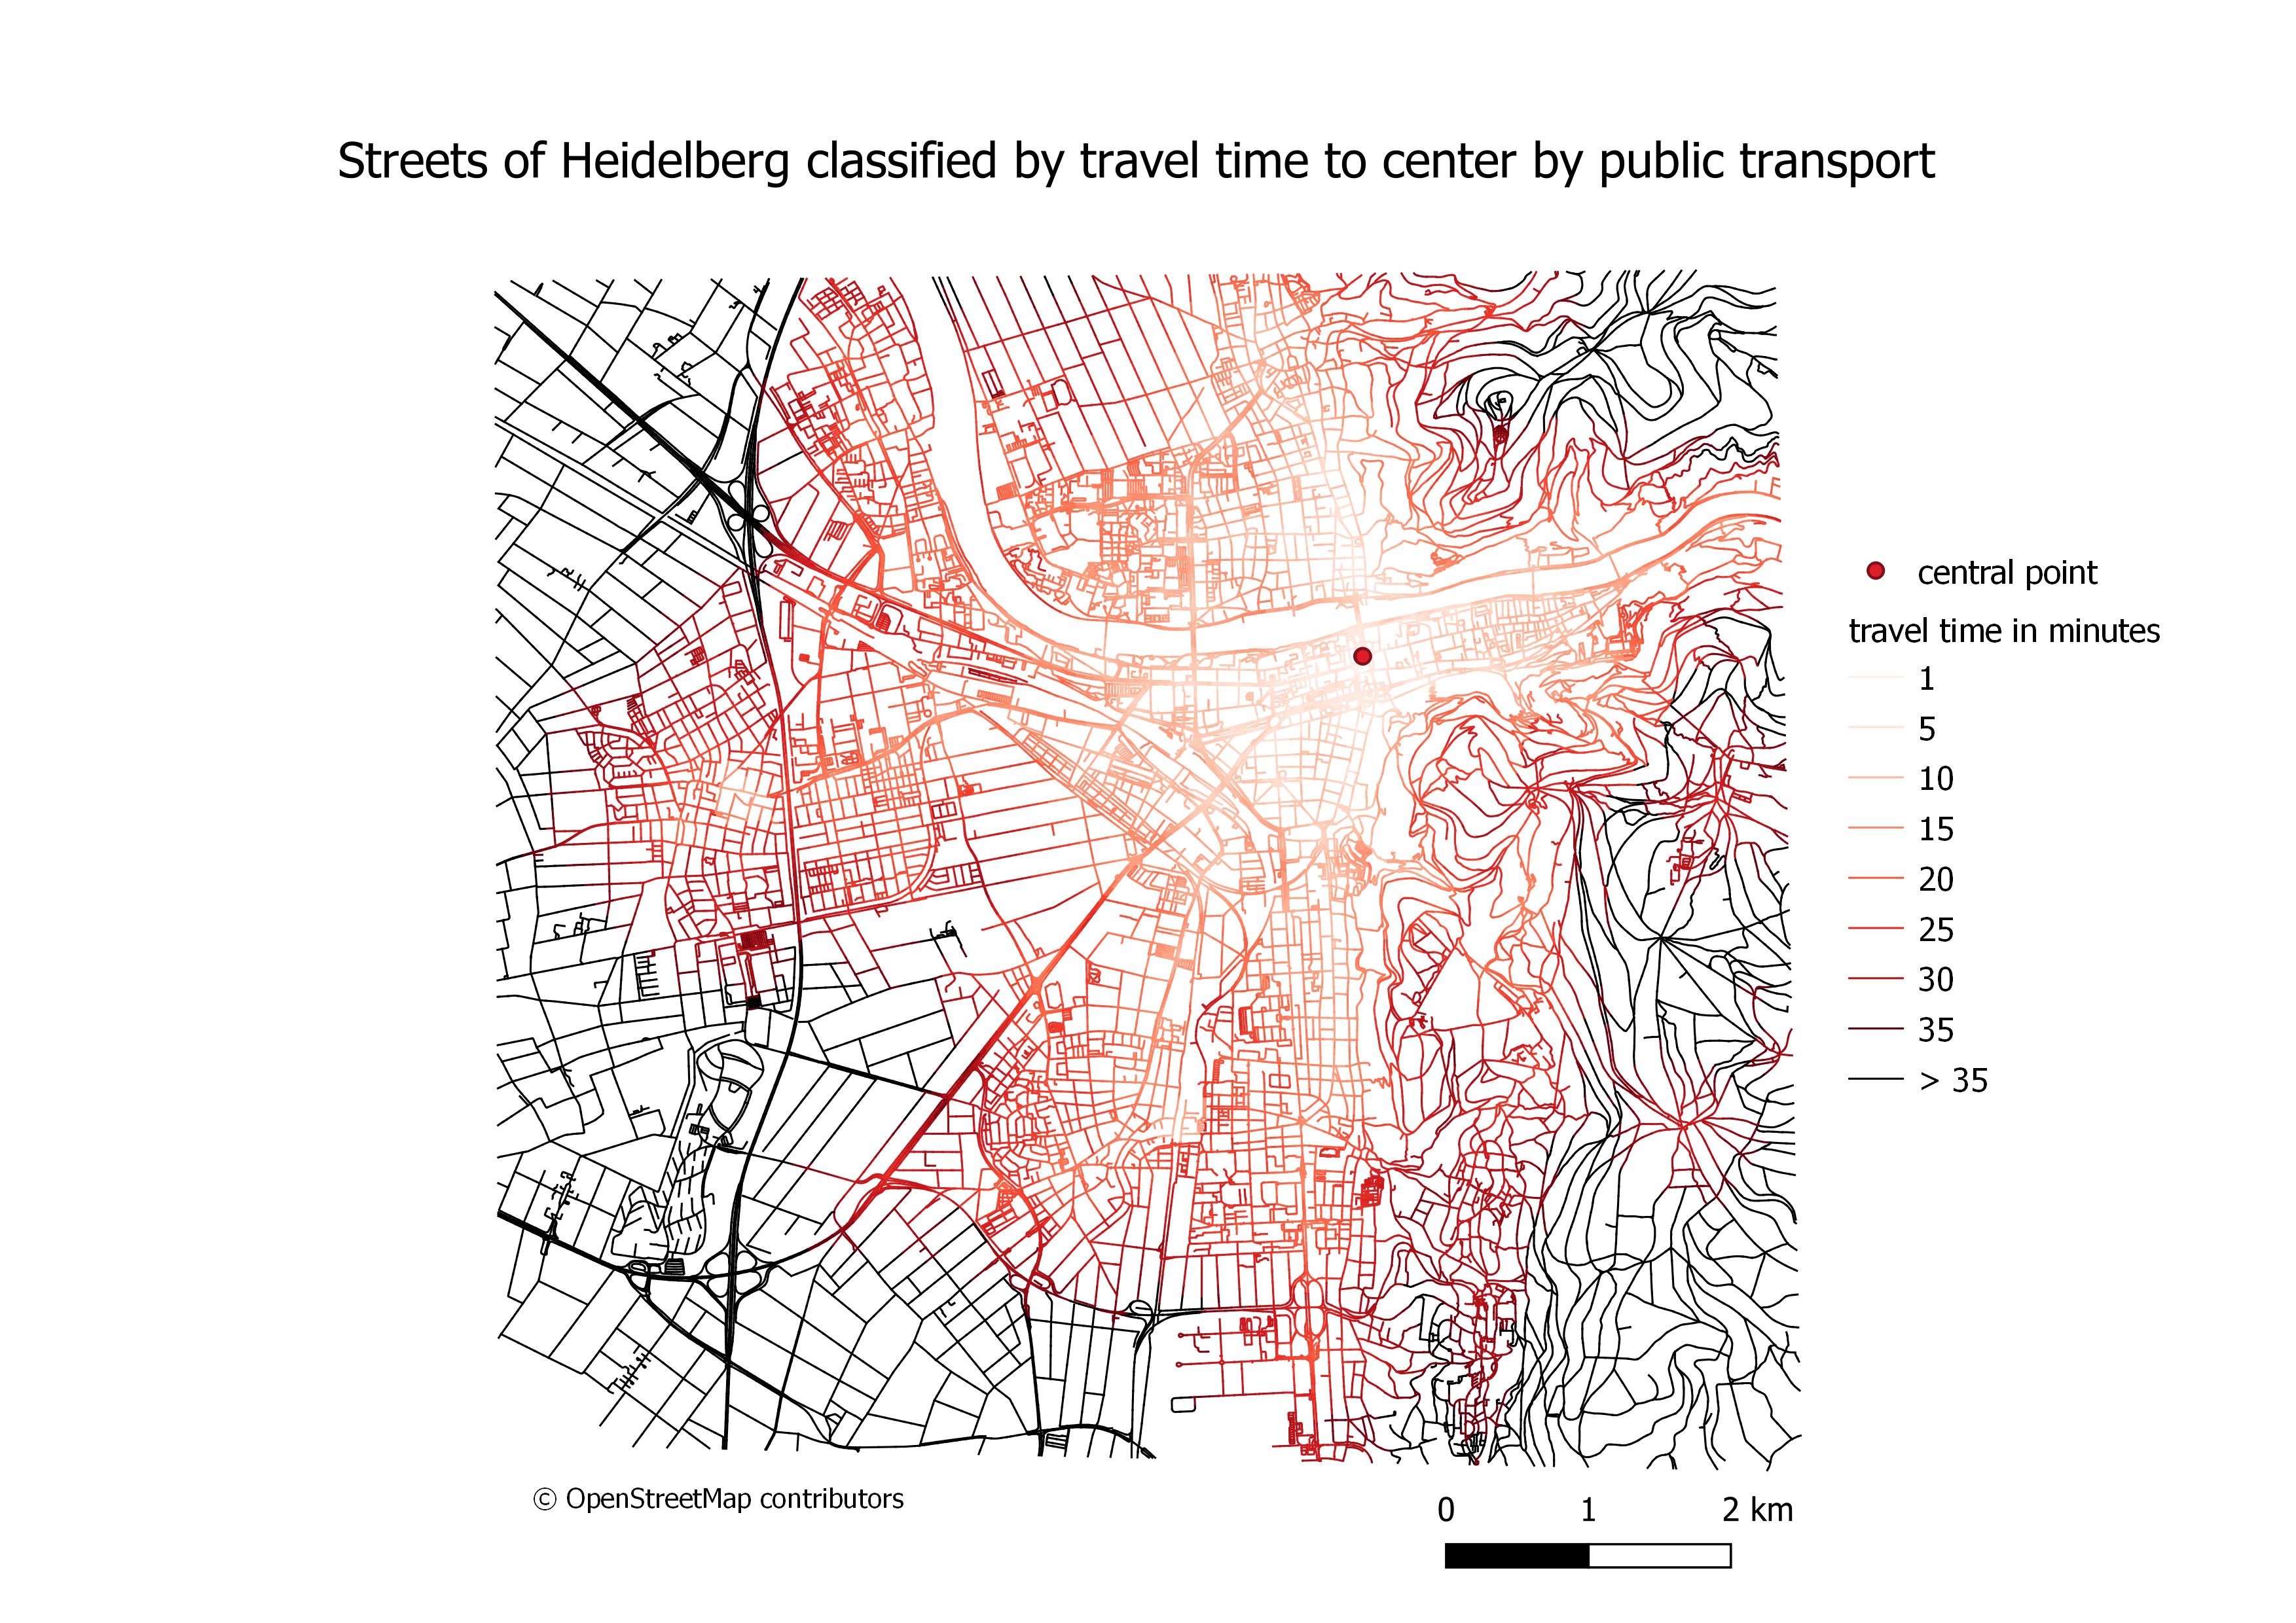

Slide 14
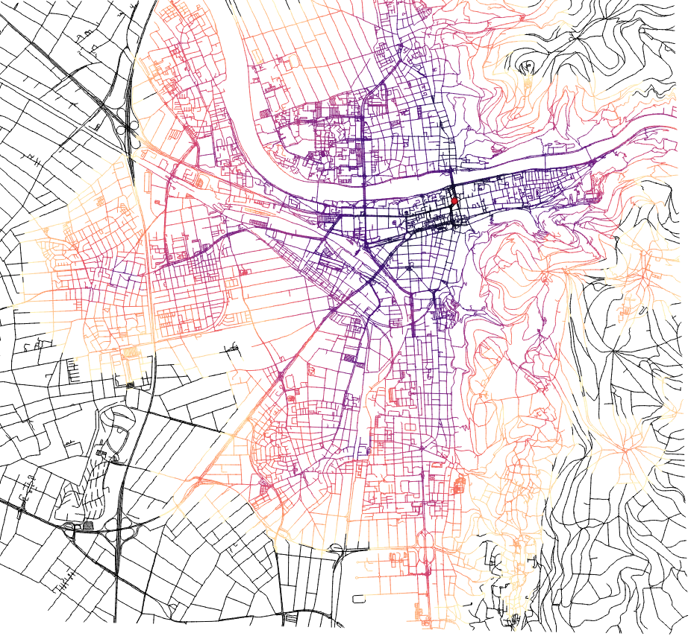

Slide 15
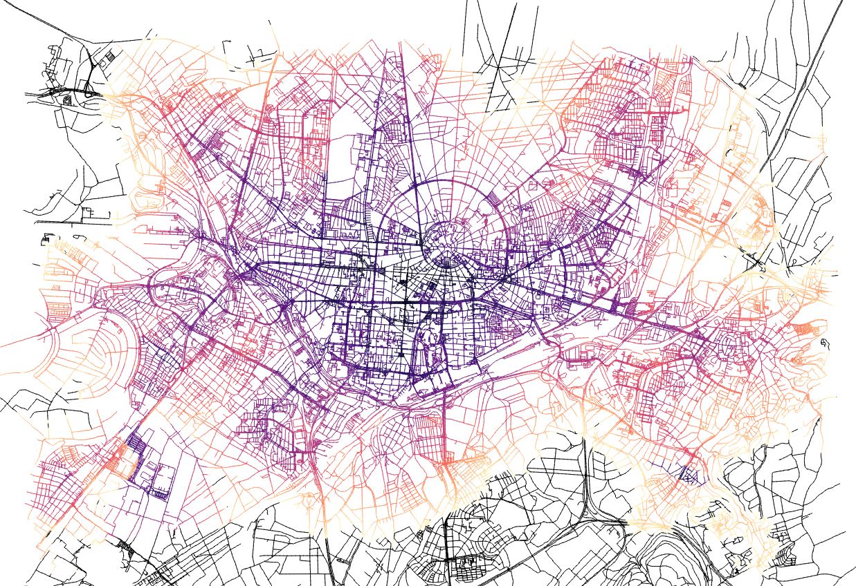

Slide 16
Encountered problems (and solutions):
SQL Errors during importing → Column names had SQL-reserved words
  → solution: Renaming columns in QGIS
Connecting costs of networks
  → solution: using “v.distance“ from net1 to stops, then from stops to net2
SQL Error with grass-tool “v.distance“ → uses key word “from“ for input map
  → solution: Underscore after key words solves collision → from_ = “...“
Implementing a way to change between lines
  → solution: Error 404 not found
      → dirty solution: combing both lines, then adding a „waiting“-penalty
But why :(

Slide 17
Current limitations (and potential improvments):
Executing takes a long time → 5 minutes for HD, 14 minutes for KA
  → better algorithms/algorithm use
Sub-optimal implementation for switching lines
Not always good data for average tram/bus speed
  → actual time between stops could be implemented with better data
Central points not always easy to pick

