Slide 1
Beware
Be Cyber aware
Josh Hollyfield
Notes:
- Welcome
Hello everyone!
I'm Josh, you might have seen me in the building a bit the past few weeks.
I've been looking your organisation's cyber security posture but today I'm here to give you a brief overview of risks we face in our day to day use of technology .
And not to beware but to
click
Be Cyber Aware [Audience rolls their eyes]
I will stop after each section and take questions about that particular topic so feel free to ask if there's anything you need to know.
Now let's start

Slide 2
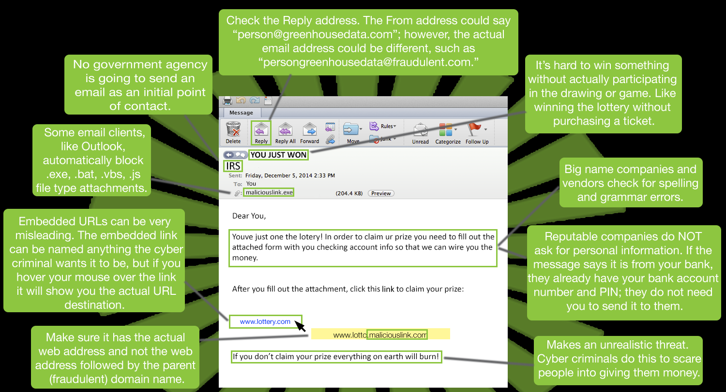
Phishing
Vishing, smishing, spear phishing, whaling
Notes:
- Phishing
One of the most common attacks you will deal with is the phishing attack.
These are done by attackers to trick people into disclosing personal information that is then used to access people's accounts or commit identity theft. Usually in the form of an email, there are other types as well
[CLICK]
Vishing – Voice/phonecalls
Smishing – via text message
Spear fishing – these target specific people
Whaling – Target high value people such as CEOs
They vary in complexity from crude emails like the one on this page to incredibly accurate forgeries of corporate emails so it is important to pay attention to the messages you receive and not enter your details whenever a site requests it.
Phishing is one form of social engineering

Slide 3

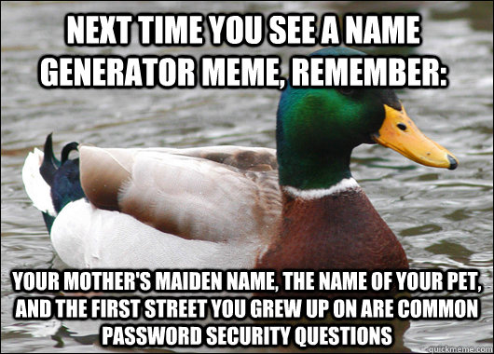
Social Engineering
A manipulation technique that exploits human error to gain private information, access or valuables.
Online or IRL
Notes:
- Social engineering
[read definition][click]
It's worth knowing about this as it happens both online and IRL (that's in real life )
The term can be used to describe techniques used by con artists and grifters
[click]
If anyone is familiar with the film Catch Me if You Can, Frank Abagnale makes good use of social engineering techniques. Taking advantage of people's assumptions and trusting nature for profit.
An example of this in a professional environment might be asking someone to let you in to a building as you've forgotten your key, when in actuality you don't work there.
It can be just as easy to disclose information online.
As the duck says even something as innocent as a name generator can provide hackers with enough information about you to cause some serious trouble.

Slide 4
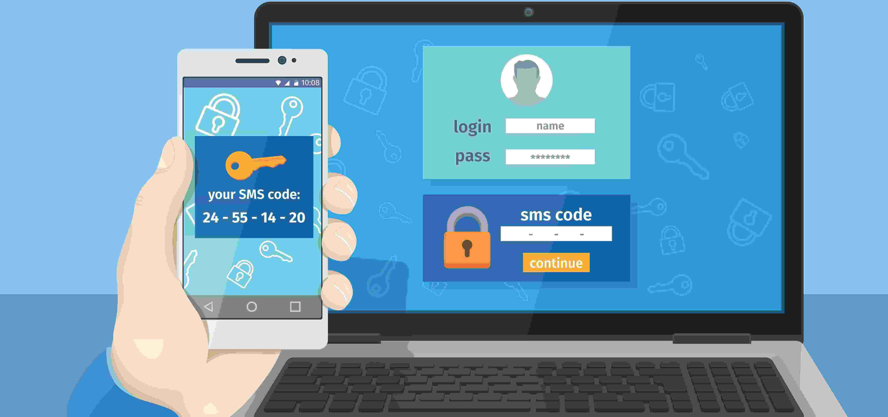
Passwords
2FA
Keep your passwords strong and different
Three words with numbers and special characters
Provides an added layer of security
Something you know, have or are
Notes:
- Passwords
Social engineering can give attackers enough information to build lists of potential passwords. This alongside special password cracking tools means it can be really easy to hack accounts.
There are also precompiled lists that are freely available for people to download. These are often lists of passwords from previous data breaches so make sure your passwords are all strong but also different, so that if one gets compromised your other accounts are still safe.
The NCSC suggest to use three random words with a mix of number and special characters as these make it even harder for attackers to guess passwords. It is also important for the passwords to be 12 characters or longer as the longer they are the more difficult they are to crack.
-2FA
Two factor authentication adds an extra step to the login process.
Having one of these things will make it more difficult for an attacker to gain access to the related account as the second factor is usually something such as a code sent to the users phone number.
Google and a lot of banks use this by default.

Slide 5
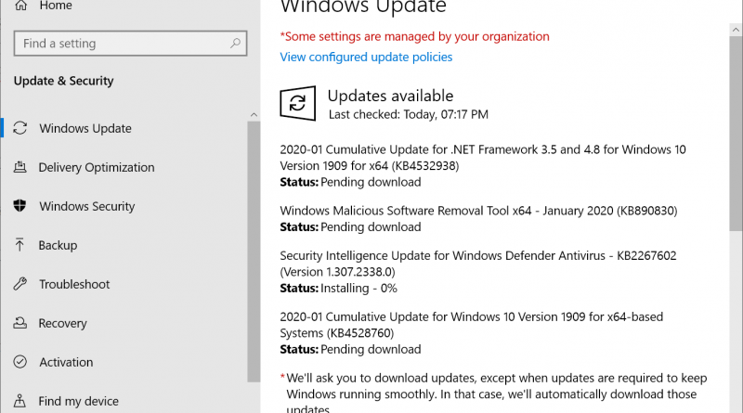
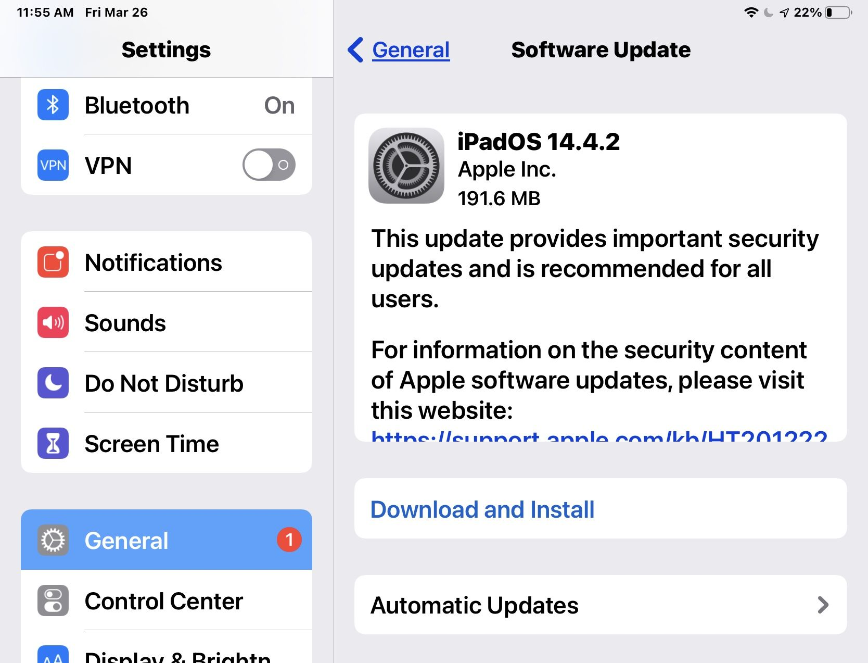
Updates!
Please keep your devices updated.
Notes:
- Updates
It is important to keep your devices updated.
Old versions of software are one of the main ways attackers are able to compromise a system.
Knowingly not updating your software and hardware is like continuing to drive a car that you know has a manufacturer's fault. Sure it's unlikely to be your car that breaks but when there's the option for a free replacement part that's safer it's foolish not to take it.
[click]
Windows and Mac make it very easy for users to update their OS, with Microsoft defaulting to automatic updates anyway and both companies mentioning when updates contain security content.
It is not just Windows and Mac products that require regular updates though..

Slide 6
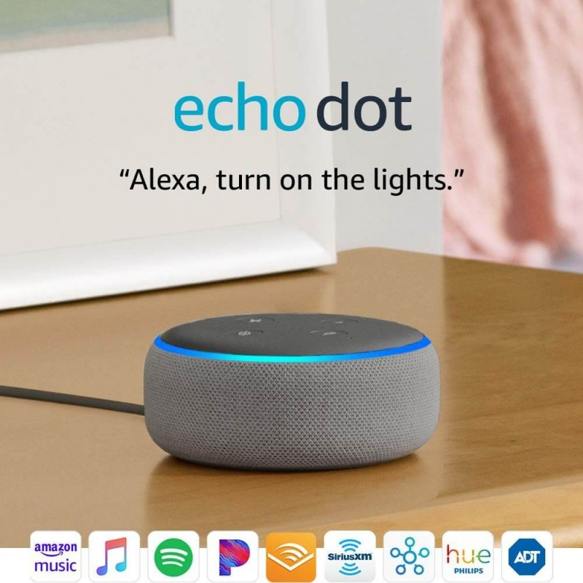
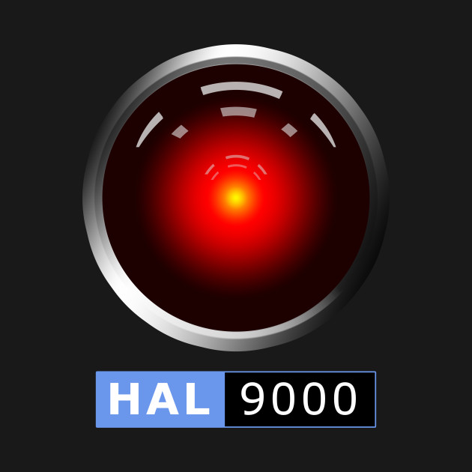
Internet of Things
The concept of connecting devices to each other and the internet and having the devices share information with each other.
Devices can pose massive security risks.
Buy from reputable manufacturers.
Make sure you know what you're getting into when investing in these devices.
Notes:
IoT
IoT devices do too. These devices greatly increase the attack surface, so keeping them updated is one way of keeping this bigger attack surface down.
These devices work by connecting to each other and the internet.
An example used by IBM is that a smart alarm clock would be able to adjust your wake up time depending on if your train is delayed/cancelled. Waking you up earlier and telling you to drive instead.
Pretty cool eh!
- Security Risks
As well as requiring updates, there are other ways these devices can pose big risks.
This can be as a result of users misconfiguring devices or manufacturers simply creating substandard products.
- Reputable manufacturers
There is a lack of regulation in the creation of these devices so if you're going to invest in them. Please. Buy from reputable companies. You want products that are going to be supported for a reasonable length of time rather than something that has been rushed out an abandoned. This g3 Amazon Echo shows list of systems it is usable with. All
-Understanding
Finally, make sure you understand how to set up an IoT network.
Keeping your devices on a separate VLAN to your information devices is a good way of keeping your data safe.
If you're unfamiliar with the term VLAN please let me know, we can discuss after but I suggest not using these devices until you understand more about how they work.

Slide 7
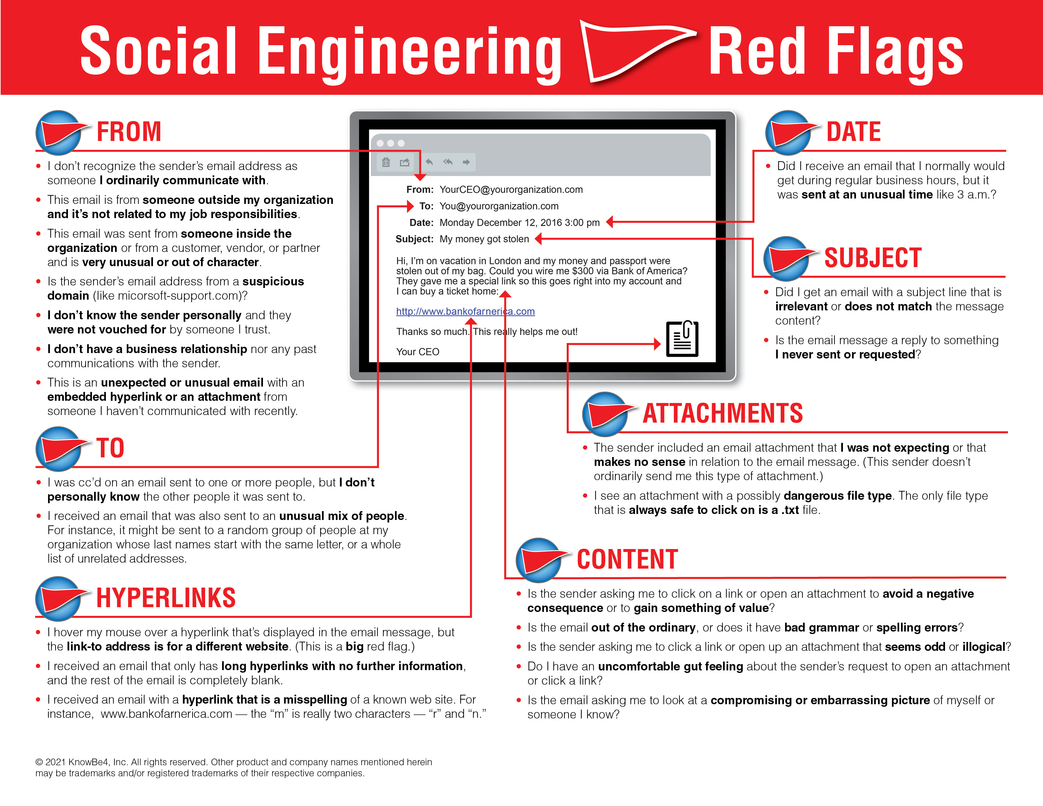
Phishing
Notes:
No, I haven't forgotten about the first slide..
I just want to hammer the point home about phishing. It's a risk both at work and home and can be so easy to fall for.
This example is a little more professional looking than the previous one.
Now is a good time to mention that they are designed to play on people's emotions as well, often conveying a sense of urgency and try to trick the user into thinking they are being sent by people with authority.

Slide 8
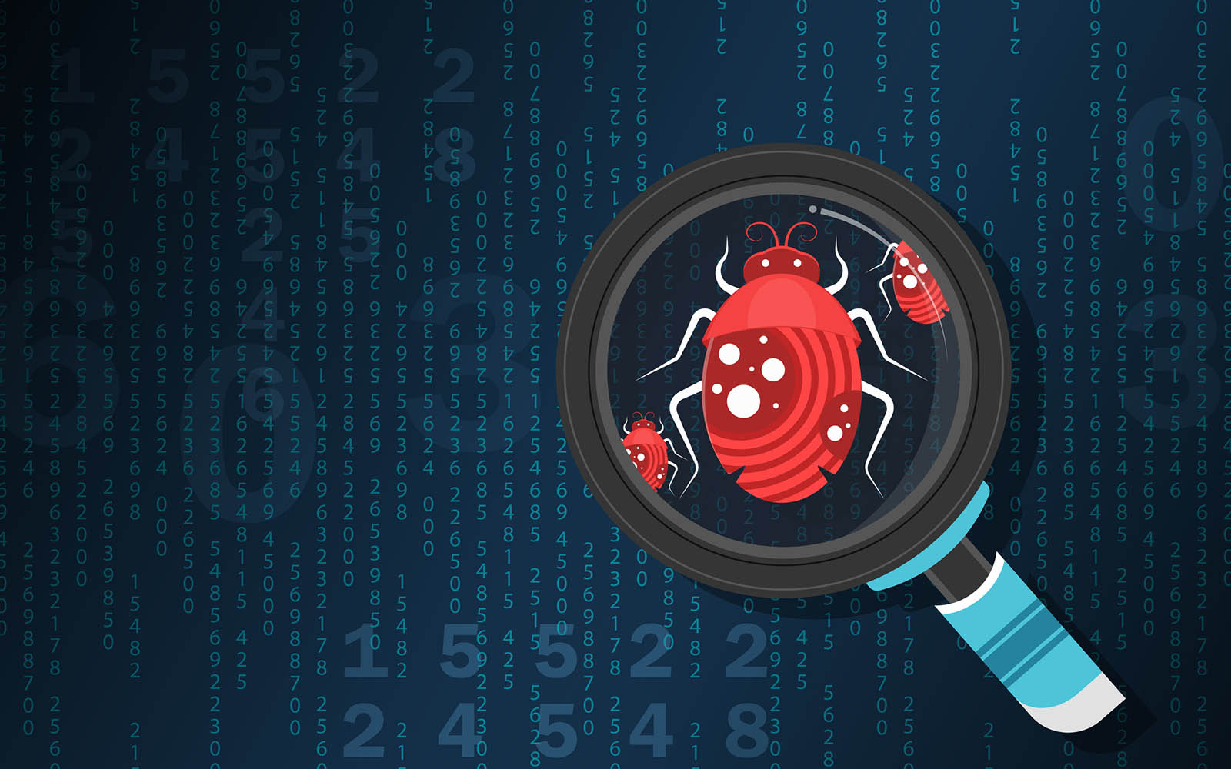
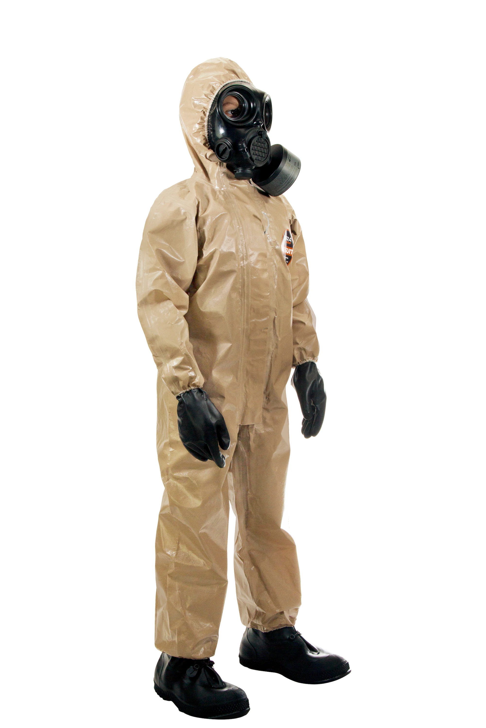
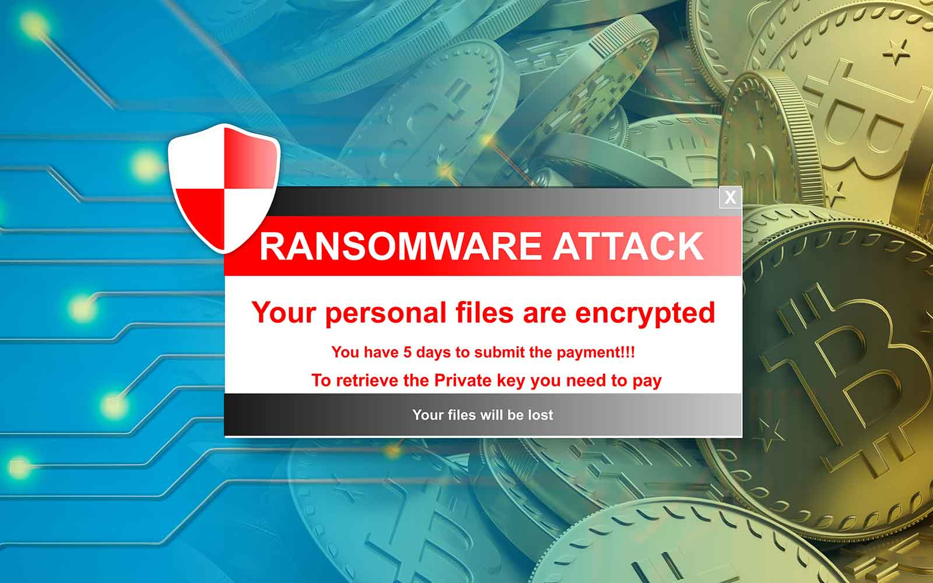
Malware
Software that has been created to harm or exploit another piece of software or hardware
Includes: Ransomware, viruses, worms, spyware and bots
Good security practices: Not downloading files from unknown sources, having anti-malware software, not using your admin account for every day tasks
Notes:
- Malware
Malware is a broad term that covers a lot of different types of programs that are made to damage software or hardware. The name is short for 'malicious software'
[click]
Some examples of malware are
Ransomware [Click] – Are any of you familiar with this kind of attack? People get locked out of their devices until they pay a ransom, and even then there isn't a guarantee that their files will be decrypted.
Viruses – A type of malware that can't execute or reproduce unless the app it has infected is running
Worms – these are similar to viruses but they are self-propagating and don't use applications to execute.
Spyware – collects user activity without their knowledge. A keylogger is an example of this kind of malware, giving the attacker access to all the keystrokes a user has made.
Bots – computers that get an infection which is controlled by a bot herder. These devices are used as proxies for the bot herder's malicious activity. Think someone stealing a car to use in a crime. In addition to this, being part of a botnet means a device is using more resources than usual so will be running slower.
[Click x2]
It's not all doom and gloom though, following these three bits of advice can go a long way in protecting you online.
Don't download files from unknown sources – this can include attachments on emails and from suspicious sites. There's just no need. Try to download software from the developer's website if you need a copy of it.
Having/updating [here it is again] your anti-virus/malware software is important. Using software that hasn't been updated means you'll still be vulnerable to undiscovered threats. It is best to use paid for ones as if you're not paying for it you're usually the product.
Finally – Have separate accounts for admin use and every day tasks. This level of separation means that even if you do get infected the malware will find it difficult to access your whole system.
Which leads me on to my last point

Slide 9
Backups
Follow the 3-2-1 rule
3 copies, 2 different media, 1 copy off site
Notes:
How many of you have more than one set of keys to your house?
Backups are like that but for your digital data.
They don't solve everything but making regular backups can reduce stress if any kind of incident occurs. This isn't limited to malware, accidental file deletion or hard disk failure can happen. Even a ransomware attack seems a lot less catastrophic if you backed all your files up recently.
For something that requires very little effort, backups go a long way!

Slide 10

Thanks for listening
Thanks for understanding!
Notes:
Before I end I just want to say
[Click]
If you are the victim of any kind of attack..
These things happen, even to the most experienced people.
Christopher Hadnagy, author of Social Engineering: The Science of Human Hacking, a professional whose job involves workplace education was in a rush before heading to a conference and fell victim to a phishing email.
If it can happen to the man who LITERALLY wrote the book on social engineering it can happen to anyone.
Staying calm and dealing with the consequences in a logical way is just as important as having protections there in the first place.
[click]
Anyone have any questions?

