Slide 1
TS Out Sort Audit Tool
July 2019
[SITE] LP team

Slide 2
TS Out Sort Audit
LP identified the need to audit the Transshipment Out Sort process.
Before totes containing products are loaded on trucks directed to other FCs for logistics reasons, they are palletized, brought to the docks and then strapped.
The defined audit process consists of sample checking relevant totes immediately before the pallet strapping process.
The TS Out Sort Audit verifies that there is correspondence between:
The virtual and the physical pallet for totes containing HRV
The virtual and the physical tote containing HRV
TASKFORCE5

Slide 3
TS Out Sort Audit Tool
LP developed a new tool to quickly identify relevant totes and help the operators to audit them.
Both the tool and the audit process are scalable to other FCs.
The tool can be changed to audit totes and TS Non-sort as well.
TASKFORCE5

Slide 4
TS Out Sort Tool Guide
TASKFORCE5

Slide 5
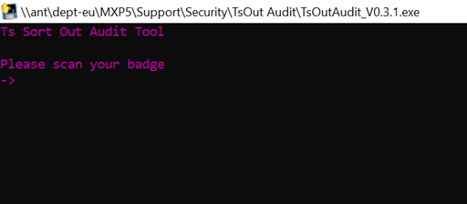
Tool log in
The tool is accessible from MXP5 Security’s shared folder. After launch, it asks for the user’s badge.
TASKFORCE5

Slide 6

Tool input
After getting the badge ID, the tool is ready to be used and asks for the Outer Scannable ID (Manifest label) of a Pallet.
TASKFORCE5

Slide 7
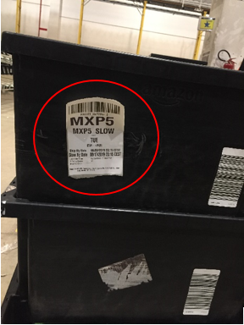
Manifest label
The Outer Scannable ID (Manifest label) is a label that is attached to the pallet once it gets 12 or 16 totes and is closed. It includes a bar code and the destination FC.
A Manifest label showing the destination (MXP5)
TASKFORCE5

Slide 8
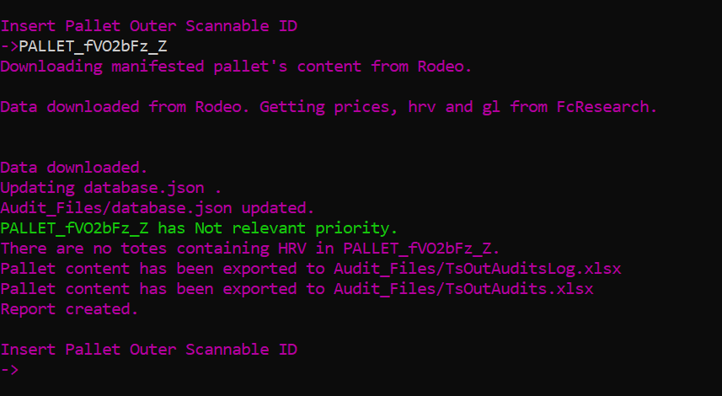
Tool functioning
After scanning the Manifest label, the tool downloads the Pallet content from https://rodeo-dub.amazon.com/ in 3-4 seconds.
TASKFORCE5

Slide 9
Tool pricing
Then the tool gets price, hrv and Italian gl name from FcResearch. This process requires about 30 seconds for 100-130 products.
TASKFORCE5

Slide 10
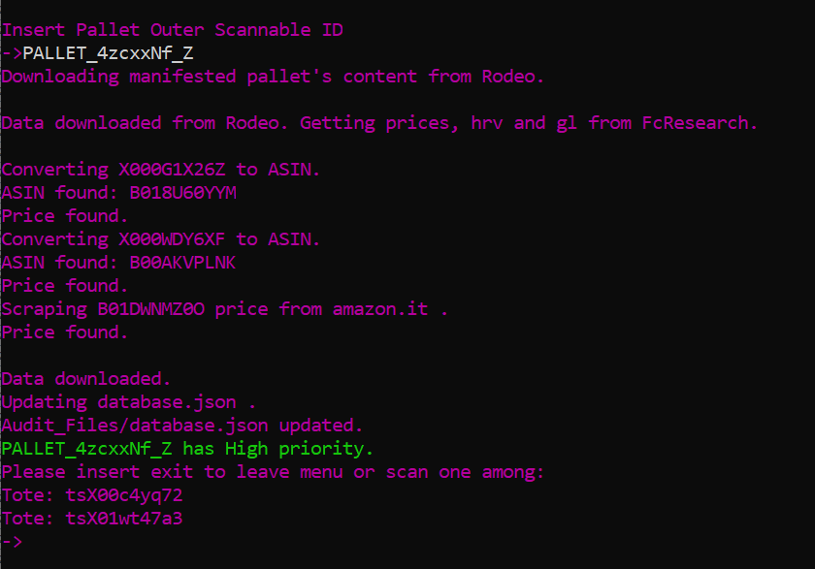
Missing data
In case FcResearch lists an item as HRV but does not provide a price, the tool gets the product ASIN from FcResearch if necessary and downloads the ASIN price from amazon.it .
Missing price for non hrv items is disregarded in order to save time.
TASKFORCE5

Slide 11
Audit priority table
Scanned pallets are classified according to the following criteria
Audit Priority | Criteria
High | HRV total value > 500 €
Medium | HRV total value > 300 €
Low | At least 1 HRV item in the pallet
Not relevant | No HRV in the pallet
TASKFORCE5

Slide 12
Audit priority
After downloading all the data, the tool prints the audit priority assigned to the pallet according to the aforementioned criteria.
TASKFORCE5

Slide 13
Not relevant pallets
Pallets classified as «Not relevant» are not audited, although an Excel log file keeps track of the scan so that the auditor’s actions can be analysed if necessary.
TASKFORCE5

Slide 14
Relevant pallets
Pallets classified as «Low», «Medium» or «High» priority are audited. The tool lists all the totes containing HRV.
TASKFORCE5

Slide 15
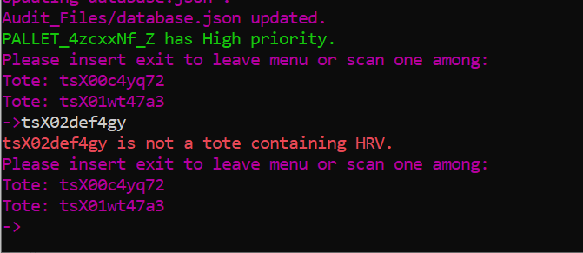
Wrong tote scanned
If the wrong tote is scanned, an error message is shown.
TASKFORCE5

Slide 16
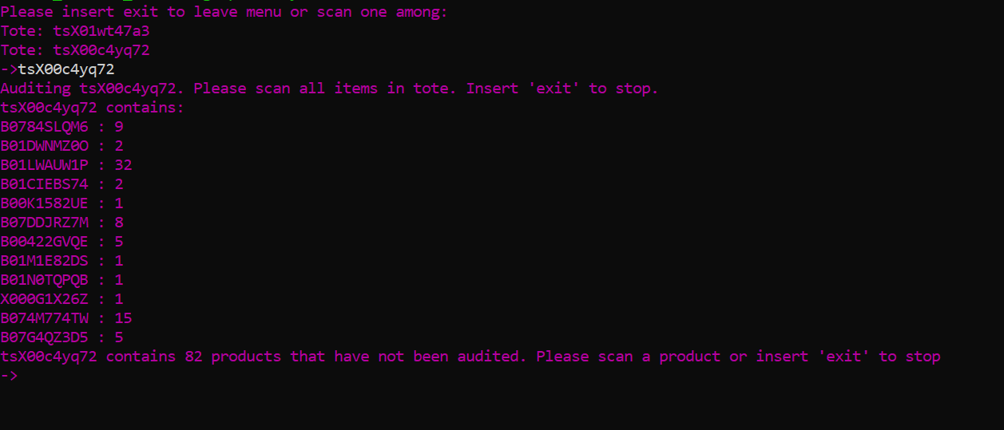
Relevant tote audit
If a relevant tote is scanned, the tool lists and asks to scan all the items in the tote.
TASKFORCE5

Slide 17
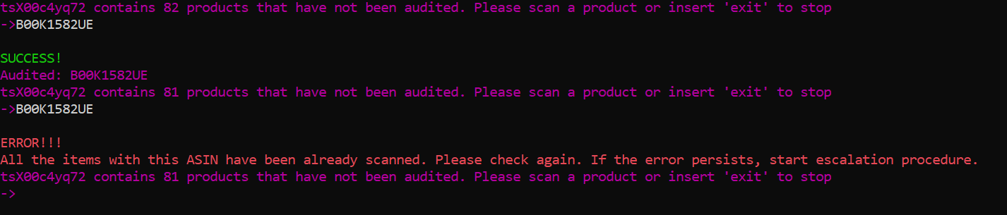
Wrong ASIN
The tool helps the operator to check that all the supposed items are in the tote.
In case the ASIN is not on the product, the tool recognizes product SKUs as well.
TASKFORCE5

Slide 18
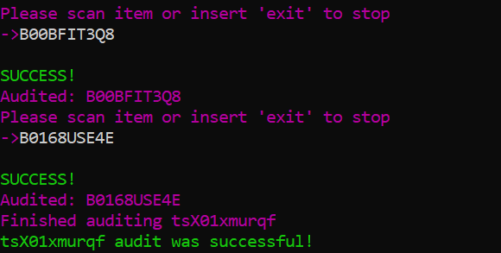
Tote audit complete
After the operator has scanned all the items in the tote, the tool informs the operator and asks to scan the other relevant totes, if there are any.
TASKFORCE5

Slide 19
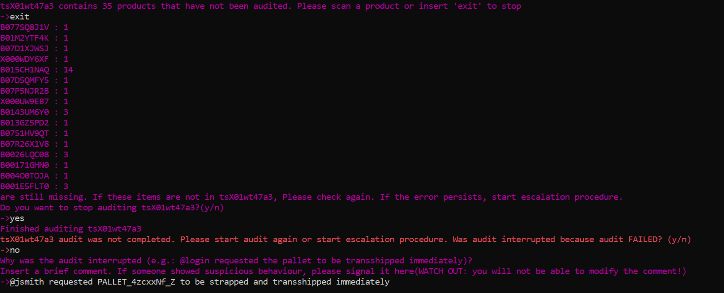
Failed/Interrupted audit
In case of failed or interrupted audit, the auditor can insert «exit». The tool will list all non audited items and will ask to confirm. Then, the auditor will be asked why audit was interrupted.
TASKFORCE5

Slide 20
Escalation procedure
In case of failed audit, the auditor will ask support from problem solvers and/or area managers and start escalation procedure.
TASKFORCE5

Slide 21
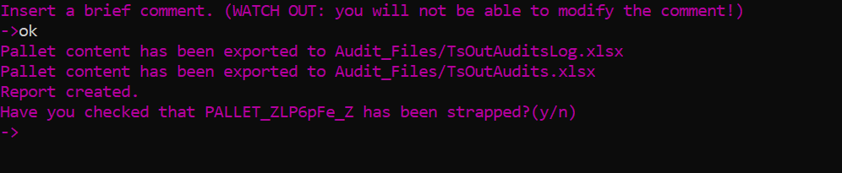
Final comment
In every case (failed/interrupted/succesful audit), the auditor is asked to insert a comment and then to confirm.
Comment in case of successful audit with nothing to declare. The auditor must still confirm he checked that the pallet has been strapped.
TASKFORCE5

Slide 22
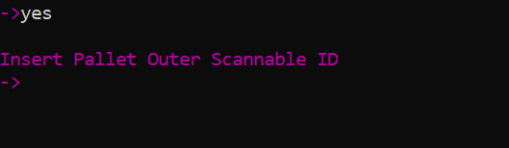
Audit complete
After giving confirmation, the auditor can audit another pallet.
TASKFORCE5

Slide 23
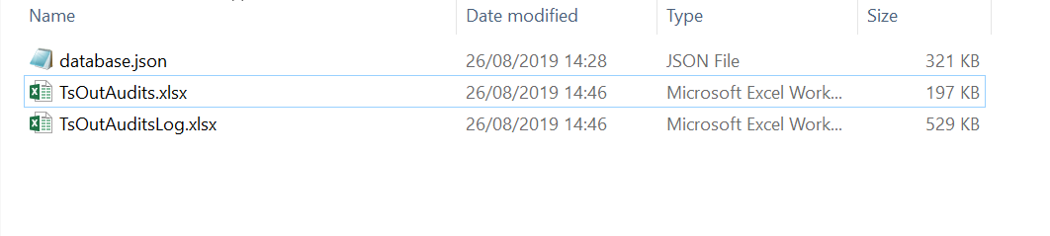
Log files
Every audit is automatically saved on the shared folder to ensure comprehensive analysis and trackability.
TsOutAuditsLog.xlsx contains all available informations for deep analysis
TsOutAudits.xlsx contains only the most relevant fields
database.json locally stores downloaded price, hrv and gl infos. This allows to save time when analysing the same ASIN more than once.
TASKFORCE5

Slide 24
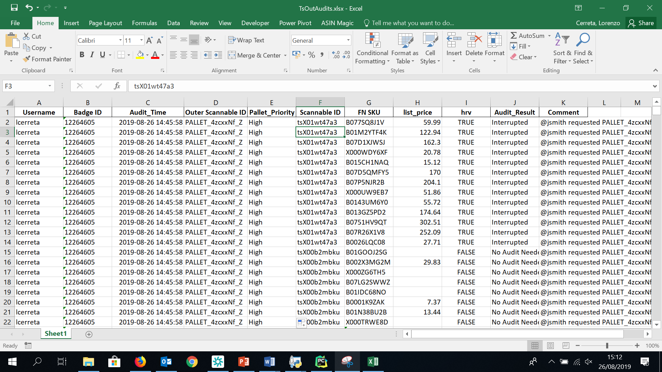
TsOutAudits.xlsx
TASKFORCE5

Slide 25
Thank you
TASKFORCE5

