Slide 1
IBM CAPSTONE PROJECT – The Battle of Neighborhoods: Hong Kong cinemas

Slide 2
Business Problem section
Would you recommend a location in Hong Kong to open a new cinema? Knowing that:
Cinema should have many restaurants and shopping places nearby.
Customer can walk to a cinema within 5 minutes from public transport facilities.
Which location should be suggested to the stakeholder?
We need to compare 5 possible locations with current cinemas in Hong Kong (Data from https://hkmovie6.com/cinema)

Slide 3
Solution
We can use content-based recommendation technique to resolve the problem.
Combined with FourSquare API which provides how many venues in different categories of Hong Kong cinemas, a matrix which captured characteristic of venues nearby cinema is built. Stakeholder's favourite list is the profile to combine with the matrix to become a weighted matrix of favourite cinema.
Lastly the weighted matrix can be applied on 5 target locations with venues information to generate a ranking result. the top one on the ranking list can be recommended to the stakeholder

Slide 4
Data and Methodology
Data: Data on Hong Kong cinemas from https://hkmovie6.com/cinema combined with FourSquare API which provides venues around cinemas
Mehodology:
Data Cleansing and Preparation;
Data Analysis and exploration;
Machine Learning recommendation system;
Results visualization

Slide 5
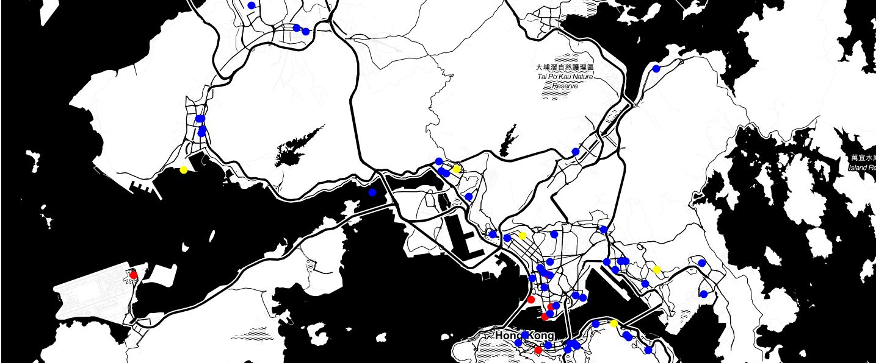
Resulting map

Slide 6
Outcome:
 | Location | Address | Latitude | Longitude | Rating
4 | L5 | Tsuen Fung Centre Shopping Arcade, Tsuen Wan | 22.372112 | 114.119317 | 0.372980
2 | L3 | Un Chau Shopping Centre, Cheung Sha Wan | 22.337280 | 114.156457 | 0.234543
3 | L4 | Prosperity Millennia Plaza, North Point | 22.291698 | 114.208168 | 0.187982
1 | L2 | Tuen Mun Ferry, Tuen Mun | 22.371780 | 113.966039 | 0.025860
0 | L1 | Sau Mau Ping Shopping Centre, Sau Mau Ping | 22.319503 | 114.232187 | 0.009726
Final locations recommended to stackeholder

