Slide 1
FPV CLUB · BROPHY COLLEGE PREPARATORY · 2026–27
Pilots before drones.
The Brophy FPV Badge Program: a standing certification path that turns beginners into responsible pilots, is taught by students, and outlives any one class of members.
$2,000
28
4
+8
ONE-TIME ASK
SKILL BADGES · 4 TRACKS
EQUIPMENT TIERS, GATED
PILOTS ALREADY TRAINING
Micah Tucker & team
1 / 14 · Brophy FPV Club · grant 2026–27
Notes:
(Before you arm the deck, the screen says DISARMED. Tap it. Let the props spin up before you say a word.)
Good morning. I'm Micah Tucker, president of the FPV Club, and this is [EDIT: names of the members presenting with you, and their roles — e.g. Marco, our editor].
We're asking for two thousand dollars. But I want to be honest about what the money is really for, because it isn't the drones.
[EDIT: one sentence on why you fly — the first time you put goggles on, or the first shot you got of campus. Make it short and real.]
What we are proposing is a certification program. Twenty-eight badges, four tiers of equipment, and a rule that nobody flies anything they haven't earned the badge for. The drones in the budget are the training fleet that program runs on.
[Click → next sheet]

Slide 2
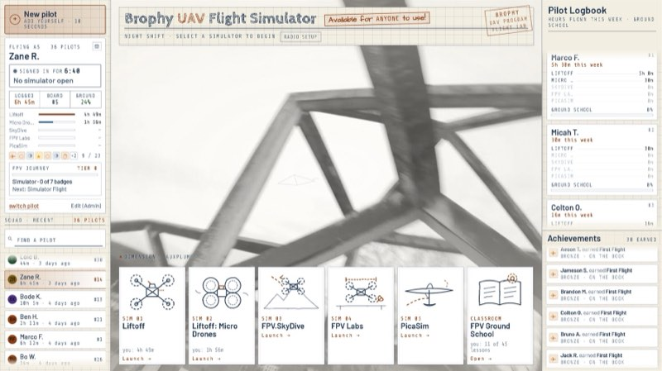
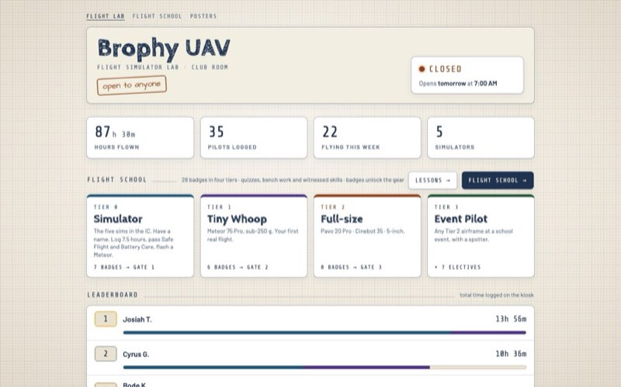
01 · WHERE WE ARE TODAY
We didn’t wait for the money. Tier 0 is already running.
Five FPV simulators in the IC, open to anyone, 7:00–4:00 on school days.
A kiosk students built: tap your name, pick a sim, fly. Hours log themselves.
Ground School lessons and quizzes run on the same machine while someone else has the seat.
A public website shows the lab’s hours, the leaderboard and the whole badge path.
As of Oct 4: 87 h 30 m flown · 35 pilots logged · 22 flying this week · 5 simulators. (Live numbers in the web deck.)
kiosk · home screen
elmagoct.github.io/brophy-uav-dashboard/
2 / 14 · Brophy FPV Club · grant 2026–27
Notes:
The first thing I want you to know is that this club didn't wait to be funded.
[Click: five simulators]
Over the summer [EDIT: when exactly — e.g. "in August, in the weeks before school started"] we set up five FPV simulators in the IC. They're open to anyone, every school day, seven to four, around class periods.
[Click: the kiosk]
[EDIT: who built the kiosk, and how long it took — e.g. "I built the kiosk software myself over about three weeks."] You walk up, tap your name, pick a simulator, and fly. The machine logs your hours by itself, keeps a leaderboard, and signs you out when you walk away.
[Click: Ground School]
While someone else has the seat, the same machine runs Ground School: lessons and quizzes on batteries, safety, radio links, airspace.
[Click: the website]
The numbers on the right are not from a slide. They're being read live from the lab right now. [EDIT: read the real number out loud — "that's X hours flown by Y students since August."] [EDIT: name the person at the top of the leaderboard and roughly how many hours they have; ask them to raise a hand if they're in the room.]
None of that cost the school anything. [EDIT: verify this — if any school equipment or licences were used, say exactly what.]
[Click → next sheet]

Slide 3
02 · THE PROBLEM
Every year a club like this restarts from zero.
Skills leave with the seniors. Whoever knew how to build, tune and fly graduates, and nothing is written down.
Nobody can say who may fly what. Expensive gear with no rule for who is trained to touch it.
FPV looks like a toy until it isn’t. LiPo fires, flyaways and controlled airspace are real, and there is no safety standard on paper.
Students who want to film for the school have no path to get there.
WHAT A GRANT USUALLY BUYS
Drones.
They get flown by the two people who already knew how, and when those two graduate the drones sit in a drawer.
WHAT WE ARE ASKING FOR INSTEAD
A training fleet for a certification system.
The drones in the budget are the hardware the badge program runs on, and the program is what the school keeps.
3 / 14 · Brophy FPV Club · grant 2026–27
Notes:
So why do we need a badge program at all?
[Click: skills leave with seniors]
Every year a club like this starts over. The two people who knew how to build, tune and fly graduate, and nothing is written down. [EDIT: if you have a real example — a club or team at Brophy or elsewhere that lost its knowledge when a class left — use it.]
[Click: who may fly what]
Right now, if the school bought a drone tomorrow, nobody could say who is allowed to fly it. That's not a safe place for expensive equipment to be.
[Click: not a toy]
FPV looks like a toy until it isn't. Lithium batteries are the biggest real fire risk in the hobby. Brophy sits near Sky Harbor's controlled airspace. There is no written safety standard for any of that today.
[Click: students with no path]
And we have students, [EDIT: the actual number — "eight right now"], who want to fly and film for the school and have no path from "interested" to "trusted with a camera drone at a football game."
The box on the right is the whole pitch in two paragraphs. A normal grant buys drones; they get flown by the two people who already knew how. We're asking for the thing the school gets to keep.
[Click → next sheet]

Slide 4
03 · THE IDEA
Badges unlock gear.
A badge is one specific, testable skill, signed off by a certified member.
Earn every badge in a tier and the gate opens: the next drone is yours to fly.
Four tiers: Simulator → Tiny Whoop → Full-size → Event Pilot.
The expensive gear is never in untrained hands, and “who may fly what” is written down, not remembered.
TIER 0
TIER 1
Simulator
Tiny Whoop
The five FPV sims in the IC
Meteor 75 Pro · sub-250 g
7 BADGES → GATE 1
6 BADGES → GATE 2
TIER 2
TIER 3
Full-size
Event Pilot
Pavo 20 Pro · Cinebot 35 · 5-inch
Any Tier 2 airframe at a school event, with a spotter
8 BADGES → GATE 3
+ 7 ELECTIVES
4 / 14 · Brophy FPV Club · grant 2026–27
Notes:
Here's the idea in one sentence: badges unlock gear.
[Click: a badge is one testable skill]
A badge is one specific, testable skill, signed off by a certified member. Not attendance. You do the thing in front of someone who holds the badge.
[Click: the gate opens]
Earn every badge in a tier and the gate opens. The next drone is yours to fly.
[Click: four tiers]
Four tiers. The simulator, which is free and where crashes cost nothing. A tiny whoop that weighs less than a smartphone. Full-size camera drones. And Event Pilot, which is the only tier allowed to fly in front of a crowd.
[Click: never in untrained hands]
So the expensive gear is never in untrained hands, and the answer to "who may fly what" is written on a board, not remembered by whoever is around.
[Click: the live rendering]
What you're watching on the right is the club's actual badge catalogue, the same file the website runs on, animating one pilot climbing from the first sim hour to Event Pilot.
[Click → next sheet]

Slide 5
04 · THE CURRICULUM
28 badges. Four tracks. Every one has a “why”.
FLIGHT
BUILD & TECH
KNOWLEDGE & SAFETY
CREW & LEADERSHIP
Simulator Flight T0 · auto
Acro muscle memory where crashes cost nothing.
Proficient Flight T0 · witnessed
Real control, not just hovering. Sim-only, so it can gate the first real flight.
Line of Sight T0 · witnessed
If video cuts out, the pilot can still level out and land.
Tiny Whoop T1 · witnessed
First real flight on a sub-250 g drone that can’t do much damage.
Freestyle Flight T1 · witnessed
Advanced control before flying expensive airframes.
Indoor Proximity T2 · witnessed
Precision in tight spaces — what an indoor rally race demands. Racing.
Racing T2 · witnessed
Gate discipline under pressure; qualifies a pilot for the rally race. Racing.
Battery Care T0 · quiz
LiPos are the biggest real fire risk in the hobby.
Building T0 · bench
Members can fix what they break.
Betaflight T0 · bench
Most “won’t fly” problems get solved here.
Soldering T1 · bench
Core electronics skill that transfers to robotics.
Field Repair T1 · bench
Keeps a shoot going instead of ending it.
Video Systems EL · bench
Footage the editor can actually use.
Tuning EL · bench
The skill behind smooth cinematic footage.
Safe Flight T0 · quiz
The baseline code of conduct for real hardware.
Electrical Components T1 · quiz
Why a 3-inch and a 5-inch need different parts.
Radio Protocol T1 · quiz
Prevents dropouts and interference at events.
FAA TRUST T2 · witnessed
Federal requirement for recreational flyers. Official.
Airspace T2 · quiz
Brophy is near Sky Harbor’s controlled airspace.
Emergency Procedures T2 · quiz
A plan for when something goes wrong.
Event Ops T2 · quiz
Ground work before flying at a game or rally.
Spotter T2 · witnessed
FPV pilots can’t see around themselves.
Cinematography T2 · witnessed
Turns pilots into shooters for Best of Brophy. Filming.
Shot Planning EL · witnessed
Working with other organizations professionally.
Editing EL · witnessed
Best of Brophy doesn’t depend on one editor.
Fleet Steward EL · witnessed
Accountability for school-funded gear.
Mentor EL · witnessed
The program trains its own replacements.
Examiner EL · witnessed
Defines who can sign badges off.
5 / 14 · Brophy FPV Club · grant 2026–27
Notes:
(This sheet has no bullets. The explorer cycles through badges on its own; tap one to hold it.)
Twenty-eight badges in four tracks: Flight, Build and Tech, Knowledge and Safety, Crew and Leadership.
Every badge has a "why" written on it: what goes wrong without it. Battery Care exists because LiPos are the biggest fire risk in the hobby. Airspace exists because we're near Sky Harbor. Spotter exists because an FPV pilot literally cannot see around themselves.
Tap two or three. I'd suggest Mentor and Examiner, because they are the ones that make this a program and not a club: Mentor is "coach a new member through their first two badges," and Examiner defines who is allowed to sign a badge off.
[EDIT: pick the one badge that means the most to you and say why — e.g. the first time you soldered an ESC, or the day you realised a flyaway needed a plan.]
[Click → next sheet]

Slide 6
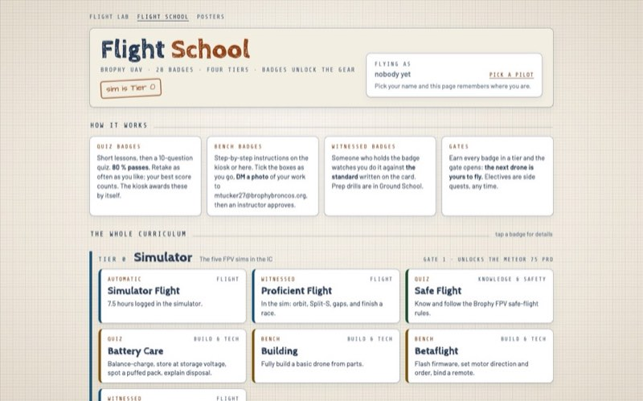
05 · HOW A BADGE IS EARNED
Demonstration, not attendance.
Quiz badges: short lessons, then a 10-question quiz. 80% passes, retake any time, the kiosk awards it by itself.
Bench badges: a step-by-step checklist on the kiosk, a photo of the work, an instructor approves.
Witnessed badges: an examiner watches you perform the standard written on the card.
Official: the free FAA TRUST certificate before anyone touches a real drone.
Students run every sign-off. Nothing here costs the school anything beyond the training fleet.
…/brophy-uav-dashboard/flightschool/
6 / 14 · Brophy FPV Club · grant 2026–27
Notes:
How does a badge actually get earned? Three ways, plus one official one.
[Click: quiz badges]
Knowledge badges are quizzes. Short lessons, then ten questions drawn from that badge's pool. Eighty percent passes. You can retake as often as you like; your best score counts. The kiosk awards those by itself.
[Click: bench badges]
Bench badges are hands-on: a step-by-step checklist on the kiosk or on your phone. You tick the boxes, DM a photo of the work, and an instructor approves it.
[Click: witnessed badges]
Witnessed badges are the flying ones. An examiner who already holds the badge watches you do it against the standard printed on the card. For Tiny Whoop that's take-off, a figure-eight through two gates, an orbit, and a landing on the pad with no wall contact.
[Click: FAA TRUST]
And before anyone touches a real drone, the free FAA TRUST certificate. Twenty minutes, can't be failed, zero cost to the school or the student.
[Click: students run every sign-off]
The point to hold onto: students run all of it. The sign-offs, the study material, the mentoring. The only thing this program needs from the school is the training fleet.
The frame on the right is the real website cycling through its pages. [EDIT: if you have the deck on a phone, hand it to a committee member and have them scan the Flight School QR later.]
[Click → next sheet]

Slide 7
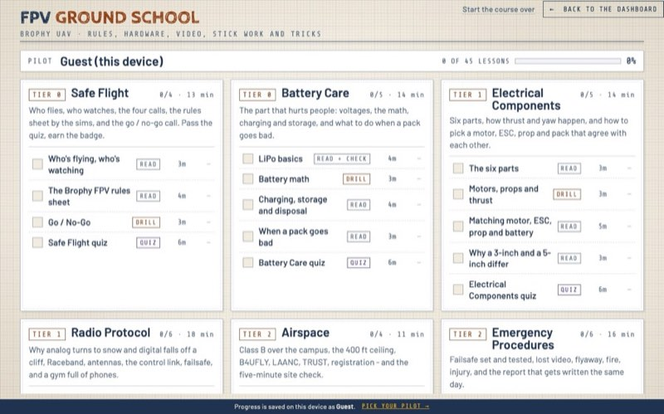
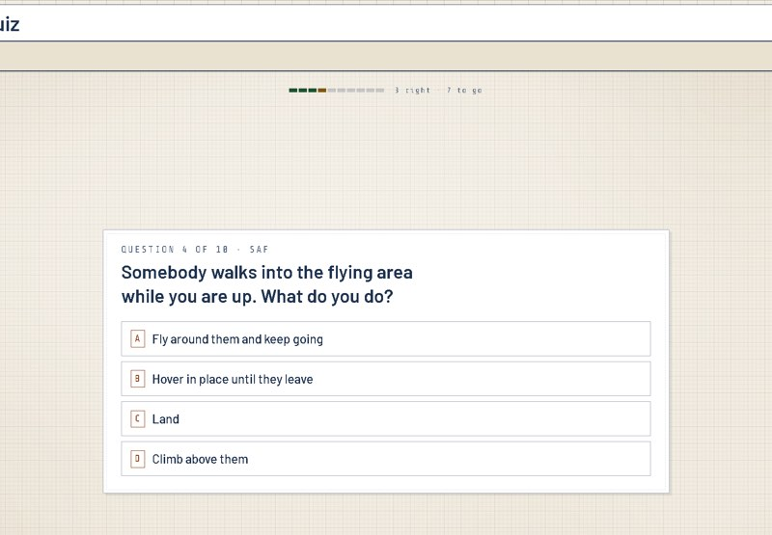
06 · TEACHING
The classroom is already built.
45 lessons, about 140 minutes, one module per knowledge badge: safety, batteries, electronics, radio, airspace, emergencies, event ops.
Works on the kiosk and on any phone. Lessons, drills and quizzes; progress follows the pilot.
Stick drills on the real transmitter: hover trainer, orientation recovery, the first flip and roll.
Written by students, maintained by students. A new member has something to do on day one, with or without a free seat.
…/brophy-uav-dashboard/groundschool/
kiosk · a lesson open
7 / 14 · Brophy FPV Club · grant 2026–27
Notes:
The classroom part is not a plan. It's built.
[Click: 45 lessons]
Forty-five lessons, about a hundred and forty minutes of material, one module per knowledge badge. [EDIT: who wrote the lessons, and over what period.]
[Click: kiosk and phone]
It runs on the kiosk and on any phone. Progress follows the pilot: pass a quiz on your phone at lunch and it shows up on the kiosk.
[Click: stick drills]
Some lessons are drills on the real transmitter: a hover trainer, orientation recovery, your first flip and roll. You learn the sticks before you have a drone.
[Click: written by students]
It was written by students and it's maintained by students, so a new member has something to do on day one even when every seat is taken.
[EDIT: one real moment — a new member who finished a module before ever flying, or a quiz question that turned out to be harder than you expected.]
[Click → next sheet]

Slide 8
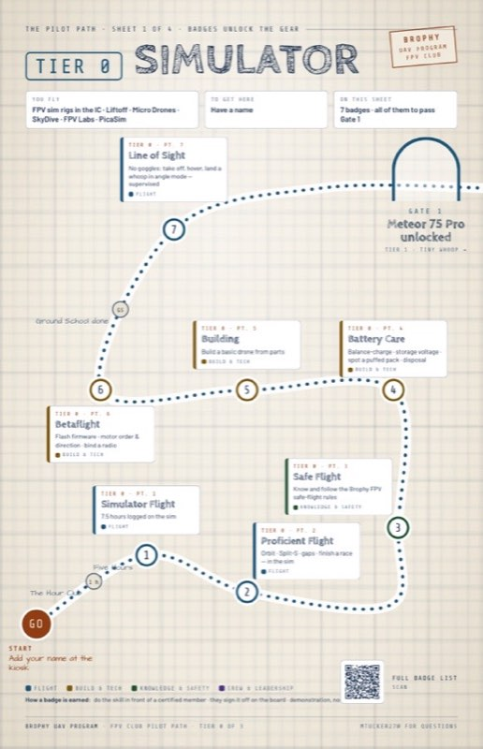
07 · WHY SIM FIRST
Crashes should cost nothing while you learn.
7.5 hours in the simulator before the first real flight. Acro muscle memory with zero risk.
Proficient Flight is sim-only on purpose: orbit, Split-S, gaps, a finished race. It gates the first real battery.
Line of Sight: if the video cuts out, the pilot can still level out and land.
Then a sub-250 g whoop that can’t do much damage. Full-size only after Freestyle, Electrical Components, Radio Protocol and Field Repair.
Every gate is placed where the next mistake starts to cost real money or real safety.
poster · Tier 0 trail map
PHOTO COMING FROM THE KIOSK
A pilot mid-flight in Liftoff
kiosk/kiosk-liftoff.jpg
8 / 14 · Brophy FPV Club · grant 2026–27
Notes:
Why do we make people fly a simulator for seven and a half hours first?
[Click: 7.5 hours]
Because crashes should cost nothing while you're learning. In the sim you can crash a hundred times a night and the only thing you lose is pride.
[Click: Proficient Flight is sim-only]
Proficient Flight is sim-only on purpose. Orbit, Split-S, gaps, finish a race. It's the badge that gates the first real battery.
[Click: Line of Sight]
Line of Sight is the one people skip in other clubs: without goggles, take off, hover and land in self-levelling mode. Because if your video feed cuts out, you need to be able to look up and land the drone.
[Click: then a sub-250 g whoop]
Then your first real aircraft is a tiny whoop that can't do much damage. Full-size only after Freestyle, Electrical Components, Radio Protocol and Field Repair.
[Click: every gate is placed where mistakes start to cost]
Every gate sits exactly where the next mistake starts to cost real money or real safety.
The card on the right is a simplified version of the kiosk's pilot card, sped up: watch the Simulator Flight bar hit seven and a half hours and turn green. [EDIT: if the Liftoff screenshot is in, point at it: "that's what the pilot sees."]
[Click → next sheet]

Slide 9
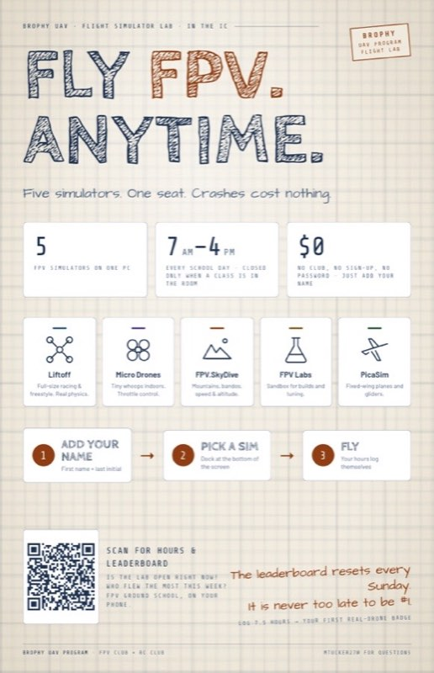
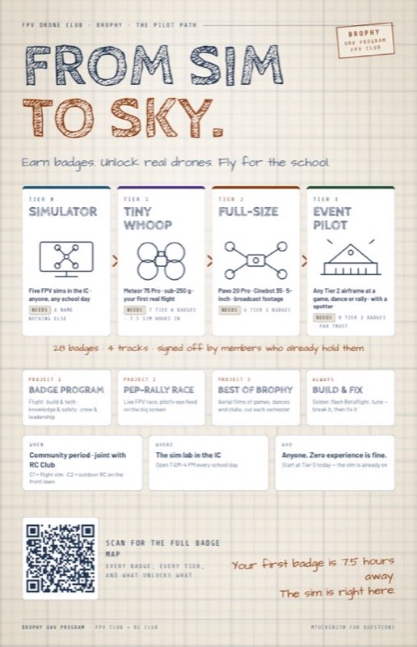
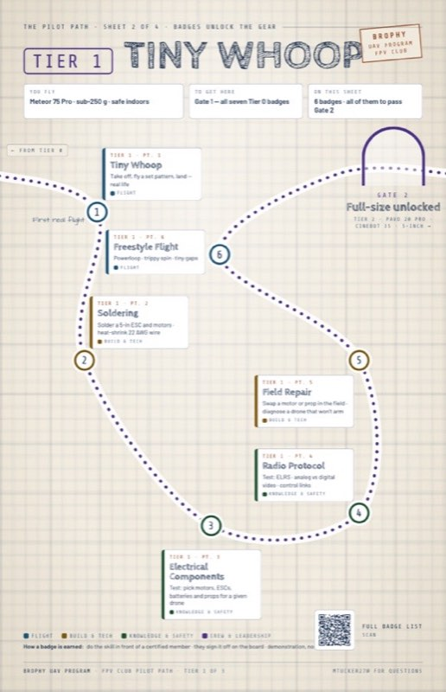
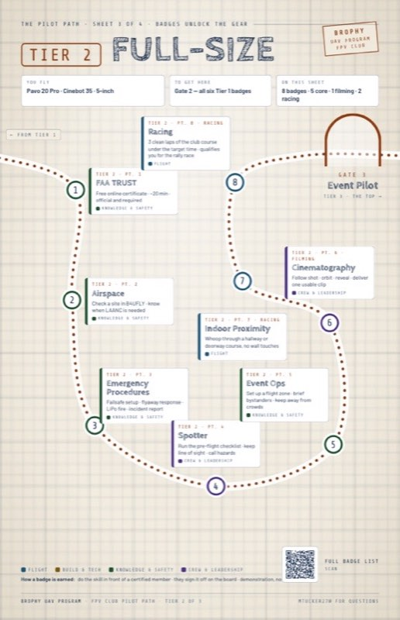
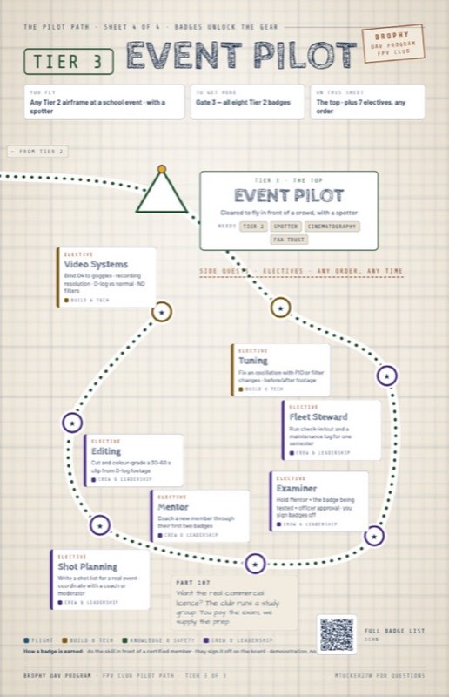
08 · SUSTAINABILITY
Built to outlive its founders.
Mentor badge: coach a new member through their first two badges. The program trains its own replacements.
Examiner badge: who may sign off is defined by badges held plus officer approval, not by who is loudest.
Fleet Steward: check-in/out and a maintenance log for school-funded gear, one semester at a time.
Everything is written down: the safety rules, the badge sheet, seven printed posters, a website that runs itself.
Every award is recorded and signed by the approving instructor, and progress only moves forward.
Gear is bought to last: goggles and radios about 8 years, airframes about 4. A one-time build-out, not a recurring ask.
PHOTO COMING FROM THE KIOSK
The printed posters above the simulators
photos/posters-wall.jpg
9 / 14 · Brophy FPV Club · grant 2026–27
Notes:
This is the sheet I care about most. [EDIT: say why — e.g. "I'm a senior. Whatever we build this year has to work without me in it."]
[Click: Mentor]
The Mentor badge: coach a new member through their first two badges. The program trains its own replacements.
[Click: Examiner]
The Examiner badge: who may sign things off is defined by the badges they hold plus an officer's approval. Not by who's loudest.
[Click: Fleet Steward]
Fleet Steward: run the check-in/check-out sheet and a maintenance log for school-funded gear for a semester. Accountability is a badge, not a chore.
[Click: everything is written down]
Everything is written down. The safety rules, the badge sheet, seven printed posters that hang above the sims, and a website that runs itself.
[Click: every award is recorded and signed]
Every award is recorded and signed by the instructor who approved it, and progress only moves forward. A badge can't be lost in a drawer.
[Click: gear bought to last]
And the gear is bought to last: goggles and radios about eight years, airframes about four. This is a one-time build-out. We are not planning to be back next year asking for the same thing.
[Click → next sheet]

Slide 10
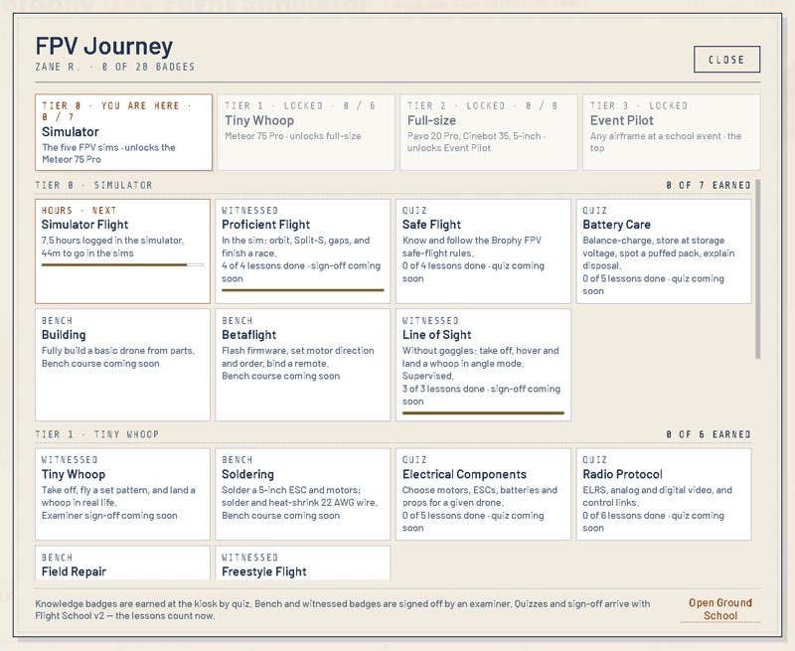
09 · FOR THE STUDENTS
What a student walks away with.
Hands: soldering, electronics, firmware, field repair. Skills that transfer straight to robotics and engineering.
Judgment: airspace law near Sky Harbor, FAA TRUST, emergency procedures, battery safety. Responsibility, not just reflexes.
Professionalism: writing a shot list with a coach, briefing bystanders, running a flight zone at a game.
Teaching: the path ends with coaching the next class, then examining them.
A record: a logged, visible badge board that says exactly what they can do.
PHOTO COMING FROM THE KIOSK
A member flying on the sim in goggles
photos/pilot-flying.jpg
kiosk · a pilot’s badge map
10 / 14 · Brophy FPV Club · grant 2026–27
Notes:
What does a student actually get out of this?
[Click: hands]
Hands. Soldering, electronics, firmware, field repair. Skills that transfer directly to robotics and engineering. [EDIT: if any members are also on Broncobots or in an engineering class, say so.]
[Click: judgment]
Judgment. Airspace law, the FAA certificate, emergency procedures, battery safety. Responsibility, not just reflexes.
[Click: professionalism]
Professionalism. Shot Planning means writing a shot list and agreeing it with a coach or a moderator. Event Ops means setting up a flight zone and briefing bystanders. Those are real skills in dealing with adults.
[Click: teaching]
Teaching. The path ends with coaching the next class, then examining them.
[Click: a record]
And a record: a badge board that says exactly what you can do, visible to anyone.
[EDIT: name one member and what they've already earned or learned this fall. Specific beats general.]
[Click → next sheet]

Slide 11
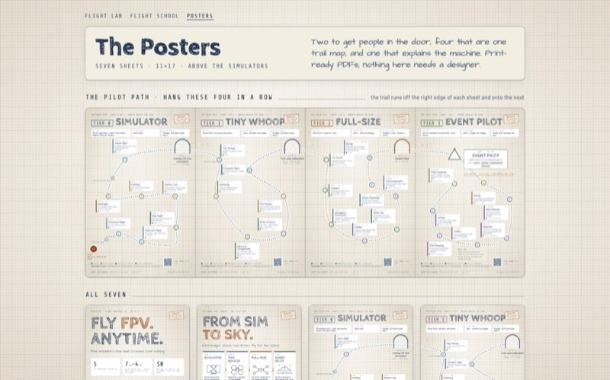
10 · FOR BROPHY
What Brophy gets.
A STANDING PROGRAM
A PIPELINE
THE OUTPUT
A safety standard and a clear answer to “who may fly what”
Trained, certified pilots every single year
Footage and moments the school can actually use
• Written rules, a published badge sheet, a signed record of every award
• FAA TRUST for every flying member, free
• Nothing over 250 g until the top tier
• New members start on Simulator Flight the week they join
• Mentors and examiners are produced by the path itself
• Fifteen joint community-period meetings with RC Club a year
• Best of Brophy: short aerial clips any team or club can use, two showcase films a year
• A live FPV race at the pep rally, pilot’s-eye view on the scoreboard
• A recruiting moment: students see FPV before they hear about it
A model other clubs can copy. Badge → gate → gear is not drone-specific. Robotics, shop, A/V: any club with expensive tools and a safety question can run the same system.
…/brophy-uav-dashboard/posters/
11 / 14 · Brophy FPV Club · grant 2026–27
Notes:
And what does Brophy get?
[Click: a standing program]
A standing program with a written safety standard and a clear answer to who may fly what. FAA TRUST for every flying member. Nothing over 250 grams until the top tier.
[Click: a pipeline]
A pipeline of trained pilots every year. New members start on Simulator Flight the week they join. We already share fifteen community-period meetings a year with RC Club. [EDIT: anything about the RC Club relationship worth saying.]
[Click: the output]
And the output, which I've deliberately kept to one box: Best of Brophy, short aerial clips any team or club can use, cut into a showcase film each semester. And, if Student Council and Student Activities approve it, a live FPV race at the pep rally with the pilot's-eye feed on the scoreboard.
[Click: a model other clubs can copy]
The last thing is the one I'd ask you to remember. Badge, gate, gear is not a drone idea. Any club with expensive tools and a safety question can run the same system.
[Click: the dashboard]
[Click → next sheet]

Slide 12
11 · THE EQUIPMENT, BRIEFLY
The drones are the training fleet the badge system runs on.
TRAINERS · TIER 1
PILOT KIT
Two Meteor 75 Pro tiny whoops
Two goggle-and-radio sets
Sub-250 g, ducted props, safe indoors, cheap to crash. Eight students are training today without a drone to share. Two trainers means two first flights at once.
Two pilots can train or fly at the same time, on the sim or in the air. Goggles and radios last about eight years, so this is the part the school buys once.
CAMERA SHIP · TIER 2
KEEP IT FLYING
One Pavo 20 Pro cinewhoop
Spares, batteries, a smoke stopper, two screwdrivers
Ducted, so it can fly near people; a D-log camera, so the footage can be graded. The drone Best of Brophy is shot on, and the airframe the top-tier badges are tested on.
Members fix what they break: that is a badge, not a chore. Spare frames, props and motors mean a crash is a repair lesson, not a purchase order.
About $1,975 estimated, inside the $2,000 ask, with the pep-rally course priced after Stuco confirms the slot. Many essentials are donated by members. The full parts list, with a reason beside every line, is in the proposal.
12 / 14 · Brophy FPV Club · grant 2026–27
Notes:
I said I wouldn't talk much about the drones, so here's the whole equipment story in four cards.
[Click: trainers]
Two Meteor 75 Pro tiny whoops. Under 250 grams, ducted props, safe indoors, and cheap to crash. Eight students are training right now without a drone to share. Two trainers means two first flights at once.
[Click: pilot kit]
Two sets of goggles and radios. Two pilots can train or fly at the same time, and this is the part that lasts eight years.
[Click: camera ship]
One Pavo 20 Pro cinewhoop. Ducted so it can fly near people, with a camera that shoots flat footage we can grade. It's what Best of Brophy is shot on, and the airframe the top-tier badges are tested on.
[Click: keep it flying]
Spares, batteries, a smoke stopper and screwdrivers. Members fix what they break; that's the Field Repair badge. A crash becomes a repair lesson instead of a purchase order.
[Click: the total]
About nineteen hundred and seventy-five dollars, inside the two-thousand-dollar ask. [EDIT: who has donated what — "several members are donating X, Y, Z."] The full list, with a reason beside every line, is in the proposal.
[Click → next sheet]

Slide 13
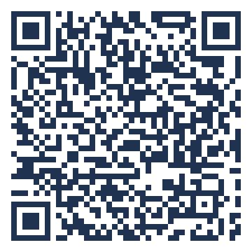
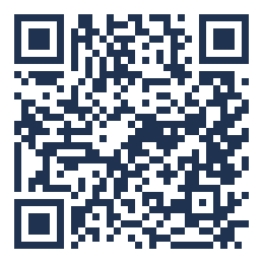
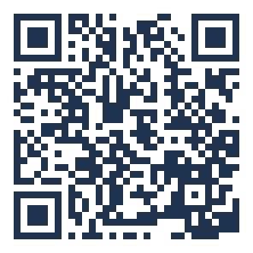
12 · THE ASK
$2,000, tied to three projects.
The Badge Program: a standing certification path, run inside every club meeting.
Best of Brophy: aerial clips through the year, a showcase film each semester.
The pep-rally race: a live FPV race on the scoreboard, if Stuco and Student Activities approve the segment.
Next steps: Mr. Reasy, then Mr. Burr for Student Activities sign-off, Stuco on the rally slot, then the fall assembly pitch with recruiting.
Once funded: order the fleet, publish the badge sheet, certify current pilots as examiners, start every new member on Simulator Flight.
Lab dashboard
hours · leaderboard
The official proposal
Google Doc · badges, budget, timeline
Flight School
13 / 14 · Brophy FPV Club · grant 2026–27
all 28 badges
Notes:
So, the ask.
[Click: the badge program]
Two thousand dollars, tied to three specific projects. The badge program, which runs inside every club meeting.
[Click: Best of Brophy]
Best of Brophy through the year.
[Click: the rally race]
And the pep-rally race, if Stuco and Student Activities want it. If the rally slot doesn't happen, the same course becomes a lunch or community-period race, so the equipment is useful either way.
[Click: next steps]
Next steps: this goes to Mr. Reasy, then to Mr. Burr for Student Activities sign-off, then to Student Council about the rally, and then we pitch it at the fall assembly alongside recruiting.
[Click: once funded]
Once it's funded: order the fleet, publish the badge sheet, certify our current pilots as examiners, and start every new member on Simulator Flight.
The big QR code is the official proposal. Scan it now if you like; it has the full badge list, the budget line by line, and the timeline.
[Click → next sheet]

Slide 14
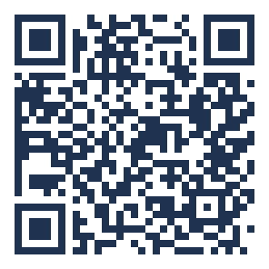
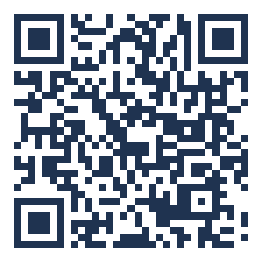
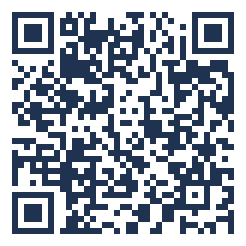
THANK YOU · QUESTIONS
Pilots before drones. Scan anything.
Proposal
This pitch
Lab dashboard
Flight School
The posters
Flight reel
the official doc
web deck
hours · leaderboard
all 28 badges
print-ready PDFs
YouTube playlist
FPV Club · Brophy College Preparatory · Micah Tucker & team · mtucker27@brophybroncos.org
14 / 14 · Brophy FPV Club · grant 2026–27
Notes:
Thank you. Pilots before drones.
Everything is on the screen: the proposal, this pitch, the live dashboard, Flight School, the posters, and the club's flight reel.
[EDIT: close with one line that is yours. Something like: "The sim lab is open tomorrow at seven. Come fly."]
Questions?

