Slide 1
PROJECT OVERVIEW
01
DATA SCIENCE PROJECT
Social Media
Impact Study
3
EDA
ML
datasets analyzed
correlations, heatmaps & boxplots
logistic regression model
Teens, students, mental health, addiction, academic performance & suicide trend correlations.
Core question
How does social media usage relate to mental health, suicide trends, and academic outcomes?
MENTAL HEALTH
ACADEMICS
ADDICTION
El Mehdi Bensouda
Social Media Impact Study

Slide 2
METHOD
02
From raw data to insight.
The project combines national trend data, teen phone-addiction data, and student social-media-addiction data.
01
02
03
Collect
Explore
Model
Three separate datasets on suicide trends, teens, and students.
EDA, correlation matrices, distributions, boxplots, and comparisons.
Logistic regression predicts whether social media affects academics.
Social Media Impact Study

Slide 3
DATASET OVERVIEW
03
The analysis connects three perspectives.
Each dataset answers a different part of the same social-media impact question.
National trend data
Social media growth vs suicide-rate change since 2010.
Teen phone addiction
Usage hours, addiction level, sleep, anxiety, depression, and academics.
Student addiction data
Daily use, addiction score, mental health, sleep, conflicts, and academic impact.
mental health
academics
behavior
trend
anxiety, depression, wellbeing
performance & self-reported impact
usage hours, addiction, sleep
national suicide-rate correlation
Social Media Impact Study

Slide 4
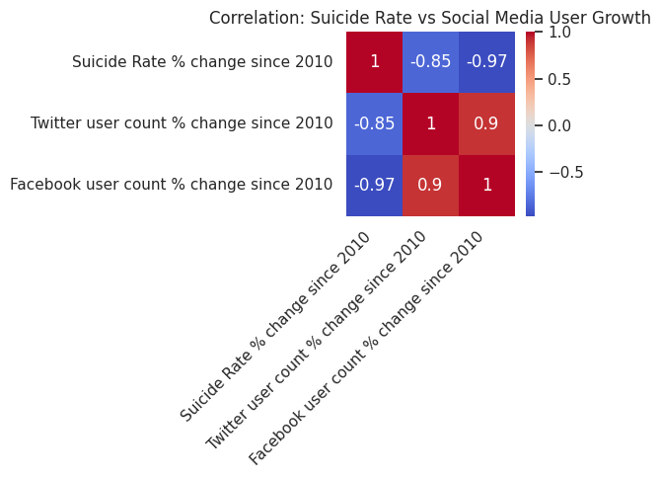
FINDING 1
04
National trend correlations were inverse.
Higher social-media user growth was associated with lower suicide-rate change in this dataset.
-0.97
-0.85
Facebook growth vs suicide-rate change
Twitter growth vs suicide-rate change
Important interpretation: correlation does not prove causation. This finding only describes the pattern visible in the dataset.
Why this matters
The national trend shows a clear pattern, but it does not explain what happens at the individual level.
Next, we examine teen and student data to explore social media use, addiction, mental health, and academic performance.
Correlation matrix from the suicide-trend dataset
Social Media Impact Study

Slide 5
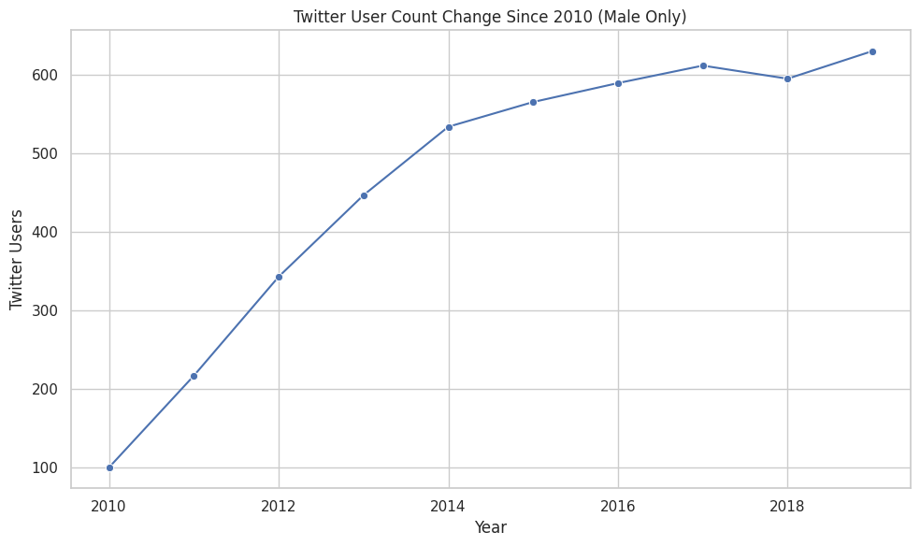
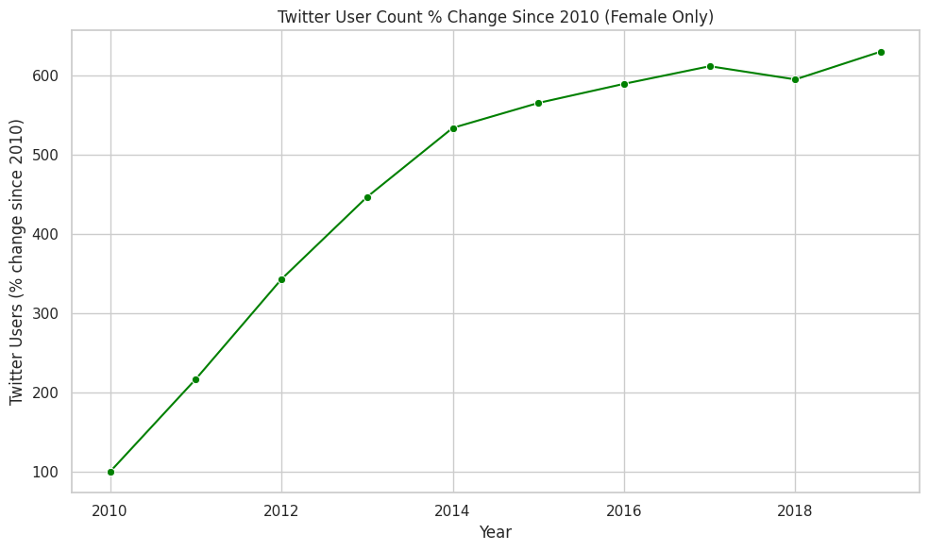
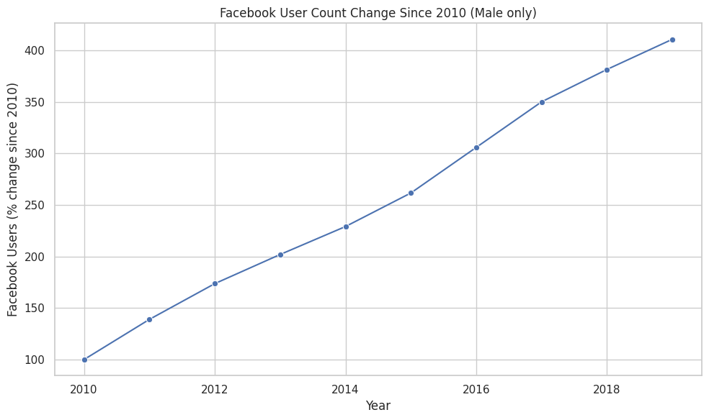
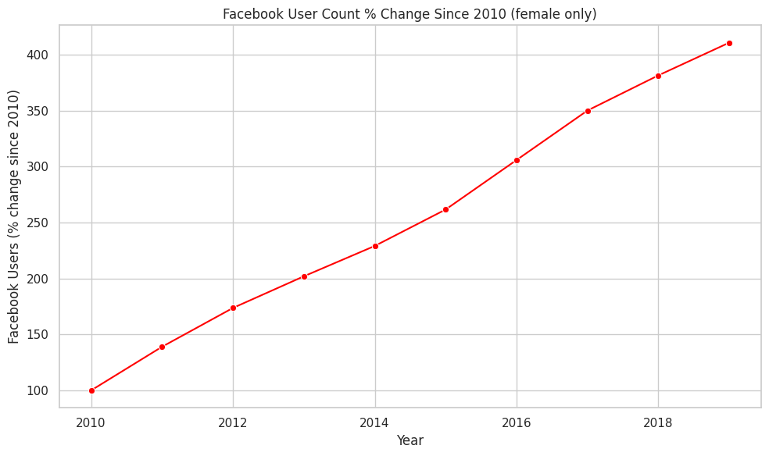
SOCIAL MEDIA GROWTH
05
Platform growth rose sharply after 2010.
Male and female user-count growth shows similar upward patterns across Twitter and Facebook.
Twitter — male
Twitter — female
Facebook — male
Facebook — female
Why this matters
The national data shows major social-media adoption growth, but it cannot explain individual outcomes by itself. That is why the teen and student datasets are necessary.
Social Media Impact Study

Slide 6
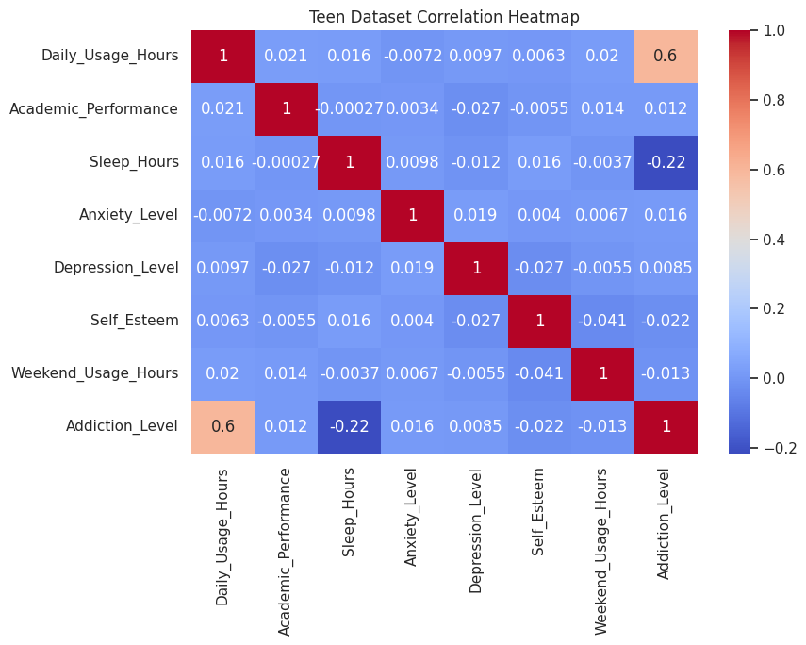
TEEN DATASET
06
For teens, usage connects most clearly to addiction.
Daily usage hours showed the strongest relationship with addiction level; academic performance was less directly connected.
0.60
-0.22
Daily usage hours ↔ addiction level
Sleep hours ↔ addiction level
Main takeaway: addiction and emotional wellbeing are more closely linked to phone usage than academic outcomes in the teen dataset.
Anxiety and depression move together.
More addicted teens tend to sleep less.
Grades may depend on other factors beyond screen time.
Teen dataset correlation heatmap
Social Media Impact Study

Slide 7
TEEN INSIGHT
07
Screen time alone was not the whole story.
The teen data suggests social-media impact is more complex than “more hours = worse grades.”
72–75
0.60
moderate
average academic score range across usage groups
usage ↔ addiction correlation
anxiety and depression moved together
Interpretation
For teens, the more important story is not just time spent online. Addiction, sleep, and emotional wellbeing appear more meaningful than daily usage alone.
Social Media Impact Study

Slide 8
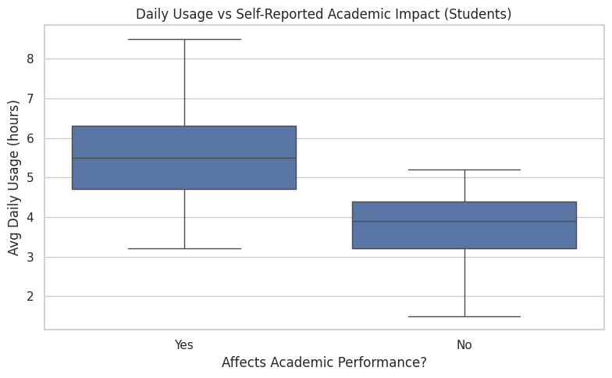
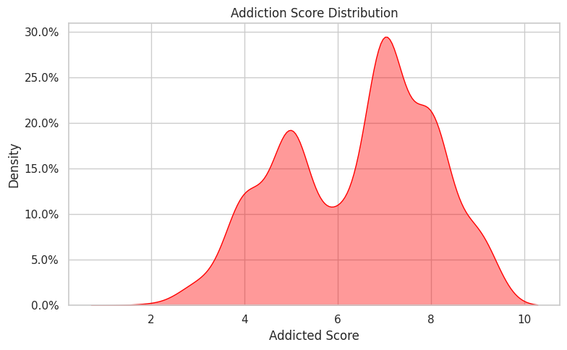
STUDENT DATASET
08
Among students, the academic impact was clearer.
Students who reported academic impact tended to use social media more and show higher addiction scores.
Daily usage by academic-impact group
Student addiction-score distribution
Students in the “Yes, it affects academics” group had a higher median daily usage and wider spread, including heavy-use outliers.
Social Media Impact Study

Slide 9
ACADEMIC IMPACT
09
Heavier daily use aligned with reported academic impact.
The boxplot shows a clear separation between students who report academic impact and those who do not.
~5.5 hrs
~4 hrs
median usage for students reporting academic impact
median usage for students reporting no impact
The “Yes” group uses social media more daily.
The “Yes” group has wider usage variation.
Some students report 7–8 hours per day.
Daily social-media usage by group
Social Media Impact Study

Slide 10
ADDICTION SIGNAL
10
Addiction intensity was a major signal.
Moderate to high addiction scores were common, and higher addiction was strongly tied to poorer outcomes in the student data.
7.4
4.5
average addiction score for students reporting academic impact
average addiction score for students reporting no impact
-0.95
addiction score ↔ mental health score
The strongest student finding: addiction level appears more explanatory than daily use alone.
Addiction-score distribution
Social Media Impact Study

Slide 11
COMPARISON
11
Teens and students showed different patterns.
The analysis suggests that age/context changes how social-media behavior appears in the data.
Teens
Students
Academic scores stayed in a narrow range.
Usage linked to addiction and emotional wellbeing.
Screen time alone did not strongly explain grades.
Academic impact split into clearer groups.
Higher addiction was linked to worse outcomes.
Heavy use tied to sleep and mental health patterns.
Social Media Impact Study

Slide 12
MACHINE LEARNING
12
A simple model confirmed the EDA pattern.
Logistic regression predicted academic impact from behavioral and wellbeing variables.
Usage
Sleep
Mental
Health
Addiction
Academic
Impact
100%
Note: 100% accuracy is very high, so it should be explained carefully as a sign of strong patterns in this dataset, not automatic real-world perfection.
reported model accuracy
Social Media Impact Study

Slide 13
CONCLUSION
13
Final takeaways.
The strongest findings were about addiction, academic impact, sleep, and mental health — not just raw screen time.
Heavy use
Students with heavier daily use were more likely to report academic impact.
Teens
Teen grades did not shift much by usage group, suggesting more complex causes.
Addiction
Higher addiction scores were tied to poorer academic and mental-health outcomes.
Awareness
Moderation and awareness are important, especially for high-addiction patterns.
Social Media Impact Study

Slide 14
PORTFOLIO USE
14
Ready for the portfolio.
A cleaner project story that can be shown on a personal website, résumé, or internship application.
Project card copy
What this project shows
Social Media Impact Study
Data cleaning and exploratory analysis
Correlation interpretation and careful wording
Clear visualization of student behavior patterns
Basic machine-learning classification workflow
Analyzed social media usage, mental health, addiction, and academic performance using EDA, heatmaps, boxplots, and logistic regression.
Python
Pandas
EDA
Visualization
Logistic Regression
Social Media Impact Study

